Slide 1
Smart Codes, Smart Process

Slide 2
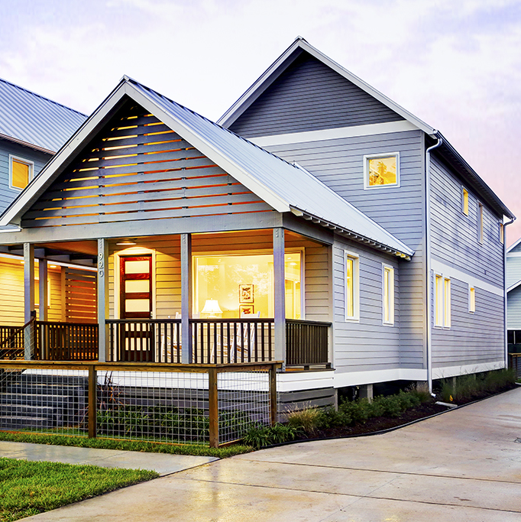
Time is Money for Everyone
Developers
Homebuyers
Government
Becker at Porch Street on Adele, TK Images

Slide 3
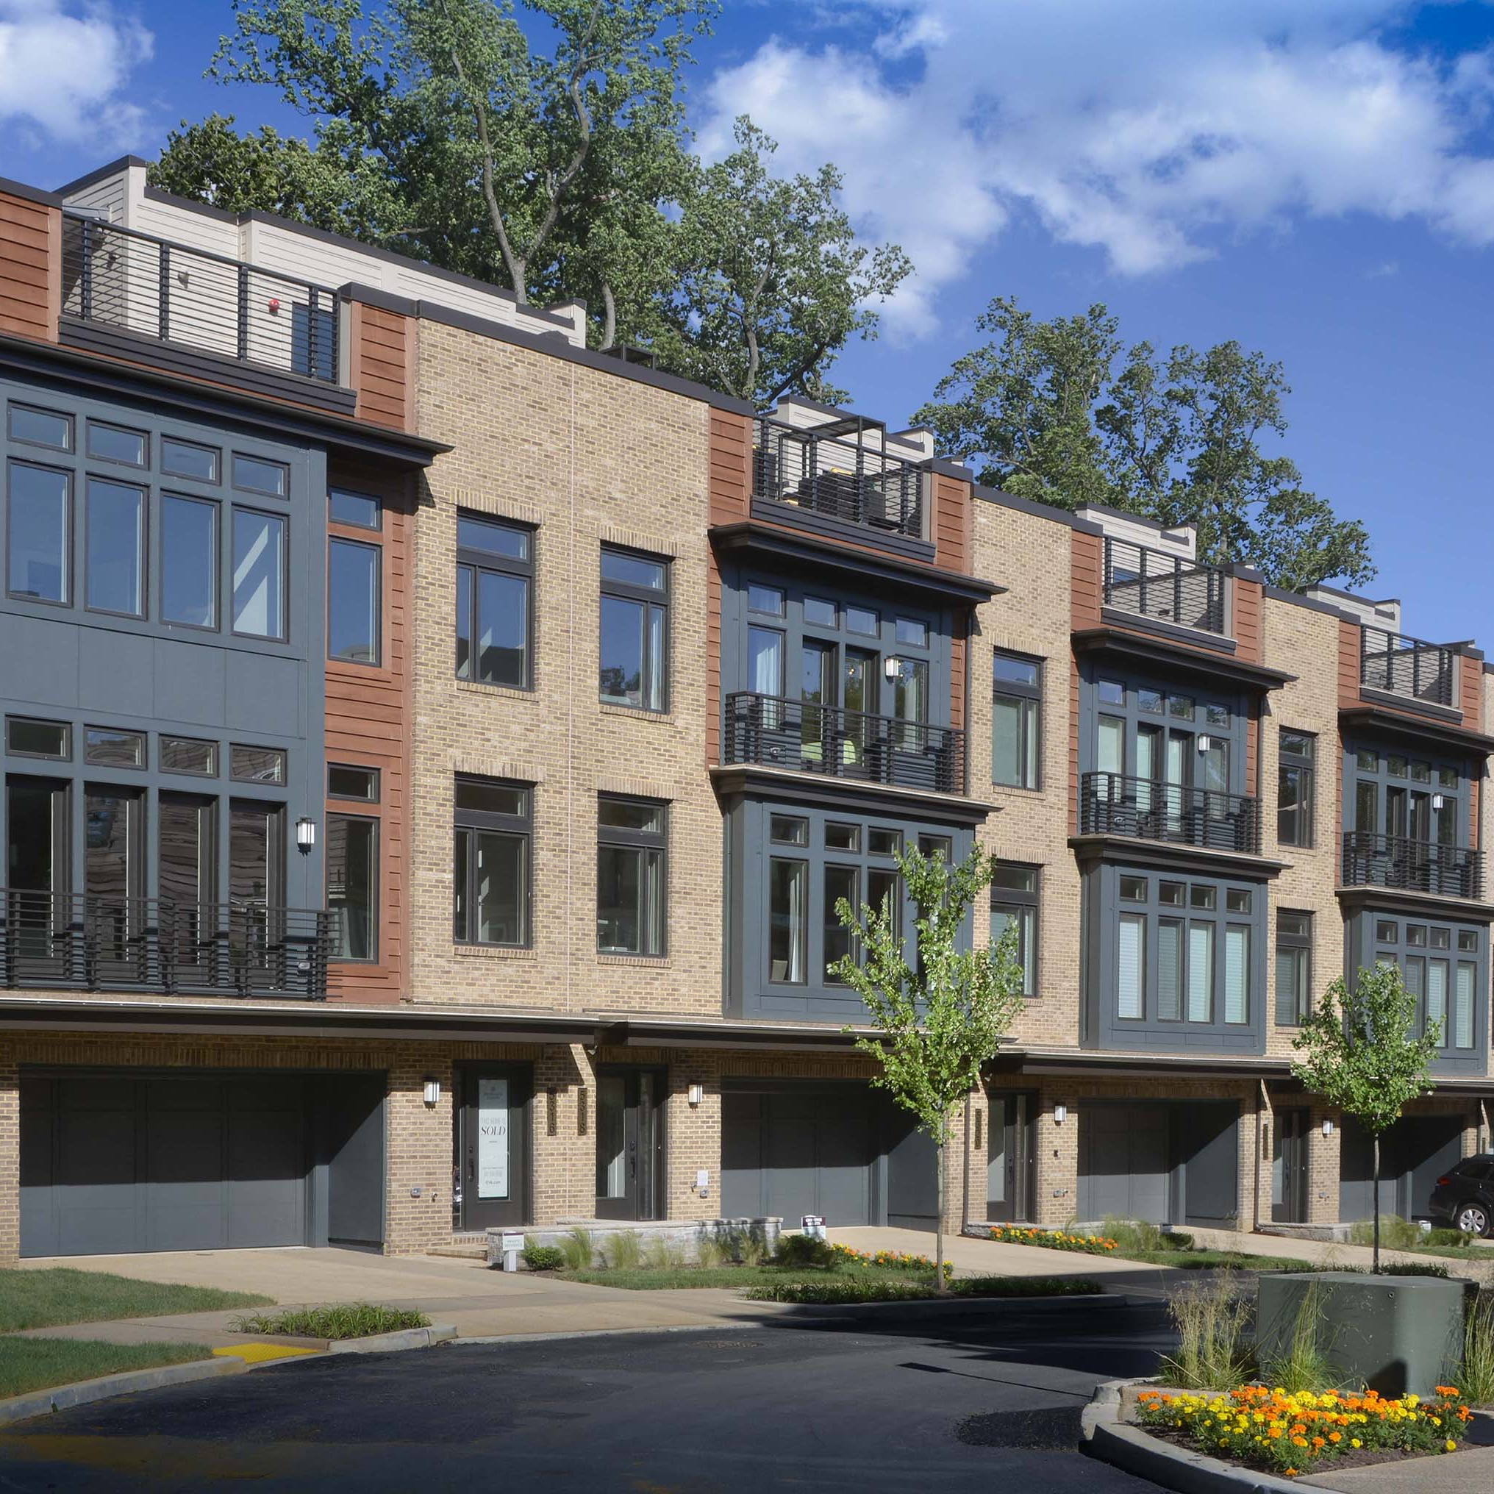
Smart Codes
Prepare a truly comprehensive plan
  Include a housing and economic development element in addition to land use and transportation
  Integrate the different elements of the plan and understand their interdependency
  Ensure affordability and availability of both housing and lots
Link implementing regulations to the plan
EYA at Grosvenor, Thomas Arledge
Notes:
Communities can enhance housing affordability with a comprehensive planning and development framework

Slide 4
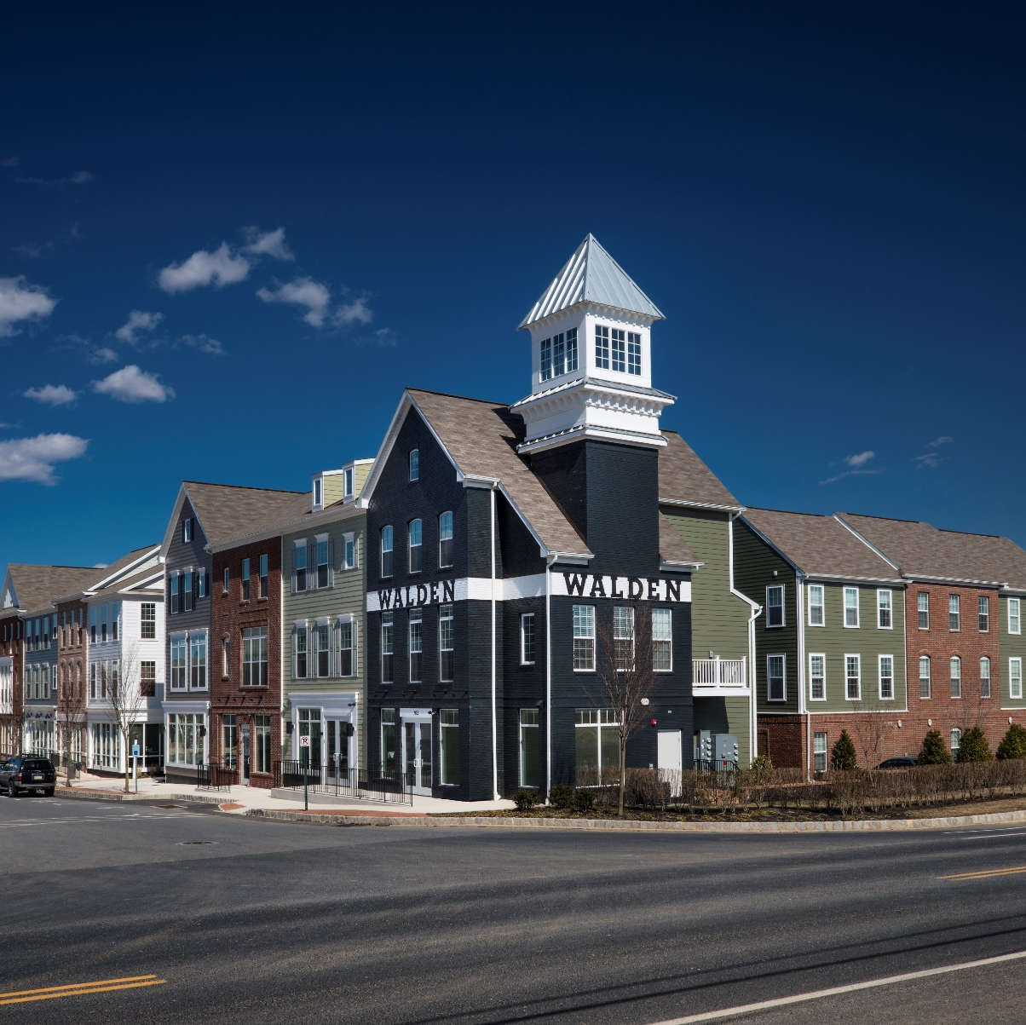
Smart Codes
Allow a mix of land uses, including open space
Allow “as of right” a variety and mix of housing types, including:
  Attached/multifamily
  Manufactured homes/modular
  Accessory Dwelling Units
  Live-work Units
  Accessible Units
Walden, Charter Homes & Neighborhoods

Slide 5
Smart Codes
Allow innovation and flexibility in site planning and design, including:
  Planned Unit Development (PUD)
  Cluster
  Small lots
  Pocket neighborhoods/bungalow courts/cottage clusters
  Higher density
  Traditional Neighborhood Development (TND)
  Zero Lot Line
  Reduced setback requirements
  Reduced street widths
  Multimodal streets and connectivity
  Alternative street and sidewalk surfaces
  Alleys
  Shared parking/access
  Alternative stormwater and septic system approaches
  Altered utility installation

Slide 6
Smart Codes
Allow and encourage infill and redevelopment
Offer incentives for providing community amenities/affordable housing/sustainable features, including:
  Density bonuses or transfers
  Tax credits
  Reduced fees/rebates
  Expedited permitting
  Reduced parking requirements
Terraces at Santiago, Applied Photography

Slide 7
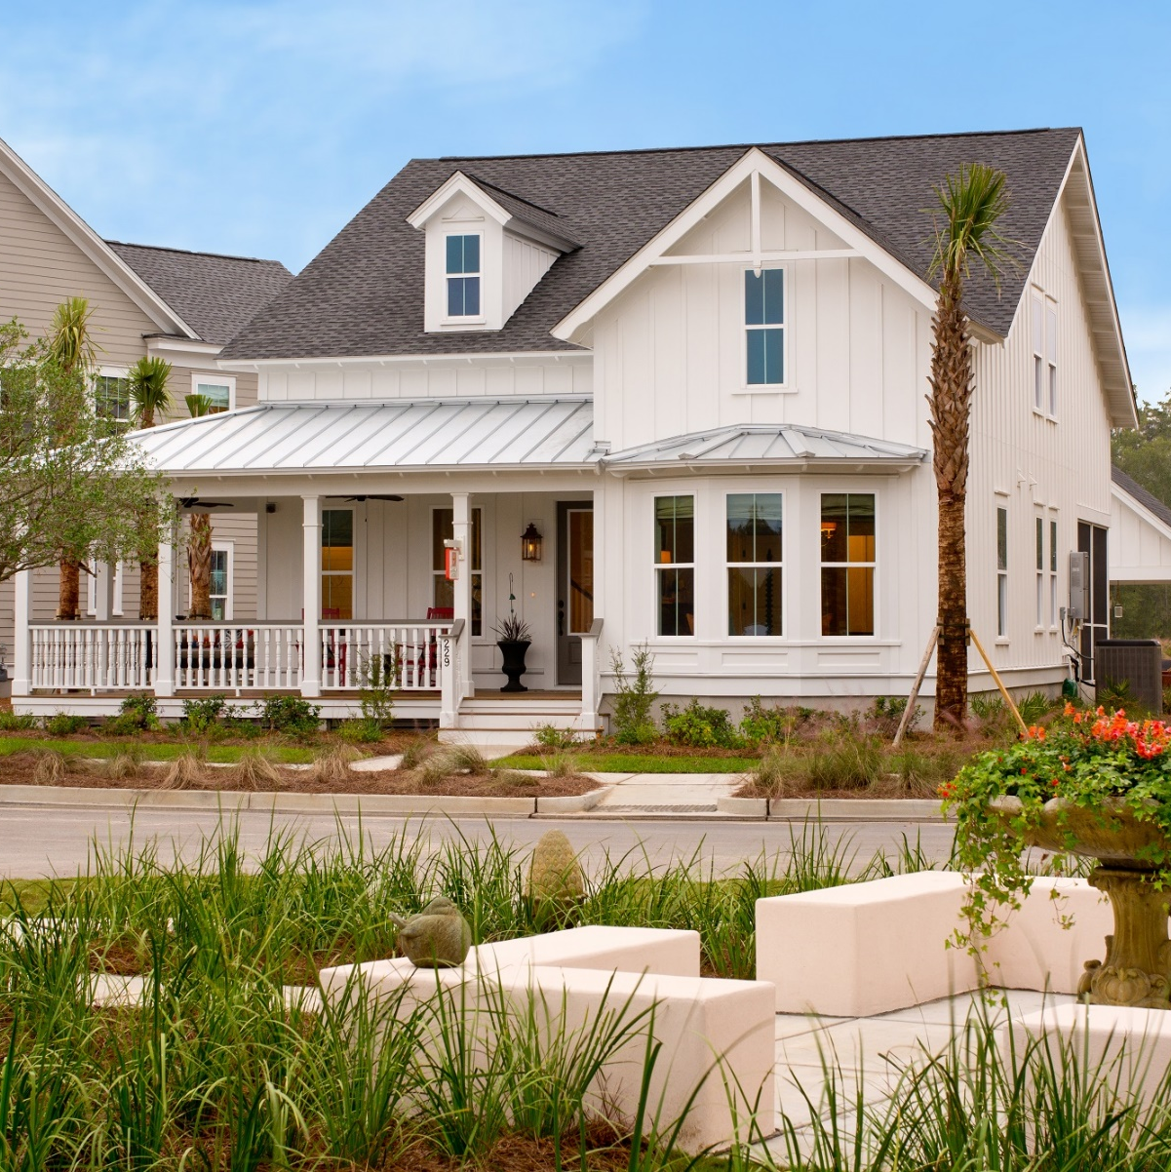
Smart Codes
Limit scope and duration of moratoria
Plan for and fund infrastructure/capital improvements program (CIP)
Coordinate CIP with comprehensive plan
Use fair and broad-based funding mechanisms
If fees and exactions are imposed, ensure they are properly set (proportionality, nexus, dedication)
Camelia at Summers Corner, Johnson Pictures Inc.

Slide 8
Smart Process
Streamline and consolidate the review process
  Designate an interdepartmental review coordinator
  Conduct pre-application conferences
  Provide ordinance approval process checklists and flow charts
  Specify timeframes/limits for review and approvals (including public hearing) to ensure clear process and timely decisions
  Consider a “deemed approved” provision
  Conduct concurrent, not sequential, reviews wherever possible
Notes:
Ensure an efficient land development review and approval process. Certainty, stability, predictability and presumption of approval should be guiding principles.

Slide 9
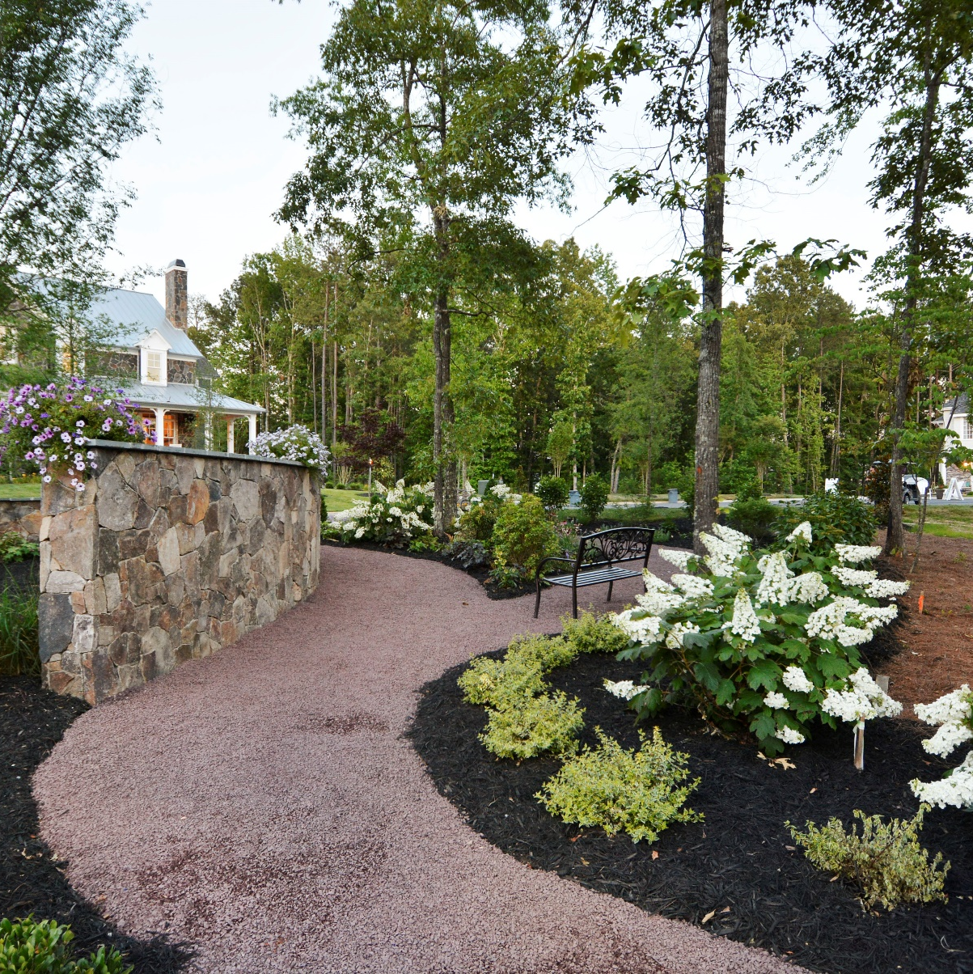
Smart Process
Create a process for expedited review
  Minimize reliance on rezonings and special approvals
  Uses allowed by right should receive administrative approval
  Expedite desirable housing projects such as affordable housing (120 percent AMI and below), infill, redevelopment, cluster
Hallsley, Bryan Chavez

Slide 10

Smart Process
Have a one-stop permitting/central permit information desk
Implement online permitting, online submission of building plans, and real-time permit tracking and inspection status
Increase capacity by maintaining appropriate staffing levels, hiring specialized staff, and providing training and cross-training
Have clear submittal requirements with appropriate level of detail
Hallsley, Bryan Chavez

Slide 11
Smart Process
Allow broad and inclusive public participation in formulation of plans and ordinances but more limited participation at site-specific permit stage
Eliminate multiple hearings and reopening of settled issues
Allow and use vesting and development agreements
Use remediation/mediation as alternatives to appeals
Allow self-certification of plans and/or inspections by engineers
Specify timeframe for inspection of constructed improvements and release of performance bonds/guarantees, and combine inspections

Slide 12
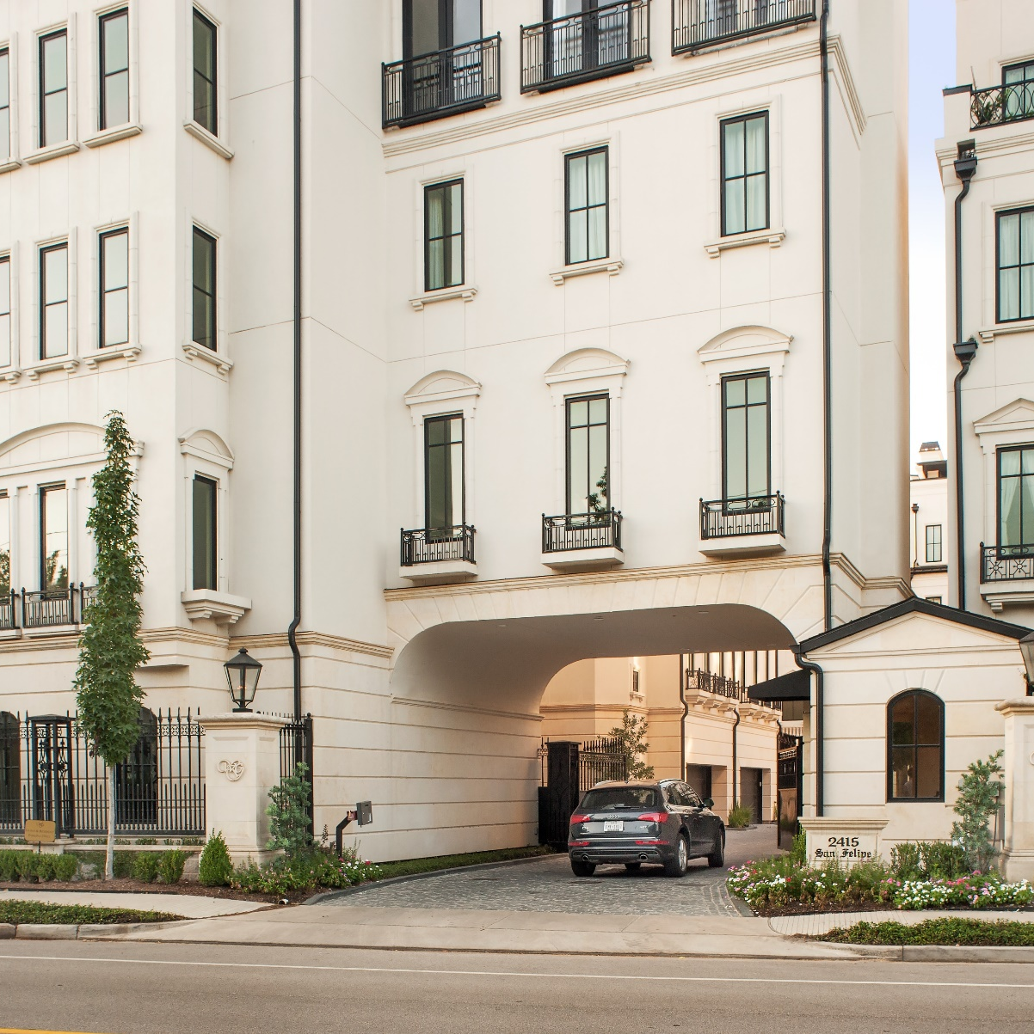
Smart Process
Implement a land market monitoring/buildable lot inventory system to ensure land availability and achievable densities and to examine effects on affordability
Inventory vacant/publically owned land for possible public-private partnerships
Winfield Gate, Rob Muir
Notes:
Evaluation and accountability – shine a light on the process

Slide 13
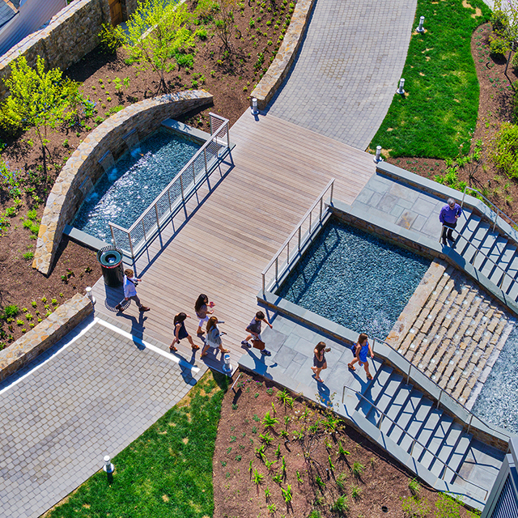
Smart Process
Update/evaluate plans and regulations regularly
  Simplify and reduce the number of zoning districts
  Define key terms and use simple, clear, direct, objective language
Regularly evaluate the process (especially length and complexity), content, and consistency of regulation
  Prepare annual report, including statistics such as average approval time
  Customer satisfaction surveys
The Darcy + The Flats, Max Zhang
Notes:
Evaluation and accountability – shine a light on the process

Slide 14
Questions?
Nicholas Julian
Program Manager, Land Use, NAHB
njulian@nahb.org
202-266-8309

