Slide 1
Orientation to the Land Development Process

Slide 2
Outline
Part One: Regulatory Framework
Part Two: Development Process

Slide 3
Regulatory Framework
Beacon Park, Damian Tsutsumida
Notes:
“It all starts with the land.”
“All land use is local”.
Developers still get the essential green light to proceed with a project from local government, even though regulations from other layers of government come into play too.

Slide 4
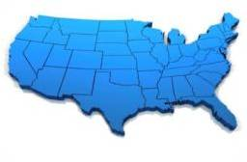
What You Can Do with a Piece of Property is Governed by Laws And Policies:
Federal State Local
+
+
Notes:
There is a complex layering of government regulations that can impact a piece of land.
This may include a federal authority, such as the US Army Corps of Engineers or EPA; a state authority, such as the highway department; and local authorities, such as cities or counties.
All of these authorities and requirements can affect a single piece of property, no one authority takes precedence, and the more layers of authority involved, the more complex the approval process becomes.

Slide 5
Federal Level Issues
There is no federal land use law—so far!
Primarily Environmental Requirements:
Clean Air Act
Clean Water Act
Endangered Species Act
Waste Disposal Laws
Flood Disaster Protection Act
Historic Preservation
Emerging Issues
Notes:
But there is no overarching federal land use law, or any uniform set of national development standards, either.
Instead, most of the federal land regulations are issue-specific and primarily concerned with environmental quality concerning water, air, land, species, and the like.
The federal government also has laws in place that regulate land in order to protect against natural disasters, such as with FEMA and the Flood Insurance Rate Maps that identify floodplains and compel communities to take steps to reduce risks and to ensure appropriate protection and preservation of cultural and historical resources.

Slide 6
Clean Air Act
Establishes ambient air quality standards
Requires State Implementation Plans (SIPs)
Increased scrutiny of vehicle emissions
Increasing focus on land use patterns
Notes:
The Clean Air Act is designed to protect public health and public welfare by establishing National Ambient Air Quality Standards (NAAQS) and regulating emissions of hazardous air pollutants.
To do so, it directs the states to develop state implementation plans (SIPs), which outline the regulations the state will use to reduce emissions from both industrial and mobile sources and clean up polluted areas. (The SIP becomes the state's legal guide for local enforcement of the CAA).
As the most problematic industrial sources have been addressed, the states have been forced to look for smaller and smaller sources that they can regulate to meet their CAA goals. In many instances, one of the few remaining unregulated sources is vehicle emissions.
One source that several states have identified is construction equipment. One local area, in an effort to meets its emissions reductions, went so far as to propose to ban the use of construction equipment from mid-morning to mid-afternoon.
In many other areas, citing emissions from automobile use, there has been an increasing focus on using the CAA and the SIP process to promote land use patterns that are thought to reduce emissions, such as high density and mixed use communities.
While it may not be apparent, the Clean Air Act will continue to play a role in the shaping and development of our communities!

Slide 7
Clean Water Act
Prohibits discharges of pollution
Establishes water quality standards
Requires permits for stormwater and wetlands fills
Notes:
The Clean Water Act (CWA) is the cornerstone of surface water quality protection in the United States. (The Act does not deal directly with ground water nor with water quantity issues.)
The goal of the Clean Water Act is to “restore and maintain the chemical, physical, and biological integrity of the nation’s waters.”
To do so, it:
Prohibits the discharge of pollutants from point sources to waters of the United States without a permit;
Requires the states to develop water quality standards that outline the uses they expect for each water body (e.g., recreation, water supply, aquatic life, agriculture) and then set site-specific allowable pollutant levels so that those use goals can be met; and
Establishes a permitting program for municipal and industrial wastewater and stormwater discharges (including stormwater discharges from construction sites) and for the discharge of dredged or fill material into waters and wetlands.
Because CWA permits are required for nearly every construction project, they obviously play a major role in where new development occurs and what it looks like.

Slide 8
Endangered Species Act
Identifies species threatened by extinction
Designates “critical habitat”
Prohibits “taking” and harming species and their habitat
Requires permits for habitat alteration
Notes:
The purpose of the Endangered Species Act (ESA) is to protect and recover endangered plants and animals and the habitats in which they are found.
After identifying species whose survival is in peril, the U.S. Fish and Wildlife Service and/or the NOAA Fisheries Service takes action to protect it by placing them on the endangered species or threatened species list.
The ESA then requires the designation of “critical habitat” for most listed species. Critical habitat includes geographic areas that contain the physical or biological features that are essential to the conservation of the species and that may need special management or protection to ensure they continue to provide for the species.
Once listed, the ESA makes it unlawful for a person to “take” a listed animal without a permit. Take is defined as “to harass, harm, pursue, hunt, shoot, wound, kill, trap, capture, or collect or attempt to engage in any such conduct.”
The law also requires federal agencies, in consultation with the U.S. Fish and Wildlife Service and/or the NOAA Fisheries Service, to ensure that actions they authorize, fund, or carry out (such as an action conducted in compliance with a Clean Water Act Section 404 wetlands permit) are not likely to jeopardize the continued existence of any listed species or result in the destruction or adverse modification of designated critical habitat of such species.
Since two-thirds of federally listed species have at least some habitat on private land, and some species have most of their remaining habitat on private land, the requirements of the ESA increasingly have a visible impact on the land development process.

Slide 9
Waste Disposal Laws
Comprehensive Environmental Risk, Compensation and Liability Act (CERCLA or “Superfund”)
Imposes liability on owners/operators regardless of who created the mess and requires clean-up
Resource Conservation and Recovery Act (RCRA)
Regulates the transport/disposal of hazardous waste
Mandates that states create and implement solid waste management plans for non-hazardous waste
EPA’s Brownfields Program
Encourages the reuse of contaminated properties
Notes:
The Comprehensive Environmental Response, Compensation, and Liability Act -- otherwise known as CERCLA or Superfund provides a federal "Superfund" to clean up uncontrolled or abandoned hazardous-waste sites as well as accidents, spills, and other emergency releases of pollutants and contaminants into the environment.
Through CERCLA, EPA has the power to seek out the parties responsible for any release and assure their cooperation in the cleanup.
The Resource Conservation and Recovery Act (RCRA) was enacted to protect human health and the environment from the potential hazards of waste disposal, conserve energy and natural resources, reduce the amount of waste generated, and ensure that wastes are managed in an environmentally sound manner.
It gives EPA the authority to control hazardous waste from the "cradle-to-grave,“ which includes the generation, transportation, treatment, storage, and disposal of hazardous waste (including waste from underground tanks storing petroleum and other hazardous substances).
RCRA also sets forth a framework for the management of non-hazardous solid wastes by establishing minimum federal technical standards and guidelines for state solid waste plans in order to promote environmentally sound management of solid waste.
Although construction and demolition debris (C&D) is neither classified as RCRA hazardous waste nor RCRA municipal solid waste (MSW), if C&D debris is sent to municipal solid waste landfills, those landfills must still meet federal regulations set forth in RCRA.
EPA's Brownfields Program is designed to empower states, communities, and other stakeholders in economic redevelopment to work together in a timely manner to prevent, assess, safely clean up, and sustainably reuse brownfields.
A brownfield is a property, the expansion, redevelopment, or reuse of which may be complicated by the presence or potential presence of a hazardous substance, pollutant, or contaminant.
It is estimated that there are more than 450,000 brownfields in the U.S.
Cleaning up and reinvesting in these properties has many benefits, including increasing local tax bases, facilitating job growth, utilizing existing infrastructure, and taking development pressures off of undeveloped, open land. There are many steps that must be followed, however, to have a successful brownfield revitalization project.

Slide 10
Flood Disaster Protection Act
Creates national flood insurance program
Requires FEMA to develop risk-based floodplain maps
Requires local regulation of development in floodplains in exchange for the availability of flood insurance
Mandates the purchase of flood insurance for properties within Special Flood Hazard Areas
Notes:
Another federal program that impacts where development may occur is the Flood Disaster Protection Act.
This law created the National Flood Insurance Program (NFIP), a program that enables property owners in participating communities to purchase insurance protection against losses from flooding. The intent was to reduce future flood damage through community floodplain management ordinances and provide protection for property owners against potential losses through an insurance mechanism that requires a premium to be paid for the protection.
In order to determine the risks of flooding, the Act directed the Federal Emergency Management Agency (FEMA) to develop community-wide flood insurance rate maps (FIRMs) that depict where flooding is expected to occur. These maps provide the basis for the law’s obligations.
If a local community wants to participate in the NFIP, it must agree to adopt and enforce a floodplain management ordinance that reduces future flood risks to new construction in Special Flood Hazard Areas (SFHA), typically those areas where floodwaters have a 1% or greater chance of being equaled or exceeded in any single year. These ordinances may direct new development away from mapped floodplains, require special mitigation plans, or even prohibit new construction.
Finally, the law also stipulates that all residential structures located within a special flood hazard area within a “participating community” must purchase flood insurance – a requirement that could affect the viability and marketing of a new development project.

Slide 11
National Historic Preservation Act
Created National Register of Historic Places, National Historic Landmarks and State Historic Preservation Offices
Partnership w/states to preserve historic resources
Must assess impacts of actions on any sites listed on, or eligible for listing on, the National Register of Historic Places
May require redesign, mitigation, or other actions to reduce or eliminate impacts
Notes:
The National Historic Preservation Act (NHPA) was passed to preserve historical and archaeological sites.
The Act created the National Register of Historic Places, the list of National Historic Landmarks and the State Historic Preservation Offices.
The Act expects the various levels of governments to work together in this effort. The federal government plays and oversight role, while the State Historic Preservation Offices are responsible for coordinating statewide inventories of historic properties, nominating properties to the National Register, maintaining a statewide preservation plan, and participating in the Section 106 review.
The NHPA comes into play in the development process because it requires federal agencies to evaluate the impact of all federally funded or permitted projects on historic properties (buildings, archaeological sites, etc.) to consider the effects on historic properties and "seek ways to avoid, minimize or mitigate" any adverse effects on historic properties.
If an adverse effect is expected, the agency is required to work with the local State Historic Preservation seeks ways for the project to avoid having an adverse effect on historic properties. This process helps decide different approaches and solutions to the project, but does not prevent any site from demolition or alteration.

Slide 12
Emerging Federal Level Issues
Improving Energy Policies and Efficiency
Promoting Green Development and Green Building
Addressing Climate Change/Improving Sustainability and Resiliency
Notes:
While most of the federal land regulations have been on the books for decades, more recently, there has been an increasing interest to take a number of steps that will also have an impact on how and where land development may occur.
First, are efforts aimed at improving energy transmission and reducing usage, which could impact the location of not only energy producing facilities, but also to energy users. There is also increasing pressure to improve the energy efficiency of buildings and appliances via national codes and incentives.
Second is the continuing push to realize a whole variety of benefits through the promotion of green building and the use of green infrastructure. These benefits can include increased water and energy efficiency, use of renewable materials, and reduced environmental footprints, among others.
Third, are efforts to curb climate change and the improve overall sustainability of our cities and towns. and initiatives and incentives to promote more transportation choices.
Clearly, these efforts, too, will have a significant impact on how and where new development can and will occur.
Increasing focus on presumed connection between automobile use, development patterns, greenhouse gases, public health
Boosting density and transit vs. highways
Steering development towards existing communities
Getting people to drive less and walk more
Increasing federal role in state and local land use through “incentives” in grant programs

Slide 13
State Level Issues
State land use plans rare
Regional governments rare
State mandates for local plans do exist
Affordable housing “remedies”
Environmental permits too
Impact fee and taxation powers
Notes:
Some States are more aggressive than others in mandating statewide planning that is reviewed and approved by the state. States that have programs that are more “top down” include Florida, Oregon, Washington, New Jersey and Rhode Island, although Florida has recently rolled back a good part of its statewide planning requirements.
Yet others have state level directives for local governments or appeals provisions for decisions by local governments that are relevant to housing—e.g. NJ Mt. Laurel, Mass. 40B rule, CT appeals process.
And many simply authorize local governments to utilize specific tools or techniques.

Slide 14
Local Level Issues
Local planning authority is delegated by states, and differently:
“Dillon” Rule versus Home Rule
Bottom up vs. top down
Many issues and players
Multiple departments/agencies
Little coordination/communication
Many opportunities for public participation
Notes:
Home rule states generally vest local jurisdictions with more land use power than Dillon rule states, where that power must be explicitly granted by the state. Virginia is a classic Dillon rule state.
Many home rule states have difficulty managing issues on a region-wide basis, as each local jurisdiction is vested with its own power. Pennsylvania’s township based government is a good example of this.
Bottom up vs. top down—e.g. Pennsylvania township government versus Oregon state land use system
In either system, there are a lot of different agencies and steps in the review process, and these typically aren’t well coordinated.
Public participation opportunities are both a plus and a minus as well.

Slide 15
Public Participation is Critical
Who is involved?
What is the public participation process?
What is the Comprehensive Plan and how is it implemented?
Notes:
Local politics involve many contentious issues, and lots of different players and interests. Decision-making may be based on a complex number of circumstances.
Many times, vocal neighborhood groups can sway decision-making based on emotion instead of empirical data and careful planning.
This can lead to decisions that are contrary to city policies, such as comprehensive plans and zoning requirements.
We’ll go into more detail about the comprehensive plan after talking a bit more about the players.

Slide 16
Local Players
Mayor/City Manager/County Executive
City or County Council/Board of Supervisors
Planning Commission
Planning Department
Stakeholders—interest groups and citizens
Board of Appeals
Notes:
These are the typical officials involved in the local regulatory process.
The mayor is basically the community’s CEO; he must be the community’s visionary leader and be willing to implement the plan or it will bog down in NIMBY opposition when developments apply for approval.
The City or County Council or Board of Supervisors are elected officials with the legislative functions of approving the comprehensive plan, enacting ordinances, and imposing taxes & fees.
The Planning Commission is an advisory group to the legislative body appointed by Chief Executive or City/County Council. This group approves subdivision & site plans and recommends changes to or adoption of the comprehensive plan, zoning ordinances, and subdivision regulations.
The Planning Department is usually paid staff charged with developing draft comprehensive plan and implementing regulations, performing studies to support the plan, and making recommendations on plan and development applications. Some communities have no planning staff and retain outside consultants to provide these services, e.g. Pennsylvania.
The Board of Appeals or Adjustment is a local body or hearing examiner that hears appeals of decisions by zoning administrator, planning commission, or county or city board (i.e. reviews development denials when requested and also may consider requests for variances and waivers).

Slide 17
Public Participation Process
The public can be involved in:
Defining community values
Shaping local plans, policies, and regulations
Commenting on changes to any of those and on development proposals
Notes:
All of these various citizens and interest groups can help define a community’s values and goals by participating in community surveys and focus groups and in public meetings and hearings during the formation of the comprehensive plan
They are also given formal opportunities to comment on any proposed amendments to the plan once it’s adopted and on specific development applications
Remember all of these opportunities later when we discuss the actual development approval process.
It is essential that the building industry understand their role in this process and get involved early on.

Slide 18
Local Policies/Regulations
Comprehensive Land Use Plan
Capital Improvement Program (CIP)—the budget for the Plan
Implementing Regulations for the Plan
Zoning ordinances
Subdivision regulations
Natural resource protection
Exactions/Fees/Taxes for infrastructure
Notes:
Local policies start with a comprehensive plan and then include links to a capital improvement plan and implementing ordinances.
The CIP is the budget for carrying out the comprehensive plan, and the implementing ordinances are the requirements imposed on development so that it presumably occurs in accordance with the community goals set out in the plan.
Local policies and regulations are developed to assist the local officials in decision-making, in an attempt to carry out more orderly and successful development in a community over time and ensure predictable outcomes.

Slide 19
Comprehensive Land Use Plan
A vision of what the community wants to be
Physical written plan, including a land use map
Comprehensive in scope
Long range — 10- to 20-year horizon
Policy document that guides implementing regulations and development approvals
Notes:
A community land use plan is a look back at what’s happened so far in the community as well as a blueprint from which the future of the community is to be constructed.
It includes:
Policy Statement -principles, standards and criteria for how the community will develop and grow
Physical plan & maps - depicting what the community will look like and how it will function. Where will jobs and housing be located? Where will they allow higher densities, low densities, or a mix? What is the plan for public open space?
Comprehensive - covering the entire geographic area of the community and all issues important to the physical , social, and economic functioning of the community.
Long Range - focusing on what the community will be in 10, 15 or 20 years in the future.
Decision-Making Guide - to assist elected officials, agency staff, the public, and builders and developers in determining where to build and under what circumstances.

Slide 20
Comprehensive Plan
Community Goals & Objectives
Background Analysis
Natural resource inventory
Existing land use & infrastructure
Population growth, employment & housing needs
Future Land Use Plan and Map
Notes:
There are three main components to a comprehensive plan: G and O’s, background analysis, future land use plan.
Goals and objectives are value-based—a vision of what the community should be. Yet stakeholders have conflicting desires:
Good jobs, easy commutes but no change to their community character
High level of services but low taxes
Big house on a big lot but access to transit and shopping
As a result, plans often include goals that people don’t really want to see implemented near where they live.
Background Analysis documents bring together current resource, land use, and demographic information.
Remarkably, many plans give short shrift to housing needs and fail to draw a connection between jobs and housing.
The future land use map graphically represents the land use pattern the community expects to achieve when the plan has been implemented.

Slide 21
Capital Improvements Plan (CIP)
The budget for the plan
Timing & location of infrastructure improvements
5 & 10-year service areas
Sewer versus septic
Public water versus wells
Highways versus transit
Funding levels & mechanisms
Notes:
The capital improvements plan is the budget and schedule for infrastructure. It is a critical piece that is unfortunately often missing.
It should list all the capital facilities (i.e., infrastructure) that require construction or improvements. These typically include water, wastewater, roads, public transit, storm water facilities, etc.
It should address where these facilities will be provided (service areas), when they will be built or improved, and how they will be funded (taxes, impact fees, or a combination of methods).

Slide 22
Implementing Regulations
How the community will meet the vision and goals of the plan
Contain specific standards/criteria to be met
Should be consistent with comprehensive plan
Ordinances must be updated regularly and after plan adoption for successful implementation
Notes:
Implementing ordinances are where the rubber meets the road.
The other key pieces of the plan are the implementing ordinances and revenue mechanisms.
These include the zoning ordinance, subdivision regulations, and special purpose ordinances for resource protection and fee assessment.
Sometimes the zoning and subdivision regulations are in a combined document called a unified development ordinance.
They spell out the detailed requirements that will presumably implement the goals and objectives set out in the comprehensive plan.
For this reason, they should be updated every time the plan is updated.
Often, however, this doesn’t occur, and the community’s regulations become out of step with the new plan.

Slide 23
Implementing Regulations: Zoning Ordinance
“. “The division of a municipality (or county” into districts for the purpose of regulating the use of land.”
“ . . . To protect health, safety, and welfare.”
Separates uses into districts
Defines allowed, conditional, and special uses
Specifies density/bulk controls and parking/loading requirements
Includes development standards for non-subdivided parcels (multifamily, commercial, etc.)
Notes:
Most communities are vested with “police powers” from the state that enable them to regulate private property in order to achieve the health, safety, and general welfare of the overall community.
Zoning was originally nuisance and health based—the basic idea was to separate factories from homes, ensure adequate light and air and sanitary water and sewer facilities.
There are usually several different types of residential districts allowing development at different densities, including attached and detached units.
Agricultural districts are often created as sort of a holding zone for future development.
This can create conflicts later when development moves into agricultural areas.
Rezonings, conditional uses . . .

Slide 24
Implementing Regulations: Density/Bulk Controls
Lot size
Height limits
Lot setbacks
Lot coverage/open space requirements
Impervious surface limits
Notes:
Densities are expressed in terms of dwelling units per acre for residential uses, and floor area ratios for nonresidential uses.
All the controls taken together dictate the placement of a structure on a lot as well as its overall size and massing.

Slide 25
Implementing Regulations: Subdivision Regulations
Govern lot creation process
Contain development standards
Specify land reservation & dedication requirements
Must obtain approvals for concept, preliminary and final plans.
Notes:
Subdivision regulations are administered in conjunction with zoning and focus on the platting and recordation of all land subdivisions.

Slide 26
Subdivision Regulations: Development Standards
Lot configuration = size, shape, slope, frontage
Infrastructure improvements
Circulation & access
Easements & dedications
Tree preservation & landscaping
Notes:
Subdivision regulations are administered in conjunction with zoning and focus on the platting and recordation of all land subdivisions
They include requirements for lot size and width, access, landscaping, easements, and so forth.

Slide 27
Subdivision Regulations: Offsite vs. Onsite Improvements
Water & sewer
Grading standards
Stormwater requirements
Utility placement
Notes:
Infrastructure both onsite and offsite.

Slide 28
Subdivision Regulations: Circulation and Access
Street system/hierarchy
Pavement and right of way width, curb radii
Connectivity
Access
Privacy and safety
Ownership and maintenance
Notes:
Hierarchy—arterials, collectors, local streets, alleys
Connectivity—grid vs. cul de sac, sidewalks and pathways
Access—type of street, driveways, parking, entrances
Privacy and safety—parking, alleys
Ownership and maintenance—public vs. private

Slide 29
Implementing Regulations: Natural Resource Protection
Another layer of protection for special areas
Can be more stringent than state/federal
May include:
Tree protection
Wetlands
Riparian areas
Stormwater
Buffers
Notes:
These are sometimes an entirely separate ordinance that addresses:
Buffering & screening of parking lots and differing uses
Specimen tree requirements
Site disturbance and tree replacement requirements
Coordination with utilities to minimize disturbance

Slide 30
Implementing Regulations: Taxes and Fees
Ways to pay for needed new infrastructure:
Property, sales, business taxes
Impact fees
Alternative funding mechanisms
Notes:
The taxing and fee levying authority of local communities varies greatly from state to state.
State statutes are often very explicit as to what taxes and fees a community can levy, while some say very little.
This can often have a significant impact on where development occurs and how expensive it is.
Taxes are the conventional means of raising revenues.
However, these have become politically unpopular for a variety of reasons.
Impact fees shift the burden of funding new infrastructure to new homes instead of the broader community.
Proffers are used in Virginia, where impact fees are not authorized, but they are not really so much voluntary as they are conditions imposed on development.

Slide 31
Local Policies/
Regulations
The ideal end result:
components that work together to attain the community’s vision and goals and direct existing and future land use.

Slide 32
Development Process
Beacon Park, Damian Tsutsumida

Slide 33
Site Planning
“The process by which developers prepare a development plan for a particular site. "
The point at which regulations get applied to a piece of property.
The site plan must balance private and public objectives and interests.

Slide 34
Site Level Issues
Private Sector:
Site constraints
Market demand
Development feasibility & success
Public Sector/Citizens:
Community character
Resource impacts
Fiscal/infrastructure impacts
Notes:
The site level concerns of the community focus on the impact of a project on a community’s character and resource base, be that environmental, fiscal, or infrastructure. Community officials and citizens are also concerned that development comply with federal, state, and local regulations to respond to what they perceive to be problems with development.
As discussed, these many and varied regulatory objectives determine what a builder and developer MAY do with a particular property.
But builders and developers must also discern what they CAN or WANT to do—i.e. the feasibility of developing a project on a particular site, and managing that so it is a success.
This includes many steps that we will discuss here today.

Slide 35
What Do Developers Do?
Subdivide land
Obtain entitlements/approvals
Build project infrastructure
Provide project amenities
Create finished lots

Slide 36
Land Subdivision
Legal division of one large parcel into smaller parcels
Allows transfer of ownership

Slide 37
Infrastructure
Residential streets
Water
Wastewater
Electricity
Gas
Including process for transfer and long-term maintenance

Slide 38
Amenities
Open space--public or private
Trails
Golf courses
Swimming pools
Tennis courts
Hallsley, Bryan Chavez

Slide 39
Creation of Finished Lots
Create community setting & vision
Establish development pattern
Sell lots to builders to construct homes
Heritage Sands, Alison Caron

Slide 40
Site Planning Process
Natural resource analysis (Mother Nature)
Site analysis/context (man-made aspects)
Market analysis
Financial analysis
Plan approval
Oftentimes the process is iterative

Slide 41
Natural Resource Analysis
Geology/Soils
Topography/Slope
Vegetation/Habitat
Wildlife
Hydrology
Wetlands
Floodplains
Leyden Rock, Jay Simon and Rocky Mountain Aerials
Notes:
The purpose of the resource analysis is to fully understand what is (and isn’t) on the property and how those resources may impact a development plan
Identifies:
Constrained areas
“No build” areas
Opportunities to use resources as amenities

Slide 42
Site Analysis
Prior and adjacent land uses
Infrastructure availability/access to site
Land use & zoning
Easements/Deed restrictions
Environmental constraints and permitting requirements
Neighbor & citizen interests & concerns
Leyden Rock, Jay Simon and Rocky Mountain Aerials
Notes:
The site analysis includes looking at what happened to the site previously, adjacent land uses, access to the site, infrastructure capacity and availability, and how the land is zoned.
This step is more important than ever before, and not just on infill and redevelopment sites.
It also includes consideration of any limitations placed on the land through covenants or deed restrictions, environmental constraints, and neighborhood attitudes and concerns.

Slide 43
Market Analysis
Who are the buyers?
What can they afford?
What is the demand?
What amenities do they want?
What is the supply?
What is in the pipeline already?
Notes:
The developer has to look closely at the market for his proposed product. This information is not available through public sector plans and process and requires independent market research.

Slide 44
Financial Analysis
Land acquisition costs
Entitlements: length & certainty of approval
Loan structure
Cash flow analysis/return on investment
Construction scheduling
Notes:
The cost of completing any project involves many sources of financing and ultimately determines whether the project will be feasible or not, much less profitable.
Costs can be affected dramatically by lengthy and complex government approval procedures, which are often the most unpredictable aspect of the development process.
See our Development Process Efficiencies: Cutting Through the Red Tape report for more information on the importance of streamlining the process, available in the Land Use 101 toolkit on nahb.org.

Slide 45
Subdivision Plan Approval Steps
1. Concept Plan
3. Final Plan/ Record Plat
2. Preliminary
Plan
Notes:
There are three steps in the development approval process:
The concept plan or pre-application conference. This should be a voluntary step, not a formal approval, but should be taken advantage of, because it can help developers understand likely requirements before they have expended considerable time, money, and effort.
The next step is preliminary plan approval, followed by final plan approval and recordation.
Communities vary in when they allow construction to begin, but most commonly it is after preliminary plan approval.
In reality, of course, the steps involved here are more complex and somewhat iterative.

Slide 46
Concept Plan: Major Determinants of Site Design
No build” areas
Street layout
Stormwater management
Lot arrangement/neighborhood design concept
Availability of public infrastructure
Allowable density
Desired amenities
Notes:
This is where the natural resource, market, and financial analyses are applied to determine the site design.
Even more importantly, this is where the plans and regulations get applied to a piece of property and where negotiations with the community begin.
Keep in mind what we discussed in the comprehensive plan section—that very often citizens say they want something but really don’t want it near them.

Slide 47
What Are Communities Looking For Today?
Protect/provide access to the natural environment
Use land in an efficient and innovative way
Encourage multiple transportation options
Incorporate a mix of land uses
Be pedestrian friendly and walkable
Residences at Mercato, Naples Kenny

Slide 48
What Are Communities Looking For Today?
Provide housing choices
Respect local traditions & community character
Take advantage of infill and redevelopment opportunities
Deliver a genuine experience of place
Hallsley, Bryan Chavez

Slide 49
Concept Plan: Community Concepts
Traditional neighborhood design
Green/sustainable development
Cluster development
Low impact development
Emerald Star, Tucker English

Slide 50
Preliminary Plan Approval
Basic densities and site layout established
No major changes without special approval
Construction can usually begin
For large, long-term build-out projects, vesting at this stage becomes important so requirements don’t change midstream

Slide 51
Final Plan/Site Plan
Detailed construction documents
Surety bonds, letters of credit, or other guarantees posted to guarantee construction of required infrastructure improvements.
Inspection and financial release provisions

Slide 52
Final Site Plan: Recordation of Plat
Official legal record of development
Legal designation of ownership & maintenance responsibilities
Fee simple lot boundaries
Common areas & other public dedications
Required prior to issuance of building permits
Notes:
Every deed should:
Be in writing
Include a legal description of the property
Be signed, dated, notarized and recorded

Slide 53
Planning sounds like a rational process, but it doesn’t play out that way
Like most situations, it’s
20 percent technique, and
80 percent politics and communication.

Slide 54
Where the Process Breaks Down
Excessive/obsolete controls
NIMBY attitudes and intervention
Limited land availability
Exactions

Slide 55
Excessive/Obsolete Controls
A broken planning process:
Outdated plans and ordinances
Regulations not in step with comprehensive plan
Delays add true costs:
Complex and lengthy approval process
Unclear process and authority
Certainty vs. flexibility
Flexibility often triggers heightened scrutiny
“Zoning to the nth degree”:
Too many districts
Overly detailed requirements
Gold-plated standards
Notes:
Ordinances are often not updated to be in step with a comprehensive plan and thus do not always reflect current needs and market conditions
Such outdated regulations force developers to obtain rezonings, waivers, variances in order to build projects that meet current market demand
Often, ordinances do not spell out what the steps in the approval process are and who has final decision-making authority.
Reviews are often open ended, with no time limits set for decisions.
Proposals to do anything different from the norm—such as for mixed use or mixed income developments--are subjected to case-by-case reviews, even when the comprehensive plan says it supports Smart Growth approaches.
Complex and lengthy permit requirements and inefficient review processes add delays and uncertainty for everyone.
For developer, this often has a real “time is money cost” impact on a project that can add to the cost of housing and even affect the very feasibility of a project.
It also adds to administrative costs for government.
Zoning is often overly detailed, containing too many districts with few differences between them
Has gone well beyond original nuisance basis, with detailed aesthetic requirements for buffering, anti-monotony, etc., added in
This is a problem I call “Zoning to the nth degree”

Slide 56
NIMBY Attitudes
NIMBY = Not In My Back Yard!
Every development proposal is a battle
Creates housing affordability crisis
Affects wide range of people providing much needed services, ex: workforce housing
Notes:
Comprehensive plans often fail to examine housing needs sufficiently in the context of employment trends.
Jobs-housing mismatch
Plans and ordinances also may not provide for a sufficient variety of housing types and densities.
This can create a shortfall in affordable housing and lead to battles in the approval process when developers try to obtain approvals to build such units.
Affordable housing is often misunderstood as being housing affordable to people with very low incomes, but it’s much broader than that.
It includes “workforce housing” as well-- housing for teachers, nurses, firefighters, policemen, and all the other people who provide essential services in a community.

Slide 57
NIMBYs and Affordable Housing
Approaches to help solve the affordable housing challenge:
Streamlining approvals
Planning for housing
Ensuring land availability
Creating public/private partnerships
Schoolhouse Terrace, Ari Burling
Notes:
A better approach is to address the affordable housing problem at the front end, through:
streamlining the approval process
planning and zoning for a variety of housing types
ensuring that sufficient land is available for development
Public-private partnerships—e.g. see workforce housing award winners
When plans and process fail to provide enough affordable housing, a community’s response is often to adopt inclusionary zoning ordinances
This is a requirement imposed on builders to construct a certain percentage of units in every new market-rate development that will be affordable to people identified as having low incomes
Incentives can help offset costs, but NIMBY reaction to incentives is high

Slide 58
Limited Land Availability
Buildable versus vacant land
Developability of land is constrained by many competing environmental factors
New tools and opportunities:
Buildable lot inventories or Land market monitoring systems
Infill and redevelopment
Notes:
It is increasingly difficult to find land in many areas.
When the supply of land is constrained, the cost of developable lots increases.
This exacerbates the affordability problem.
Buildable lot inventories are a tool that involve collecting better planning data about land supply and availability.
They can help address the gap between what’s merely vacant land and what’s actually developable
It’s especially important/useful where growth controls are being imposed, such as the urban growth boundary in Portland, Oregon or in Maryland, where public funding of infrastructure is limited to certain areas.
Infill and redevelopment also offer opportunities to take full advantage of existing available land.

Slide 59
Exactions: Impact Fees
Applied to increasing range of facilities
Impacts affordability of new & existing homes
Many abuses by local government
Excessive fees charged
Fees not used to build facilities but put in general budget
Charged for facilities that benefit everyone not just needed for new development
Notes:
The list gets longer, fees get higher—public art fees!
Impact fees add to housing costs. They’re passed on by developers and builders in the price of a home and are usually paid by the buyer at closing.
Thus, they are typically rolled into a mortgage, making their net cost and thus impact higher than the flat amount of the initial fee.
New development should not be required to pay for more than their proportional share of the cost of infrastructure, and they should not be used to make up for deficiencies in existing infrastructure. The Nollan and Dolan court cases helped establish these legal principles.
The amount of the fees should also be based on actual costs, not some arbitrary number. For this reason, they should be related to the CIP—which you’ll remember from yesterday is the budget for the comprehensive plan.

Slide 60
Exactions: Taxes & Fees
Alternative financing solutions
Public-private partnerships
Revolving loan funds
Districts
Tax increment financing
Special assessment districts
Community development districts
Notes:
NAHB has done substantial research on alternatives to impact fees.
There is tremendous room for innovation, but surprisingly little information available about the most promising mechanisms for financing and managing infrastructure.
Several viable strategies, as well as compelling examples of successful implementation of them, can be found in NAHB’s series of publications on innovative infrastructure solutions, in the Land Use 101 toolkit on www.nahb.org.
We also worked with NCSL to research which states currently authorize the use of these alternatives and which states have the best legislation for particular tools.

Slide 61
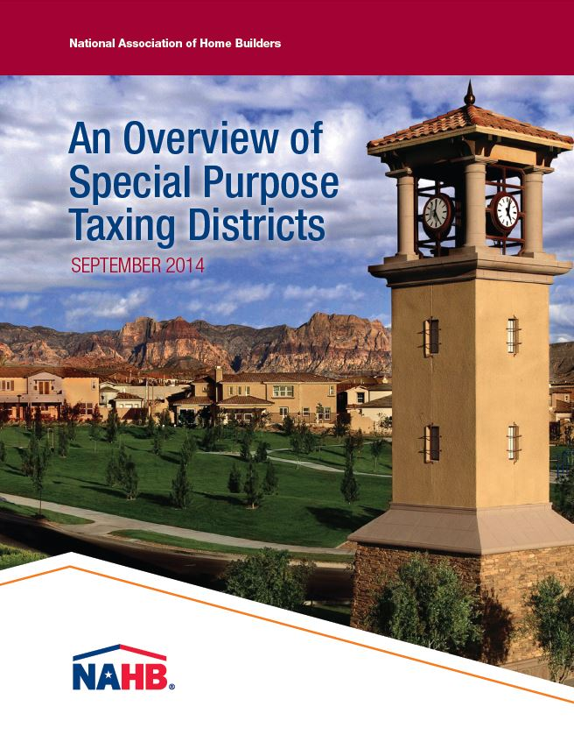
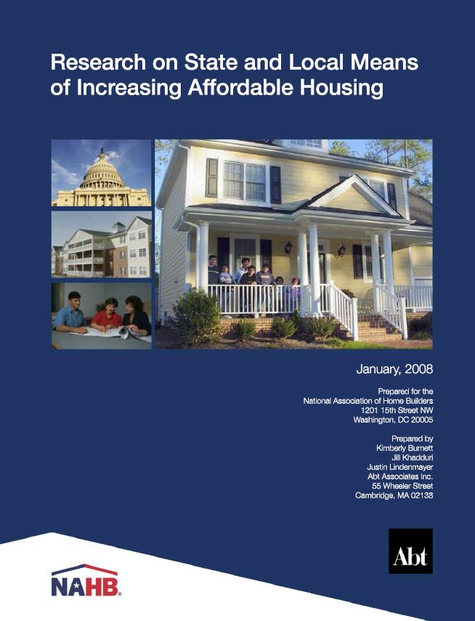
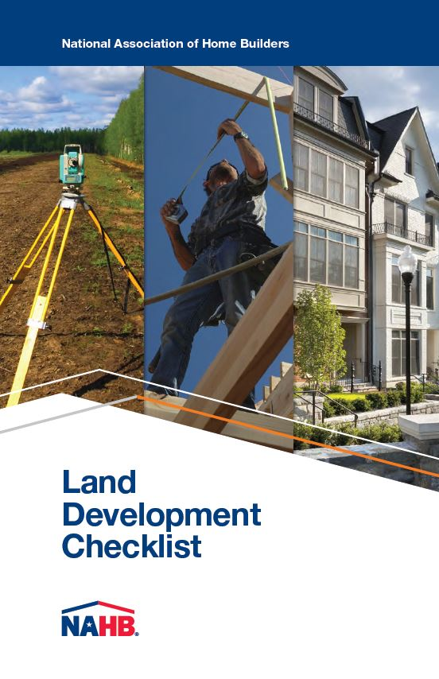
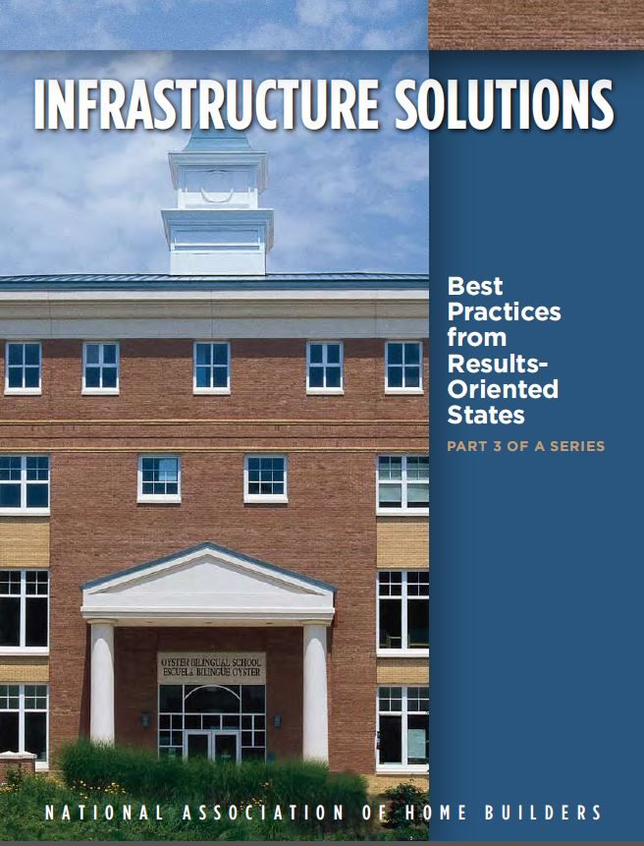
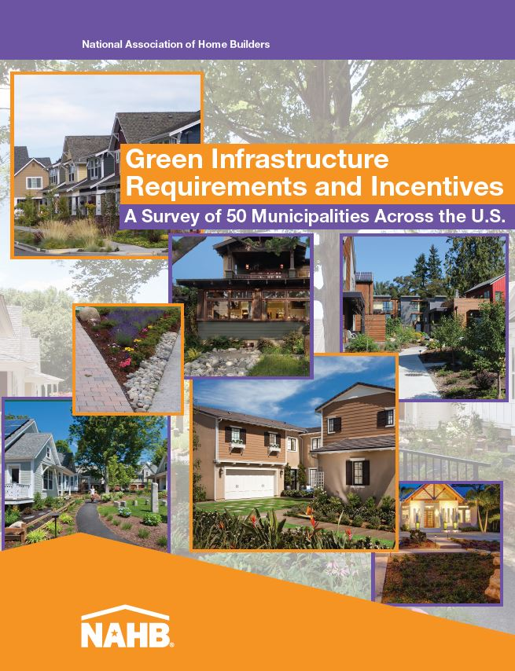
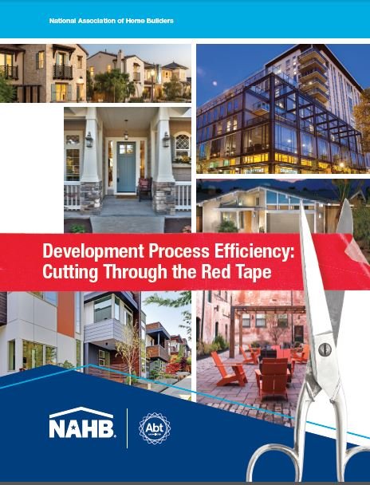
Other Resources

Slide 62
Questions?
Nicholas Julian
Program Manager, Land Use, NAHB
njulian@nahb.org
202-266-8309

