Slide 1
Low Impact Development Practices

Slide 2
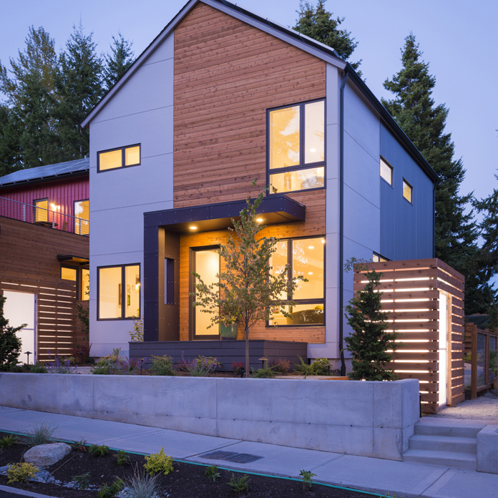
What is LID?
LID is an approach to land development (or re-development) that works with nature to manage stormwater as close to its source as possible. LID employs principles such as preserving and recreating natural landscape features, minimizing effective imperviousness to create functional and appealing site drainage that treat stormwater as a resource rather than a waste product.
Grow Community, Anthony Rich
Notes:
While most engineering plans pipe water to low spots as quickly as possible, LID uses micro-scale techniques to manage precipitation as close to where it hits the ground as possible
By implementing LID principles and practices, water can be managed in a way that reduces the impact of built areas and promotes the natural movement of water within an ecosystem or watershed. Applied on a broad scale, LID can maintain or restore a watershed's hydrologic and ecological functions.
LID measures provide a means to address both pollutant removal and the protection of predevelopment hydrological functions.
One of the primary goals of LID design is to reduce runoff volume by infiltrating rainfall water to groundwater, evaporating rain water back to the atmosphere after a storm

Slide 3
Where Can I Use LID Practices?
LID can be applied to new development, redevelopment, or as retrofits to existing development.
LID has been adapted to a range of land uses from high density ultra-urban settings to low density development.
Alta Del Mar, Eric Figge Photography
Notes:
LID techniques such as rooftop retention, permeable pavements, bioretention and disconnecting rooftop rain gutter spouts are valuable tools that can be used in urban areas. For example, stormwater flows can easily be directed into rain barrels, cisterns or across vegetated areas in high-density urban areas. Further, opportunities exist to implement bioretention systems in parking lots with little or no reduction in parking space. The use of vegetated rooftops and permeable pavements are 2 ways to reduce impervious surfaces in highly urbanized areas.

Slide 4
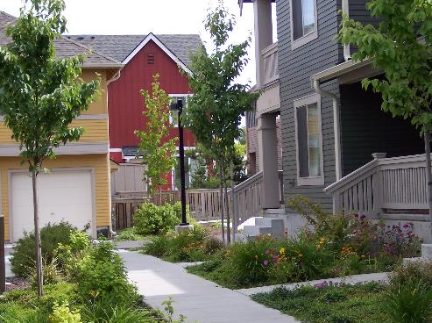
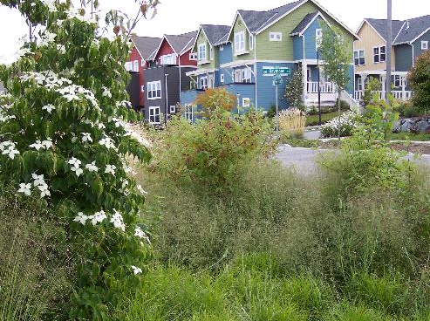
Obstacles to Using LID Practices
The appropriateness of LID practices is dependent on site conditions, and is not based strictly on spatial limitations.
Evaluation of soil permeability, slope and water table depth must be considered in order to effectively use LID practices.
Many communities have development rules that may restrict innovative practices that would reduce impervious cover.
High Point
Notes:
These "rules" refer to a mix of subdivision codes, zoning regulations, parking and street standards and other local ordinances that determine how development happens (Center for Watershed Protection, 1998). These rules are responsible for wide streets, expansive parking lots and large-lot subdivisions that reduce open space and natural features. These obstacles are often difficult to overcome.

Slide 5
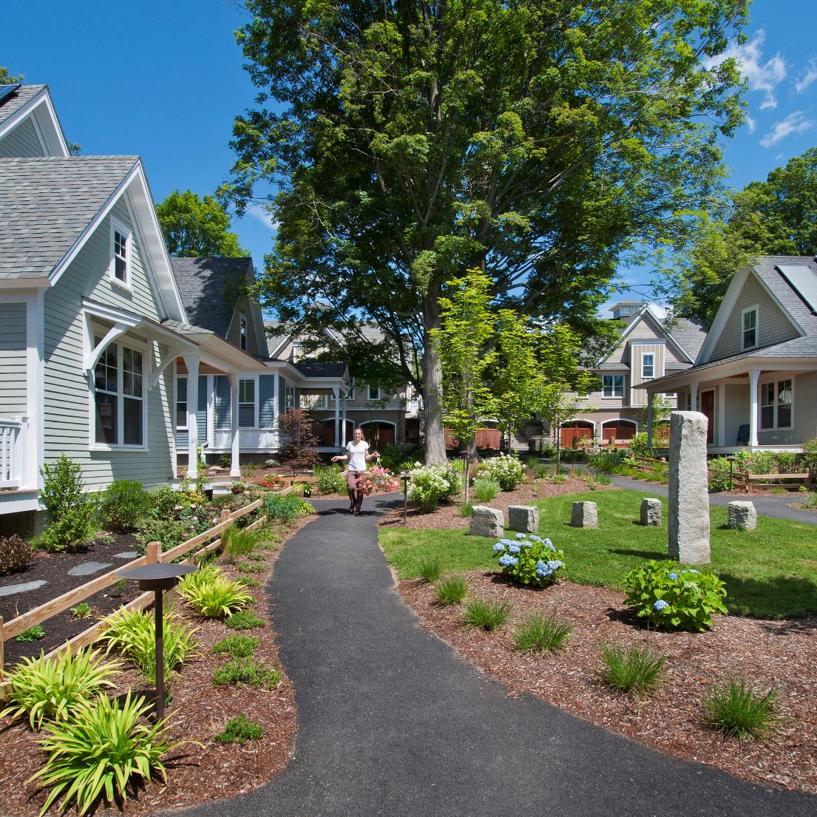
Types of LID Practices?
Bioretention Facilities
Rain Gardens
Vegetated Rooftops
Rain Barrels
Permeable Pavements
Concord Riverwalk, Nat Rea
Notes:
This is not a complete list, but rather some of the most commonly used practices.

Slide 6
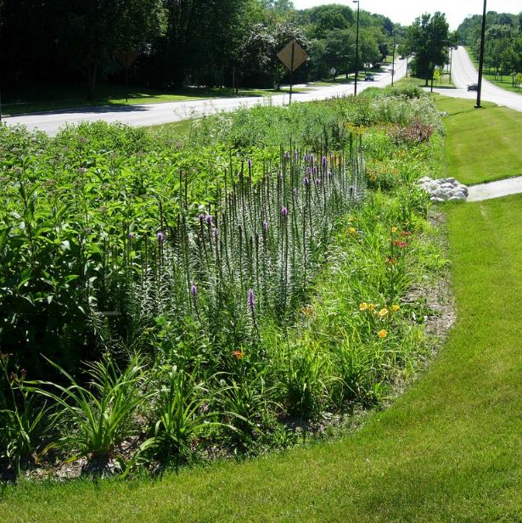
Bioretention Systems
Bioretention facilities are less cost intensive than traditional structural stormwater conveyance systems.
For example, bioretention practices reduced the amount of storm drain pipe at a Medical Office building in Prince George's County, Maryland from 800 to 230 feet, which resulted in a cost savings of $24,000 or 50% of the overall drainage cost for the site
Annual maintenance is required for the overall success of bioretention systems.
Notes:
Six typical components found in bioretention cells:
Grass buffer strips reduce runoff velocity and filter particulate matter.
Sand bed provides aeration and drainage of the planting soil and assists in the flushing of pollutants from soil materials.
Ponding area provides storage of excess runoff and facilitates the settling of particulates and evaporation of excess water.
Organic layer performs the function of decomposition of organic material by providing a medium for biological growth (such as microorganisms) to degrade petroleum-based pollutants. It also filters pollutants and prevents soil erosion.
Planting soil provides the area for stormwater storage and nutrient uptake by plants. The planting soils contain some clays which adsorb pollutants such as hydrocarbons, heavy metals and nutrients.
Vegetation (plants) functions in the removal of water through evapotranspiration and pollutant removal through nutrient cycling.
Construction of a typical bioretention area in Prince George's County, Maryland is between $5,000 and $10,000 per acre drained, depending on soil type (Weinstein, 2000). Other sources estimate the costs for developing bioretention sites at between $3 and $15 per square foot of bioretention area.

Slide 7
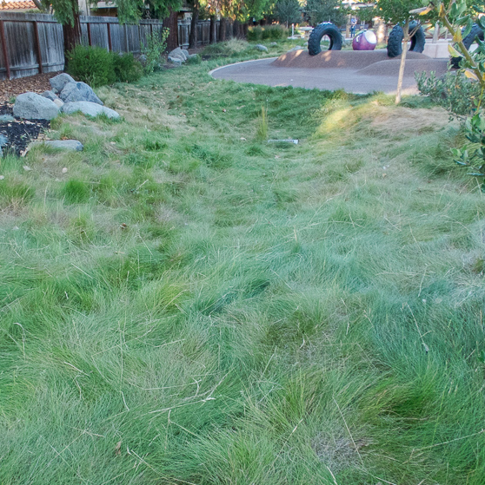
Grass Swales
Adaptable to a variety of site conditions, are flexible in design and layout, and are relatively inexpensive
They function as a mechanism to reduce runoff velocity and as filtration/infiltration devices.
Engineered swales are less costly than installing curb and gutter/storm drain inlet and storm drain pipe systems.
Notes:
Sedimentation is the primary pollutant removal mechanism, with additional secondary mechanisms of infiltration and adsorption.
The cost for traditional structural conveyance systems ranges from $40–$50 per running foot. This is two to three times more expensive than an engineered grass swale (Center for Watershed Protection, 1998).

Slide 8
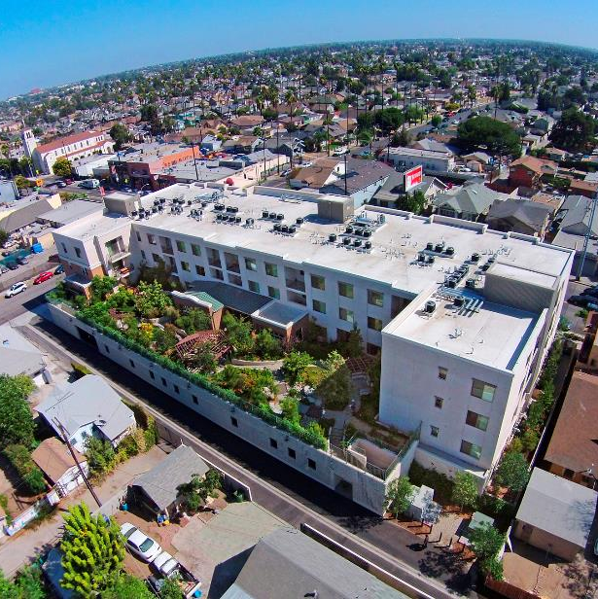
Vegetated Roof Covers/Green Roofs
Reduces urban stormwater runoff by reducing the percentage of impervious surfaces in urban areas.
Vegetated roof covers in urban areas offer a variety of benefits, such as extending the life of roofs, reducing energy costs and conserving valuable land that would otherwise be required for stormwater runoff controls.
Green roofs are highly effective in reducing total runoff volume.
Can be added to existing rooftops without additional reinforcement or structural design requirements
Jefferson Square, AG Photography
Notes:
The green roof is a multilayered constructed material consisting of a vegetative layer, media, a geotextile layer and a synthetic drain layer.
Simple vegetated roof covers, with approximately 3 inches of substrate can reduce annual runoff by more than 50 percent in temperate climates

Slide 9
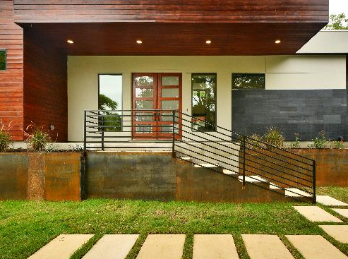
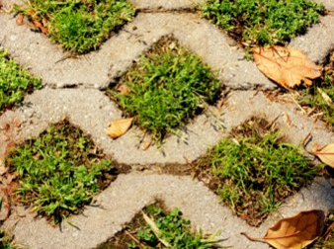
Permeable Pavement
Effective means of reducing the percent of imperviousness in a drainage basin.
Porous pavements are best suited for low traffic areas, such as parking lots and sidewalks.
Permeable pavements allow stormwater to infiltrate into underlying soils promoting pollutant treatment and recharge, as opposed to producing large volumes of rainfall runoff requiring conveyance and treatment.
Tarrytown Modern, Luxury Homes
Notes:
The most successful installations of alternative pavements are found in coastal areas with sandy soils and flatter slopes

Slide 10
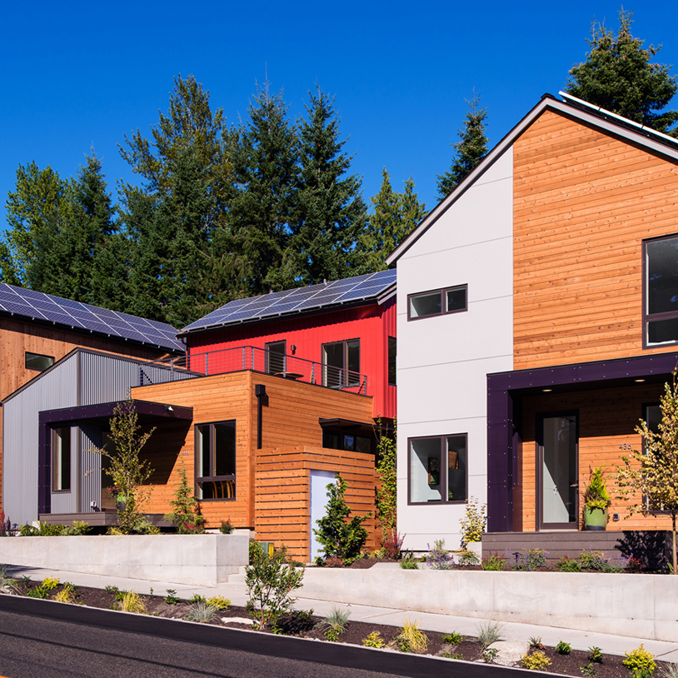
Benefits of LID
Economical and environmental benefits
Less disturbance of the development area
Conservation of natural features
Can be less cost intensive than traditional stormwater control mechanisms
Grow Community, Anthony Rich
Notes:
Cost savings for control mechanisms are not only for construction, but also for long-term maintenance and life cycle cost considerations.
For example, an alternative LID stormwater control design for a new 270 unit apartment complex in Aberdeen, NC will save the developer approximately 72% or $175,000 of the stormwater construction costs (EPA).

Slide 11
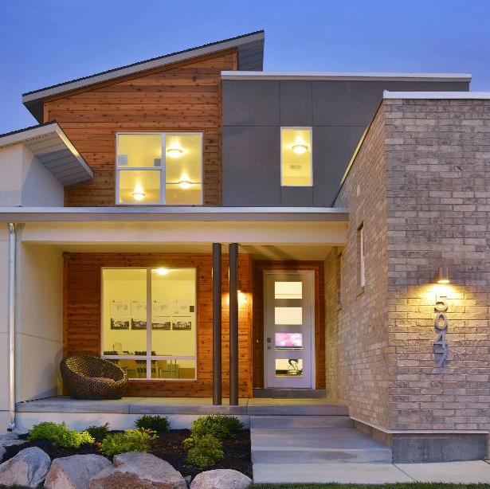
Builder Concerns with LID
Many homeowners want large-lots and wide streets and view reduction of these features as undesirable and even unsafe.
Many people believe that without conventional controls, such as curbs and gutters and end of pipe BMPs, they will be required to contend with basement flooding and subsurface structural damage.
Concerns that open channels are potential nuisance problems, present maintenance problems, or impact pavement stability.
Bellasol at Rosecrest, John Bare Photography / Vivint
Notes:
Two of the most frequent challenges facing developers who contemplate the use of LID center around restrictive local ordinances and local officials’ and citizens’ opposition to the approach. However, careful project planning, close collaboration with the local municipality, and education programs can reduce the challenges.
Misconceptions and minimal data regarding the safety and long-term viability of LID systems, particularly in terms of flood control and public health and safety. Studies have shown that once residents understand the benefits to local water quality, they are more likely to support and accept alternative technologies.
In many cases, developers wishing to use LID may have to obtain some type of variance or waiver from their local planning agency. As a pure business decision, it usually does not make sense for a developer to go through the potentially time consuming steps of the variance process. One way to address this issue is to have municipalities reword their zoning ordinances in order to allow (NOT REQUIRE) LID in residential land development projects.

Slide 12
Questions?
Nicholas Julian
Program Manager, Land Use, NAHB
njulian@nahb.org
202-266-8309

