Slide 1

Alternative Infrastructure Financing Solutions
Summerlin

Slide 2

Overview
The Challenge
Search for Solutions
Extensive Resources
Sienna
Notes:
Both public and private sector resources are more constrained than ever before, and the issue of how to fund infrastructure remains a significant one.
In fact, it’s typically one of the first issues that comes up when developers propose new projects.

Slide 3
The Challenge
Development process is more complicated and riskier today
Commercial lending for new development is still limited
Government revenues remain constrained too
How to finance infrastructure efficiently and effectively without driving up housing costs?
More and better financing mechanisms needed than ever before
Notes:
The development entitlements process too has become increasingly lengthy and complex, making it both less certain and more costly. More sites today have unexpected surprises, and there is often citizen resistance to development of any sort.
There is also still limited funding from commercial banks for new development, so there’s a greater reliance on private investors.
The challenge and opportunity for all is to figure out how to work together to incentivize desired new projects and finance needed infrastructure as effectively, reliably, and efficiently as possible without driving up housing costs in the process.

Slide 4

Local Government Fiscal Stress and the Rise of Impact Fees
Easy to impose
But can’t be used for community-wide facilities
Shifts burden to new home buyers
Effects on housing cost and affordability
Not a steady, pay-as-you-go revenue stream
Eastmark
Notes:
As communities struggle with finding adequate revenues for roads, schools, water, sewer, and more, it is common for them to revive and increase impact fees on new homes, on the assumption that new development must pay its way.
Yet NAHB’s extensive research and experience has shown that impact fees are an imperfect tool for financing infrastructure, because they can’t be spent until they accumulate, they rise and fall with the pace of construction, and they burden new home buyers with paying for what is fundamentally a broader community need.
Impact fees are also passed on to buyers in the form of higher house prices. Households who no longer qualify for a mortgage after the price increase are then often “priced out” of the market. Further, many new home buyers are not actually new households, but people moving within the same community.
Finally, relying on impact fees during the sustained construction boom that preceded the recession did not help build our way out of the infrastructure challenge.

Slide 5


The Search for Solutions
  Need to better understand available tools and where they have been used successfully
  Rethink assumptions and better leverage available existing resources
  Requires innovation and collaboration between public and private sectors
Eastmark
Notes:
NAHB has worked with credentialed experts to conduct substantial research on infrastructure financing options over the past several years.
This research shows that there are many alternative municipal finance solutions that better meet the needs of both private development, the public sector, and new home buyers, but that there is also a continuing need to share information about the most promising approaches and where they’ve been used successfully.

Slide 6

NAHB Resources
Go to www.nahb.org
Land Use 101 Toolkit
Infrastructure Finance and Development Fees section
Notes:
There is a broad range of creative strategies that can make a tremendous difference in the ultimate cost of infrastructure, improve the equity of who bears those costs, reduce the time it takes to get facilities built, and increase the efficiency in how they are managed.
Based on this research, NAHB has developed a broad palette of resources to help foster positive and collaborative solutions to these challenges at the state and local level.

Slide 7
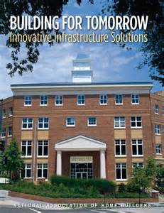
Building for Tomorrow
Notes:
Key resources include the three-part series of publications called the Building for Tomorrow series.
The first publication--Building for Tomorrow: Innovative Infrastructure Solutions--explains an array of innovative financing tools and methods of delivery and operation that are available to local governments, along with case studies of where they have been used successfully.

Slide 8
Building for Tomorrow:
Innovative Infrastructure Solutions
  Details 27 alternative tools, such as:
  Tax increment financing
  Special districts
  Community development districts
  State revolving loan funds
  Tax-exempt municipal leasing
  Public-Private Partnerships
  Small-scale water and wastewater systems
Notes:
These tools include special financing districts of various types, municipal leasing arrangements, state and federal loan and fund sources, and public/private partnerships, to name a few.
Some tools, such as TIFs, CDDs, and leaseback arrangements have been used in parts of the country for years, but word has spread slowly about their successes—including how they are increasingly being used together.
Some tools have also been used more often for fairly large, urban projects with single property owners, but they are now starting to be used for other types of projects as well, including smaller projects or projects with multiple owners in suburban and rural areas.

Slide 9
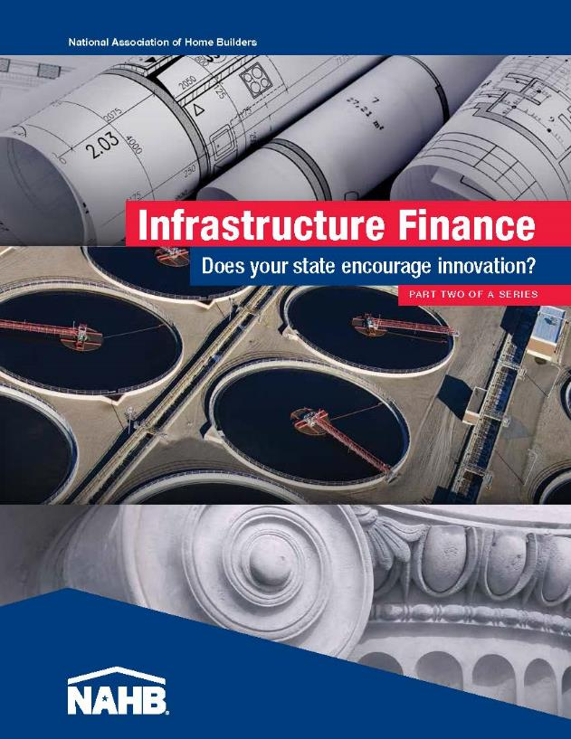
States that Allow The Use of Key Tools
Easy-to-use matrix backed up by full report, with links to enabling statutes.
Shows what has changed from 2007 to 2012.
Notes:
Many of the strategies require state enabling legislation to authorize local governments to use them.
So NAHB retained the National Conference of State Legislatures in 2005, 2007, and 2012 to take stock of which states allow the use of 11 core tools.
NCSL is a well-respected, bipartisan source of policy information.
This second report--Infrastructure Finance: Does Your State Encourage Innovation?—has been especially popular, as it shows at a glance which states allow various financing tools, and which are the most progressive in that regard.

Slide 10
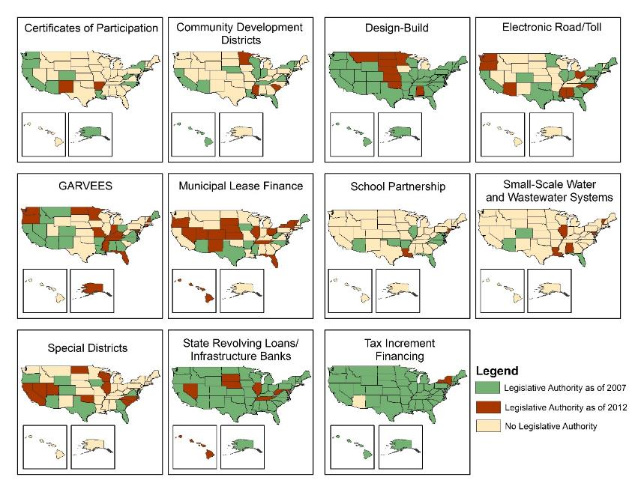
Change in Enabling Authority 2007-2012
Notes:
As is evident from these maps that were generated based on NCSL’s research, there was a lot of productive work being done by states between 2007 and 2012, while the recession was underway.
The green shading represents the states that allowed these tools as of 2007.
The red shows the states that added this capacity since then.
Yellow indicates states that still do now allow use of particular tools.
Many more states added enabling authority over that time, showing that they were clearly retooling for what lies ahead. Some of these tools are now widely authorized for use, just as tax increment financing, or TIFs, have been for some time.
These are very encouraging results, as the tools with the most change are also ones that are very useful to public-private collaboration on complex projects such as infill, mixed use, and transit-oriented development.

Slide 11
Best Practices from Results-Oriented States
Identifies states with most effective enabling authority for 11 key tools
A guide for states who do not yet authorize particular tools
Notes:
The third publication in the series is Infrastructure Solutions—Best Practices from Results-Oriented States.
This was also prepared by NCSL and spotlights good examples of enabling statutes for the same 11 key tools, as models for states that do not yet authorize their use.
NCSL looked at statutory language from all of the states and, based on a set of criteria developed in conjunction with NAHB, highlighted the best written laws that showed the most promise for helping local governments make effective use of these tools.
What NCSL concluded, however, was that good enabling authority is only half the picture, and a clear commitment to implementation is also critical to success.

Slide 12
Many States Now Allow the Use of Special Districts
Notes:
Here is the snapshot of state enabling authority for special districts, with two more states added—Idaho and Hawaii—since the NCSL update in 2012.
In 2005, only a handful of states authorized their use--now it’s nearly half.
Some of the more common names for the various special districts in use across the country include municipal utility districts, public improvement districts, special assessment districts, community development districts, and tax increment financing districts.
They can be used for a wide variety of types of facilities, as well as in combination with other tools.
The IRS proposed a rule about a year ago that would have dramatically limited their use. NAHB and many others submitted comments on that rule, and the rule has been recently withdrawn.

Slide 13
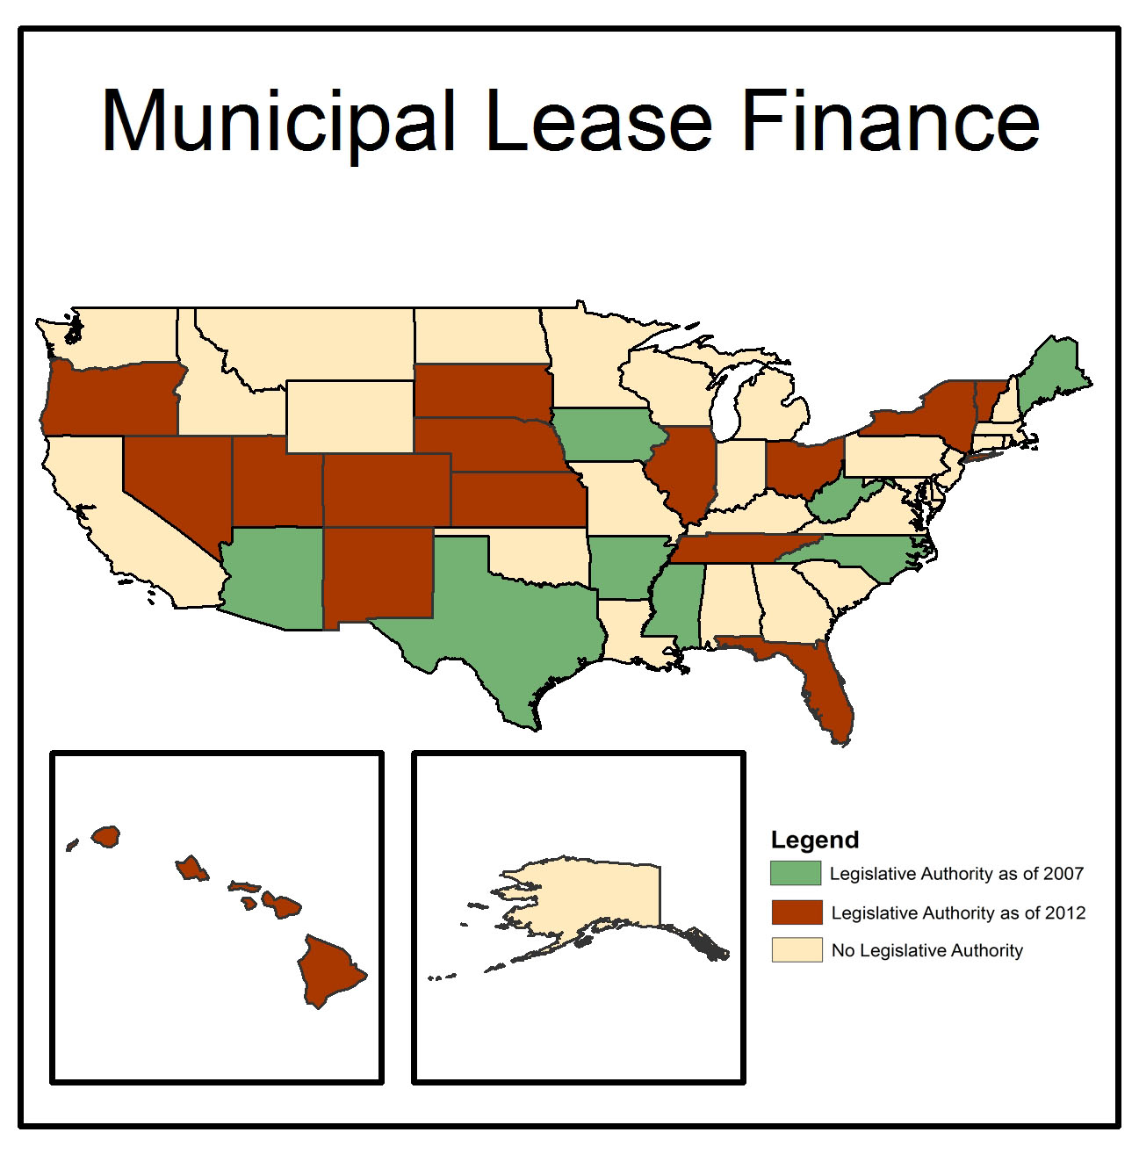
Municipal Lease Financing
Notes:
Municipal lease financing allows municipalities to “rent-to-own” buildings and facilities.
The municipality does so by paying renewable obligations on a given project until the debt is retired.
At that point, it becomes the property of the municipal lessee.
It is a flexible, cost-effective alternative to bonds that allows municipalities to finance projects without incurring debt or holding a bond referendum.
Both Design/Build and lease financing are widely used in public-private partnership projects.
As of 2012, it was authorized for use in 23 states and has been used to finance and construct an array of facilities, including schools, courthouses, prisons, libraries, parking facilities, municipal buildings, recreational facilities, and wastewater treatment systems, often more quickly as well than via bonds.
Maine is featured in our Best Practices report as a good example of authorizing legislation for this tool, as it includes a wide range of direct and indirect financing options.

Slide 14
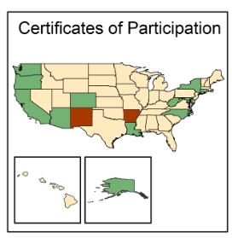
Certificates of Participation
Notes:
In a COP financing arrangement, the jurisdiction enters into a lease agreement to pay a fixed amount annually to a third party lessor, usually a nonprofit agency or a private leasing company.
The lessor raises funds through the sale of COPs to investors, which provides the funds needed to purchase or build the asset.
The distinguishing characteristic of a COP is that the lease agreement is divided and sold to multiple investors in small fractions, usually $5,000 denominations. Each certificate represents a proportional interest in the rental payments that will be made by the municipality.
The municipality pays yearly rental payments to the certificate holders until the debt is retired.
Upon repayment, ownership of the asset is transferred to the jurisdiction.
As with municipal lease financing, the transaction is not considered debt and so is not subject to either voter approval or debt limits. North Carolina is highlighted in our Best Practices report as a good example of legislation authorizing COPs.

Slide 15
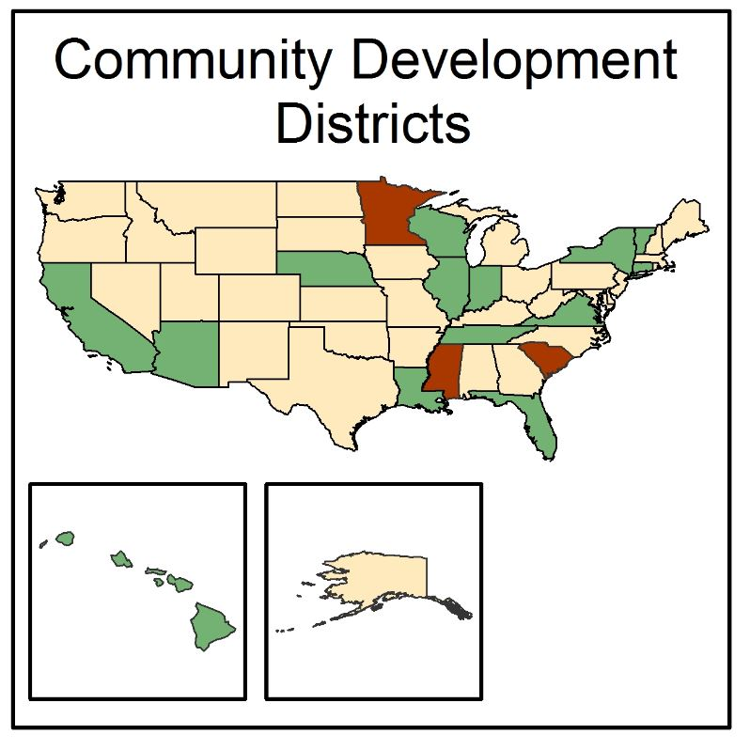
Community Development Districts
Notes:
Community development districts are quasi-governmental entities with distinct boundaries and so are a form of special district financing.
These districts usually provide financing for specific public services, typically charging homeowners within the district’s boundaries an annual tax surcharge.
Arizona and Hawaii are featured as good models for state legislation, in part because of the diversity of types of assistance that are available in Arizona, and a provision for affordable housing in Hawaii’s program.
The Special Districts report by DPFG also notes what facilities can be financed with CDD-type instruments in various states and gives examples of their use in actual development projects.

Slide 16
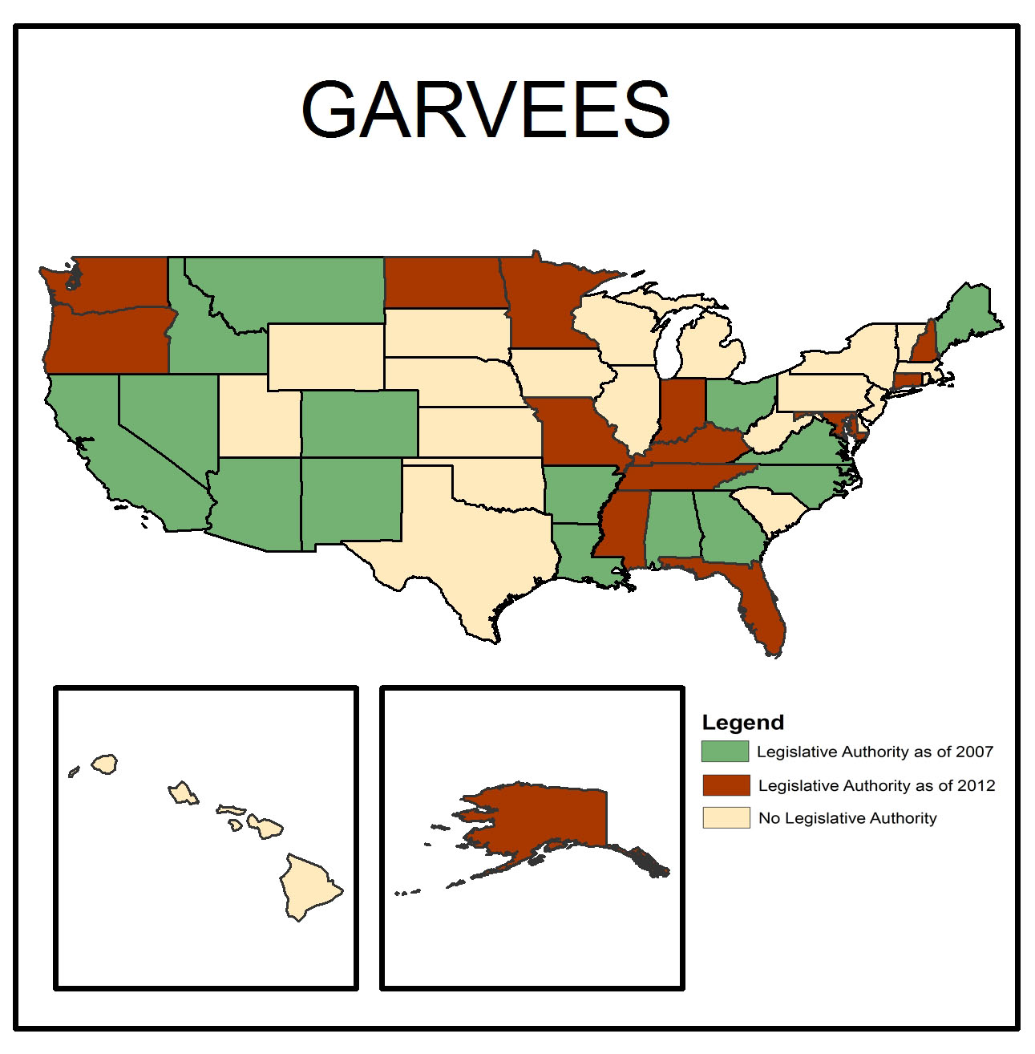
GARVEEs
Notes:
GARVEEs stand for “Grant Anticipation Revenue Vehicles”. They are bonds that are debt-secured by anticipated federal funding for a project, often highway construction.
States essentially pledge a share of the future federal funding toward payment of debt service on a long-term bond issue.
They are not considered general obligations of the issuing entity and can result in construction of facilities sooner than would otherwise be possible.
Our first publication, Building for Tomorrow, gives an example from Alabama of how GARVEEs were used to replace older bridges.
Our Best Practices report highlights California as a good model because it provided for the first GARVEE issue in the country by a local government.

Slide 17
Tax Increment Financing
Notes:
TIFs use the difference between a site’s pre- and post-development tax revenues for a proposed development to finance that development within a specified district.
This is why TIFs are called a “value capture” tool.
The increment is created without dipping into the base tax revenues present at the time of adoption.
Some states and jurisdictions, such as Iowa and the District of Columbia, also base them on the increased sales tax revenues that are generated within a TIF district.
The District of Columbia used Sales Tax TIFs to spur the extensive and very successful redevelopment of the Chinatown/Gallery Place section of downtown, near what is now called the Capital One sports arena.
A 2013 article from the Legislative Services Agency in Iowa describes several different potential applications of their Sales Tax TIFs, including flood mitigation projects and reinvestment zones.

Slide 18
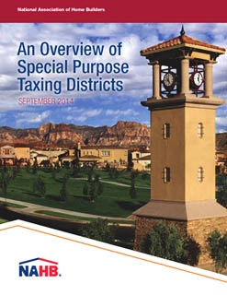
Latest in NAHB’s Series of Reports
Notes:
More recently, NAHB hired DPFG, Inc., to write a report on what they and others believe are the best alternatives to impact fees: special district financing.
As DPFG notes, special districts are more reliable as well as more equitable revenue sources, drawing on everyone within a defined district to help finance public infrastructure instead of just new residents.
There is a clearer connection between the assessed fee and what benefits are being bought with them.
They are also levied on an annual basis and so are not rolled into a mortgage as with impact fees.
They can also be used more easily with other financing tools, such as TIFs, thus accelerating the financing of public improvements in advance of growth.
These benefits encourage a more positive collaboration between the public and private sectors.

Slide 19

Good Climate for Collaboration
  Hard work, no question!
  But:
  Public & private sectors realize they cannot do this on their own
  Public-private partnerships manage risks and rewards for both partners
Sienna
Notes:
Based on ongoing work on these issues, and in light of today’s constrained financial environment, it has become clearer than ever before that we need a broad, flexible array of tools, not a scaling back.
We need to work together to understand these tools and share insights gleaned from the new realities of the marketplace on how best to structure these tools to safeguard both public and private sector interests.
Creativity, innovation, and collaboration are the key to meeting our infrastructure challenges together.
Go to last slide.

Slide 20
Questions?
Debbie Bassert
AVP, Land Use & Design, NAHB
dbassert@nahb.org
202-266-8443
Nicholas Julian
Program Manager, Land Use
njulian@nahb.org
202-266-8309

