Slide 1
Section 5
Additional Fall Protection Systems

Slide 2
Disclaimer
This material was produced under grant number SH-31198-SH7 from the Occupational Safety and Health Administration, U.S. Department of Labor. It does not necessarily reflect the views or policies of the U.S. Department of Labor, nor does mention of trade names, commercial products, or organizations imply endorsement by the U.S. Government. Revisions were made to this material under grant number SH-05122-SH9 from the Occupational Safety and Health Administration, U.S. Department of Labor.
This presentation is intended to discuss Federal Regulations only - your individual State requirements may be more stringent as many states operate their own state OSHA and they may have adopted construction standards that are different from information presented in this training. If you live in a state with an OSHA approved state plan, you should contact your local administrator for further information on the standards applicable in your state.
These materials are meant for informational purposes only.
No representation is made as to the thoroughness of the presentation.
Notes:
This material was produced under the Susan Harwood training grant number SH-05122-SH9 from the Occupational Safety and Health Administration, U.S. Department of Labor.

Slide 3
Disclaimer, continued 1
It is not the intent to provide compliance-based training in this presentation, the intent is more to address hazard awareness in the residential construction (i.e. home building) industry, and to recognize the overlapping hazards present in many construction workplaces.
Photos shown in this presentation may depict situations that are not in compliance with applicable OSHA/safety requirements.
No legal advice is offered or implied, and no attorney-client relationship is intended or established. If legal advice or other expert assistance is required the services of a competent professional person should be sought.
It is the responsibility of the employer and its employees to comply with all pertinent OSHA/safety rules and regulations in the jurisdiction in which they work.
Notes:
Please read the disclaimer for legal purposes, this is required under the Susan Harwood Training Grant program.

Slide 4
Copyright Information © 2018
This material is the copyrighted property of the Job-Site Safety Institute and the National Association of Home Builders. By federal regulation, OSHA reserves a license to use and disseminate such material for the purpose of promoting safety and health in the workplace. The Job-Site Safety Institute and the National Association of Home Builders hereby authorizes employers and workplace safety and health professionals to use this material, distributed by or through OSHA, in their workplaces or practices in accordance with the guidance contained in the material.
To this end, permission is granted to use such copyrighted material solely for non-commercial, instructional, personal, or scholarly purposes. The material may be used and incorporated into other workplace safety and health programs on the condition that no fee may be charged for the subsequent use of the material. Use of the material for any other purpose, particularly commercial use, without the prior, express written permission of the copyright owner/s is prohibited. Furthermore, any modification to the material is prohibited without the prior, express written permission of the copyright owners.
Notes:
Note that the these materials are copyrighted by the Job-Site Safety Institute and the National Association of Home Builders. Permission is granted to use such copyrighted material in accordance with the terms on the slide.

Slide 5
Learning Objectives: Section 5
Identify types of Additional Fall Protection Systems and “alternative” fall protection systems.
Discuss potential uses and limitations of using an “alternative” form of fall protection.
Identify key requirements and basic safety practices for each alternative protection system.
Understand when a written fall protection plan is necessary.
Notes:
Discuss the learning objectives for Section 5. In this section we will identify additional fall protection systems as well as “alternative” fall protection. We will also discuss uses and limitations of these types of systems and identify key requirements for each alternative protection system. Lastly, we will understand when a written fall protection plan is necessary.

Slide 6
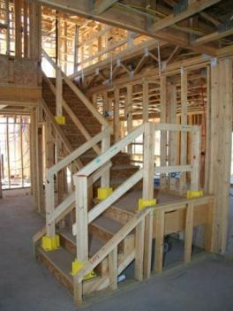
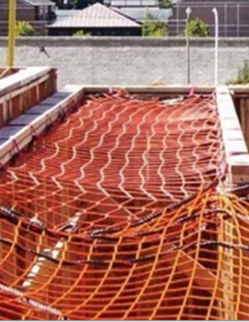
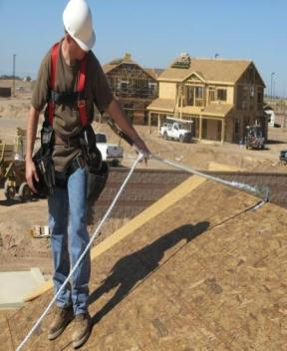
Reminder of Conventional Fall Protection
3) Personal Fall
Arrest System
(PFAS)
1) Guardrails
2) Safety Nets
Notes:
As a reminder, the three conventional forms of fall protection are guardrails, safety nets and personal fall arrest systems.

Slide 7
Additional Fall Protection Systems
In this section we will learn about:
  Handrails and Stair rails
  Floor Hole Covers
  Controlled Access Zones
  Positioning Device Systems
  Alternative Fall Protection
Notes:
Additional fall protection systems covered in this section are:
Handrails and Stair rails
Floor Hole Covers
Controlled Access Zones
Positioning Device Systems
Alternative Fall Protection

Slide 8
Handrails and Stairrails - Requirements
Toprail
  36 in. (.9 m) above the tread vertically in line with the riser
  Install handrail 3” from wall
Midrail
  Halfway between toprail and stair stringer
Toe Board
  Minimum of 3 1/2 in. (4 in. nominal) (10.2 cm)
Weight Requirement
  At least 200 lbs. (90.9 kg)
Notes:
Explain the requirements for handrails and stairrails.
The toprail must be placed 36 inches above the tread and in-line with the riser, and placed 3 inches from the wall.
The midrail should be halfway between stair stringer and toprail.

Slide 9
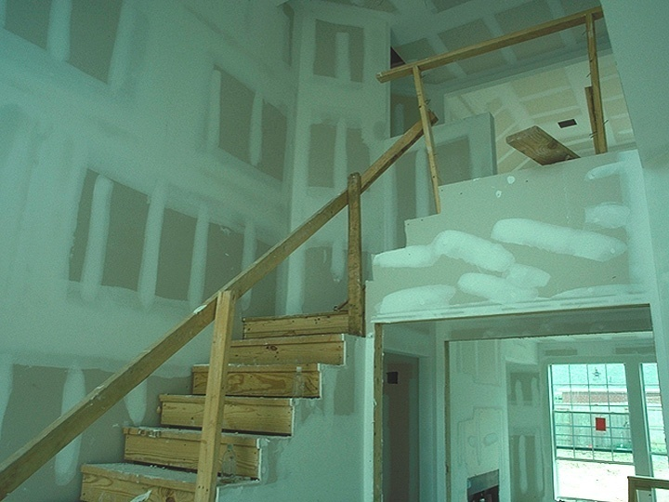

Identify the Hazards
How many hazards do you see in this photo?
Notes:
Discuss the hazards you see in this photo. An example of a hazard could be a missing midrail in the top portion of the guardrail. Also, will this system be capable of withstanding 200 pounds of force downward and outward?

Slide 10
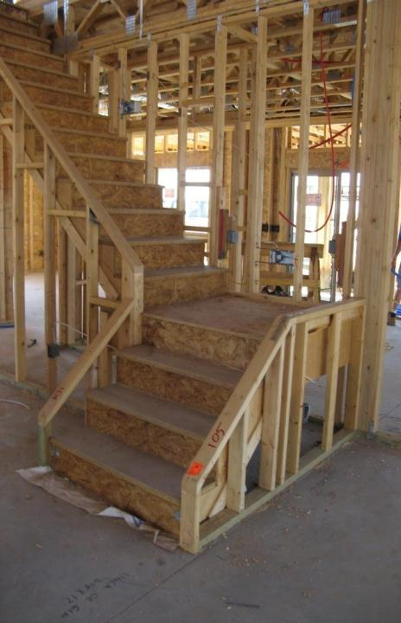
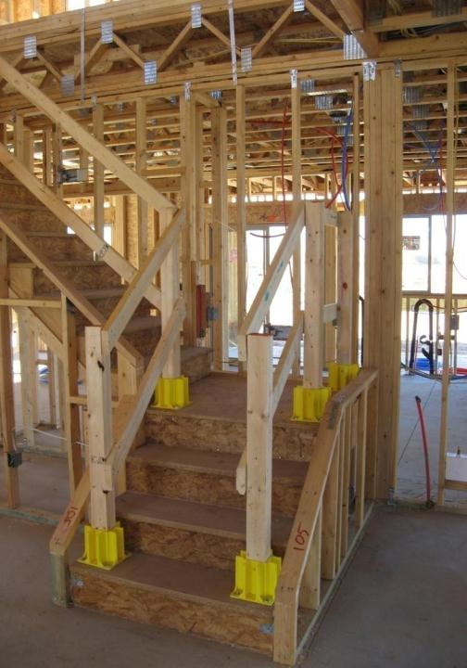
Guardrail boot system
Notes:
Describe the properly installed guardrail boot system utilized on the picture on the right.

Slide 11
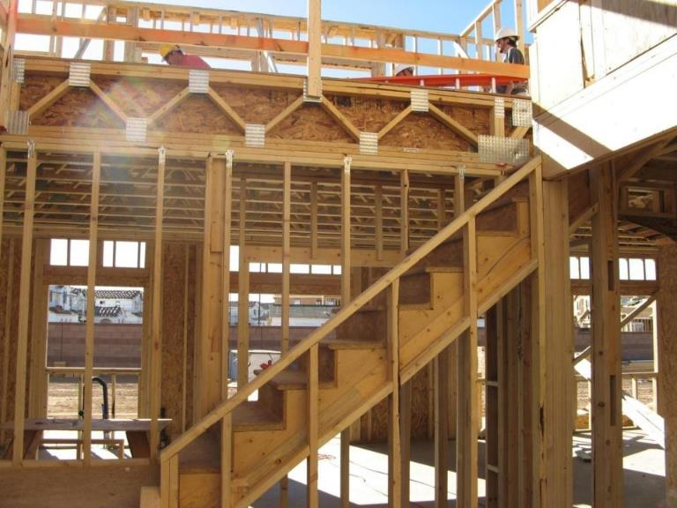
Identify the Hazards, continued 1
How many hazards do you see in this photo?
Notes:
This photo shows missing handrails on a stairway under construction.

Slide 12
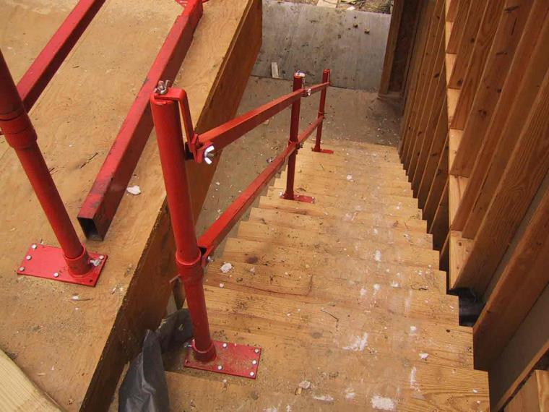
Hand and Stairrail Solution
Notes:
Properly installed metal adjustable guardrail system. Image shows a steel stairrail and hand rail solution installed to a stairway under construction.

Slide 13
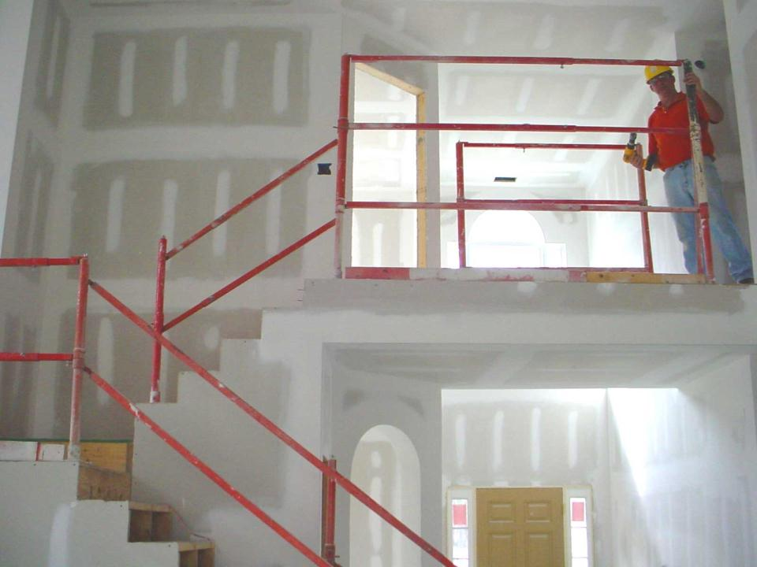
Stair raild installed
Install a toprail 36 in. (.9 m) high to allow one railing to serve as both a handrail and stair rail.
Notes:
Properly installed metal adjustable guardrail system. By installing a toprail 36 inches high, allows one railing system to serve as both a hand rail and stairrail.
Discuss how this particular system can be modified to protect workers on stilts by adding a double top rail.

Slide 14
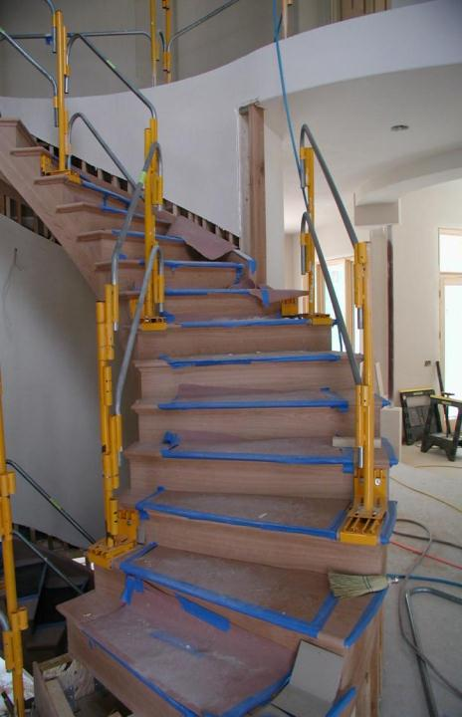
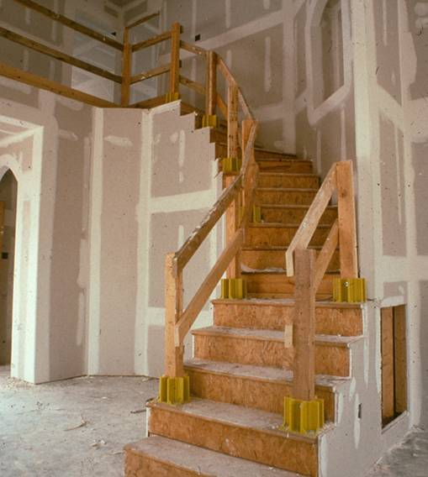
Starrail Solutions
More Hand and Stairrail Solutions.
Notes:
Discuss these two temporary guardrail systems used on a stairway.

Slide 15
Hole Covers
Secured and marked cover which protects workers from tripping or stepping into or through a hole and keeps objects from falling through a hole
Protects against falls through hazards in this category:
  Floor Holes
Notes:
A hole cover is a secured and marked cover which protects workers from tripping or stepping into or through a hole on walking/working surfaces and keeps objects from falling through a hole.

Slide 16
Hole Covers Are Needed For:
Any hole larger than 2” x 2”, such as:
  Fireplace openings
  Skylights
  Basement stair openings
  Floor heating, ventilating, and air-conditioning (HVAC) registers
  Plumbing floor cutouts
Notes:
Hole covers must be used on any hole larger than 2 inches by 2 inches. Examples of these openings include:
Fireplace openings
Skylights
Basement stair openings
Floor heating, ventilating, and air-conditioning (HVAC) registers
Plumbing floor cutouts

Slide 17
Hole Cover Requirements
Hole Covers must be:
  Capable of supporting at least two times the maximum anticipated load
  Secured from movement by nailing in place or other effective method
  Clearly marked indicating the location of the hole
Notes:
Define:
Window and Wall Openings
Unprotected Sides and Edges
Floor Holes

Slide 18
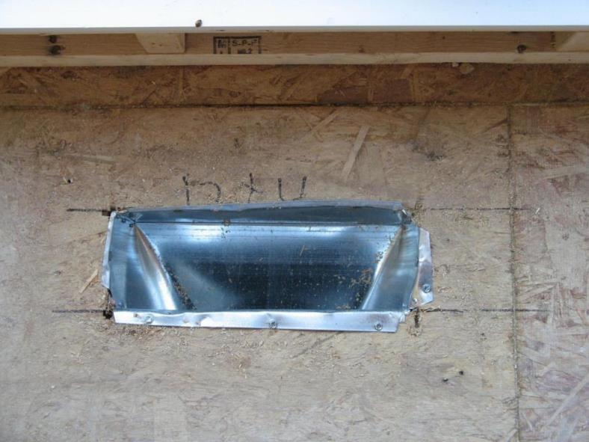
Hole Covers Must Support 2x Intended Load
Cover floor openings larger than 2” by 2” with material to safely support the working load.
Notes:
Discuss whether this floor hole cover is capable of withstanding at least two times the maximum anticipated load?
It is also missing the wording “hole” or “cover” or “hole cover”

Slide 19
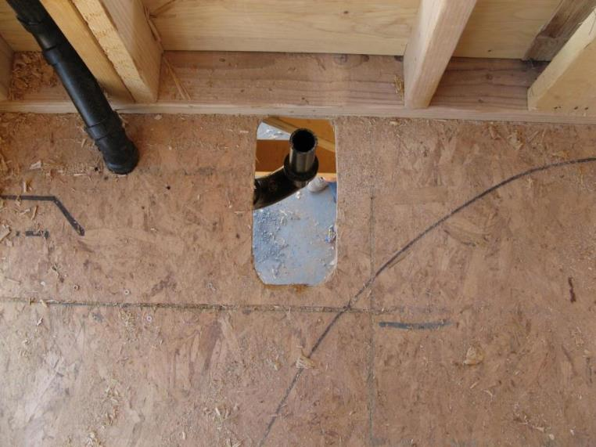
Identify the Hazards, continued 2
How many hazards do you see in this photo?
Notes:
Image shows an improper floor hole cover as the cover poses an impalement hazard, does not appear secured to prevent displacement, and is missing the words hole or cover.

Slide 20
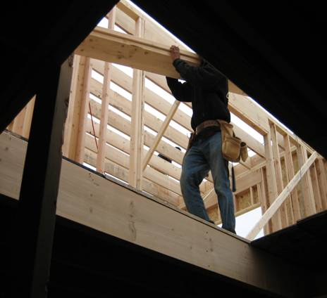
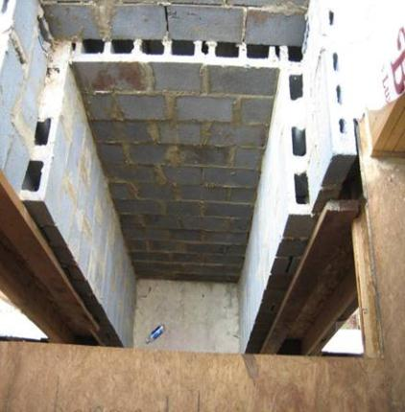
Identify the Hazards, continued 3
How many hazards do you see in these photos?
Notes:
These photos show floor hole hazards that are uncovered.

Slide 21
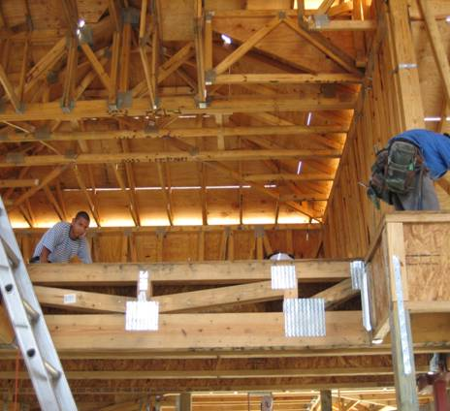
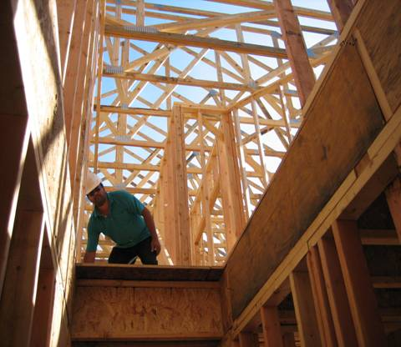
Identify the Hazards, continued 4
How many hazards do you see in these photos?
Notes:
These photos show floor hole hazards that are uncovered and potentially a ladder placed at an improper angle.

Slide 22
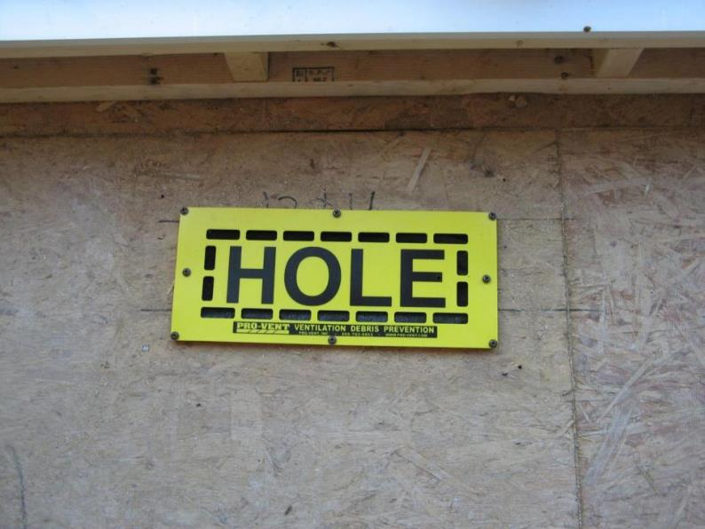
Clearly Marked “Hole” or “Cover”
Notes:
This is a picture of a properly installed floor hole cover. This is a Pro-Vent system that can be used to also prevent debris from entering a ventilation system.

Slide 23
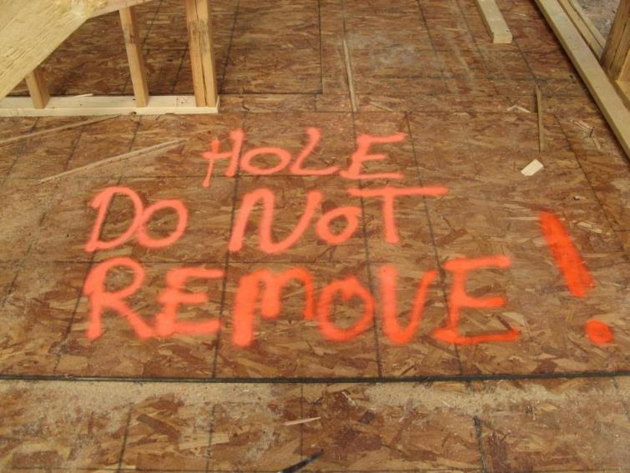
Clearly Marked “Hole” or “Cover”, continued 1
Bright orange paint is a good way to make sure hazards are seen.
Notes:
This hole cover is clearly marked and must be properly secured to prevent displacement. It is a best practice to use a bright colored spray paint to be sure that workers know not to remove covers.

Slide 24

Positioning Device System
A positioning device system is rigged to allow a worker to be supported on an elevated vertical surface, such as a wall, and work with both hands free while leaning.
Notes:
A fall positioning device system prevents workers from falling by holding you in-place and preventing you from falling in the first place.

Slide 25
Positioning Device System, continued 1
Are used to safely position workers away from fall hazards, or in a working position where a fall cannot occur
NOT designed for fall arrest
Must be rigged such that a worker cannot free fall more than 2 feet
Must be secured to an anchor point capable of withstanding 3,000 pounds
Notes:
Discuss instances where a positioning system may be used. Examples include encroachment to floor holes or wall openings. This system is designed to prevent workers from ever reaching an area where a fall may occur. Also discuss using shorter lanyards attached directly to the D-ring and the anchor point to securely hold a worker in place to prevent falls from occurring.

Slide 26
Positioning Device System, continued 2
Inspect for wear, damage, deterioration or defective components prior to EACH USE.
You can wear body belts for positioning device systems not for fall arrest systems.
Best practice is to wear full-body harness even when using positioning device system.
Notes:
Similar to a PFAS, a positioning device system must be inspected before each use. You can use a body belt as a positioning device system but not for fall arrest.

Slide 27
Positioning Device System, continued 3
A body belt or body harness system rigged to allow an employee to be supported on an elevated vertical surface and work with both hands free while leaning.
Notes:
Discuss how a positioning device system may be used to stabilize a worker while working at heights.
There are limitations to this system in a residential construction environment.

Slide 28
Alternative Fall Protection
Residential Construction Exception*
  When employers can demonstrate that it is infeasible or creates a greater hazard to use “conventional” fall protection systems, they must develop and implement a fall protection plan, as needed, in accordance with §1926.502(k).
Notes:
Discuss how a positioning device system may be used to stabilize a worker while working at heights.
There are limitations to this system in a residential construction environment.

Slide 29
What does “Infeasible” mean?
Infeasible means:
  Impossible to perform construction work using conventional fall protection or
  It is technologically impossible to use conventional fall protection
Source: 1926.500(b)
Notes:
These examples are found directly in OSHA’s Preamble to the 1994 Subpart M-Fall Protection rulemaking record.
Note: There is a presumption that it is feasible and will not create a greater hazard to implement one of the conventional fall protection methods (personal fall arrest system, guardrails, or safety nets); and accordingly the employer has the burden of establishing that it is appropriate to implement a fall protection plan that complies with 1926.502(k).

Slide 30
Examples of Infeasibility
OSHA believes it would be unreasonable to expect a home builder to rent a crane when the jobsite is difficult to access (terrain or remote location) or when the home builder has only a single roof to raise.
OSHA does not expect home builders to erect scaffolds around the entire perimeter of a house, or to take other extremely burdensome measures such as erecting separate structures (telephone poles, e.g.) and stringing a lifeline to use as an attachment point for personal fall arrest equipment.
Source: Preamble to Final Fall Protection Rule, Section 3 - III. Summary and Explanation of the Final Rule, August 9, 1994
Notes:
OSHA does not consider "economic infeasibility" to be a basis for failing to provide conventional fall protection for employees performing residential construction work.
Note: There is a presumption that it is feasible and will not create a greater hazard to implement one of the conventional fall protection methods (personal fall arrest system, guardrails, or safety nets); and accordingly the employer has the burden of establishing that it is appropriate to implement a fall protection plan that complies with 1926.502(k).

Slide 31
What does “Creating a Greater Hazard” mean?
Hazards created by compliance with the standard are greater than those created by non-compliance.
Source: Preamble to Final Fall Protection Rule, Section 3 - III. Summary and Explanation of the Final Rule, August 9, 1994
Notes:
If an employer can demonstrate that conventional fall protection (i.e., guardrail systems, safety net systems, or personal fall arrest systems) is infeasible or presents a greater hazard, a written, site specific fall protection plan meeting the requirements of 1926.502(k) can be implemented.
The employer has the burden of establishing that it is appropriate to implement a fall protection plan.
Note: There is a presumption that it is feasible and will not create a greater hazard to implement one of the conventional fall protection methods (personal fall arrest system, guardrails, or safety nets); and accordingly the employer has the burden of establishing that it is appropriate to implement a fall protection plan that complies with 1926.502(k).

Slide 32
Establishing “Greater Hazard”, cont.
OSHA acknowledges that, regardless of an employer's ability to preplan for fall protection, there may be cases where the installation or use of conventional fall protection systems poses a greater hazard than that to which employees performing the construction work would otherwise be exposed.
OSHA expects an employer who seeks to make that case to indicate specifically how compliance with the requirement for conventional fall protection systems would pose a greater hazard.
OSHA will assess each such case on its particular merits.
Source: Preamble to Final Fall Protection Rule, Section 3 - III. Summary and Explanation of the Final Rule, August 9, 1994
Notes:
Discuss: Employers must evaluate the use of conventional fall protection systems, and other work practices covered under OSHA standards (i.e. ladders, scaffolding or aerial lifts) prior to implementing any alternative work practices and establishing a written, site-specific fall protection program.
If an employer can demonstrate that conventional fall protection (i.e., guardrail systems, safety net systems, or personal fall arrest systems) is infeasible or presents a greater hazard, a written, site specific fall protection plan meeting the requirements of 1926.502(k) can be implemented.
The employer has the burden of establishing that it is appropriate to implement a fall protection plan.
Note: There is a presumption that it is feasible and will not create a greater hazard to implement one of the conventional fall protection methods (personal fall arrest system, guardrails, or safety nets); and accordingly the employer has the burden of establishing that it is appropriate to implement a fall protection plan that complies with 1926.502(k).

Slide 33
Fall Protection Plan
This option is available for those engaged in “residential construction” work who can establish that conventional fall protection is infeasible or creates a greater hazard.
Note: It is OSHA’s presumption that conventional fall protection is feasible and will not create a greater hazard, and it is the employer’s burden to establish that it is appropriate to implement a fall protection plan.
Notes:
Discuss: Employers cannot use alternative fall protective measures until it has been documented and proven that conventional fall protective systems are either infeasible/their use creates a greater hazard.
This includes OSHA’s Appendix E to Subpart M, employers must exhaust all conventional means of providing fall protection prior to implementing a fall protection plan that meets the requirements of 1926.502(k).

Slide 34
Fall Protection Plan, continued 1
Site-specific and written plan that identifies and evaluates fall hazards on a jobsite, establishes the protection methods to be used, and assesses the ability of workers to follow related work rules and use equipment safely.
A qualified person develops the plan.
A competent person implements the plan.
Notes:
Discuss: Employers must evaluate the use of conventional fall protection systems, and other work practices covered under OSHA standards (i.e. ladders, scaffolding or aerial lifts) prior to implementing any alternative work practices and establishing a written, site-specific fall protection program.
If an employer can demonstrate that conventional fall protection (i.e., guardrail systems, safety net systems, or personal fall arrest systems) is infeasible or presents a greater hazard, a written, site specific fall protection plan meeting the requirements of 1926.502(k) can be implemented.
The employer has the burden of establishing that it is appropriate to implement a fall protection plan.
Note: There is a presumption that it is feasible and will not create a greater hazard to implement one of the conventional fall protection methods (personal fall arrest system, guardrails, or safety nets); and accordingly the employer has the burden of establishing that it is appropriate to implement a fall protection plan that complies with 1926.502(k).

Slide 35
Fall Protection Plan, continued 2
OSHA considers the implementation of a fall protection plan, outlining alternative fall protection measures, to be a “last resort”!
  Allowed only where the other options for fall protection have been exhausted.
Source: Preamble to Final Fall Protection Rule, Section 3 - III. Summary and Explanation of the Final Rule, August 9, 1994
Notes:
Discuss: Employers must evaluate the use of conventional fall protection systems, and other work practices covered under OSHA standards (i.e. ladders, scaffolding or aerial lifts) prior to implementing any alternative work practices and establishing a written, site-specific fall protection program.
If an employer can demonstrate that conventional fall protection (i.e., guardrail systems, safety net systems, or personal fall arrest systems) is infeasible or presents a greater hazard, a written, site specific fall protection plan meeting the requirements of 1926.502(k) can be implemented.
The employer has the burden of establishing that it is appropriate to implement a fall protection plan.
Note: There is a presumption that it is feasible and will not create a greater hazard to implement one of the conventional fall protection methods (personal fall arrest system, guardrails, or safety nets); and accordingly the employer has the burden of establishing that it is appropriate to implement a fall protection plan that complies with 1926.502(k).

Slide 36
Fall Protection Plan, continued 3
A fall protection plan must identify how and where fall protection will be used on the jobsite and also the safe work practices that will be used.
NOTE: Prior to implementing a fall protection plan (1926.502(k)) the employer has the burden to establish why the use of conventional fall protection is infeasible or creates a greater hazard
Notes:
A written fall protection plan identifies and evaluates fall hazards on a jobsite, establishes the protection methods to be used, and assesses the ability of workers to follow related work rules and use equipment safely.
The plan identifies protective methods for hazards in this category: Leading Edges

Slide 37
Fall Protection Plan, continued 4
Documents reasons why the use of conventional fall protection systems are infeasible or their use creates a greater hazard.
Includes a written discussion of other measures that will be taken to reduce or eliminate the fall hazard.
Identifies locations where conventional fall protection cannot be used and then classify these areas as controlled access zones (CAZ).
Notes:
Discuss what is required in a fall protection plan, and refer back to the definition of “qualified person” and “competent person” (if needed).
Note: the employer has the burden to establish that conventional fall protective systems are either infeasible or their use creates a greater hazard.

Slide 38
Fall Protection Plan, continued 5
Must be written and site specific
A written plan developed for the repetitive use for a particular style/model home would be considered site-specific with respect to a particular site only if it fully addresses all issues related to fall protection at that site
Notes:
Previously under OSHA’s Interim Fall Protection Compliance Guidelines for Residential Construction, employers had the option to utilize a fall protection plan without prior showing of infeasibility/greater hazard and without having a written site-specific fall protection plan.
Beginning June 16, 2011 employers engaged in residential construction that establish that conventional fall protection systems are either infeasible or create a greater hazard and implement a fall protection plan meeting the requirements of 1926.502(k) will be required to establish a written and site-specific fall protection plan.

Slide 39
Fall Protection Plan, continued 6
Write it down & keep at jobsite
Must be kept current and up-to-date
Implementation/supervision by designated individuals
Must include:
  Reasons “conventional” fall protection are infeasible or create greater hazard
  Alternative measures to reduce or eliminate fall hazards
  Location and who can work in Controlled Access Zone (CAZ)
Notes:
Discuss the requirements of a fall protection plan.
If an employer can demonstrate that conventional fall protection (i.e., guardrail systems, safety net systems, or personal fall arrest systems) is infeasible or presents a greater hazard, a written, site specific fall protection plan meeting the requirements of 1926.502(k) can be implemented.
The employer has the burden of establishing that it is appropriate to implement a fall protection plan.

Slide 40
Establishing a Controlled Access Zone (CAZ)
Designated/restricted work area that may have increased hazards related to otherwise unprotected fall hazards and/or falling material.
Restricts access to processes found in this hazard category:
  Leading Edges
Notes:
A controlled access zone is a designated/restricted work area that may have increased hazards related to otherwise unprotected fall hazards and/or falling material.

Slide 41
Requirements for a CAZ
The competent person must:
Determine where to place the boundaries of a CAZ.
Ensure that the requirements of the fall protection plan are in place before work begins in a CAZ.
Monitor workers while they are in a CAZ; correct any unsafe practices or conditions immediately.
Notes:
In a CAZ, a competent person must determine where to place the boundaries, ensure that the requirements of the fall protection plan are in place and monitor workers while they are in a CAZ. They must also correct any unsafe practices or conditions immediately.

Slide 42
Requirements for a CAZ, continued 1
The controlled access zone must be:
Posted at the perimeter in plain view.
Clearly visible to a person approaching the area.
Restricted to authorized personnel.
Notes:
In a CAZ, the area must be posted at the perimeter, clearly visible to anyone approaching the area and restricted to unauthorized personnel.

Slide 43
Evaluation Section
The following section is meant to provide an open forum for discussion between attendees and instructors.
Note: The practices and procedures shown may or may not meet the intent of OSHA’s Subpart M-Fall Protection requirements, check with your Local OSHA Area Office prior to implementing alternative fall protection procedures.
Notes:
Instructor: Please review this slide with student attendees.
The following slides are meant to start discussions regarding when it may be appropriate to implement alternative fall protection procedures and a written fall protection plan.
This section is intended to assist employers in their efforts to comply with fall protection requirements for residential construction work. The Occupational Safety and Health Act requires employers to comply with safety and health standards promulgated by OSHA or by a state with an OSHA-approved state plan.
The burden is on each employer to determine when it may be appropriate to use alternative fall protection procedures, and should check with their Local Area OSHA Offices prior to implementing these procedures on a jobsite.

Slide 44
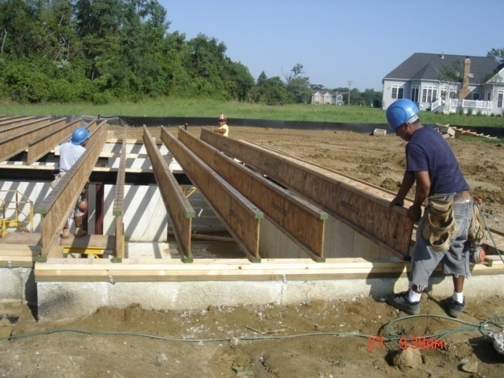
Discuss Fall Hazards
Discuss: Is conventional fall protection required?
Notes:
Engage the audience and facilitate a discussion on this picture.
The worker is exposed to an interior fall hazard of 6 feet or more, however one might argue that is infeasible or creates a greater hazard to use a conventional fall protection system.
What type of conventional fall protection methods can be used to protect this worker from an interior fall hazard?
Explain the safe work practices that should be utilized to safety protect workers who are performing these tasks, which should include the use of conventional fall protection systems (personal fall arrest systems, guardrails, or safety nets) and ladders and scaffolding.
This picture shows the installation of floor joists and the worker is working from the ground to set them into place; however they are exposed to an interior fall hazard of 6 feet or more.
Discuss the installation of the floor joist, and the process to do so.
Limitations of conventional fall protection systems during the installation of floor joists may include:
Lack of a suitable anchor point to withstand 5000 pounds or twice the intended load from a falling worker.
Manufacturers of the floor joists may prohibit inserting anchor points that may cause the joist to crack or fail.
Manufacturers of personal fall arrest system components may prohibit the anchor point to be placed at ground level, or below a workers ‘D’ ring on their harness.
Clearance distance below a worker, which is needed when using a personal fall arrest system, may not be sufficient to prevent the worker from contacting the next lower level, should a fall occur.
Manufacturers may have differing installation/usage requirements; always refer to the manufacturers’ instruction prior to use.
Note: It is important to remember that employers must demonstrate why conventional fall protection is either infeasible or creates a greater hazard for each part of a task prior to implementing alternative fall protection measures and a written fall protection plan. There are numerous parts of each job task that goes into the construction of a house, and throughout the duration of a specific task there may be a combination of conventional and alternative safe work practices that may be utilized. In order to remain in compliance with OSHA’s Subpart M- Fall Protection regulation employers have the burden of establishing a written argument as to why alternative fall protection procedures were used and where conventional fall protection systems were either infeasible or created a greater hazard.

Slide 45
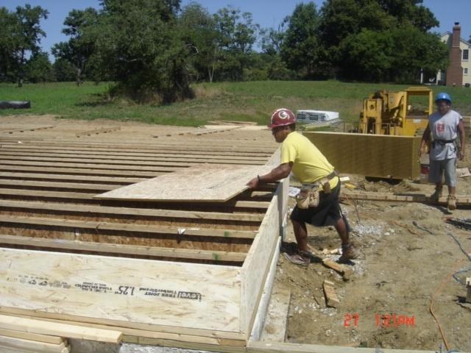
Discuss Fall Hazards
Discuss: Is conventional fall protection required?, continued 1.
Notes:
Engage the audience and facilitate a discussion on this picture.
The worker is exposed to an interior fall hazard of 6 feet or more, however one might argue that is infeasible or creates a greater hazard to use a conventional fall protection system.
What type of conventional fall protection methods can be used to protect this worker from an interior fall hazard?
Explain the safe work practices that should be utilized to safety protect workers who are performing these tasks, which should include the use of conventional fall protection systems (personal fall arrest systems, guardrails, or safety nets) and ladders and scaffolding.
This picture shows the installation of floor joists and the worker is working from the ground to set them into place; however they are exposed to an interior fall hazard of 6 feet or more.
Discuss the installation of the floor joist, and the process to do so.
Limitations of conventional fall protection systems during the installation of floor joists may include:
Lack of a suitable anchor point to withstand 5000 pounds or twice the intended load from a falling worker.
Manufacturers of the floor joists may prohibit inserting anchor points that may cause the joist to crack or fail.
Manufacturers of personal fall arrest system components may prohibit the anchor point to be placed at ground level, or below a workers ‘D’ ring on their harness.
Clearance distance below a worker, which is needed when using a personal fall arrest system, may not be sufficient to prevent the worker from contacting the next lower level, should a fall occur.
Manufacturers may have differing installation/usage requirements; always refer to the manufacturers’ instruction prior to use.
Note: It is important to remember that employers must demonstrate why conventional fall protection is either infeasible or creates a greater hazard for each part of a task prior to implementing alternative fall protection measures and a written fall protection plan. There are numerous parts of each job task that goes into the construction of a house, and throughout the duration of a specific task there may be a combination of conventional and alternative safe work practices that may be utilized. In order to remain in compliance with OSHA’s Subpart M- Fall Protection regulation employers have the burden of establishing a written argument as to why alternative fall protection procedures were used and where conventional fall protection systems were either infeasible or created a greater hazard.

Slide 46
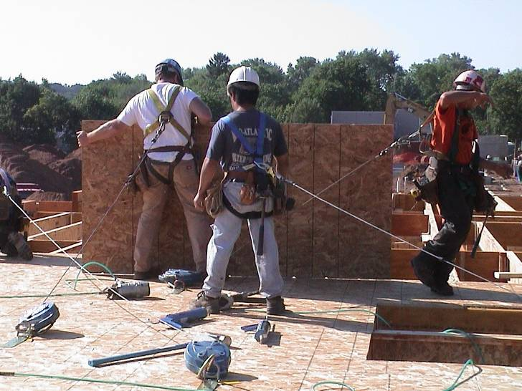
Discuss Fall Hazards
Discuss: Is this the correct application for conventional fall protection?
Notes:
This picture shows three workers attached to separate self-retracting lifelines (SRL) to protect from fall hazards of 6 feet or more.
Discuss the installation of floor sheathing.
Limitations of conventional fall protection systems during the installation of floor sheathing may include:
Lack of a suitable anchor point to withstand 5000 pounds or twice the intended load from a falling worker.
Installation of guardrail system could involve more risk, due to the duration of the fall exposure.
Manufacturers of the floor joists may prohibit inserting anchor points that may cause the joist to crack or fail.
Manufacturers of personal fall arrest system components may prohibit the anchor point to be placed at ground level, or below a workers ‘D’ ring on their harness.
Clearance distance below a worker, which is needed when using a personal fall arrest system, may not be sufficient to prevent the worker from contacting the next lower level, should a fall occur.
Manufacturers may have differing installation/usage requirements; always refer to the manufacturers’ instruction prior to use.
Note: It is important to remember that employers must demonstrate why conventional fall protection is either infeasible or creates a greater hazard for each part of a task prior to implementing alternative fall protection measures and a written fall protection plan. There are numerous parts of each job task that goes into the construction of a house, and throughout the duration of a specific task there may be a combination of conventional and alternative safe work practices that may be utilized. In order to remain in compliance with OSHA’s Subpart M- Fall Protection regulation employers have the burden of establishing a written argument as to why alternative fall protection procedures were used and where conventional fall protection systems were either infeasible or created a greater hazard.

Slide 47
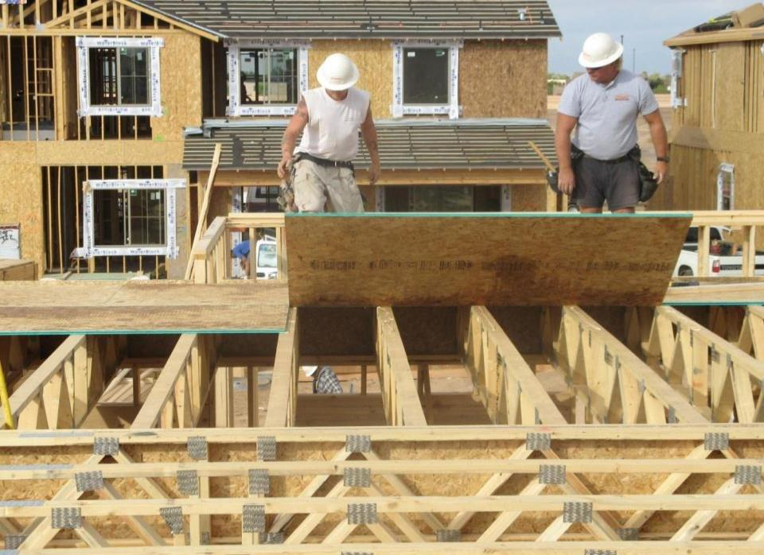
Discuss Fall Hazards
This picture shows the use of both conventional and alternative fall protection procedures, which still requires the use of a written, site-specific fall protection plan
Notes:
Discuss: Employers must evaluate the use of conventional fall protection systems, and other work practices covered under OSHA standards (i.e. ladders, scaffolding or aerial lifts) prior to implementing any alternative work practices and establishing a written, site-specific fall protection program.
This picture shows the installation of the second row of sheathing, and utilizes both guardrails to protect from an exterior fall and the use of alternative safe work practices that show workers working from a previously established deck.
If an employer can demonstrate that conventional fall protection (i.e., guardrail systems, safety net systems, or personal fall arrest systems) is infeasible or presents a greater hazard, a written, site specific fall protection plan meeting the requirements of 1926.502(k) can be implemented.
The employer has the burden of establishing that it is appropriate to implement a fall protection plan.
Limitations of conventional fall protection systems during the installation of floor sheathing may include:
Lack of a suitable anchor point to withstand 5000 pounds or twice the intended load from a falling worker.
Installation of guardrail system could involve more risk, due to the duration of the fall exposure.
Manufacturers of the floor joists may prohibit inserting anchor points that may cause the joist to crack or fail.
Manufacturers of personal fall arrest system components may prohibit the anchor point to be placed at ground level, or below a workers ‘D’ ring on their harness.
Clearance distance below a worker, which is needed when using a personal fall arrest system, may not be sufficient to prevent the worker from contacting the next lower level, should a fall occur.
Manufacturers may have differing installation/usage requirements; always refer to the manufacturers’ instruction prior to use.
Note: There is a presumption that it is feasible and will not create a greater hazard to implement one of the conventional fall protection methods (personal fall arrest system, guardrails, or safety nets); and accordingly the employer has the burden of establishing that it is appropriate to implement a fall protection plan that complies with 1926.502(k).

Slide 48
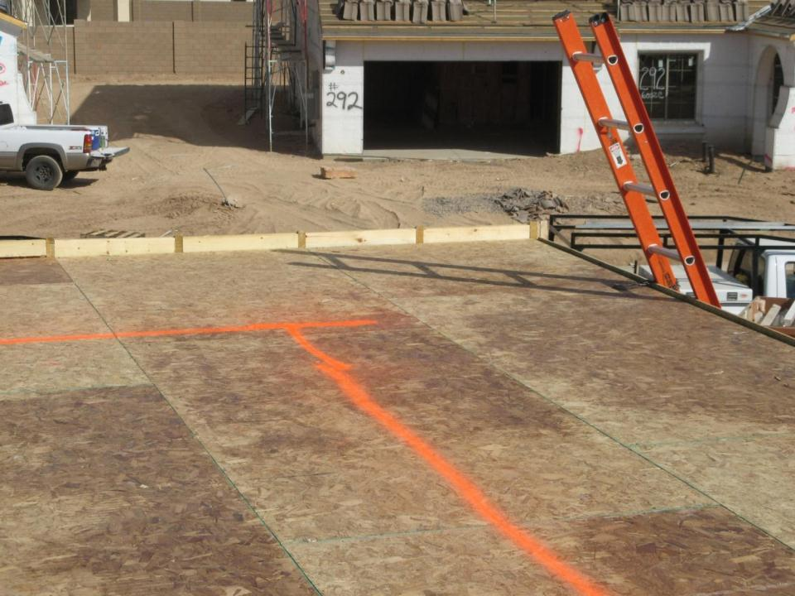
Discuss Fall Hazards
Discuss: Can conventional fall protection be provided?
6 Feet
Employers must first exhaust all options to provide conventional fall protection, or other work methods covered by OSHA regulations prior to implementing a safety monitor system and warning line
Notes:
Discuss: Employers must evaluate the use of conventional fall protection systems, and other work practices covered under OSHA standards (i.e. ladders, scaffolding or aerial lifts) prior to implementing any alternative work practices and establishing a written, site-specific fall protection program.
This picture shows the installed deck of floor sheathing in preparation for the installation of exterior walls. There is a warning line painted that is part of a safety monitor system. This shows an example of an alternative fall protection procedure.
If an employer can demonstrate that conventional fall protection (i.e., guardrail systems, safety net systems, or personal fall arrest systems) is infeasible or presents a greater hazard, a written, site specific fall protection plan meeting the requirements of 1926.502(k) can be implemented.
The employer has the burden of establishing that it is appropriate to implement a fall protection plan.
Limitations of conventional fall protection systems during the installation of exterior walls may include:
Lack of a suitable anchor point to withstand 5000 pounds or twice the intended load from a falling worker.
Installation of guardrail system could involve more risk, due to the duration of the fall exposure.
Manufacturers of the floor joists may prohibit inserting anchor points that may cause the joist to crack or fail.
Manufacturers of personal fall arrest system components may prohibit the anchor point to be placed at ground level, or below a workers ‘D’ ring on their harness.
Clearance distance below a worker, which is needed when using a personal fall arrest system, may not be sufficient to prevent the worker from contacting the next lower level, should a fall occur.
Manufacturers may have differing installation/usage requirements; always refer to the manufacturers’ instruction prior to use.
Note: There is a presumption that it is feasible and will not create a greater hazard to implement one of the conventional fall protection methods (personal fall arrest system, guardrails, or safety nets); and accordingly the employer has the burden of establishing that it is appropriate to implement a fall protection plan that complies with 1926.502(k).

Slide 49
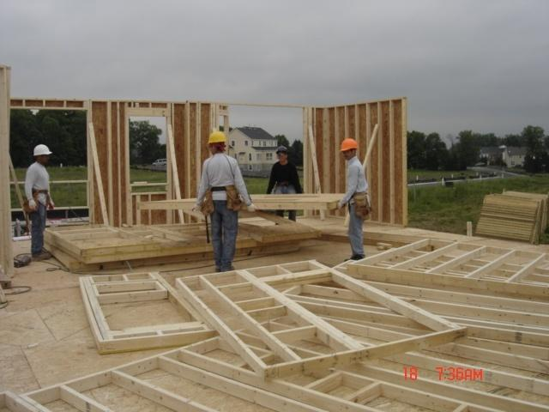
Discuss Fall Hazards
Discuss: Can conventional fall protection be provided?, continued 1
Notes:
Discuss: Employers must evaluate the use of conventional fall protection systems, and other work practices covered under OSHA standards (i.e. ladders, scaffolding or aerial lifts) prior to implementing any alternative work practices and establishing a written, site-specific fall protection program.
This picture shows the installed deck of floor sheathing in preparation for the installation of exterior walls. Workers are in the process of erecting the 2nd floor exterior walls.
If an employer can demonstrate that conventional fall protection (i.e., guardrail systems, safety net systems, or personal fall arrest systems) is infeasible or presents a greater hazard, a written, site specific fall protection plan meeting the requirements of 1926.502(k) can be implemented.
The employer has the burden of establishing that it is appropriate to implement a fall protection plan.
Limitations of conventional fall protection systems during the installation of exterior walls may include:
Lack of a suitable anchor point to withstand 5000 pounds or twice the intended load from a falling worker.
Installation of guardrail system could involve more risk, due to the duration of the fall exposure.
Manufacturers of personal fall arrest system components may prohibit the anchor point to be placed at ground level, or below a workers ‘D’ ring on their harness.
Clearance distance below a worker, which is needed when using a personal fall arrest system, may not be sufficient to prevent the worker from contacting the next lower level, should a fall occur.
Manufacturers may have differing installation/usage requirements; always refer to the manufacturers’ instruction prior to use.
Note: There is a presumption that it is feasible and will not create a greater hazard to implement one of the conventional fall protection methods (personal fall arrest system, guardrails, or safety nets); and accordingly the employer has the burden of establishing that it is appropriate to implement a fall protection plan that complies with 1926.502(k).

Slide 50
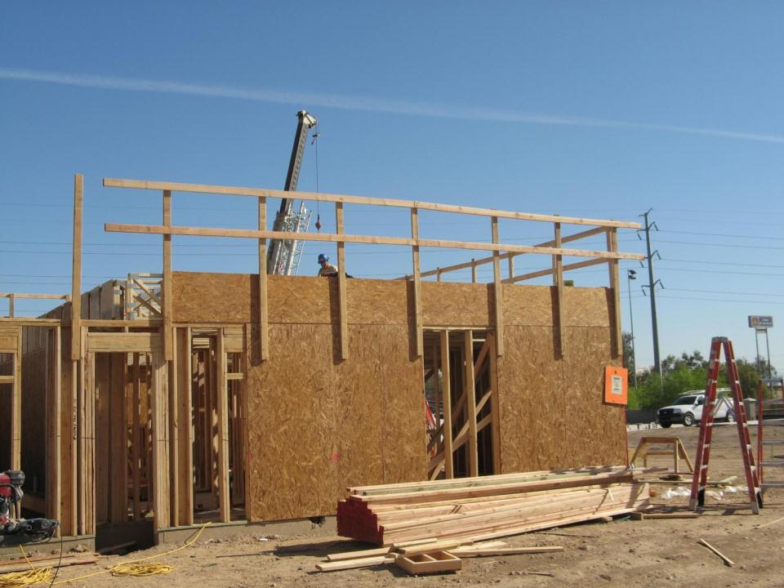
Discuss Fall Hazards
This picture shows the use of guardrails to protect against exterior fall hazards
Notes:
This picture shows the installation of floor sheathing, and utilizes guardrails to protect from an exterior fall hazard. It is unclear what type of conventional or alternative fall protection is provided to the workers on the floor deck.
Discuss: Employers must evaluate the use of conventional fall protection systems, and other work practices covered under OSHA standards (i.e. ladders, scaffolding or aerial lifts) prior to implementing any alternative work practices and establishing a written, site-specific fall protection program.
If an employer can demonstrate that conventional fall protection (i.e., guardrail systems, safety net systems, or personal fall arrest systems) is infeasible or presents a greater hazard, a written, site specific fall protection plan meeting the requirements of 1926.502(k) can be implemented.
The employer has the burden of establishing that it is appropriate to implement a fall protection plan.
Limitations of conventional fall protection systems during the installation of floor sheathing may include:
Lack of a suitable anchor point to withstand 5000 pounds or twice the intended load from a falling worker.
Installation of guardrail system could involve more risk, due to the duration of the fall exposure.
Manufacturers of the floor joists may prohibit inserting anchor points that may cause the joist to crack or fail.
Manufacturers of personal fall arrest system components may prohibit the anchor point to be placed at ground level, or below a workers ‘D’ ring on their harness.
Clearance distance below a worker, which is needed when using a personal fall arrest system, may not be sufficient to prevent the worker from contacting the next lower level, should a fall occur.
Manufacturers may have differing installation/usage requirements; always refer to the manufacturers’ instruction prior to use.
Note: There is a presumption that it is feasible and will not create a greater hazard to implement one of the conventional fall protection methods (personal fall arrest system, guardrails, or safety nets); and accordingly the employer has the burden of establishing that it is appropriate to implement a fall protection plan that complies with 1926.502(k).

Slide 51
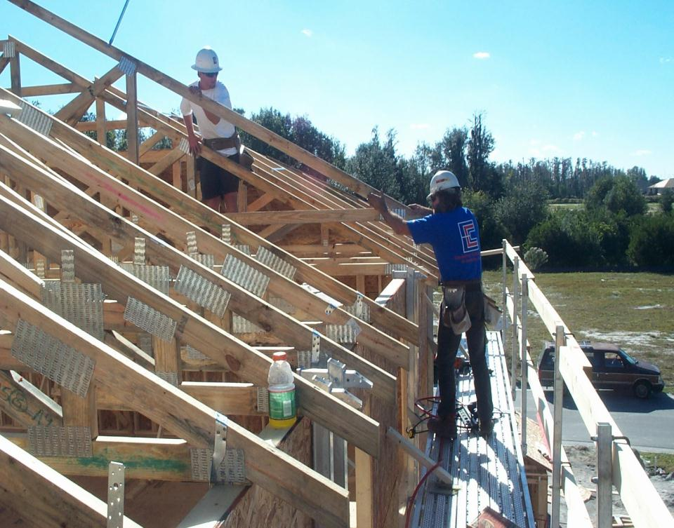
Discuss Fall Hazards
Discuss: Can conventional fall protection be provided?, continued 2
This picture shows the use of both conventional and alternative fall protection procedures, which still requires the use of a written, site-specific fall protection plan
Notes:
This picture shows the use of both conventional and alternative fall protection procedures utilized to set and brace roof trusses. Employers must determine and evaluate each job task to determine when and where conventional fall protection can be provided, prior to implementing alternative fall protection procedures.
Discuss: Employers must evaluate the use of conventional fall protection systems, and other work practices covered under OSHA standards (i.e. ladders, scaffolding or aerial lifts) prior to implementing any alternative work practices and establishing a written, site-specific fall protection program.
If an employer can demonstrate that conventional fall protection (i.e., guardrail systems, safety net systems, or personal fall arrest systems) is infeasible or presents a greater hazard, a written, site specific fall protection plan meeting the requirements of 1926.502(k) can be implemented.
The employer has the burden of establishing that it is appropriate to implement a fall protection plan.
Limitations of conventional fall protection systems during the installation of roof trusses may include:
Lack of a suitable anchor point to withstand 5000 pounds or twice the intended load from a falling worker.
Roof trusses are not designed to resist lateral impact loads.
A falling worker attached to a single roof truss could cause all the trusses to collapse.
Installation of guardrail system could involve more risk, due to the duration of the fall exposure.
Manufacturers of the roof trusses may prohibit inserting anchor points that may cause the truss to fail.
Clearance distance below a worker, which is needed when using a personal fall arrest system, may not be sufficient to prevent the worker from contacting the next lower level, should a fall occur.
Manufacturers may have differing installation/usage requirements; always refer to the manufacturers’ instruction prior to use.
Note: There is a presumption that it is feasible and will not create a greater hazard to implement one of the conventional fall protection methods (personal fall arrest system, guardrails, or safety nets); and accordingly the employer has the burden of establishing that it is appropriate to implement a fall protection plan that complies with 1926.502(k).

Slide 52
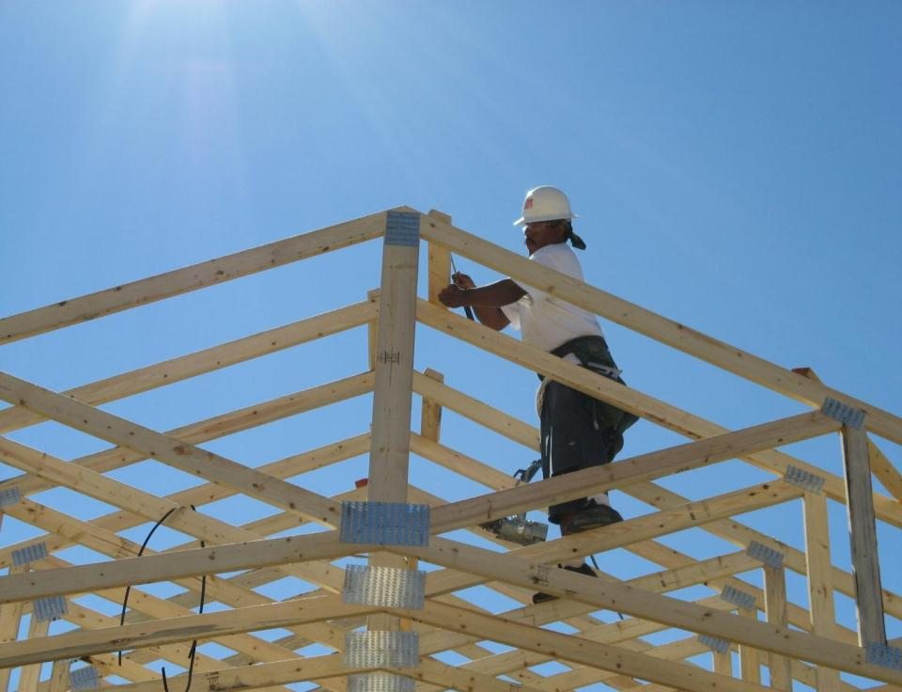
Discuss Fall Hazards
Discuss: Can conventional fall protection be provided?, continued 3
Employers must first exhaust all options to provide conventional fall protection, or other work methods covered by OSHA regulations prior to implementing alternative fall protection procedures
Notes:
Discuss: Employers must evaluate the use of conventional fall protection systems, and other work practices covered under OSHA standards (i.e. ladders, scaffolding or aerial lifts) prior to implementing any alternative work practices and establishing a written, site-specific fall protection program.
If an employer can demonstrate that conventional fall protection (i.e., guardrail systems, safety net systems, or personal fall arrest systems) is infeasible or presents a greater hazard, a written, site specific fall protection plan meeting the requirements of 1926.502(k) can be implemented.
The employer has the burden of establishing that it is appropriate to implement a fall protection plan.
Limitations of conventional fall protection systems during the installation of floor joists may include:
Roof trusses are not designed to resist lateral impact loads.
A falling worker attached to a single roof truss could cause all the trusses to collapse
Lack of a suitable anchor point to withstand 5000 pounds or twice the intended load from a falling worker.
Manufacturers of the roof trusses may prohibit inserting anchor points that may cause the truss to fail.
Manufacturers of personal fall arrest system components may prohibit the anchor point to be placed at ground level, or below a workers ‘D’ ring on their harness.
Clearance distance below a worker, which is needed when using a personal fall arrest system, may not be sufficient to prevent the worker from contacting the next lower level, should a fall occur.
Manufacturers may have differing installation/usage requirements; always refer to the manufacturers’ instruction prior to use.
Note: There is a presumption that it is feasible and will not create a greater hazard to implement one of the conventional fall protection methods (personal fall arrest system, guardrails, or safety nets); and accordingly the employer has the burden of establishing that it is appropriate to implement a fall protection plan that complies with 1926.502(k).

Slide 53

Discuss Fall Hazards
Discuss: Can conventional fall protection be provided?, continued 4
Notes:
This picture shows the use of both ladders and alternative fall protection procedures utilized to set and brace roof rafter portions. Employers must determine and evaluate each job task to determine when and where conventional fall protection can be provided, prior to implementing alternative fall protection procedures.
Discuss: Employers must evaluate the use of conventional fall protection systems, and other work practices covered under OSHA standards (i.e. ladders, scaffolding or aerial lifts) prior to implementing any alternative work practices and establishing a written, site-specific fall protection program.
If an employer can demonstrate that conventional fall protection (i.e., guardrail systems, safety net systems, or personal fall arrest systems) is infeasible or presents a greater hazard, a written, site specific fall protection plan meeting the requirements of 1926.502(k) can be implemented.
The employer has the burden of establishing that it is appropriate to implement a fall protection plan.
Limitations of conventional fall protection systems during the installation of roof rafters and while stick framing may include:
Lack of a suitable anchor point to withstand 5000 pounds or twice the intended load from a falling worker.
Roof rafters are not designed to resist lateral impact loads.
Roof structures are unstable until some sheathing is installed.
A falling worker attached to a single rafter could cause the entire roof portion to fail.
Installation of guardrail system could involve more risk, due to the duration of the fall exposure.
Manufacturers of the roof trusses may prohibit inserting anchor points that may cause the truss to fail.
Clearance distance below a worker, which is needed when using a personal fall arrest system, may not be sufficient to prevent the worker from contacting the next lower level, should a fall occur.
Manufacturers may have differing installation/usage requirements; always refer to the manufacturers’ instruction prior to use.
Note: There is a presumption that it is feasible and will not create a greater hazard to implement one of the conventional fall protection methods (personal fall arrest system, guardrails, or safety nets); and accordingly the employer has the burden of establishing that it is appropriate to implement a fall protection plan that complies with 1926.502(k).

Slide 54
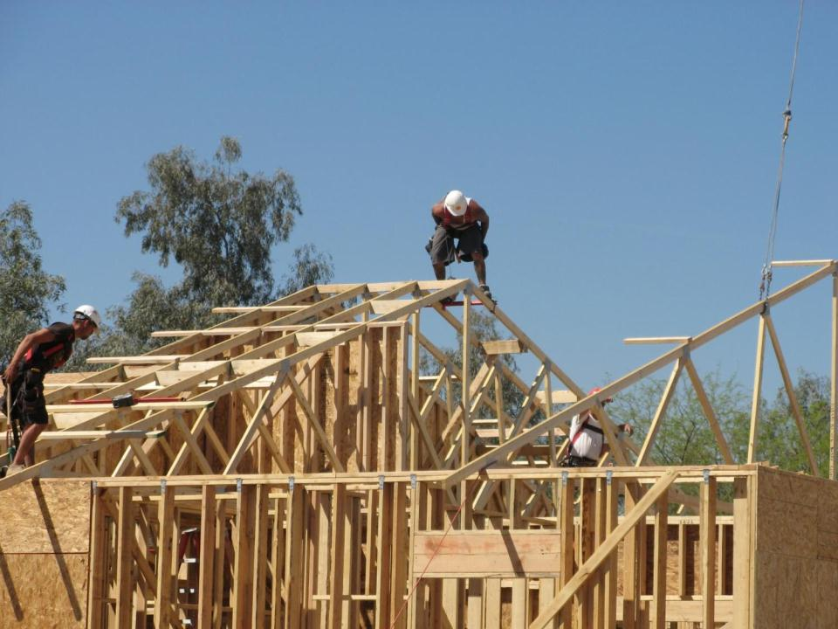
Discuss Fall Hazards
This picture shows the use of conventional fall protection procedures, notice the personal fall arrest systems.
Notes:
This picture shows the use of a personal fall arrest system utilized to set and brace roof rafter portions. Employers must determine and evaluate each job task to determine when and where conventional fall protection can be provided, prior to implementing alternative fall protection procedures.
Discuss: Employers must evaluate the use of conventional fall protection systems, and other work practices covered under OSHA standards (i.e. ladders, scaffolding or aerial lifts) prior to implementing any alternative work practices and establishing a written, site-specific fall protection program.
If an employer can demonstrate that conventional fall protection (i.e., guardrail systems, safety net systems, or personal fall arrest systems) is infeasible or presents a greater hazard, a written, site specific fall protection plan meeting the requirements of 1926.502(k) can be implemented.
The employer has the burden of establishing that it is appropriate to implement a fall protection plan.
Limitations of conventional fall protection systems during the installation of roof rafters and while stick framing may include:
Lack of a suitable anchor point to withstand 5000 pounds or twice the intended load from a falling worker.
Roof rafters are not designed to resist lateral impact loads.
Roof structures are unstable until some sheathing is installed.
A falling worker attached to a single rafter could cause the entire roof portion to fail.
Installation of guardrail system could involve more risk, due to the duration of the fall exposure.
Manufacturers of the roof trusses may prohibit inserting anchor points that may cause the truss to fail.
Clearance distance below a worker, which is needed when using a personal fall arrest system, may not be sufficient to prevent the worker from contacting the next lower level, should a fall occur.
Manufacturers may have differing installation/usage requirements; always refer to the manufacturers’ instruction prior to use.
Note: There is a presumption that it is feasible and will not create a greater hazard to implement one of the conventional fall protection methods (personal fall arrest system, guardrails, or safety nets); and accordingly the employer has the burden of establishing that it is appropriate to implement a fall protection plan that complies with 1926.502(k).

Slide 55

Discuss Fall Hazards
Discuss: Can conventional fall protection be provided?, continued 5
Employers must first exhaust all options to provide conventional fall protection, or other work methods covered by OSHA regulations prior to implementing alternative fall protection procedures
Notes:
Install slide guards on steep pitched roofs after the first row of sheathing is installed.
OSHA’s new compliance directive has not outlawed the use of slide guards or safety monitors.
Now, employers must first demonstrate that it is infeasible to comply with the provisions of the standard, or that it creates a greater hazard.
Then they can use those systems as part of a written, site-specific fall protection plan that meets the requirements of 1926.502(k).
Slide guards cannot simply be used in lieu of conventional fall protection methods under 1926.501(b)(13). However, slide guards may be used as part of a written, site-specific fall protection plan that meets the requirements of 1926.502(k) if the employer can demonstrate that the use of conventional fall protection (i.e., guardrail, safety net, or personal fall arrest systems) would be infeasible or create greater hazards.
Discuss: Employers must evaluate the use of conventional fall protection systems, and other work practices covered under OSHA standards (i.e. ladders, scaffolding or aerial lifts) prior to implementing any alternative work practices and establishing a written, site-specific fall protection program.
If an employer can demonstrate that conventional fall protection (i.e., guardrail systems, safety net systems, or personal fall arrest systems) is infeasible or presents a greater hazard, a written, site specific fall protection plan meeting the requirements of 1926.502(k) can be implemented.
The employer has the burden of establishing that it is appropriate to implement a fall protection plan.
Limitations of conventional fall protection systems during the installation of roof sheathing may include:
Roof trusses are not designed to resist lateral impact loads.
Roof structures are unstable until some or all sheathing is installed
Lack of a suitable anchor point to withstand 5000 pounds or twice the intended load from a falling worker.
Installation of guardrail system could involve more risk, due to the duration of the fall exposure.
Manufacturers of the roof trusses may prohibit inserting anchor points that may cause the truss to fail.
Manufacturers of personal fall arrest system components may prohibit the anchor point to be placed at ground level, or below a workers ‘D’ ring on their harness.
Clearance distance below a worker, which is needed when using a personal fall arrest system, may not be sufficient to prevent the worker from contacting the next lower level, should a fall occur.
Manufacturers may have differing installation/usage requirements; always refer to the manufacturers’ instruction prior to use.
Note: There is a presumption that it is feasible and will not create a greater hazard to implement one of the conventional fall protection methods (personal fall arrest system, guardrails, or safety nets); and accordingly the employer has the burden of establishing that it is appropriate to implement a fall protection plan that complies with 1926.502(k).

Slide 56
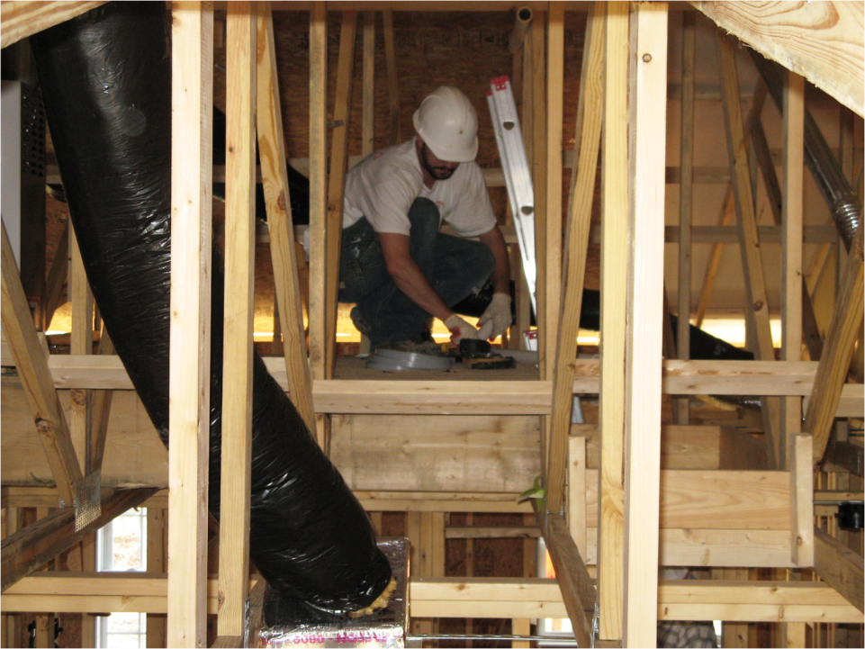
Discuss Fall Hazards
Discuss: Can conventional fall protection be provided?, continued 6
Notes:
Discuss: Employers must evaluate the use of conventional fall protection systems, and other work practices covered under OSHA standards (i.e. ladders, scaffolding or aerial lifts) prior to implementing any alternative work practices and establishing a written, site-specific fall protection program.
This picture shows an installed working platform in the attic, which is an example of an alternative fall protection procedure.
If an employer can demonstrate that conventional fall protection (i.e., guardrail systems, safety net systems, or personal fall arrest systems) is infeasible or presents a greater hazard, a written, site specific fall protection plan meeting the requirements of 1926.502(k) can be implemented.
The employer has the burden of establishing that it is appropriate to implement a fall protection plan.
Limitations of conventional fall protection systems while performing attic work may include:
Even if an anchor point is used, the use of a personal fall arrest system through rafters and trusses creates an added swing fall hazard.
Installation of anchor point exposes a worker to a fall hazard when they are unprotected while installing the anchor point in the peak of the attic.
A falling worker attached to a single roof truss could cause all the trusses to collapse.
Lack of a suitable anchor point to withstand 5000 pounds or twice the intended load from a falling worker.
Manufacturers of the roof trusses may prohibit inserting anchor points that may cause the truss to fail.
Manufacturers of personal fall arrest system components may prohibit the anchor point to be placed at ground level, or below a workers ‘D’ ring on their harness.
Clearance distance below a worker, which is needed when using a personal fall arrest system, may not be sufficient to prevent the worker from contacting the next lower level, should a fall occur.
Manufacturers may have differing installation/usage requirements; always refer to the manufacturers’ instruction prior to use.
Note: There is a presumption that it is feasible and will not create a greater hazard to implement one of the conventional fall protection methods (personal fall arrest system, guardrails, or safety nets); and accordingly the employer has the burden of establishing that it is appropriate to implement a fall protection plan that complies with 1926.502(k).

Slide 57
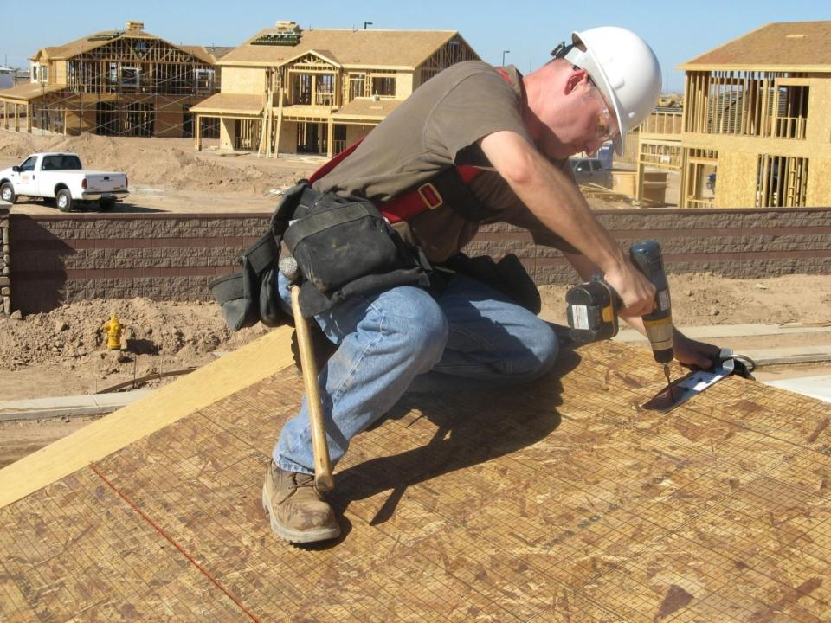
Discuss Fall Hazards
Discuss: Can conventional fall protection be provided?, continued 7
Notes:
This picture shows the installation of an anchor point prior to performing roofing work.
Employers must determine and evaluate each job task to determine when and where conventional fall protection can be provided, prior to implementing alternative fall protection procedures.
Discuss: Employers must evaluate the use of conventional fall protection systems, and other work practices covered under OSHA standards (i.e. ladders, scaffolding or aerial lifts) prior to implementing any alternative work practices and establishing a written, site-specific fall protection program.
If an employer can demonstrate that conventional fall protection (i.e., guardrail systems, safety net systems, or personal fall arrest systems) is infeasible or presents a greater hazard, a written, site specific fall protection plan meeting the requirements of 1926.502(k) can be implemented.
The employer has the burden of establishing that it is appropriate to implement a fall protection plan.
Discuss: How can you provide conventional fall protection for this worker who is installing anchor points?
Note: There is a presumption that it is feasible and will not create a greater hazard to implement one of the conventional fall protection methods (personal fall arrest system, guardrails, or safety nets); and accordingly the employer has the burden of establishing that it is appropriate to implement a fall protection plan that complies with 1926.502(k).

Slide 58
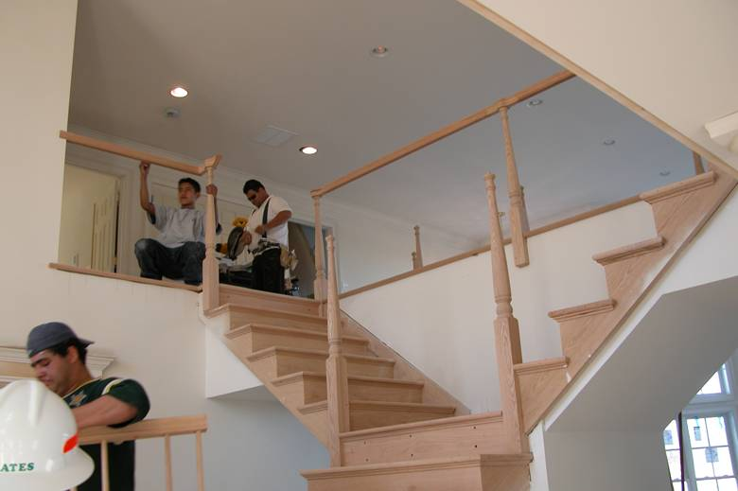
Discuss Fall Hazards
Discuss: Can conventional fall protection be provided?, continued 8
Notes:
This picture shows installation of permanent stair rails. Employers must determine and evaluate each job task to determine when and where conventional fall protection can be provided, prior to implementing alternative fall protection procedures.
Discuss: Employers must evaluate the use of conventional fall protection systems, and other work practices covered under OSHA standards (i.e. ladders, scaffolding or aerial lifts) prior to implementing any alternative work practices and establishing a written, site-specific fall protection program.
If an employer can demonstrate that conventional fall protection (i.e., guardrail systems, safety net systems, or personal fall arrest systems) is infeasible or presents a greater hazard, a written, site specific fall protection plan meeting the requirements of 1926.502(k) can be implemented.
The employer has the burden of establishing that it is appropriate to implement a fall protection plan.
Limitations of conventional fall protection systems during the installation of permanent stair rails may include:
Hand rail is custom built on the jobsite, which requires the carpenter to measure and cut frequently. This also requires the installer to go up and down the stairs to measure, cut and level the rail components. The use of a personal fall arrest system would require the carpenter to attach to an anchor point at 6 feet and then detach hundreds of times, in addition to an added slip, trip and fall hazard introduced into a small working surface, i.e. stairway.
Manufacturers may have differing installation/usage requirements; always refer to the manufacturers’ instruction prior to use.
Note: There is a presumption that it is feasible and will not create a greater hazard to implement one of the conventional fall protection methods (personal fall arrest system, guardrails, or safety nets); and accordingly the employer has the burden of establishing that it is appropriate to implement a fall protection plan that complies with 1926.502(k).

Slide 59
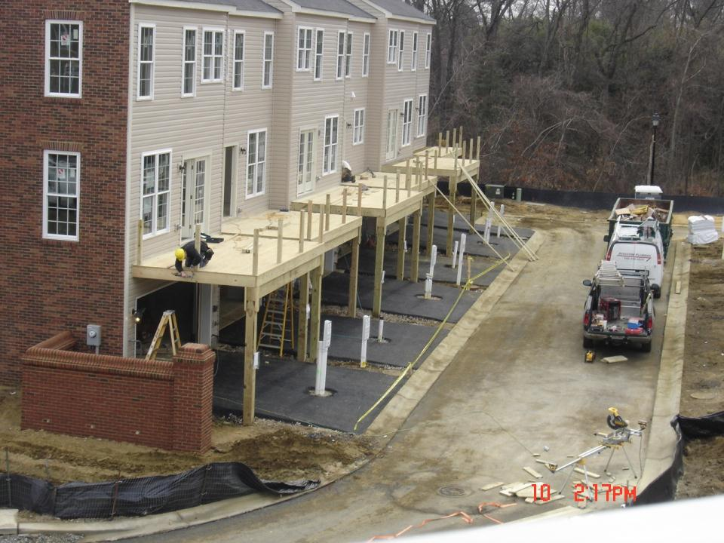
Discuss Fall Hazards
Discuss: Can conventional fall protection be provided?, continued 9
Notes:
This picture shows the construction of decks attached to a home. Employers must determine and evaluate each job task to determine when and where conventional fall protection can be provided, prior to implementing alternative fall protection procedures.
Discuss: Employers must evaluate the use of conventional fall protection systems, and other work practices covered under OSHA standards (i.e. ladders, scaffolding or aerial lifts) prior to implementing any alternative work practices and establishing a written, site-specific fall protection program.
If an employer can demonstrate that conventional fall protection (i.e., guardrail systems, safety net systems, or personal fall arrest systems) is infeasible or presents a greater hazard, a written, site specific fall protection plan meeting the requirements of 1926.502(k) can be implemented.
The employer has the burden of establishing that it is appropriate to implement a fall protection plan.
Limitations of conventional fall protection systems during the construction of decks attached to the home may include:
Clearance distance below a worker, which is needed when using a personal fall arrest system , may not be suitable to prevent the worker from contacting the next lower level, should a fall occur.
The use of guardrails would prevent the carpenter from installing permanent portions of the deck.
Manufacturers may have differing installation/usage requirements; always refer to the manufacturers’ instruction prior to use.
Note: There is a presumption that it is feasible and will not create a greater hazard to implement one of the conventional fall protection methods (personal fall arrest system, guardrails, or safety nets); and accordingly the employer has the burden of establishing that it is appropriate to implement a fall protection plan that complies with 1926.502(k).

