Slide 1
Section 3
SCAFFOLDS

Slide 2
Disclaimer
This material was produced under grant number SH-31198-SH7 from the Occupational Safety and Health Administration, U.S. Department of Labor. It does not necessarily reflect the views or policies of the U.S. Department of Labor, nor does mention of trade names, commercial products, or organizations imply endorsement by the U.S. Government. Revisions were made to this material under grant number SH-05122-SH9 from the Occupational Safety and Health Administration, U.S. Department of Labor.
This presentation is intended to discuss Federal Regulations only - your individual State requirements may be more stringent as many states operate their own state OSHA and they may have adopted construction standards that are different from information presented in this training. If you live in a state with an OSHA approved state plan, you should contact your local administrator for further information on the standards applicable in your state.
These materials are meant for informational purposes only.
No representation is made as to the thoroughness of the presentation.
Notes:
This material was produced under grant number SH-31198-SH7 from the Occupational Safety and Health Administration, U.S. Department of Labor. It does not necessarily reflect the views or policies of the U.S. Department of Labor, nor does mention of trade names, commercial products, or organizations imply endorsement by the U.S. Government. Revisions were made to this material under grant number SH-05122-SH9 from the Occupational Safety and Health Administration, U.S. Department of Labor.

Slide 3
Disclaimer, continued 1
It is not the intent to provide compliance-based training in this presentation, the intent is more to address hazard awareness in the residential construction (i.e. home building) industry, and to recognize the overlapping hazards present in many construction workplaces.
Photos shown in this presentation may depict situations that are not in compliance with applicable OSHA/safety requirements.
No legal advice is offered or implied, and no attorney-client relationship is intended or established. If legal advice or other expert assistance is required the services of a competent professional person should be sought.
It is the responsibility of the employer and its employees to comply with all pertinent OSHA/safety rules and regulations in the jurisdiction in which they work.
Notes:
Please read the disclaimer for legal purposes, this is required under the Susan Harwood Training Grant program.

Slide 4
Copyright Information © 2018
This material is the copyrighted property of the Job-Site Safety Institute and the National Association of Home Builders. By federal regulation, OSHA reserves a license to use and disseminate such material for the purpose of promoting safety and health in the workplace. The Job-Site Safety Institute and the National Association of Home Builders hereby authorizes employers and workplace safety and health professionals to use this material, distributed by or through OSHA, in their workplaces or practices in accordance with the guidance contained in the material.
To this end, permission is granted to use such copyrighted material solely for non-commercial, instructional, personal, or scholarly purposes. The material may be used and incorporated into other workplace safety and health programs on the condition that no fee may be charged for the subsequent use of the material. Use of the material for any other purpose, particularly commercial use, without the prior, express written permission of the copyright owner/s is prohibited. Furthermore, any modification to the material is prohibited without the prior, express written permission of the copyright owners.
Notes:
Note that the these materials are copyrighted by the Job-Site Safety Institute and the National Association of Home Builders. Permission is granted to use such copyrighted material in accordance with the terms on the slide.

Slide 5
Learning Objectives: Section 3
Identify general requirements for safely building and using scaffolds.
Identify competent person responsibilities.
How to access scaffolds safely.
Determine proper fall protection including guardrails and personal fall arrest systems.
Identify safety requirements applicable to specific types of scaffolds.
Notes:
Discuss the learning objectives for Section 3. In this section we will address ladder and scaffold safety, including:
Identify safety requirements and practices for scaffolding, including aerial lifts.

Slide 6
Scaffolds

Slide 7
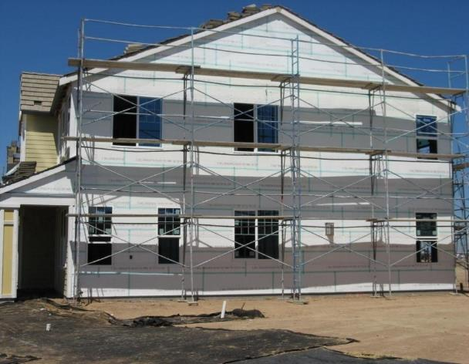
Scaffolding
A safe alternative to using ladders is to use:
Interior and Exterior Scaffolding
Aerial Lifts
...if OSHA requirements and safety practices are followed.
Notes:
A safer alternative to working from a ladder is to use interior and exterior scaffolding or aerial lifts.

Slide 8
Types of Scaffolding
Three basic types:
Supported scaffolds -- platforms supported by rigid, load bearing members, such as poles, legs, frames, & outrigger.
Suspended scaffolds -- platforms suspended by ropes or other non-rigid, overhead support.
Aerial Lifts -- such as “cherry pickers” or “boom trucks”.
Notes:
There are three basic types of scaffolding, including:
Supported scaffold
Suspended scaffold
Aerial lifts

Slide 9
Competent Person Requirements
Designated by the employer.
Has the knowledge and experience required to identify existing and predictable hazards.
Has authority to eliminate unsafe working conditions.
Has authority to stop work if unsafe conditions exists.
Notes:
A competent person plays an important role when working on or around scaffolds. A competent person is:
Designated by the employer.
Has the knowledge and experience required to identify existing and predictable hazards.
Has authority to eliminate unsafe working conditions.
Has authority to stop work if unsafe conditions exists.

Slide 10
Competent Person Requirements, continued 1
Train employees who erect, dismantle, move, or alter scaffolds.
Determine if it is safe for employees to work on or from a scaffold during storms or high winds.
Inspect scaffolds and scaffold components for visible defects before each work shift.
Notes:
A competent person is responsible to:
Train employees who erect, dismantle, move, or alter scaffolds.
Determine if it is safe for employees to work on or from a scaffold during storms or high winds.
Inspect scaffolds and scaffold components for visible defects before each work shift.

Slide 11
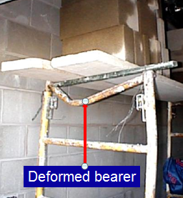

Scaffold Inspection
Competent person inspects scaffolds for visible defects before each shift and after any alterations
Defective parts must be immediately repaired
Notes:
Before each shift, and after any alterations, a competent person must inspect the scaffold for visible defects. Any defective parts must be immediately repaired.
Photo courtesy of OSHA.

Slide 12
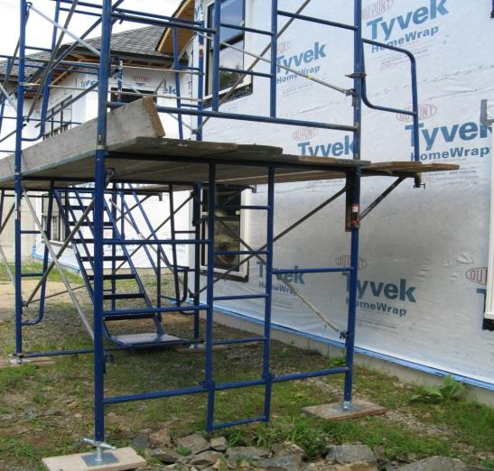
Types of Common Scaffolds
Fabricated Frame Scaffold
Notes:
The photo shows a fabricated frame scaffold.
Photo provided by materials developed through a Susan Harwood Training Grant, a program of the US Department of Labor, Occupational Safety & Health Administration.

Slide 13
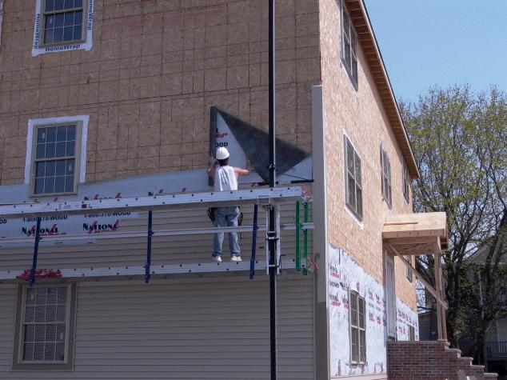
Types of Common Scaffolds, continued 1
Pump-Jack Scaffold
Notes:
The photo shows an example of a pump-jack scaffold.
Photo provided by materials developed through a Susan Harwood Training Grant, a program of the US Department of Labor, Occupational Safety & Health Administration.

Slide 14
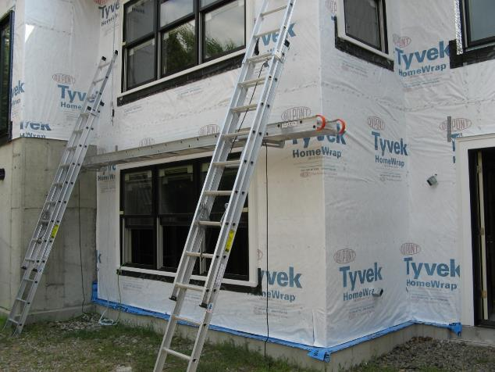
Types of Common Scaffolds, continued 2
Ladder-Jack Scaffold
Notes:
This photo shows an example of a ladder-jack scaffold.
Photo provided by materials developed through a Susan Harwood Training Grant, a program of the US Department of Labor, Occupational Safety & Health Administration.

Slide 15
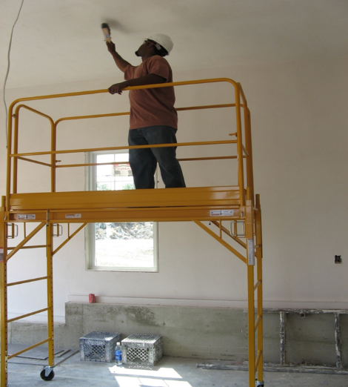
Types of Common Scaffolds, continued 3
Interior-Mobile Scaffold
Notes:
This photo shows an example of an interior mobile scaffold.
Photo provided by materials developed through a Susan Harwood Training Grant, a program of the US Department of Labor, Occupational Safety & Health Administration.

Slide 16
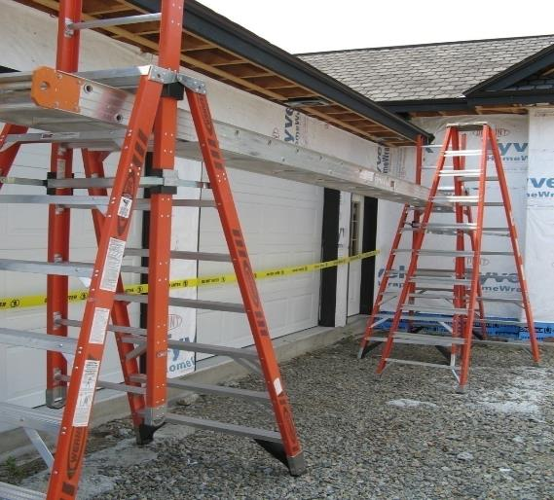
Types of Common Scaffolds, continued 4
Trestle Scaffold
Notes:
This photo shows an example of a trestle scaffold.
Photo provided by materials developed through a Susan Harwood Training Grant, a program of the US Department of Labor, Occupational Safety & Health Administration.

Slide 17
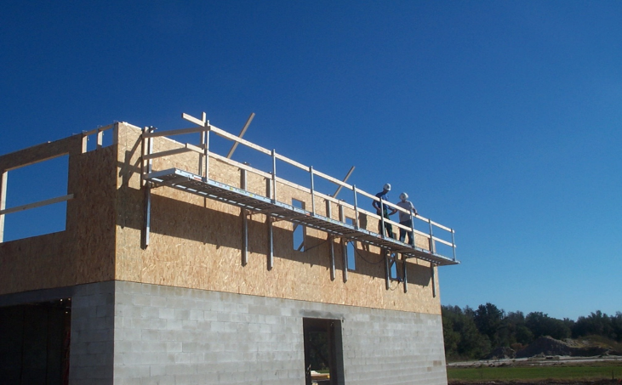
Types of Common Scaffolds, continued 5
Top-Plate Scaffold
Notes:
This photo shows an example of a top plate scaffold. This type of scaffold can be used to set floor joists, or roof joists.
Photo provided by materials developed through a Susan Harwood Training Grant, a program of the US Department of Labor, Occupational Safety & Health Administration.

Slide 18
Interior and Exterior Scaffolding
Job-built scaffolding that is improperly constructed is extremely hazardous.
Various types and brands of interior and exterior scaffolding are commercially available.
  Always, follow the manufacturer’s safety instructions.
Notes:
Discuss the hazards associated with improperly constructed job-built scaffolds, and the types of interior and exterior scaffolding that is commercially available. It is important to always follow the manufacturer’s safety instructions regarding proper setup and use.

Slide 19
Common Hazards on Jobsites
Defective wood planks and inadequate planking overhang.
Unsafe access to scaffold.
Cross bracing not adequate.
Inadequate footings.
Bridging of scaffolds.
Working within 10 feet of overhead power lines (discuss in greater detail)
Notes:
Discuss examples of common scaffold hazards on jobsites; which include:
Defective wood planks and inadequate planking overhang.
Unsafe access to scaffold.
Cross bracing not adequate.
Inadequate footings.
Bridging of scaffolds.
Working within 10 feet of overhead power lines (discuss in greater detail)

Slide 20
Training Requirements
All employees must be trained prior to working on scaffolds.
Qualified person must conduct the training and include the following:
  Electrical Hazards
  Fall Protection
  Falling Object Protection
  Proper Use
  Material Handling
  Load-carrying Capacities
Notes:
All employees working on a scaffold must be trained. Training should be conducted by a qualified person and include training on electrical hazards, fall protection, falling object protection, proper use, material handling and load-carrying capacities.

Slide 21
Basic Requirements
Scaffolding that is more than 10 ft. or higher must be equipped with guardrails.
A competent person must supervise the set-up and take down of all scaffolding.
Scaffolding must be fully planked, and planks must be secured so they cannot move.
Notes:
The trigger height for when guardrails must be used on a scaffold is 10 feet. Additionally, a competent person must supervise the setup and take down of all scaffolding. The working deck of a scaffold must be fully planked, and the planks must be secured to prevent movement.

Slide 22
Basic Requirements, continued 1
Erect/dismantle all scaffolds according to the manufacturer's Instructions
Capacity
    Must support 4x Intended Load
Stable Footings
    Base Plate, Screw Jacks & Mudsills
Notes:
Scaffolds must be capable of supporting 4 times the maximum intended load. Additionally, scaffolds must be placed on stable footings with a proper base plate, screw jacks and mudsills.

Slide 23
Basic Requirements, continued 2
Scaffolds must be capable of supporting its own weight and at least 4 times the anticipated load.
Expected load includes:
    Workers
    Equipment
    Tools
    Materials
Notes:
When calculating the anticipated load, factor in the weight of workers, equipment, tools and any materials being placed on the scaffold.

Slide 24
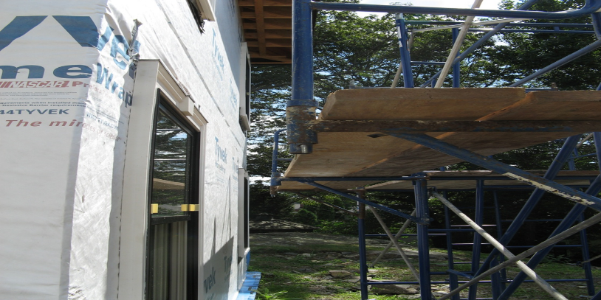
Requirements on Jobsites
Front edge of all platforms must be within 14” of face of work (i.e., structure).
Notes:
The front edge of all platforms must be within 14” of the face of the work or structure.
Photo provided by materials developed through a Susan Harwood Training Grant, a program of the US Department of Labor, Occupational Safety & Health Administration.

Slide 25
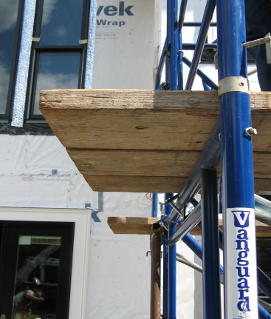
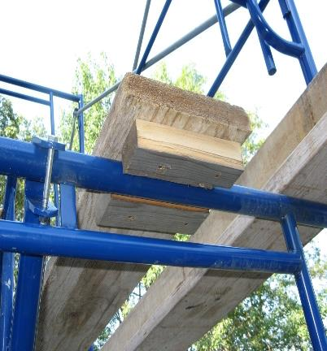
Requirements on Jobsites, continued 1
Planks – must extend 6’’ to 12” past the end of supports or be cleated.
Notes:
Ends of platforms must extend at least 6” over the center line of the support, if not equipped with cleats or hooks to prevent movement.
Photo provided by materials developed through a Susan Harwood Training Grant, a program of the US Department of Labor, Occupational Safety & Health Administration.

Slide 26
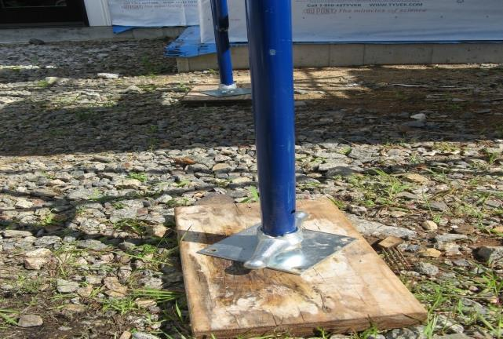
Requirements on Jobsites, continued 2
Base Plate & Mudsill are Required
Notes:
Base plates and mudsills are required.
Photo provided by materials developed through a Susan Harwood Training Grant, a program of the US Department of Labor, Occupational Safety & Health Administration.

Slide 27
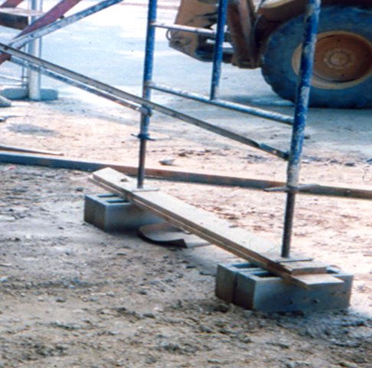
Requirements on Jobsites, continued 3
Masonry Bricks & Blocks are not acceptable scaffold bases.
Notes:
Masonry bricks and blocks are not acceptable scaffold bases.
Photo provided by SEE, Inc.

Slide 28
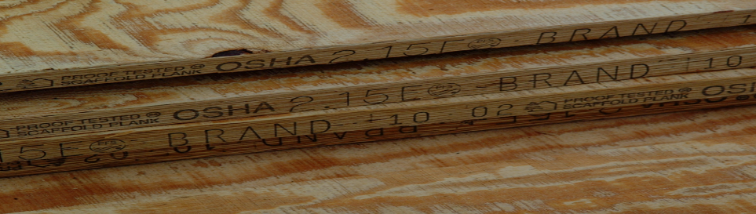
Requirements on Jobsites, continued 4
Each platform on all working levels must be fully planked and secured to prevent movement.
No more than a 1” space between decking/platform units and upright supports.
Wood scaffold planks must be nominal 2” x 10”.
Must be Scaffold Grade Planks or equivalent.
Notes:
Each platform on all working levels must be fully planked and secured. There should be no more than a 1” space between decking and planking should be nominal 2” x 10” and made of scaffold grade planks.
Photo provided by materials developed through a Susan Harwood Training Grant, a program of the US Department of Labor, Occupational Safety & Health Administration.

Slide 29
Scaffold Access
Ladders needed if access to scaffold is more than 2 feet.
Do not climb cross bracing.
Place ladders securely.
  Ladders must be positioned so they will not tip the scaffold.
OSHA permits direct access from another scaffold, structure, or personnel hoist.
Notes:
A ladder must be used when accessing a scaffold more than 2’ off the ground. Do not climb cross bracing.

Slide 30
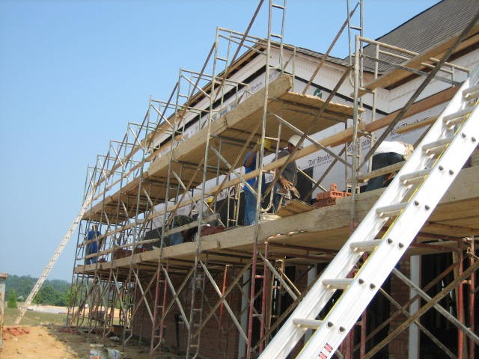
Scaffold Access, continued 1
Ladders needed if access to scaffold is more than 2 feet.
Notes:
This photo shows a ladder placed against a fabricated frame scaffold to allow workers to access the working level safely.

Slide 31
Guardrail Requirements- Scaffolds
Toprails Between 38” and 45” High
Guardrails to 200 lbs/Midrails to min. 75 lbs – 150 lbs depending on Toprail capacity.
Cross Bracing OK as Guardrail if Between 20” and 30” for Midrail; 38” to 48” for Toprail
Protect from Falling Objects
  All Workers on Scaffolds MUST Wear Hard Hats
Notes:
Discuss the requirements for guardrails on scaffolding.
OSHA states that the top edge height of toprails or equivalent member on supported scaffolds manufactured or placed in service after January 1, 2000 shall be installed between 38 inches (0.97 m) and 45 inches (1.2 m) above the platform surface. The top edge height on supported scaffolds manufactured and placed in service before January 1, 2000, and on all suspended scaffolds where both a guardrail and a personal fall arrest system are required shall be between 36 inches (0.9 m) and 45 inches (1.2 m).
Midrails, screens, mesh, intermediate vertical members, solid panels, and equivalent structural members of a guardrail system shall be capable of withstanding, without failure, a force applied in any downward or horizontal direction at any point along the midrail or other member of at least 75 pounds (333 n) for guardrail systems with a minimum 100 pound toprail capacity, and at least 150 pounds (666 n) for guardrail systems with a minimum 200 pound toprail capacity.

Slide 32
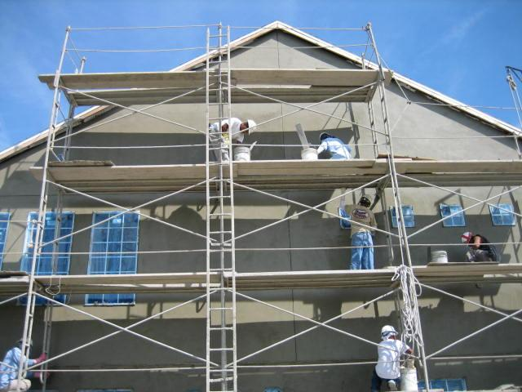
Cross Bracing OK as Top Rail
Cross Bracing OK as Toprail
Toprail
Midrail
Notes:
Overall, a pretty well built stucco scaffold with proper guardrails.
Braces are used as top rails with midrails installed approximately half way
Discuss the requirements for guardrails on scaffolding.
OSHA states that the top edge height of toprails or equivalent member on supported scaffolds manufactured or placed in service after January 1, 2000 shall be installed between 38 inches (0.97 m) and 45 inches (1.2 m) above the platform surface. The top edge height on supported scaffolds manufactured and placed in service before January 1, 2000, and on all suspended scaffolds where both a guardrail and a personal fall arrest system are required shall be between 36 inches (0.9 m) and 45 inches (1.2 m).
Midrails, screens, mesh, intermediate vertical members, solid panels, and equivalent structural members of a guardrail system shall be capable of withstanding, without failure, a force applied in any downward or horizontal direction at any point along the midrail or other member of at least 75 pounds (333 n) for guardrail systems with a minimum 100 pound toprail capacity, and at least 150 pounds (666 n) for guardrail systems with a minimum 200 pound toprail capacity.

Slide 33
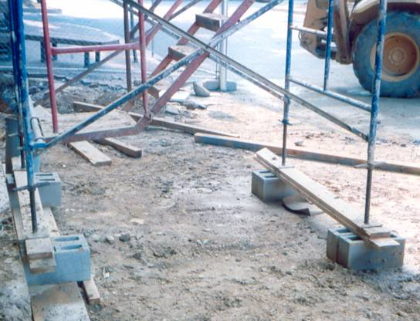
Identify the Hazards
How many hazards do you see in this photo?
Notes:
This photo shows multiple unsafe practices, such as installing a scaffold on improper footing without the use of mudsills. Scaffolds should not be placed on blocks.

Slide 34
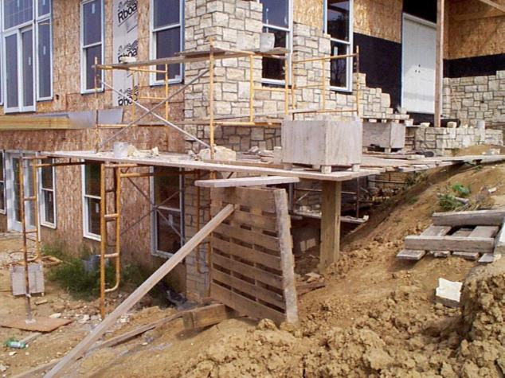
Identify the Hazards, continued 1
How many hazards do you see in this photo?
Notes:
Discuss the various safety hazards shown in this photo. Examples of these hazards include:
Improper planking
Overloading of scaffold
Improper footing
Improper use of mudsills

Slide 35
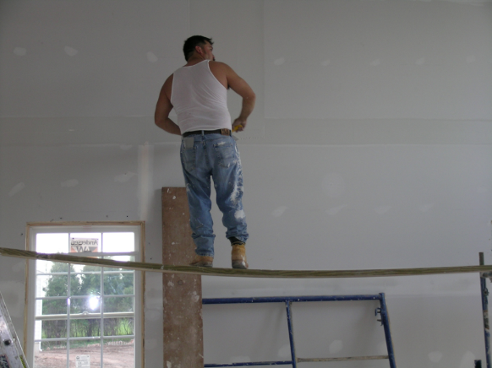
Identify the Hazards, continued 2
How many hazards do you see in this photo?
Notes:
Discuss the various safety hazards shown in this photo.

Slide 36
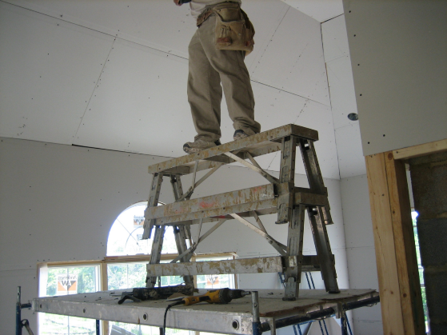
Identify the Hazards, continued 3
How many hazards do you see in this photo?
Notes:
Discuss the various safety hazards shown in this photo.

Slide 37
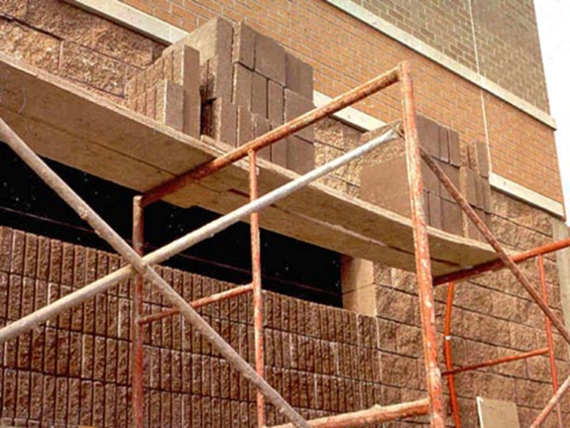
Identify the Hazards, continued 4
How many hazards do you see in this photo?
Notes:
Discuss the various safety hazards shown in this photo. Examples of these hazards include:
Improper planking
Overloading of scaffold

Slide 38
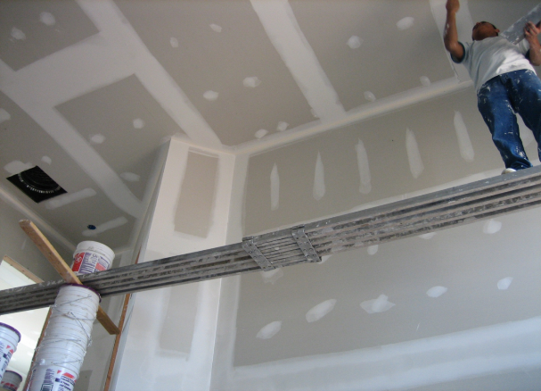
Identify the Hazards, continued 5
How many hazards do you see in this photo?
Notes:
Discuss the various safety hazards shown in this photo.

Slide 39
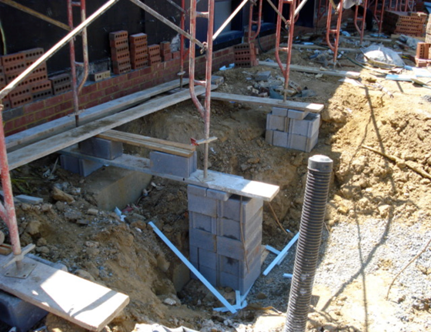
Identify the Hazards, continued 6
How many hazards do you see in this photo?
Notes:
Discuss the various safety hazards shown in this photo. Examples of these hazards include:
Improper planking
Improper footing
Improper use of mudsills

Slide 40
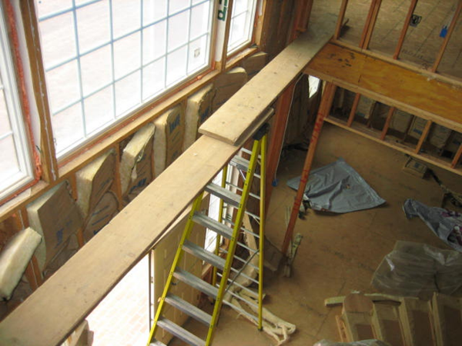
Identify the Hazards, continued 7
How many hazards do you see in this photo?
Notes:
Discuss the various safety hazards shown in this photo.

Slide 41
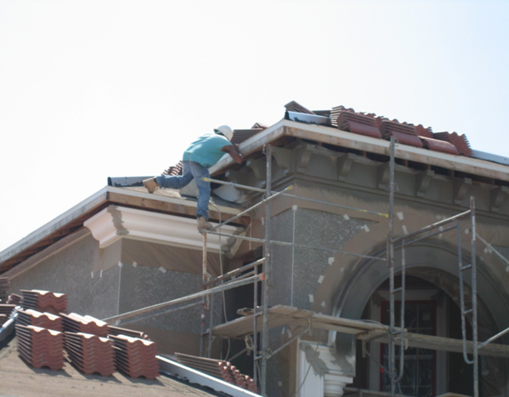
Identify the Hazards, continued 8
How many hazards do you see in this photo?
Notes:
Discuss the various safety hazards shown in this photo.

Slide 42
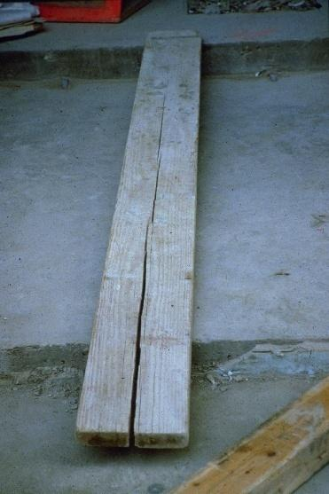
Identify the Hazards, continued 9
Notes:
Planks with visible defects, such as bowing and cracks (as shown in this slide) must not be used.

Slide 43
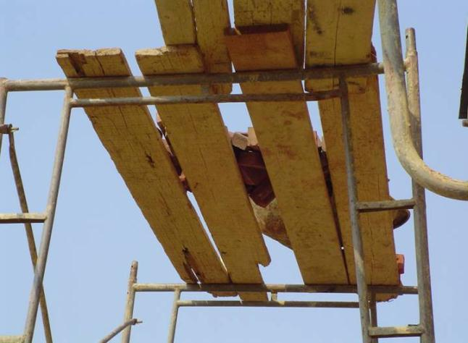
Identify the Hazards, continued 10
Notes:
Planks with visible defects, such as bowing and cracks (as shown in this slide) must not be used.

Slide 44
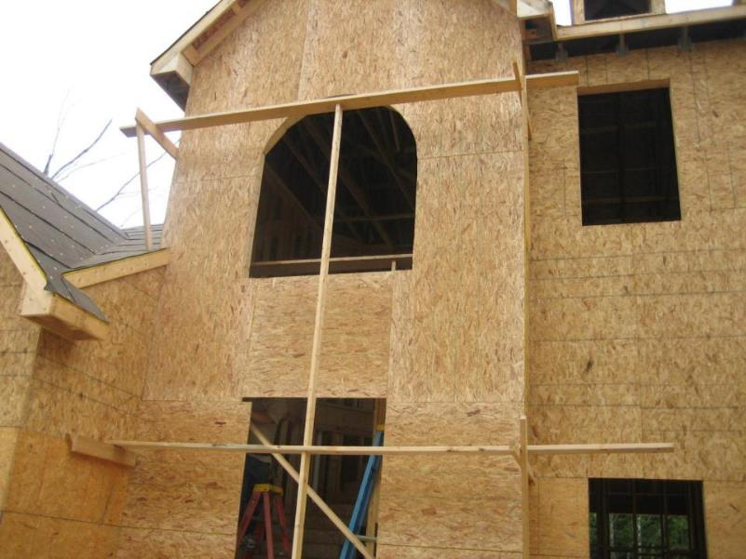
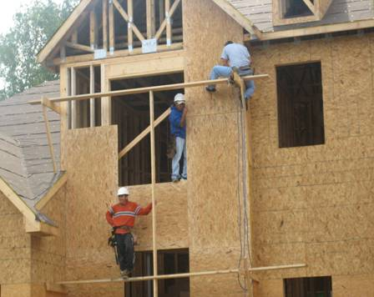
Identify the Hazards, continued 11
Notes:
There are many hazards associated with using job-made scaffolds, including the lack of available engineering data to show the maximum intended load. Only use approved scaffolding material on a jobsite. This photo shows worker using a job-made scaffold, which is unsafe and could cause a worker to experience a fatal fall.

Slide 45
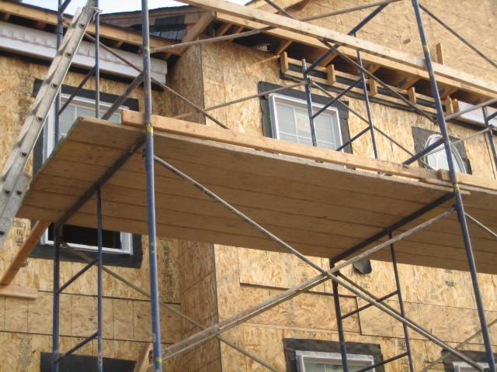
Safe Practices - Fully Planked Scaffold
Notes:
This picture shows a fully planked scaffold complete with a kick-plate.

Slide 46

Safe Practices – Pump-Jack Scaffold
Notes:
This photo shows a properly used pump jack scaffold.

Slide 47
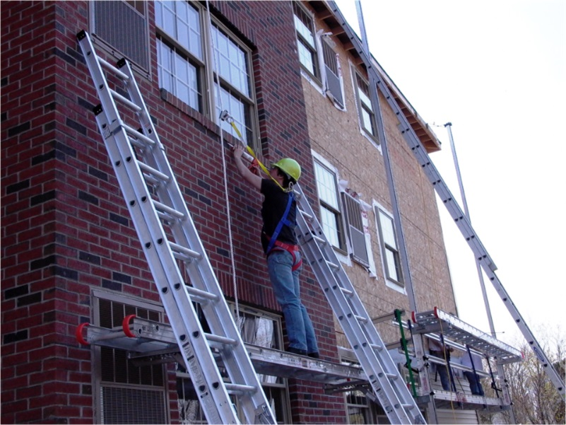
PFAS Used with Ladder Jack Scaffold
Notes:
Ladder jack scaffolds cannot exceed 20ft and workers must use a PFAS if they are working higher than 10ft.

Slide 48
Aerial Lifts
Aerial lifts (e.g., JLG boom lift) or approved personnel lift baskets on rough terrain forklifts is a safe alternative to working from:
    Ladders, or
    other types of scaffolding.
An aerial lift can be used for the installations of:
    windows
    soffit
    fascia
    gutters
    siding
Notes:
Aerial lift can be a safe alternative to working from ladders or other forms of scaffolding. These lifts can be used for a variety of tasks including the attachment of exterior fixtures or accessories.

Slide 49
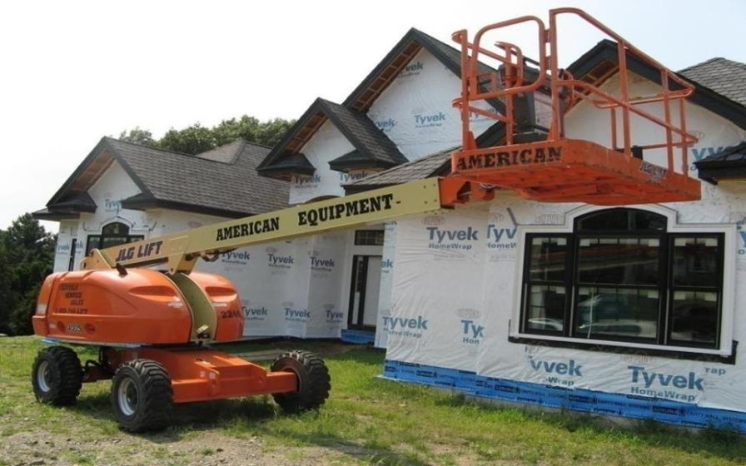
Aerial Lifts, continued 1
Notes:
Picture of an aerial lift on a residential construction jobsite.

Slide 50
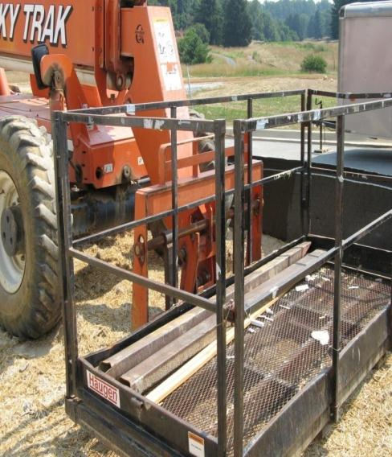
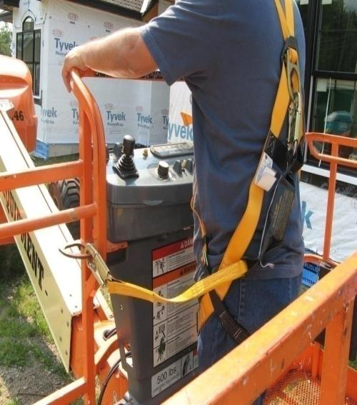
Aerial Lifts, continued 2
Notes:
Picture showing a personnel basket attached to a forklift (left) and the use of a PFAS attached to an anchor point on an aerial lift (on the right).
A personnel basket attached to a forklift must be approved by the forklift manufacturer or by a registered professional engineer.

Slide 51
Aerial Lifts, continued 3
The competent person should:
Restrict operation of aerial lifts or forklift vehicles to trained and authorized personnel.
Use only commercially built personnel baskets designed for lifting workers.
  Follow the American National Standards Institute’s (ANSI) standards for using personnel lift baskets.
Make certain that homemade boxes lifted by a forklift are not used—homemade boxes are unacceptable.
Notes:
Aerial lift competent person requirements:
Restrict operation of aerial lifts or forklift vehicles to trained and authorized personnel.
Use only commercially built personnel baskets designed for lifting workers.
Follow the American National Standards Institute’s (ANSI) standards for using personnel lift baskets.
Make certain that homemade boxes lifted by a forklift are not used—homemade boxes are unacceptable.

Slide 52
Aerial Lifts, continued 4
When in the lift:
Wear a full body harness.
Attach the lanyard to the boom or an approved anchor point inside the basket.
Notes:
When working from an aerial lift, remember to always wear a full body harness and attach and approved lanyard to the boor or approved anchor point inside the basket.

Slide 53
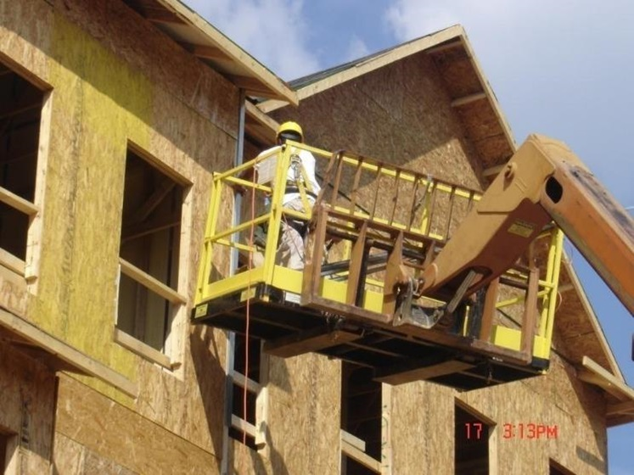
Proper use of PFAS in Basket
Notes:
Close-up picture of a worker using an aerial lift (using a PFAS).

Slide 54
Aerial Lifts, continued 5
When in the lift:
Always stand on the floor of the basket.
Do not sit or climb on the edge of the basket, lean over the edge, or climb out of the basket.
Do not use a ladder or other objects to increase reach.
Notes:
Always stand on the top floor of the basket and do not sit or climb on the edge of the basket, lean over the edge or climb out of the basket. Do not use a ladder or other objects to increase your reach.

Slide 55
Aerial Lifts, continued 6
When operating the lift:
Stay at the controls at all times.
Do not move the vehicle while a person is in the elevated basket.
Only use the equipment when it is on stable and level ground.
Maintain the required minimum clearance of 10 ft. (3 m) from power lines carrying 50 kilovolts or less.
Notes:
When operating an aerial lift, stay in control of the lift at all times and do not move the vehicle with a person inside the basket. Additionally, only use the equipment when it is on a stable and level ground. Remember – it is important to maintain the minimum clearance distance of 10 feet from all power lines.
***Please note that the clearance distances from overhead power lines may change.

Slide 56
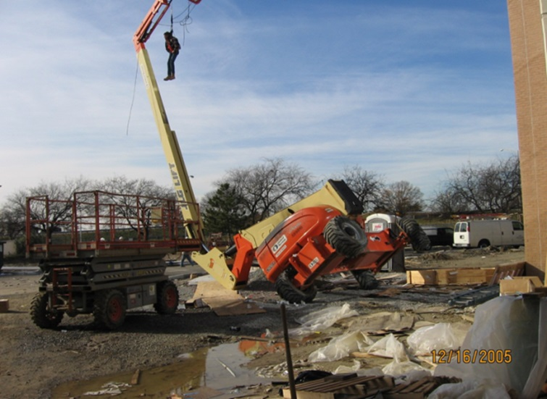
Why a harness is necessary.
Notes:
Picture showing a worker that has fallen out of lift basket and is restrained by his harness attached to the anchor point of the lift.

