Slide 1
Section 4
Conventional Fall Protection

Slide 2
Disclaimer
This material was produced under grant number SH-31198-SH7 from the Occupational Safety and Health Administration, U.S. Department of Labor. It does not necessarily reflect the views or policies of the U.S. Department of Labor, nor does mention of trade names, commercial products, or organizations imply endorsement by the U.S. Government. Revisions were made to this material under grant number SH-05122-SH9 from the Occupational Safety and Health Administration, U.S. Department of Labor.
This presentation is intended to discuss Federal Regulations only - your individual State requirements may be more stringent as many states operate their own state OSHA and they may have adopted construction standards that are different from information presented in this training. If you live in a state with an OSHA approved state plan, you should contact your local administrator for further information on the standards applicable in your state.
These materials are meant for informational purposes only.
No representation is made as to the thoroughness of the presentation.
Notes:
This material was produced under grant number SH-31198-SH7 from the Occupational Safety and Health Administration, U.S. Department of Labor. It does not necessarily reflect the views or policies of the U.S. Department of Labor, nor does mention of trade names, commercial products, or organizations imply endorsement by the U.S. Government. Revisions were made to this material under grant number SH-05122-SH9 from the Occupational Safety and Health Administration, U.S. Department of Labor.

Slide 3
Disclaimer, continued 1
It is not the intent to provide compliance-based training in this presentation, the intent is more to address hazard awareness in the residential construction (i.e. home building) industry, and to recognize the overlapping hazards present in many construction workplaces.
Photos shown in this presentation may depict situations that are not in compliance with applicable OSHA/safety requirements.
No legal advice is offered or implied, and no attorney-client relationship is intended or established. If legal advice or other expert assistance is required the services of a competent professional person should be sought.
It is the responsibility of the employer and its employees to comply with all pertinent OSHA/safety rules and regulations in the jurisdiction in which they work.
Notes:
Please read the disclaimer for legal purposes, this is required under the Susan Harwood Training Grant program.

Slide 4
Copyright Information © 2018
This material is the copyrighted property of the Job-Site Safety Institute and the National Association of Home Builders. By federal regulation, OSHA reserves a license to use and disseminate such material for the purpose of promoting safety and health in the workplace. The Job-Site Safety Institute and the National Association of Home Builders hereby authorizes employers and workplace safety and health professionals to use this material, distributed by or through OSHA, in their workplaces or practices in accordance with the guidance contained in the material.
To this end, permission is granted to use such copyrighted material solely for non-commercial, instructional, personal, or scholarly purposes. The material may be used and incorporated into other workplace safety and health programs on the condition that no fee may be charged for the subsequent use of the material. Use of the material for any other purpose, particularly commercial use, without the prior, express written permission of the copyright owner/s is prohibited. Furthermore, any modification to the material is prohibited without the prior, express written permission of the copyright owners.
Notes:
Note that the these materials are copyrighted by the Job-Site Safety Institute and the National Association of Home Builders. Permission is granted to use such copyrighted material in accordance with the terms on the slide.

Slide 5
Learning Objectives: Section 4
Identify when fall protection is required.
Identify types of “conventional” fall protection systems.
Determine which protection system to use for a given fall hazard.
Identify key requirements and basic safety practices for each protection system.
Notes:
Discuss the learning objectives for Section 4. In this section we will address conventional fall protection systems, including:
Identify when fall protection is required.
Identify types of “conventional” fall protection systems.
Determine which protection system to use for a given fall hazard.
Identify key requirements and basic safety practices for each protection system.

Slide 6
When is Fall Protection Required?
OSHA §1926 Subpart M
Where workers on a residential construction site are exposed to vertical drops of 6 feet or more, OSHA requires that employers provide fall protection in one of three ways before work begins:
1) Conventional Fall Protection
2) Other Work Methods (Section 2)
3) Non-Conventional Fall Protection (Section 4)
Notes:
Discuss that OSHA’s fall protection regulation is found in 29 Code of Federal Regulations 1926 Subpart M. When workers are exposed to fall hazards 6 feet or more, OSHA requires the use of conventional fall protection, other work methods or alternative fall protection.

Slide 7
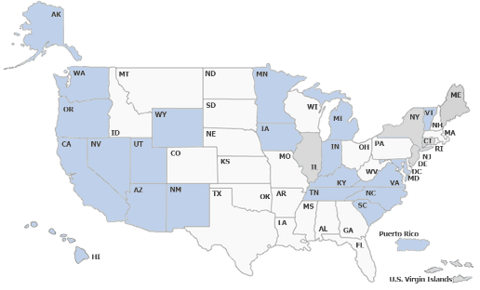
Requirements on Jobsites
Some OSHA State-Plan states may have different trigger heights of when conventional fall protection is required on residential jobsites.
These states include, but may not be limited to:
  California
  Kentucky
  North Carolina
  Arizona
  Washington
  Oregon
Approved OSHA State Plans
Notes:
Discuss that some OSHA State-Plan states may have different trigger heights of when conventional fall protection is required on residential jobsites. Participants should refer to their state-plan requirements to understand if they have different requirements from federal OSHA.

Slide 8
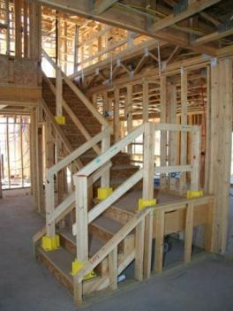
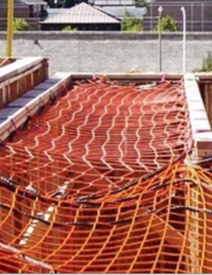
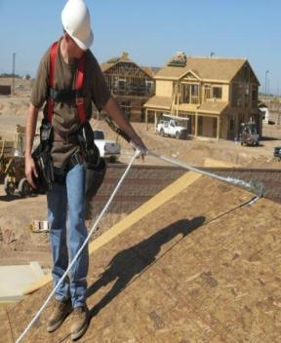
What is Conventional Fall Protection?
3) Personal Fall
Arrest System
(PFAS)
1) Guardrails
2) Safety Nets
Notes:
OSHA identifies guardrails, safety nets and personal fall arrest systems as the three types of conventional fall protection.

Slide 9
Guardrail Systems
Barrier built to OSHA specifications; constructed to prevent workers from falling to lower levels
Protects against these hazards:
  Window and Wall Openings
  Unprotected Sides and Edges
  Floor Holes
Notes:
A guardrail is a barrier built to OSHA specifications and is constructed to prevent workers from falling to lower levels. They can be used to protect against window and wall openings, unprotected sides and edges and floor hole hazards.

Slide 10
Guardrail Systems Are Needed For:
Stairwell Openings
Open-sided Wall Openings
Second and Third Story Non-loading Bearing Walls When the Studs Are 24” OC
Low (Less Than 39”) Silled Windows
Second and Third Story Deck Floor Holes for Open Foyers or Cat Walks
Sliding Glass and French Door Openings Onto Decks and Porches
Skylight Openings Cut Into the Roof
Notes:
Guardrails can be used to protect workers from falling during many stages of the residential construction process. This slide shows a variety of hazards that guardrails can be used to protect workers from falls.

Slide 11
Height Requirements for Guardrails
  Toprail
    42 in. ± 3 in. (1.1 m)
  Midrail
    21 in. ± 3 in. (50 cm)
  Toe Board
    Minimum of 3 ½ in. (4 in. nominal) (10.2 cm)
Notes:
When constructing a guardrail, the toprail should be 42 inches, plus or minus 3 inches; the midrail 21 inches, plus or minus 3 inches; and the toeboard a minimum of 3 ½ inches.

Slide 12
Requirements for Guardrails
Vertical Supports
  Install no more than every 8 ft. (2.4 m)
Weight Requirement
  Must support at least 200 lbs. (90.9 kg) of force outward and downward along top edge
Notes:
Vertical supports on guardrails must be placed no more than every 8 feet apart. Guardrails must be able to support at least 200 pounds of force outward and downward along the top edge.

Slide 13
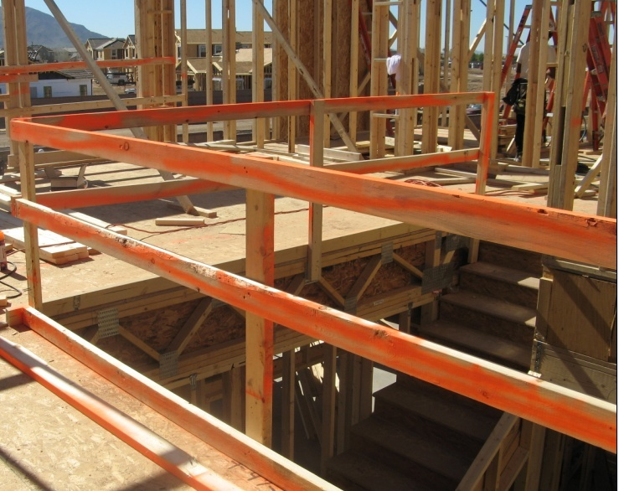
Properly installed guardrail system
Top-rail @ 42” ± 3”
Mid-rail @ 21” ± 3”
Toeboard min. 3-1/2”
Notes:
This photo shows a properly installed guardrail system around a stairwell opening.
Top-rail = 42in.
Mid-rail = 21in.
Toeboard = 3 ½ in. (4in. Nominal)

Slide 14
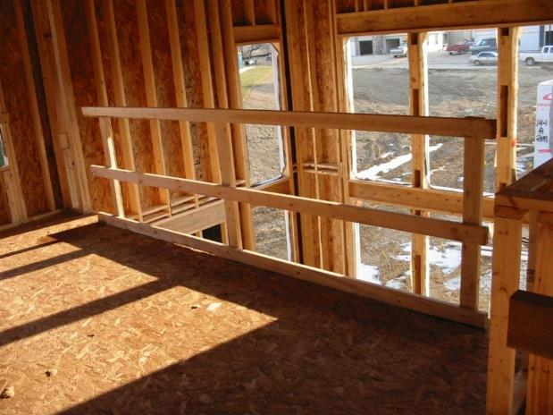
Guardrail Uses in Residential Construction
Wall Openings
  Wall openings greater than 18” need to be protected.
Notes:
This photo shows a properly constructed guardrail used to protect a wall opening greater than 18 inches.

Slide 15
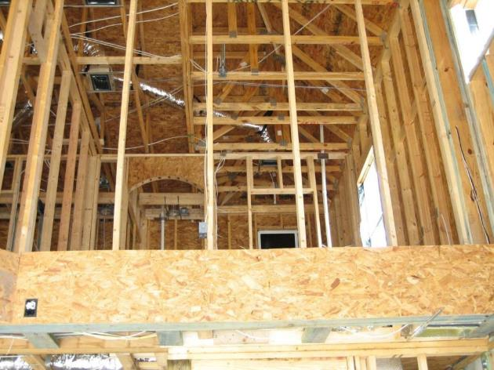
Guardrail Uses in Residential Construction, continued 1
Wall Openings
  Wall openings greater than 18” need to be protected.
Notes:
This photo shows missing guardrails on a wall opening greater than 18 inches. Guardrails were drawn-in to show the approximate location where they should be installed.

Slide 16
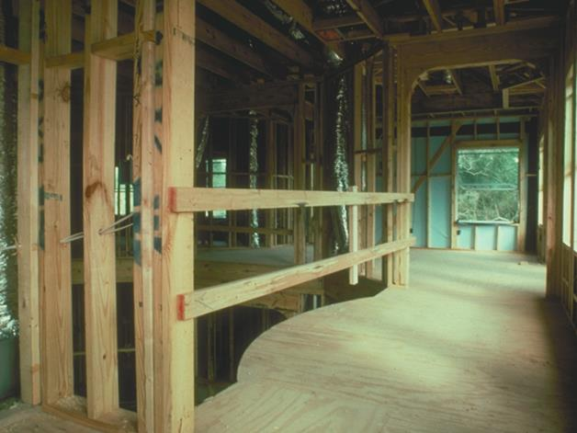
Guardrail Uses in Residential Construction, continued 2
Wall Openings
  Wall openings greater than 18” need to be protected.
Notes:
This photo shows a properly constructed guardrail used to protect a wall opening greater than 18 inches.

Slide 17
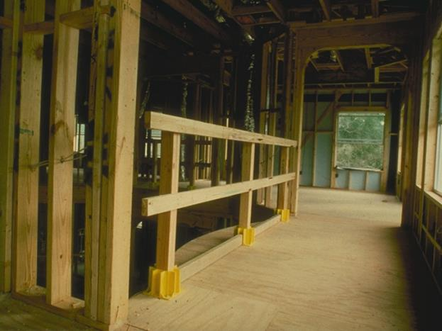
Guardrail Uses in Residential Construction, continued 3
Wall Openings
  Wall openings greater than 18” need to be protected.
Notes:
This photo shows a properly constructed guardrail used to protect a wall opening greater than 18 inches.

Slide 18
Guardrail During Drywall Installation
Prevent the need to remove guardrails during drywall installation:
  Build guardrail uprights 6 to 12 in. (15.4 to 30.5 cm) away from where drywall will be placed
Notes:
When guardrails are needed to protect wall openings, and drywall has to be installed, consider using a safety-boot system such as the example on the next slide.

Slide 19
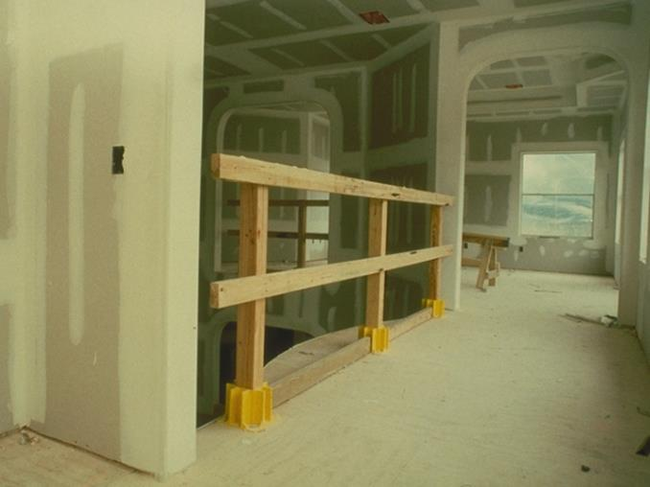
Guardrail Uses in Residential Construction, continued 4
Wall Openings even when Drywall is Installed.
Notes:
This photo shows a properly constructed guardrail used to protect a wall opening greater than 18 inches.

Slide 20
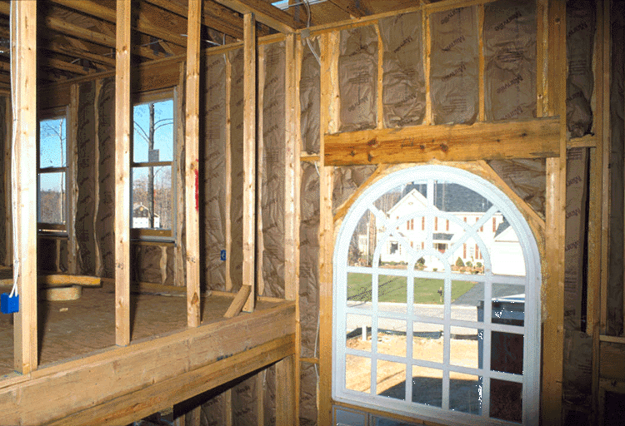
Guardrail Uses in Residential Construction, continued 5
24” on Center Studs need Guardrails
Notes:
When wall studs are 24 inches on center, guardrails must be used to protect workers from falling through the opening. This photo shows guardrails drawn-in where they should be located.

Slide 21
Requirement for Window Openings
Window openings with a 6 ft. fall hazard (1.8 m) require the installation of a guardrail system, if the bottom sill height is less than 39 in. (1.1 m).
For all window openings, the sill height determines the need for a guardrail.
Notes:
Window openings with a 6ft fall hazard requires the installation of a guardrail system. For window openings, the sill height determines the need for a guardrail.

Slide 22
Guardrail Uses in Residential Construction, continued 6
Window Openings
  Window openings with a fall hazard and low sill height.
Less than 39”
Notes:
The photo shows the approximate location where a guardrail should be placed. Since the window sill height is less than 39 inches, a guardrail is necessary.

Slide 23
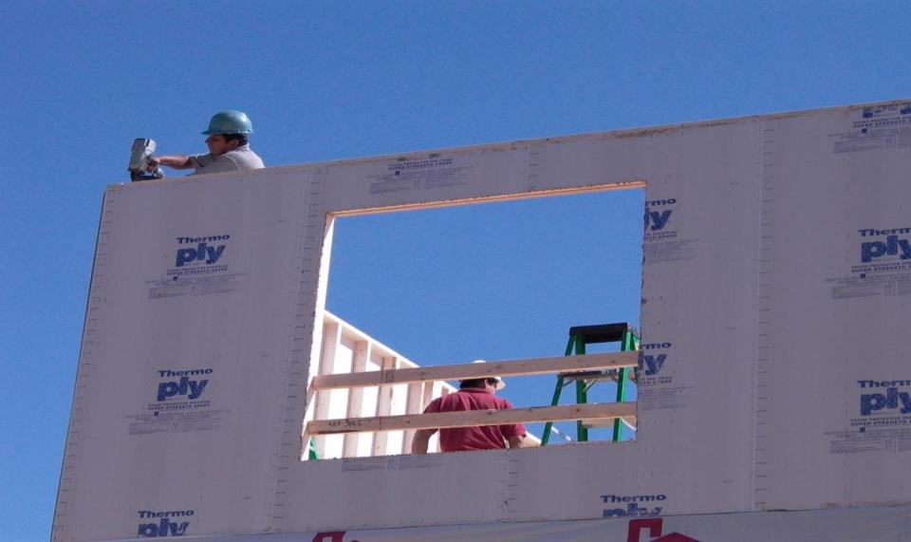
Is a guardrail required?
Notes:
Notice the ladder in the background. The use of the ladder near the window opening would require the height of the guardrail to be increased.
Discuss: The worker using the power nailer (nail gun) should be wearing protective eyewear (safety glasses) to protect from any flying object hazards.
In general OSHA requires employees to be protected from any potential eye or face injury from physical hazards.
Note: Safety glasses must meet the requirements specified in American National Standards Institute, Z87.1-1968, Practice for Occupational and Educational Eye and Face Protection.

Slide 24
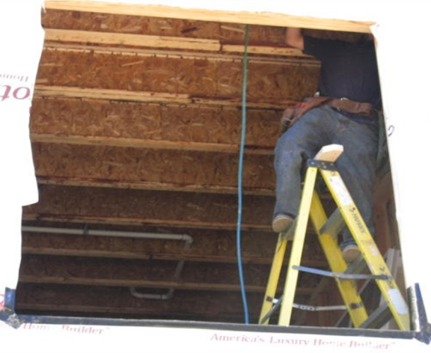

Guardrail Uses in Residential Construction, continued 7
Window Openings
  Window openings with a fall hazard and low sill height.
Notes:
This photo shows a worker standing on a stepladder and exposed to a fall hazard through a wall opening. There should be a guardrail system installed at the level the workers are working from.

Slide 25
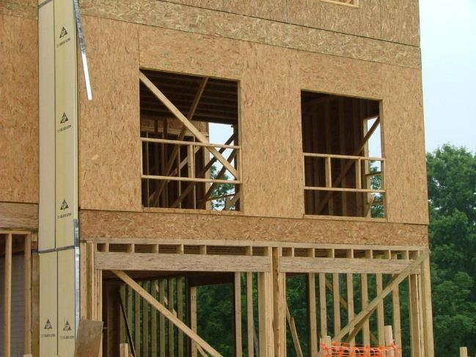
Guardrail Uses in Residential Construction, continued 8
Window Openings
  Window openings with a fall hazard and low sill height.
Notes:
This photo shows the correct use of guardrails to protect workers from falling through wall openings.

Slide 26
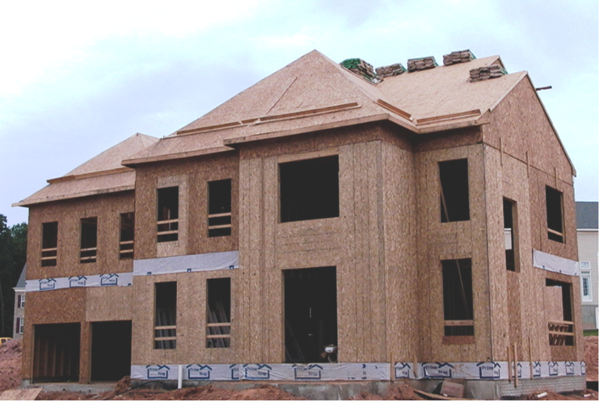
Guardrail Uses in Residential Construction, continued 9
Window Openings
  Window openings with a fall hazard and low sill height.
Notes:
This photo shows a residential home under construction with some wall and window openings with guardrails installed, and some without.

Slide 27
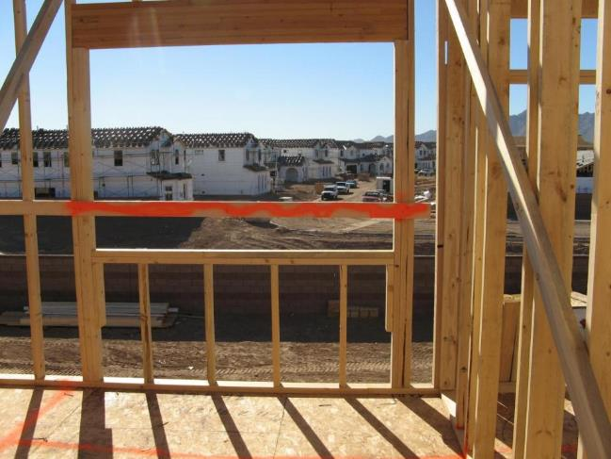
Guardrail Uses in Residential Construction, continued 10
Window Openings
  Window openings with a fall hazard and low sill height.
Notes:
This photo shows a guardrail installed on a window opening with a window sill height less than 39 inches.

Slide 28
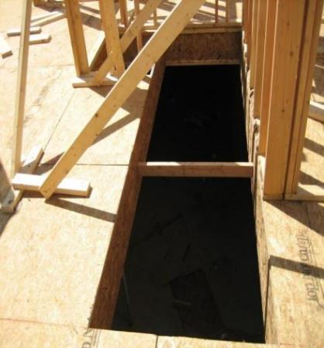
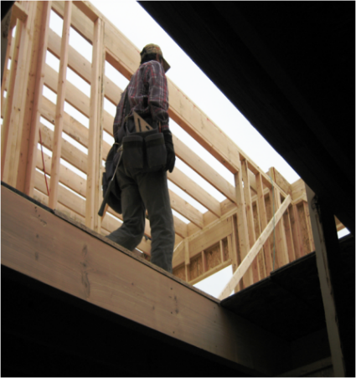
Guardrail Uses in Residential Construction, continued 11
Floor Openings
  Guardrails can be used to protect unguarded floor openings.
Notes:
The photos in the slide show unguarded floor openings. Guardrails can be used to protect workers from falling through unguarded floor holes or openings.

Slide 29
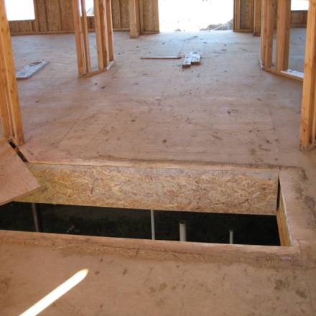
Guardrail Uses in Residential Construction, continued 12
Stair Openings
  Guardrails can be used to protect unguarded stair openings.
Notes:
The photos in the slide show unguarded stair openings. Guardrails can be used to protect workers from falling through unguarded stair holes or openings.

Slide 30
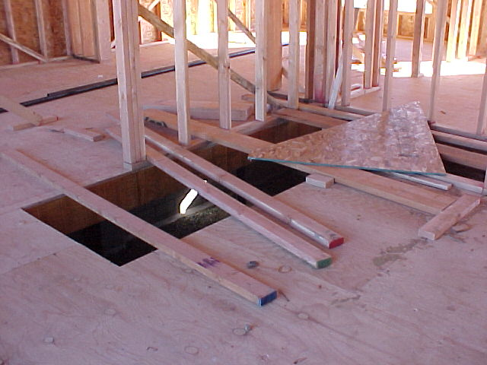
Guardrail Uses in Residential Construction, continued 13
Stair Openings
  Guardrails can be used to protect unguarded stair openings.
Notes:
The photos in the slide show unguarded stair openings. Guardrails can be used to protect workers from falling through unguarded stair holes or openings.

Slide 31
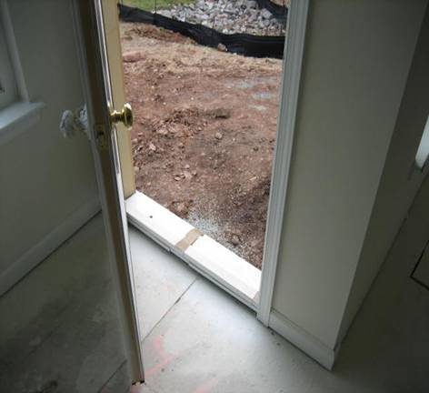
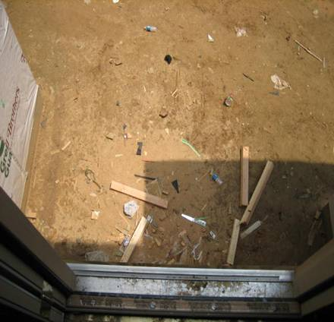
Guardrail Uses in Residential Construction, continued 14
Rear Door Openings
  Guardrails can be used to protect unguarded doorways.
Notes:
Guardrails can be used to protect unguarded doorways.

Slide 32
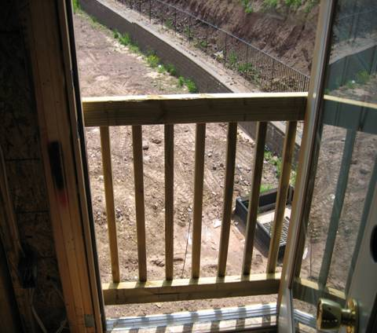
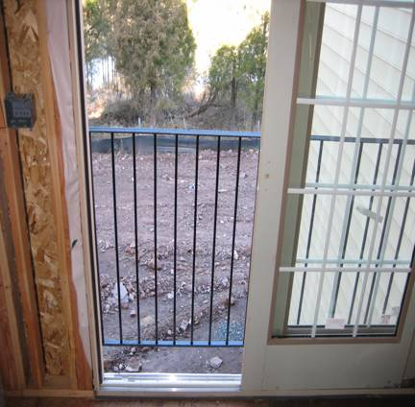
Guardrail Uses in Residential Construction, continued 15
Rear Door Openings
  Guardrails can be used to protect unguarded doorways.
Notes:
These photos show temporary and permanent guardrails placed at the location of doorways with fall hazards present.

Slide 33
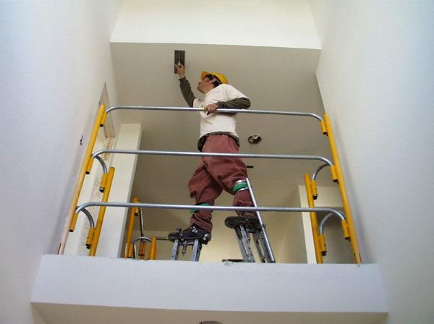
Guardrail Uses in Residential Construction, continued 16
Protect Elevated Workers
  When workers are using stilts, increase the height of the top edge of the top rail to the amount equal to height of stilts.
Notes:
When workers are using stilts, increase the height of the top edge of the top rail to the amount equal to height of stilts.

Slide 34
Guardrail Uses in Residential Construction, continued 17
Completed decks
Lofts
Stair landings
Ramps or runways
Open-sided balconies and platforms
Notes:
Guardrails can be used to protect workers on decks, lofts, stair landings, ramps and open-sided balconies.

Slide 35
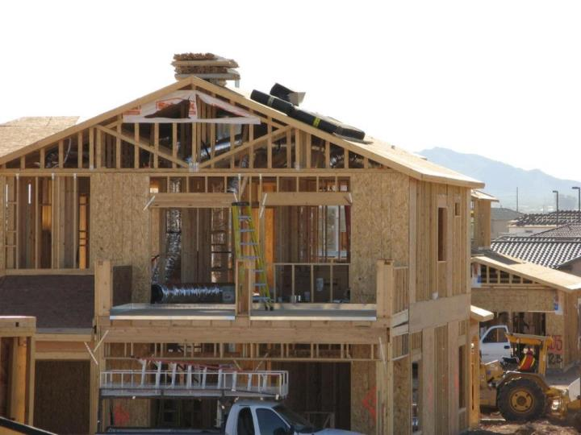
Guardrail Uses in Residential Construction, continued 18
Open-Sided Balcony and Platforms
Notes:
Guardrails can be used to protect workers from falling through an open-sided balcony and platform. This photo shows the approximate location where guardrails can be located.

Slide 36
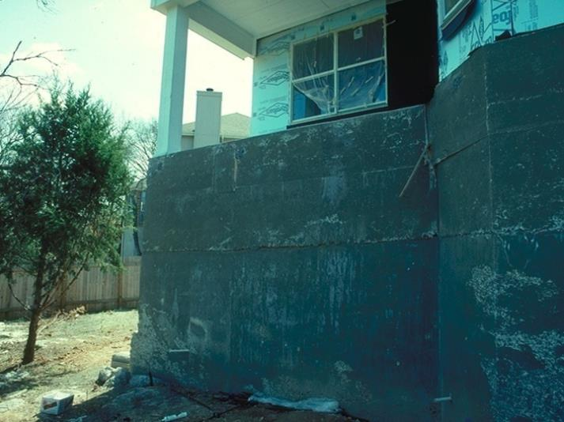
Guardrail Uses in Residential Construction, continued 19
Open-Sided Balcony and Platforms
Greater Than 6’ Fall
Notes:
Guardrails can be used to protect workers from falling through an open-sided balcony and platform. This photo shows the approximate location where guardrails can be located.

Slide 37
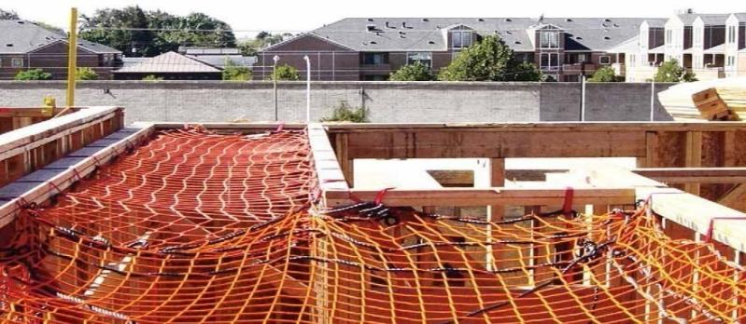
Safety Nets
System consisting of connectors and net installed below a working surface; designed to prevent a worker from contacting a lower level or structure in the event of a fall.
Notes:
Safety nets consist of connectors and net installed below a working surface; designed to prevent a worker from contacting a lower level or structure in the event of a fall.
Photo provided by materials developed through a Susan Harwood Training Grant, a program of the US Department of Labor, Occupational Safety & Health Administration

Slide 38
Safety Nets, continued 1
When used, safety must extend 8 feet beyond the edge of the work surface where employees are exposed and be installed as close under the work surface as practical but in no case more than 25 feet below.
Safety nets must be drop-tested at the jobsite after initial installation and before being used as a fall protection system, and at 6-month intervals if left in one place.
Notes:
Safety nets must:
Extend 8 feet beyond the edge of the work surface where employees are exposed.
Be installed as close under the work surface as practical but in no case more than 25 feet below.
Be drop-tested at the jobsite after initial installation and before being used as a fall protection system.

Slide 39
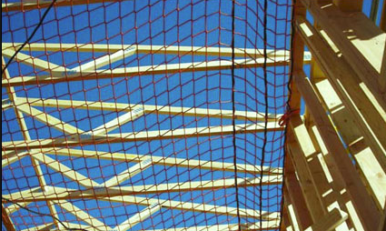
Safety Nets, continued 2
The drop-test consists of a 400 pound bag of sand, that is 28-32 inches in diameter, dropped into the net from the highest walking/working surface at which workers are exposed to fall hazards, but dropped from at least 42 inches above that level.
Notes:
Photo from OSHA

Slide 40
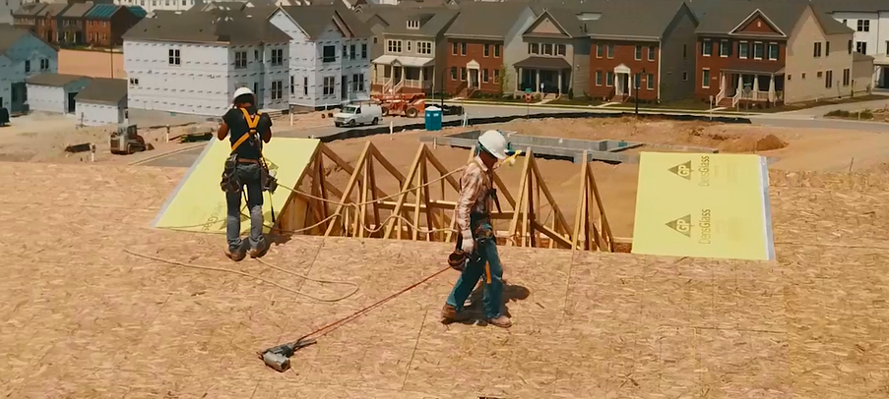
Personal Fall Arrest Systems
Commonly called a (PFAS) it’s comprised of an anchorage point, connectors, and a body harness used together to keep a worker from free falling from an elevated surface.
Notes:
A personal fall arrest system (PFAS) is comprised of an anchorage point, connectors, and a body harness used together to keep a worker from free falling from an elevated surface.
Photo courtesy of NAHB.

Slide 41
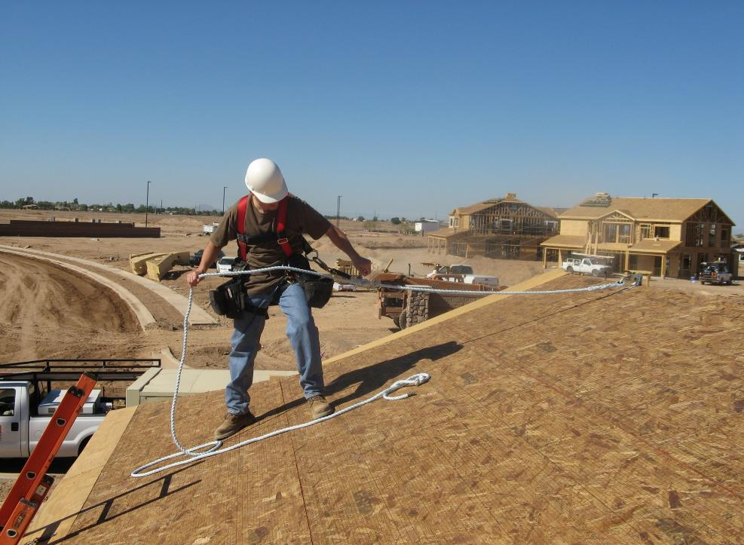
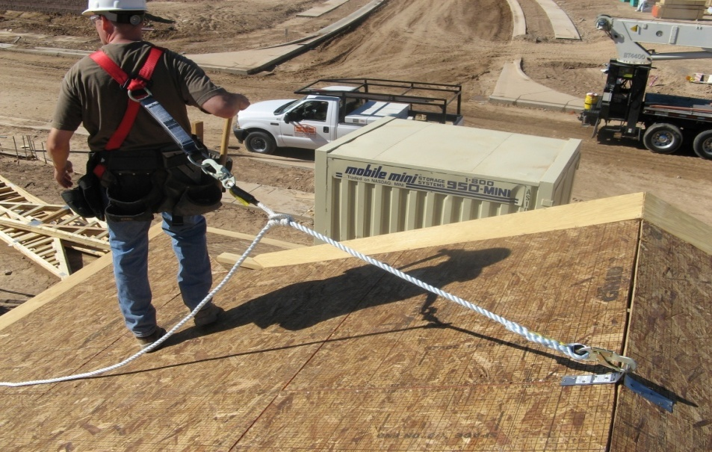
Proper PFAS for roofing
Shock Absorbing Lanyard
Full Body Harness
Rope Grab
Anchor Point
Lifeline
Notes:
Photo provided by materials developed through a Susan Harwood Training Grant, a program of the US Department of Labor, Occupational Safety & Health Administration

Slide 42

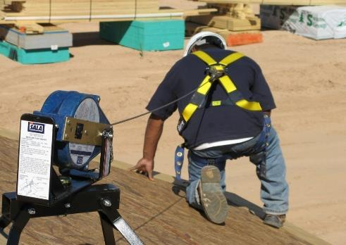
Personal Fall Arrest Systems, continued 1
Lifelines can include rope-grab systems or self-retracting lanyards (SRL’s).
Rope-grab system
Self-retracting lanyard (SRL)
Notes:
Lifelines can include rope-grab or self-retracting lanyards.
Photo provided by materials developed through a Susan Harwood Training Grant, a program of the US Department of Labor, Occupational Safety & Health Administration

Slide 43
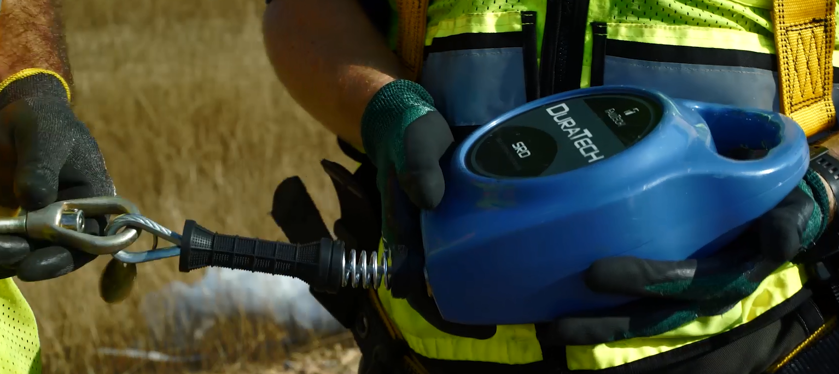
Self-Retracting Lanyards / SRL’s
The availability and lower prices of SRL’s has led to a dramatic increase in their use in recent years.
SRL’s are available for a variety of uses, including leading edge work.
Notes:
The lower prices and rising availability of self-retracting lanyards (SRL) has led to a dramatic increase in use in recent years. SRL’s serve a variety of uses to protect workers from falling.

Slide 44
PFAS – Prior to Use
Review the manufacturer's instructions for proper use, inspection, donning, limitations, accessories, and other information.
Inspect a PFAS prior to EACH USE.
Remember in the event of a fall, this protects your LIFE.
Don’t use a PFAS that is damaged, worn, or has experienced an arrested fall.
Notes:
Prior to use, a PFAS should be inspected and damaged, work or components that have experienced an arrested fall should be removed from service. All manufacturer’s instructions should be followed for proper use.

Slide 45
PFAS Components
D-rings and snaphooks must be capable of withstanding 3,600 lbs. without failure.
Snaphooks must not be attached to:
  Directly to webbing, rope or wire rope
  To each other
  To a D-ring with another snaphook or connector on it
  To a horizontal lifeline
Notes:
Components of a PFAS include:
D-rings and snaphooks which must be capable of withstanding 3,600 lbs. without failure.
Snaphooks which must not be attached to:
Directly to webbing, rope or wire rope
To each other
To a D-ring with another snaphook or connector on it
To a horizontal lifeline

Slide 46
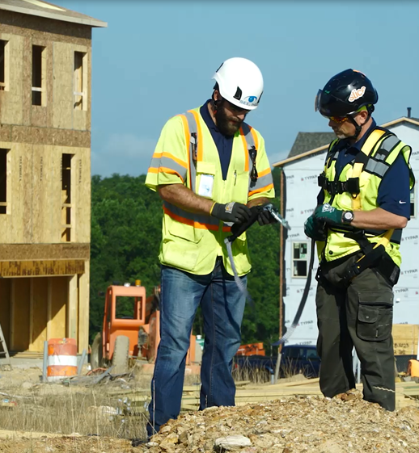
Inspecting Components of PFAS
Inspecting a harness:
  Inspecting the buckles
  Inspecting the lanyard
  Carefully checking the webbing for distortions
  Check the hardware (D-rings) connectors for defects
  Inspect rope or lifeline for any rips, tears, or deformities
Notes:
When inspecting a harness:
Inspecting the buckles
Inspecting the lanyard
Carefully checking the webbing for distortions
Check the hardware (D-rings) connectors for defects
Inspect rope or lifeline for any rips, tears, or deformities

Slide 47
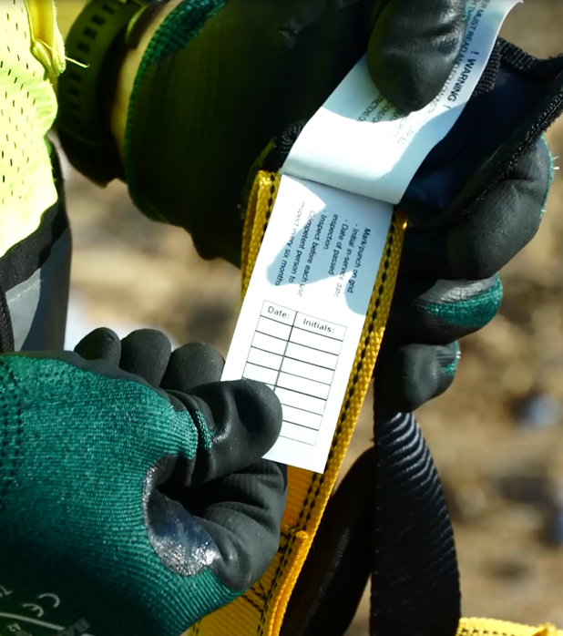
Inspecting PFAS
Quick Tip –
  Many types of harnesses and SRL’s have inspection tags installed on them.
  This makes it easy for you to keep track of the inspections you have performed.
Notes:
Many types of harnesses and SRL’s have inspection tags installed on them.

Slide 48
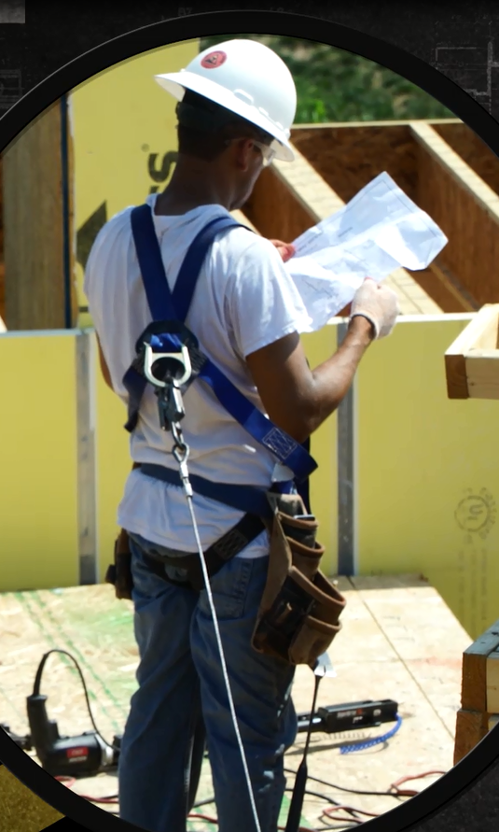
Wearing a PFAS
Proper wear: locate the D-ring on the back of the harness in the center of the back between the shoulder blades.
Notes:
When wearing a PFAS, always remember to locate the D-ring on the back of the harness in the center of the back, between the shoulder blades.

Slide 49
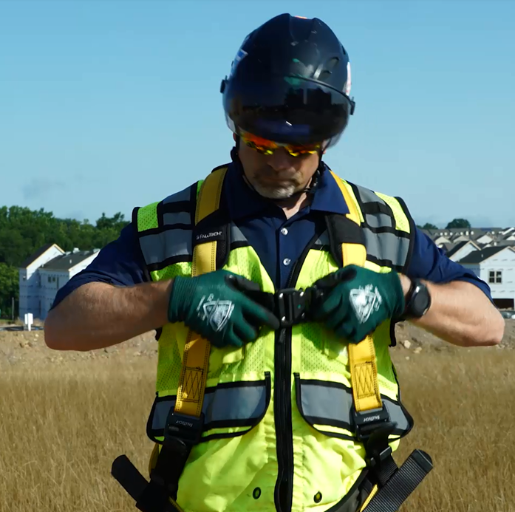
Wearing a PFAS, continued 1
Proper wear: always adjust the harness to ensure it fits tight to prevent you from falling out of the harness in the event of a fall.
Notes:
Always adjust the harness to ensure it fits tight to prevent you from falling out of the harness in the event of a fall.

Slide 50
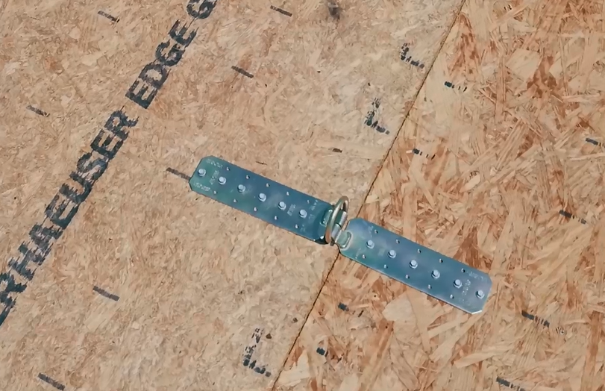
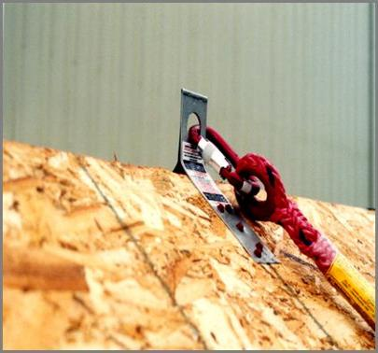
Anchor Point Requirements
Anchor points must be capable of supporting 5,000 pounds or the maximum arresting force.
Notes:
Anchor points must be capable of supporting 5,000 pounds or twice the intended load.
Photo provided by materials developed through a Susan Harwood Training Grant, a program of the US Department of Labor, Occupational Safety & Health Administration.
Second photo is directly from Miller Fall Protection by Honeywell. https://www.millerfallprotection.com/smart-solutions/guide-to-fall-protection/personal-fall-arrest-system

Slide 51
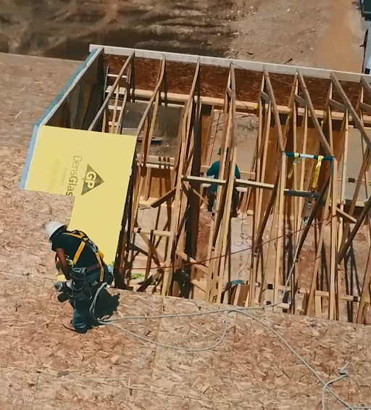
Examples of Anchor Points
Anchor point is installed on a series of braced roof trusses.
Notes:
This slide shows a worker installing roof sheathing while wearing a PFAS connected to an anchor point on a series of braced trusses.

Slide 52
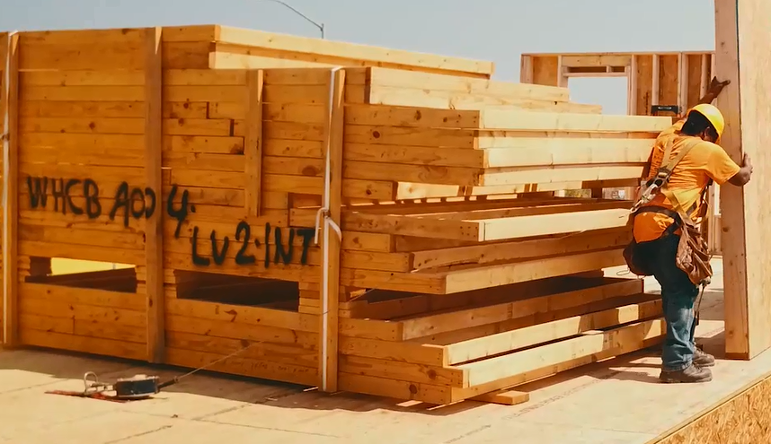
Examples of Anchor Points, continued 1
Anchor point is installed through floor sheathing into floor trusses to support a worker using a leading edge self-retracting lifeline.
Notes:
This slide shows a worker using a PFAS attached to a floor-anchor while using a leading edge self-retracting lanyard.

Slide 53
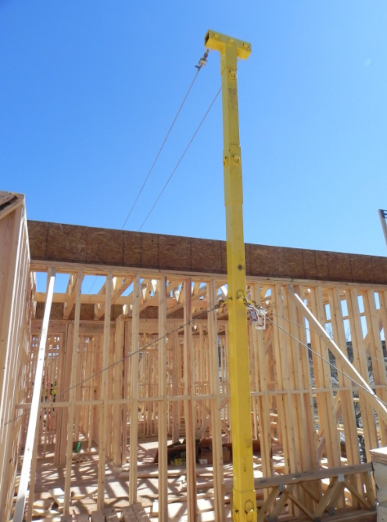
Anchor Points
A horizontal lifeline is attached to a vertical structural pole and can be used to tie off framers.
Notes:
A horizontal lifeline is attached to a vertical structural pole and is a system which can be used to tie off framers.

Slide 54
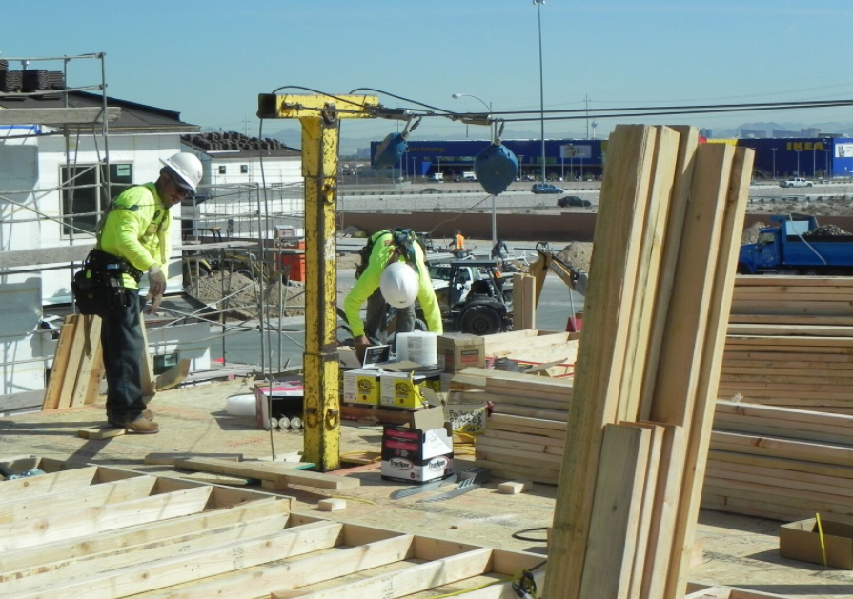
Anchor Points, continued 1
A horizontal lifeline is attached to a vertical structural pole and can be used to tie off framers.
Notes:
This slide shows workers attached to a horizontal lifeline, which is attached to a vertical structural pole used to tie off framers.

Slide 55
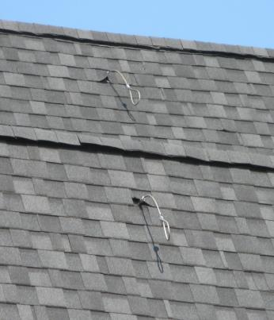
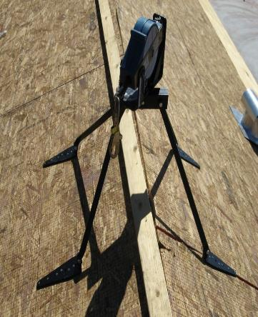
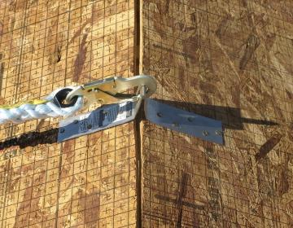
Examples of Anchor Points
Sample Anchor Points:
Notes:
This slide depicts samples of various anchor points.
Photo provided by materials developed through a Susan Harwood Training Grant, a program of the US Department of Labor, Occupational Safety & Health Administration.

Slide 56
Calculating Fall Distances
Regulations require that a worker cannot free fall 6 feet or more.
How far a worker will fall depends on a variety of factors, which include but is not limited to:
  Body size of worker
  Fit of harness, to allow for stretch
  Type of lanyard (rip-stitch or self-retracting)
  Safety factors
Notes:
Various factors go into calculating a fall distance, including the height of a worker, fit of harness, type of lanyard and built-in safety factors.

Slide 57
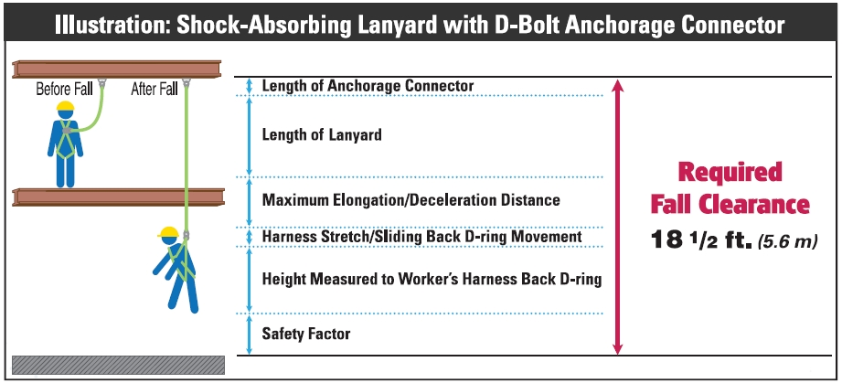
Calculating Fall Distances, continued 1
Notes:
Illustration courtesy of: Miller Fall Protection, Bacou-Dalloz.

Slide 58
Swing Fall Hazard
A hazard created if a worker is not directly below the anchor point and experiences a fall; which caused the worker to swing back towards the anchor point.
In order to minimize the swing follow a fall:
  Work directly below the anchor.
  Do not extend your work zone more than 30º from the anchor.
  Manage the slack in the rope.
Notes:
A swing fall can be created if a worker is not directly below the anchor point and experiences a fall; which caused the worker to swing back towards the anchor point.

Slide 59
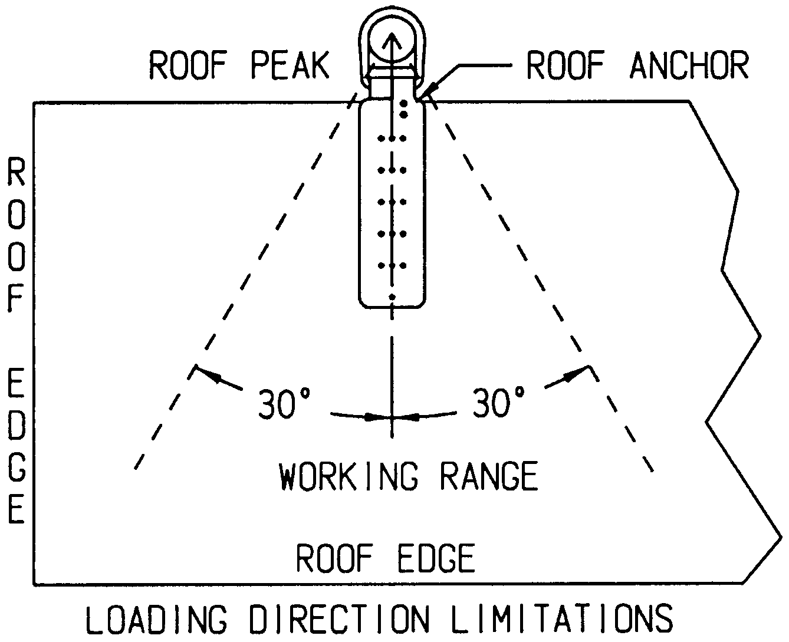
Swing Fall Hazard, continued 1
Notes:
To reduce the risk of a swing fall hazard workers should work no more than 30 degrees from an anchor point.

Slide 60
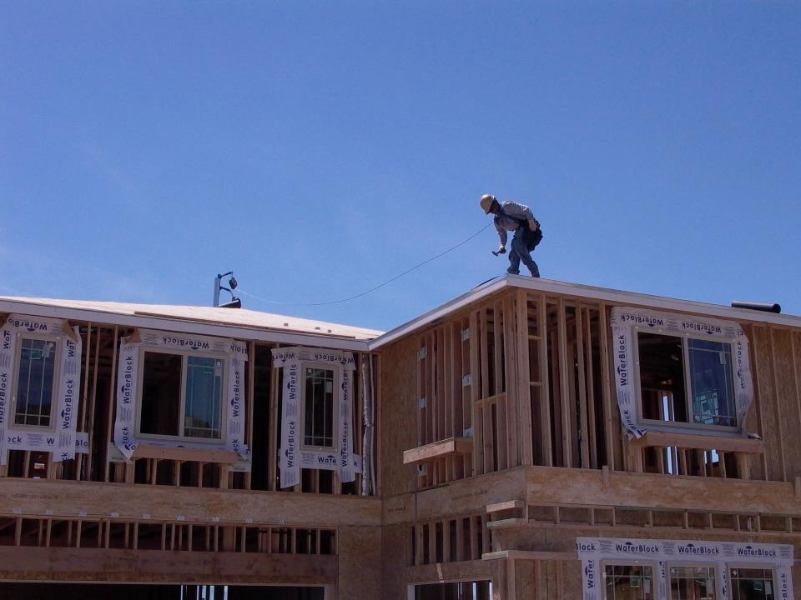
Swing Fall Hazard
Swing Fall Hazard, continued 2.
Notes:
This slide shows a worker exposed to a swing fall hazard.
Photo provided by materials developed through a Susan Harwood Training Grant, a program of the US Department of Labor, Occupational Safety & Health Administration

Slide 61

Identify the Hazards
How many hazards do you see in this photo?
Notes:
This photo shows a worker working at heights above 6 feet without utilizing conventional fall protection.

Slide 62

Identify the Hazards, continued 1
How many hazards do you see in this photo?
Notes:
This photo shows a worker working at heights above 6 feet without utilizing conventional fall protection.

Slide 63

Identify the Hazards, continued 2
How many hazards do you see in this photo?
Notes:
This photo shows stairs with 4 or more risers without proper handrails or guardrails. Additionally there is an unguarded wall opening that Is not protected by guardrails.

Slide 64
Limitations of using a PFAS
Limitations of conventional fall protection systems during the installation of exterior walls may include:
  Lack of a suitable anchor point to withstand 5000 pounds or twice the intended load from a falling worker.
  Installation of guardrail system could involve more risk, due to the duration of the fall exposure.
Notes:
Limitations of conventional fall protection systems during the installation of exterior walls may include the lack of a suitable anchor point or in special instances where the installation of guardrail system could involve more risk, due to the duration of the fall exposure.

Slide 65
Limitations of using a PFAS, continued 1
  Manufacturers of personal fall arrest system components may prohibit the anchor point to be placed at ground level, or below a workers ‘D’ ring on their harness.
  Clearance distance below a worker, which is needed when using a personal fall arrest system, may not be sufficient to prevent the worker from contacting the next lower level, should a fall occur.
  Manufacturers may have differing installation/usage requirements; always refer to the manufacturers’ instruction prior to use.

Slide 66
Recap
In construction, the trigger height for when conventional fall protection (guardrails, PFAS, safety nets) is required is 6 feet.
Before being exposed to fall hazards, workers must be trained.
Understand the proper use and limitations of fall protection systems before beginning work.
Never take shortcuts, always ask for assistance from a supervisor or competent person if you are unsure about a fall hazard or protective system.
Notes:
Remember, the trigger height for when conventional fall protection is required is 6 feet. Workers need to be trained before being exposed to fall hazards, and must understand the proper use and limitations of fall protection systems being utilized.

