Slide 1
NAHB Playhouse
Project Overview

Slide 2
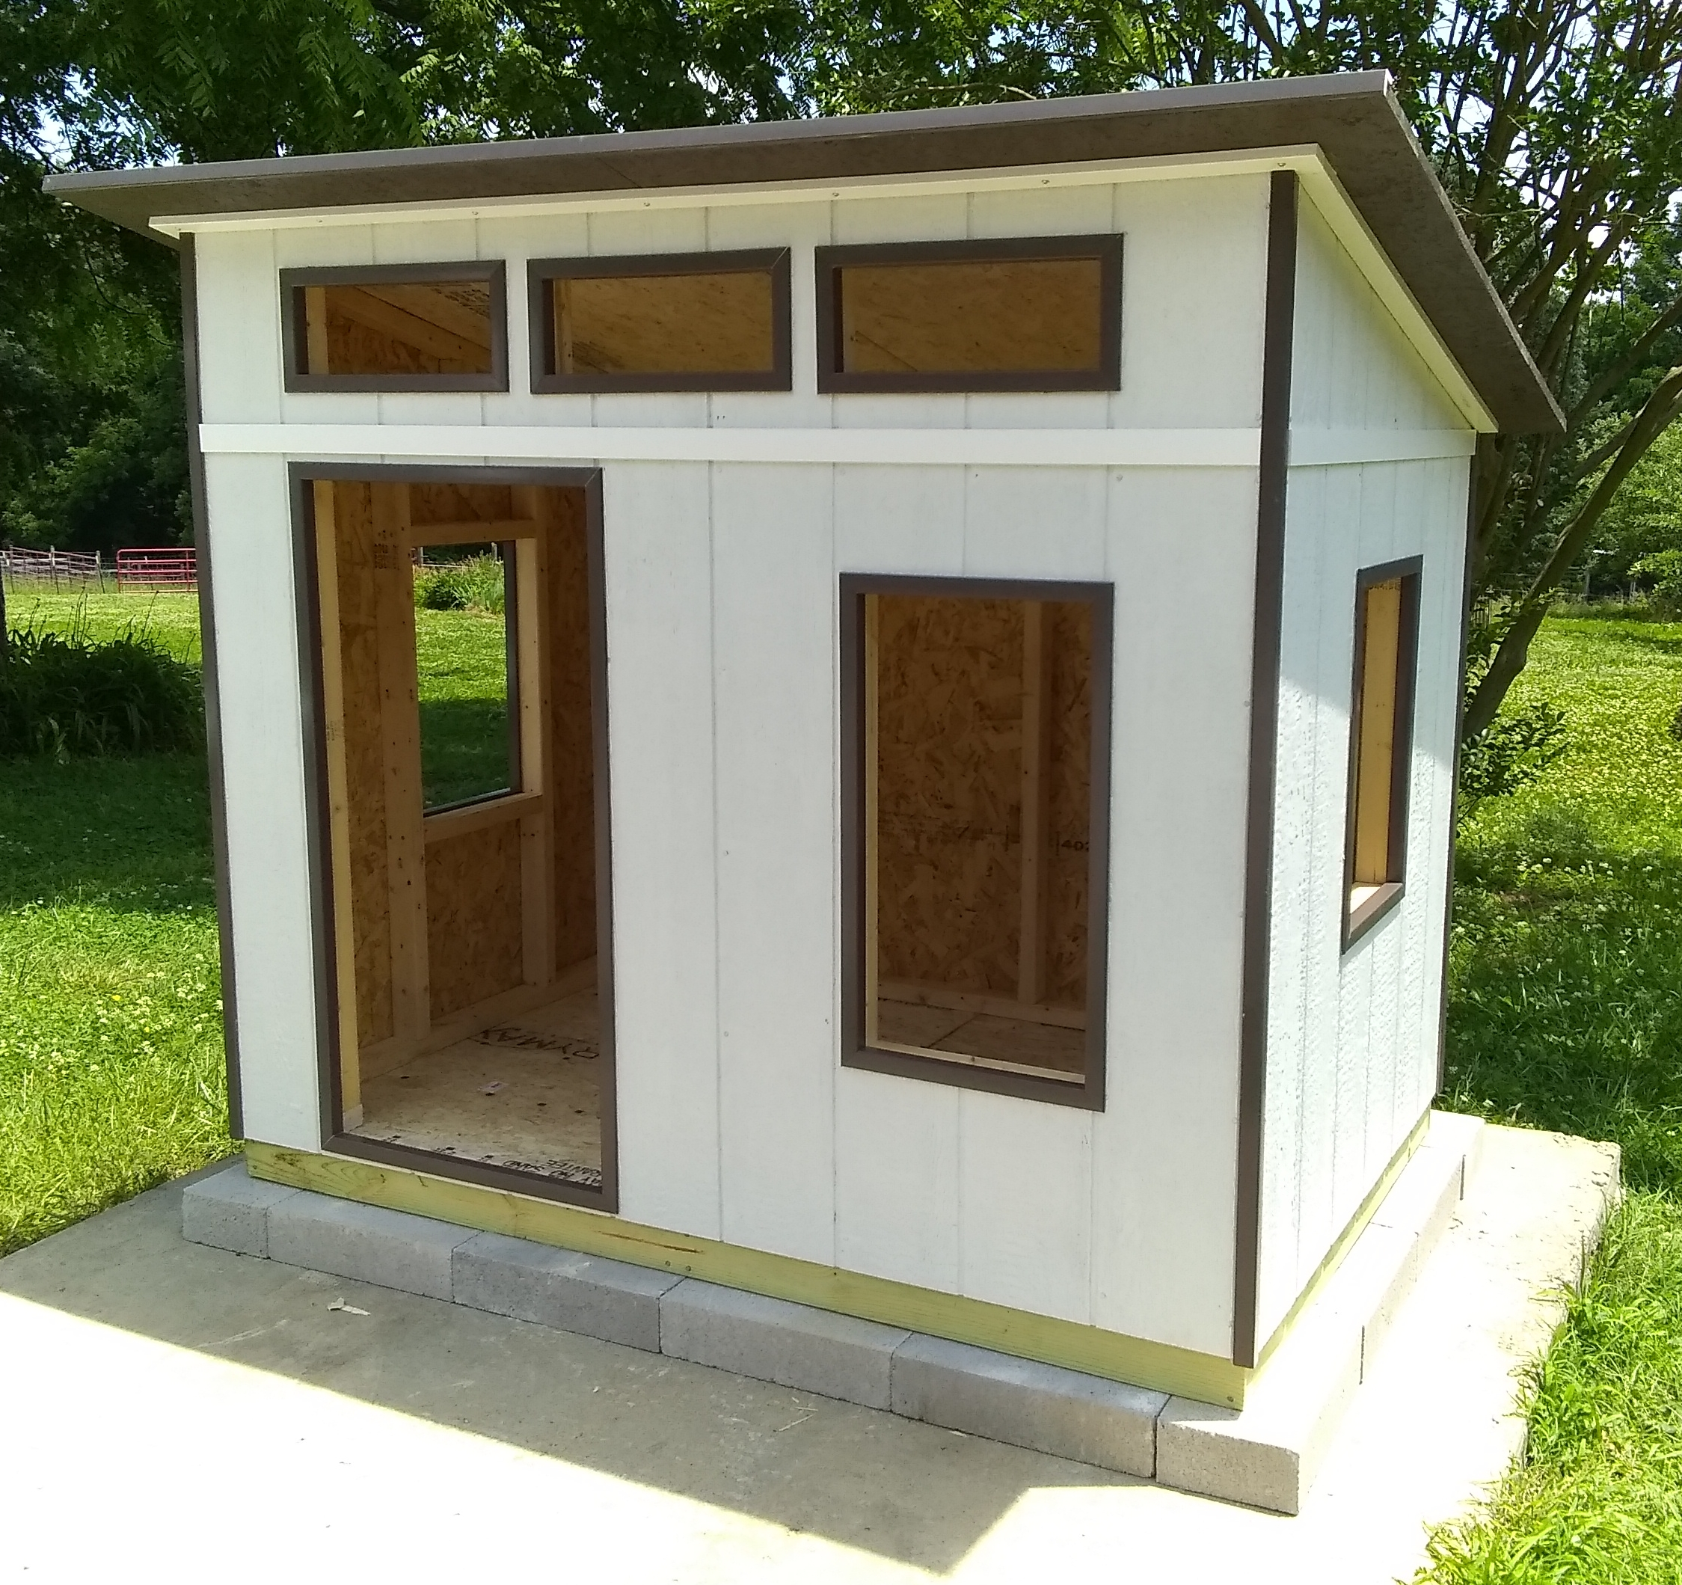
NAHB Playhouse

Slide 3
Project Overview
Groups of students will assemble a 4’ x 6’ playhouse designed similar to a residential structure
Intended for 5th though 8th grade students
Components to be prefabricated by adult volunteers or high school carpentry students
Designed to minimize material waste
Constructors will choose paint colors and may add features
Designed for outdoor use. May be modified if used indoors.

Slide 4
Design Package
The design information is presented in three Power Point presentations, a report document, and a set of seven 11x17 drawings in PDF format
Numbered Figures referred to in the text of the PowerPoints and report are presented in the PDF drawings. The drawing sheet number is given for each figure reference

Slide 5
Component Fabrication
Prior to engaging students, to ensure safety and quality, components must be
  Cut
  Marked
  Drilled
Framing member joint locations will be marked on all boards
Nail holes will be predrilled in the primary members to indicate all nail locations and assist nail driving

Slide 6
Playhouse Assembly
Assembly activities include
  Painting siding and roof
  Assembling the framing components
  Attaching the flooring and siding onto the frames
  Erecting the walls on the floor
  Attaching the roof to the walls
  Attaching the trim
Most of the assembly will require nailing through predrilled holes
The assembly can be easily broken in to tasks of roughly one hour to be completed over several sessions or by multiple groups simultaneously

Slide 7
Customization
If the playhouse will be used indoors
  Omit the concrete block foundation
  Use kiln-dried framing lumber instead of pressure treated lumber for floor framing
  Consider a lower cost T&G product for the floor and roof
If the interior walls are to be “finished,” add a stud to each end of the front and back walls for nailing the sheathing
Pieces cut for door and window openings can be used to create operable doors/windows or shutters

