Slide 1
NAHB Playhouse Playhouse Assembly

Slide 2
Playhouse Assembly
Playhouse should be assembled by the students with minimal adult supervision
Adults should orient the students to the requirements for each task, explain the drawings and procedures, then let the students determine how to proceed
If adults observe students making mistakes, reorient them through questions and suggestions
Avoid physically assisting if at all possible
Adults should always be present to ensure safe practices

Slide 3
Assembly Tools
Hammers
Tape measure
Shovel
Minimum 4-foot level
Hand saw
Step ladder

Slide 4
Assembly Activities
Site preparation
Foundation
Floor framing
Floor sheathing
Wall framing
Wall sheathing
Wall erection
Roof
Trim

Slide 5
Site Preparation
Playhouse should be placed on a fairly level site
The area under the foundation blocks should be completely leveled using a shovel before placing the blocks
We chose to build our playhouse on an existing, level concrete slab, so no preparation was required

Slide 6
Foundation
Because even treated lumber can deteriorate when in ground contact for long periods, a concrete block foundation is recommended
The concrete blocks also support the ends of the joists eliminating the need for structural joist hangers
Arrange the concrete blocks on the leveled site as shown in Figure 15 (Sheet 4)
Check the squaring dimension across both diagonals
The actual dimension will probably be slightly longer, but both diagonals should be the same length

Slide 7
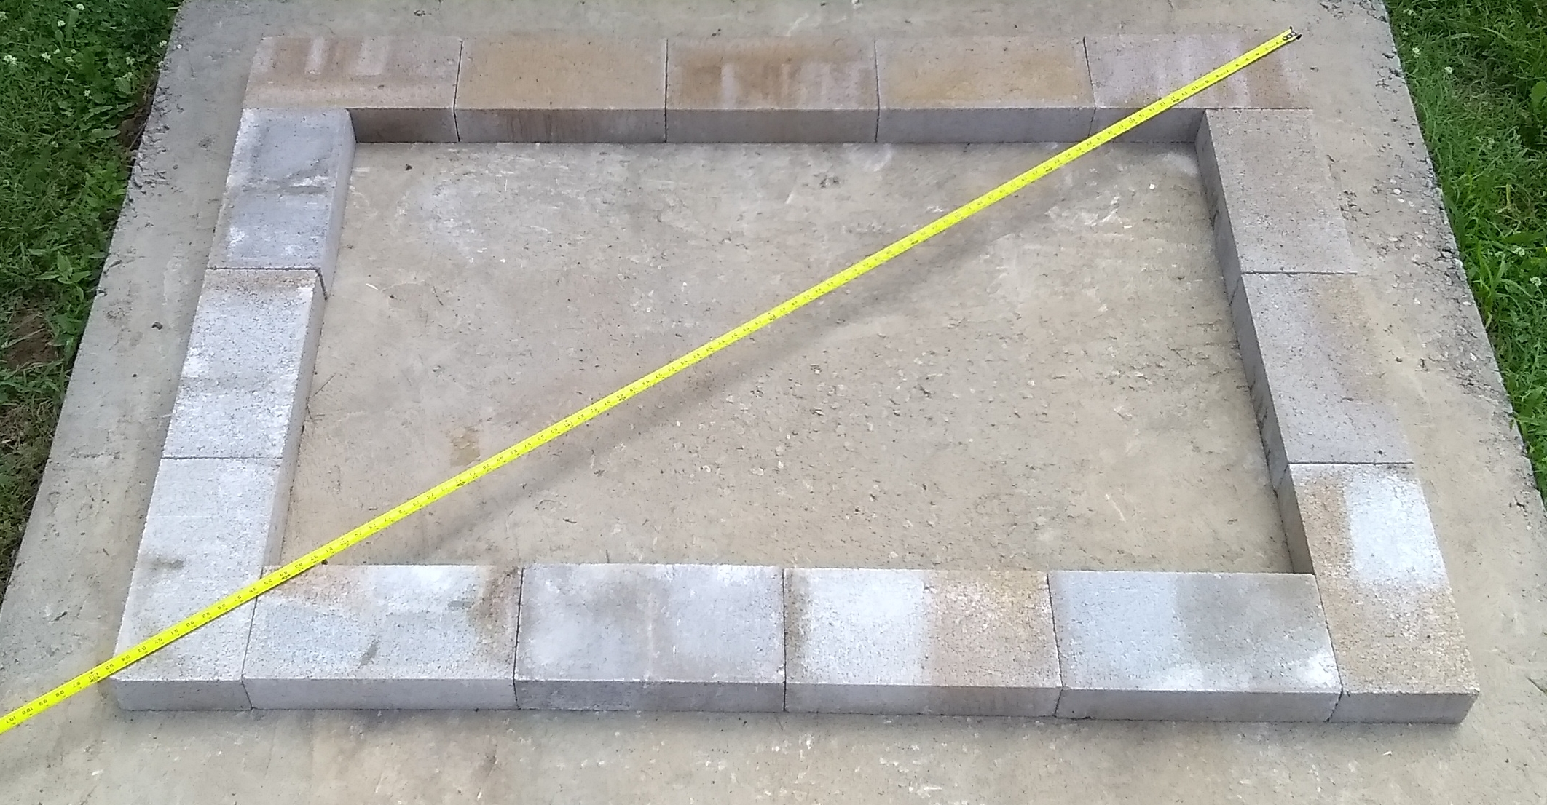
Concrete Block Foundation

Slide 8
Floor Framing
Assemble the floor framing as shown in Figure 17 (Sheet 4) referring to Figure 3 (Sheet 1)
Two 10d nails rated for treated lumber should be driven through the predrilled holes at each joint into the ends of the joists
Check the floor framing for square by comparing the lengths of the two diagonals. Adjustments will be made when attaching the sheathing
Center the framing on the foundation as shown in Figure 18 (Sheet 4)

Slide 9
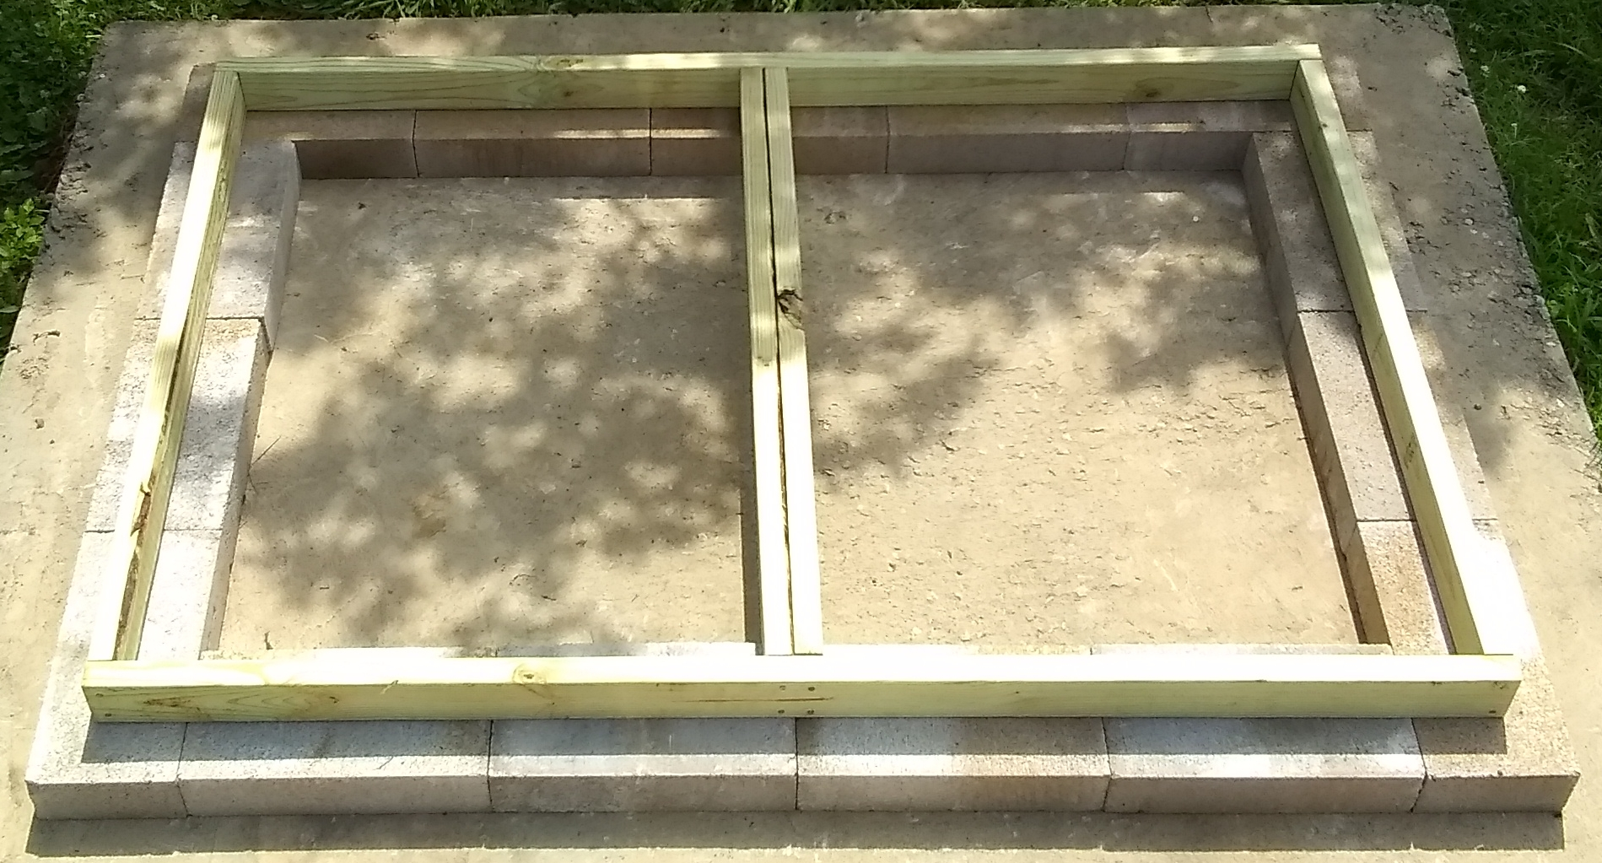
Floor Framing Placed on Foundation

Slide 10
Floor Sheathing
Place the two pieces of floor sheathing on top of the framing. Butt the two factory-cut edges in the center. In our build (pictured) we placed the tongue on the front but would recommend reversing this because the door trim with cover the grooved edge better
Carefully align the grooved edge with the front of the floor framing and drive 8d nails, rated for treated lumber, into each hole along the front edge
Adjust the back of the framing by tapping with a hammer until it is square and aligned with the sheathing
Drive nails in the remainder of the holes

Slide 11
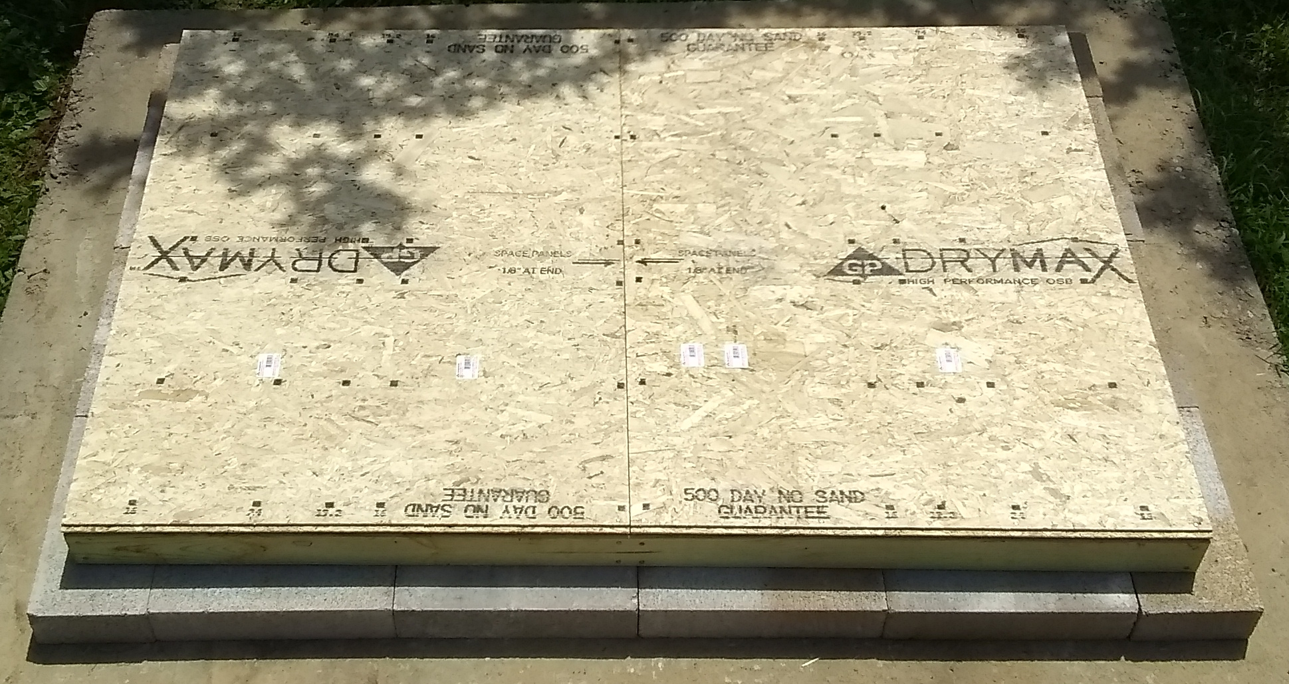
Floor Sheathing

Slide 12
Wall Framing
Assemble each wall frame as shown in Figures 21 (Sheet 5), referring to Figures 6 (Sheets 5 and 6)
The front wall will be assembled with the outside down in order to properly align the angled, top plate
Start by assembling the window and door framing as shown below
Drive 10d common nails in each nail hole
Complete framing the lower 4’ of wall

Slide 13
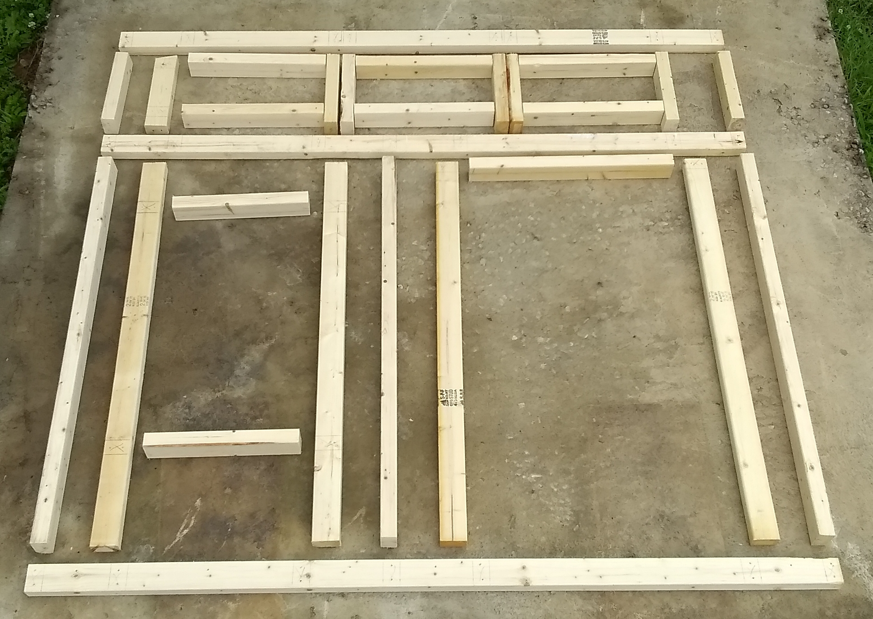
Assemble Front with Outside Down (door on right)

Slide 14
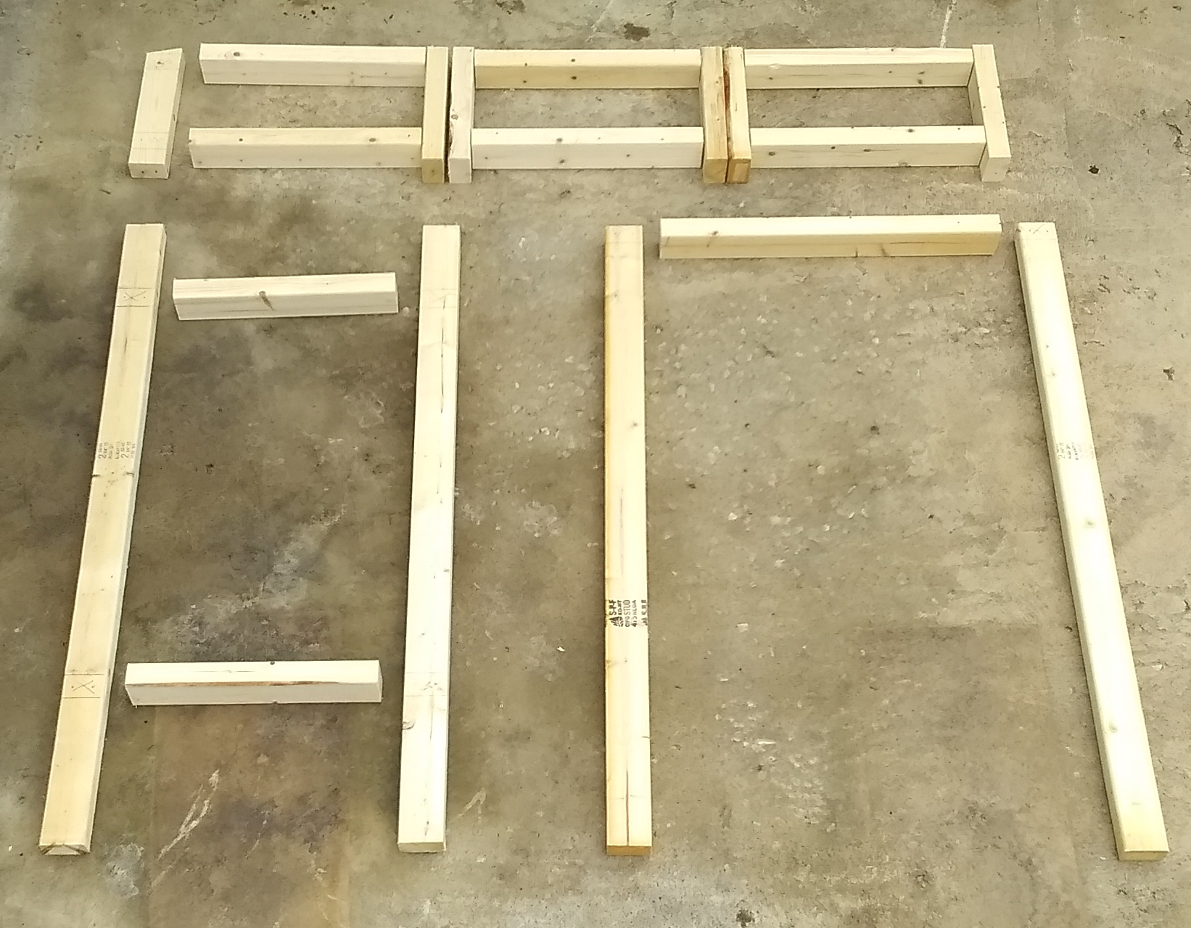
Assemble Door and Windows First

Slide 15
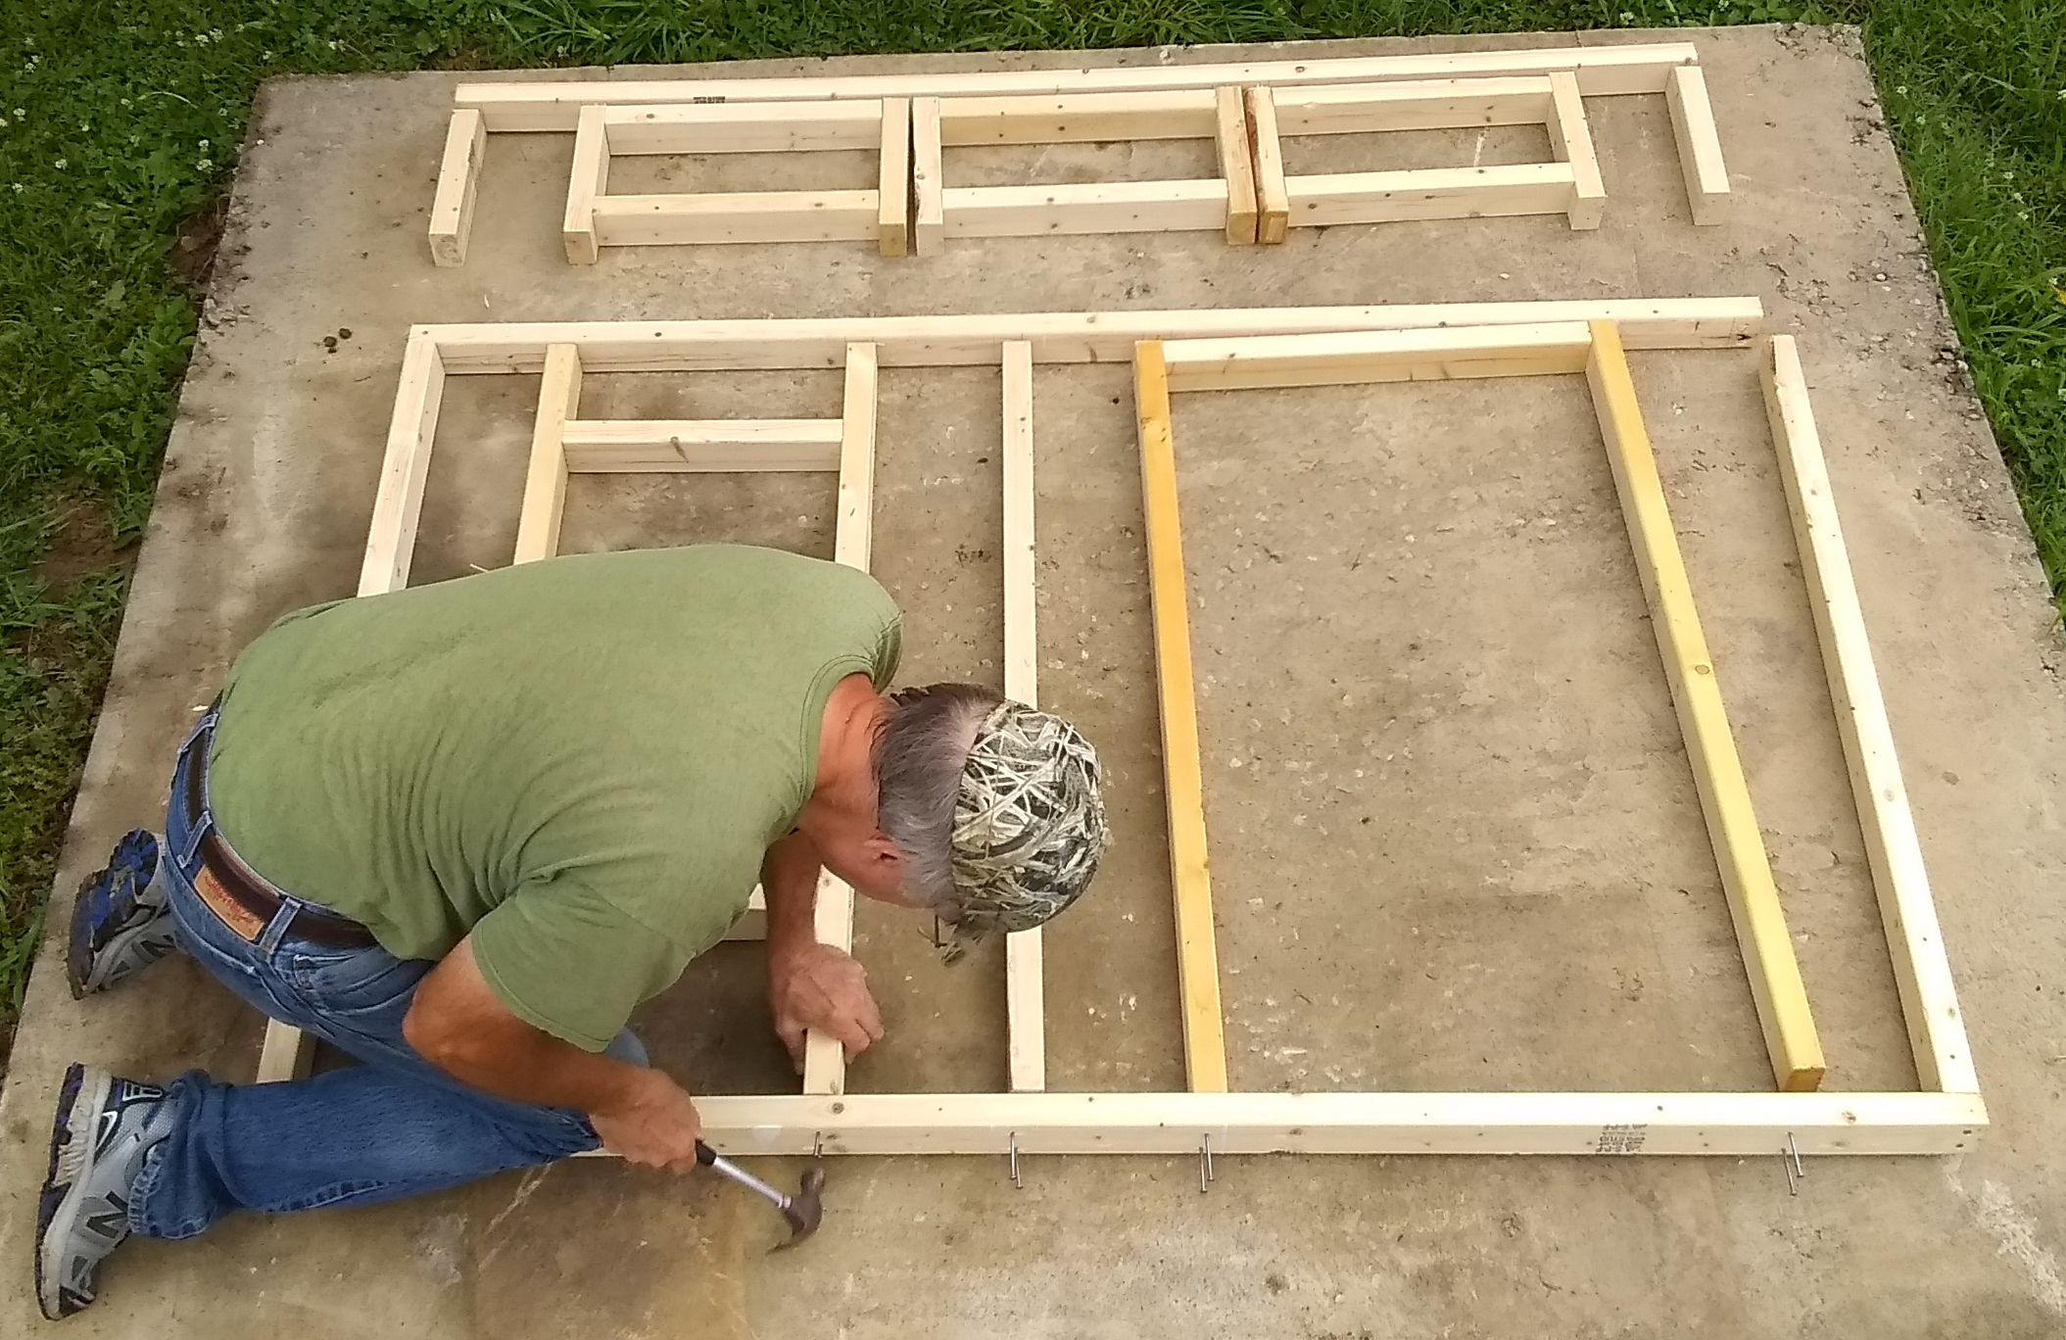
Complete the Bottom 4’ Frame

Slide 16
Wall Framing
When the stud on the top portion of the wall coincides with a stud on the bottom, or the bottom framing makes the normal nail locations inaccessible, the joints must be toenailed
Figures 6 (Sheets 5 and 6) shows the toenail locations
As studs tend to move sideways when toenailing from the side; temporary blocking may be used to secure it while nailing

Slide 17
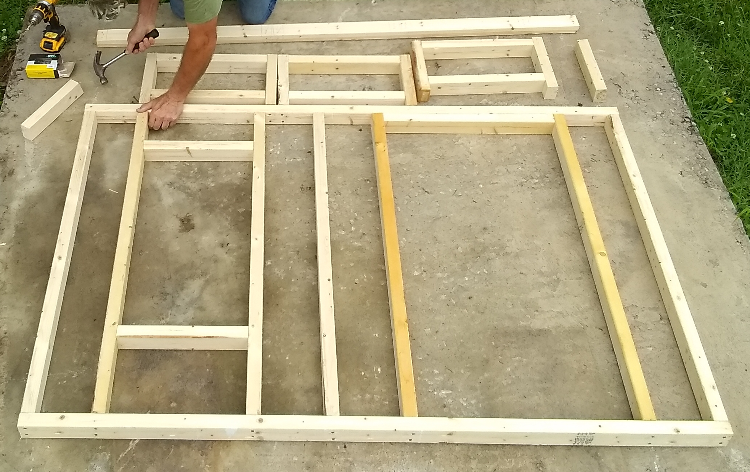
Toenailing is Required in Places

Slide 18
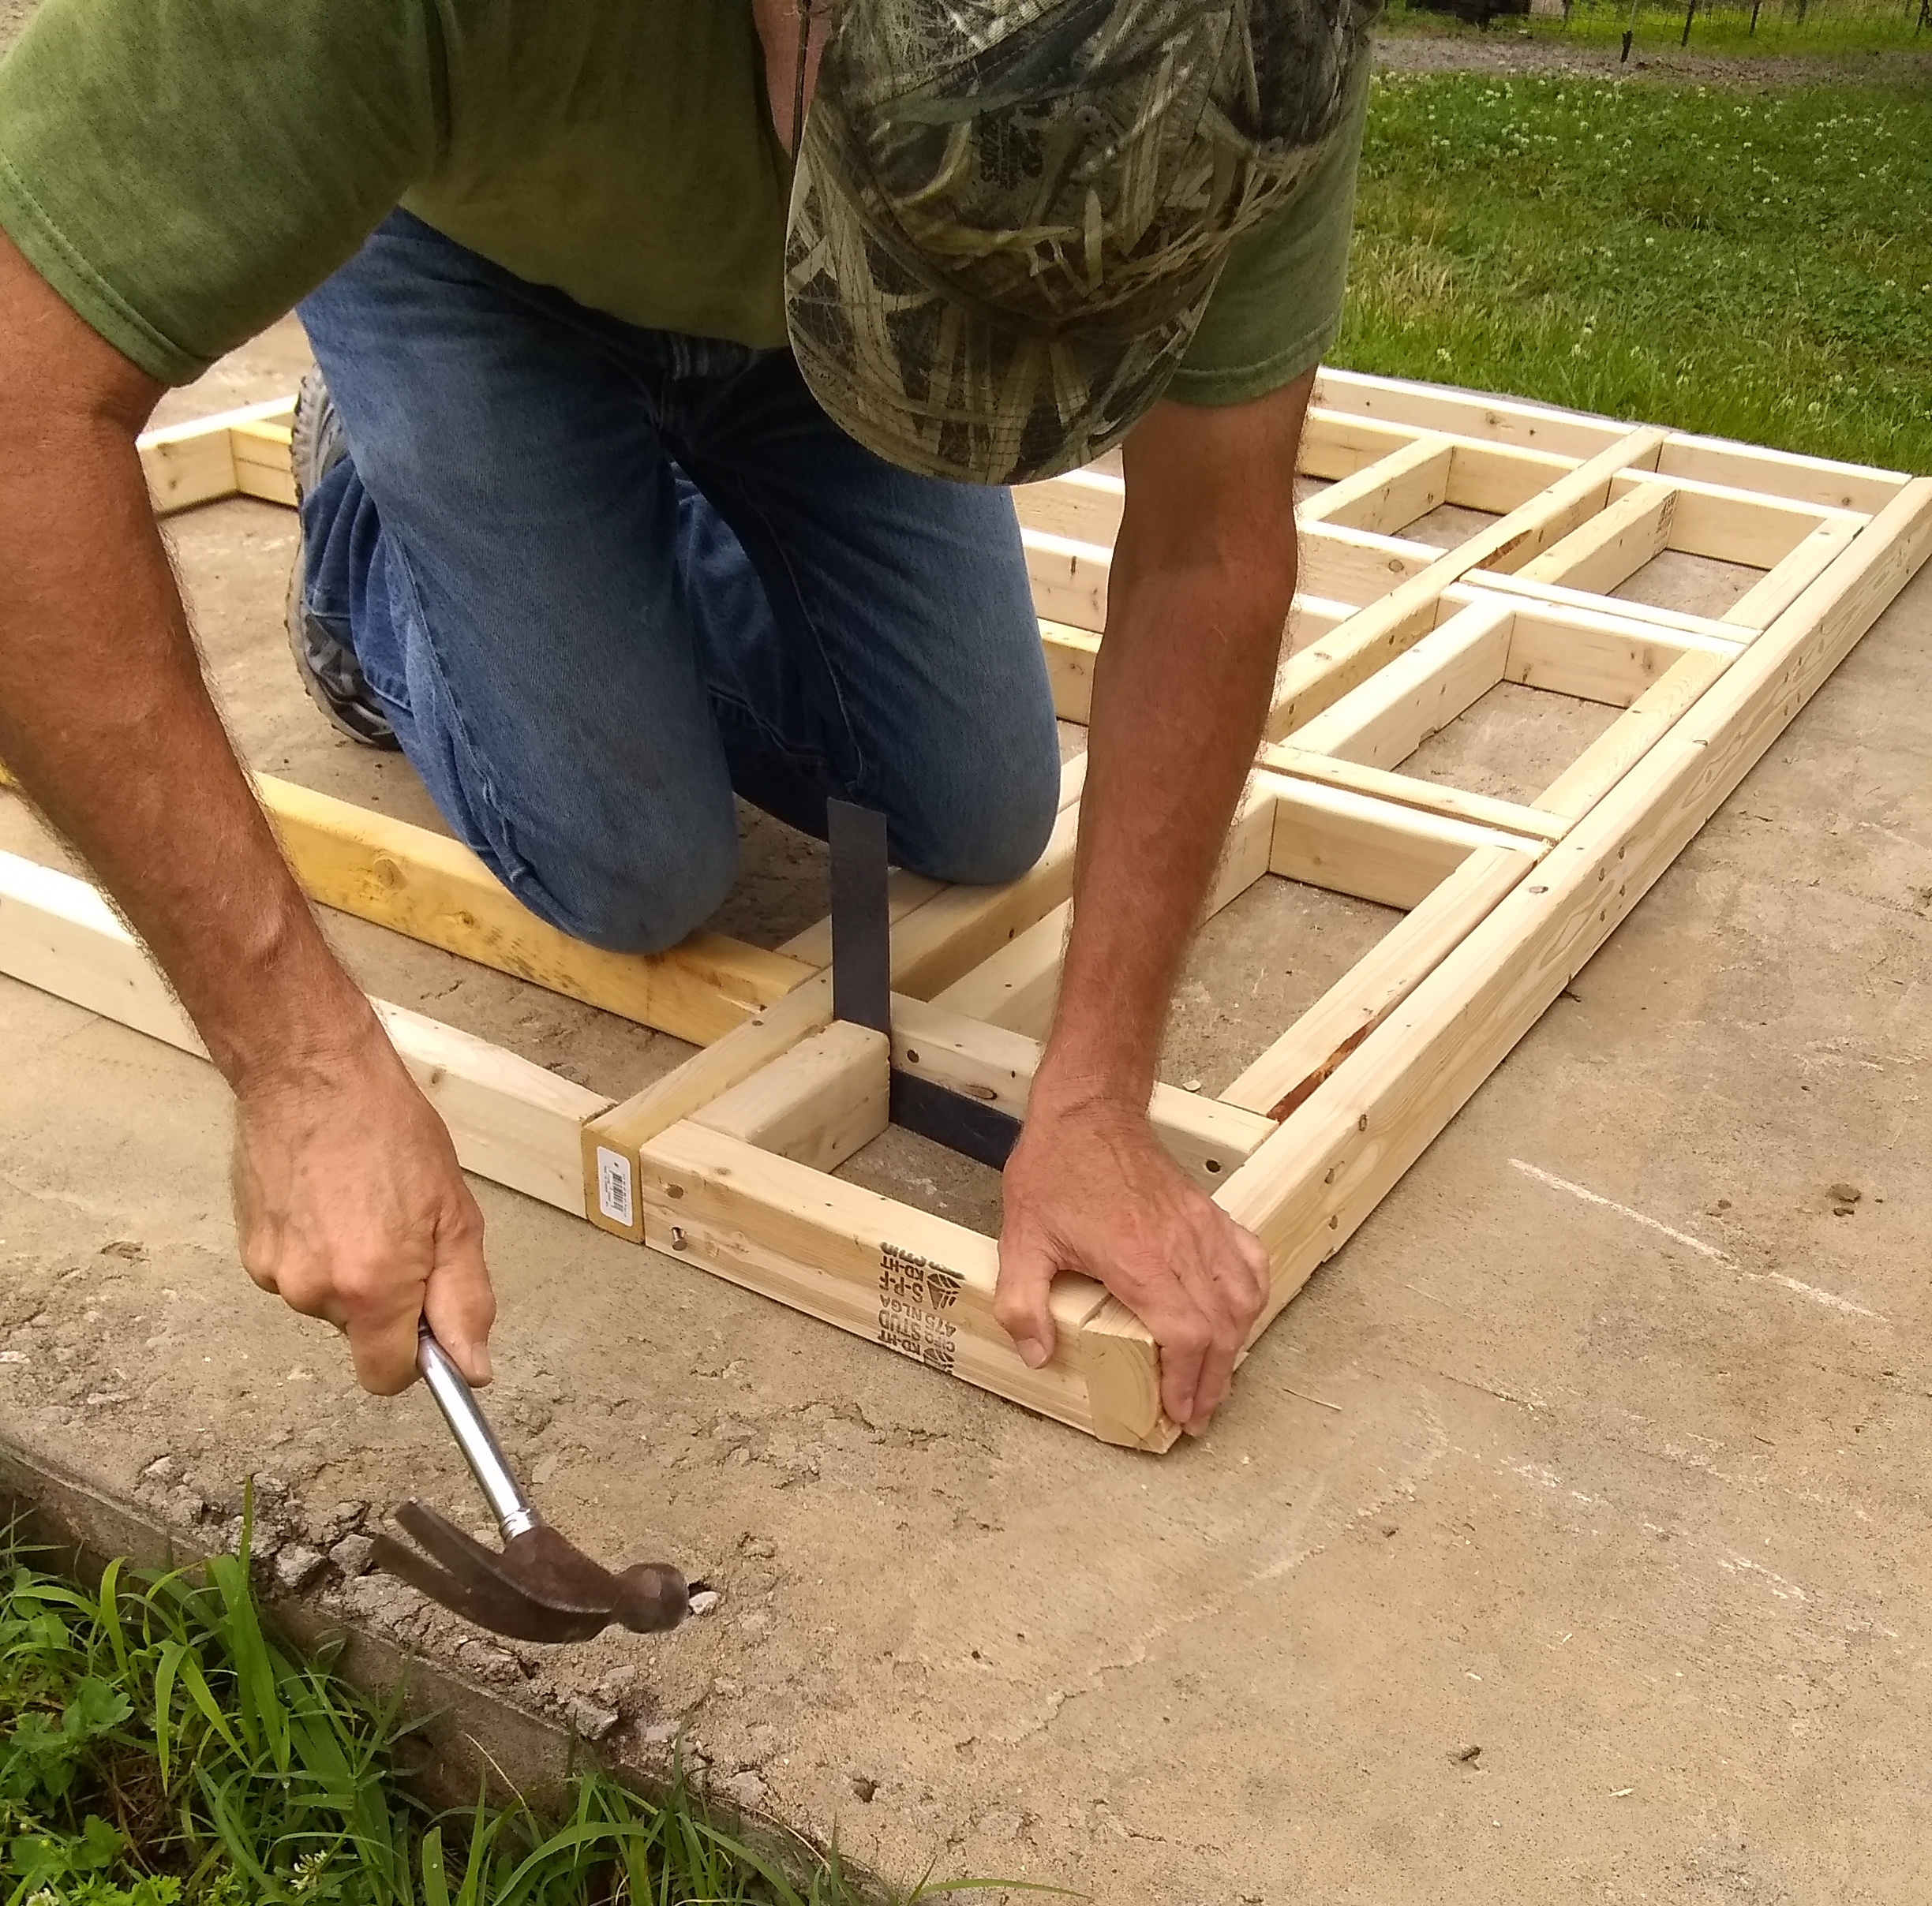
Use Blocking (w/shims) while Toenailing
Note that top plate is aligned
with outside of stud

Slide 19
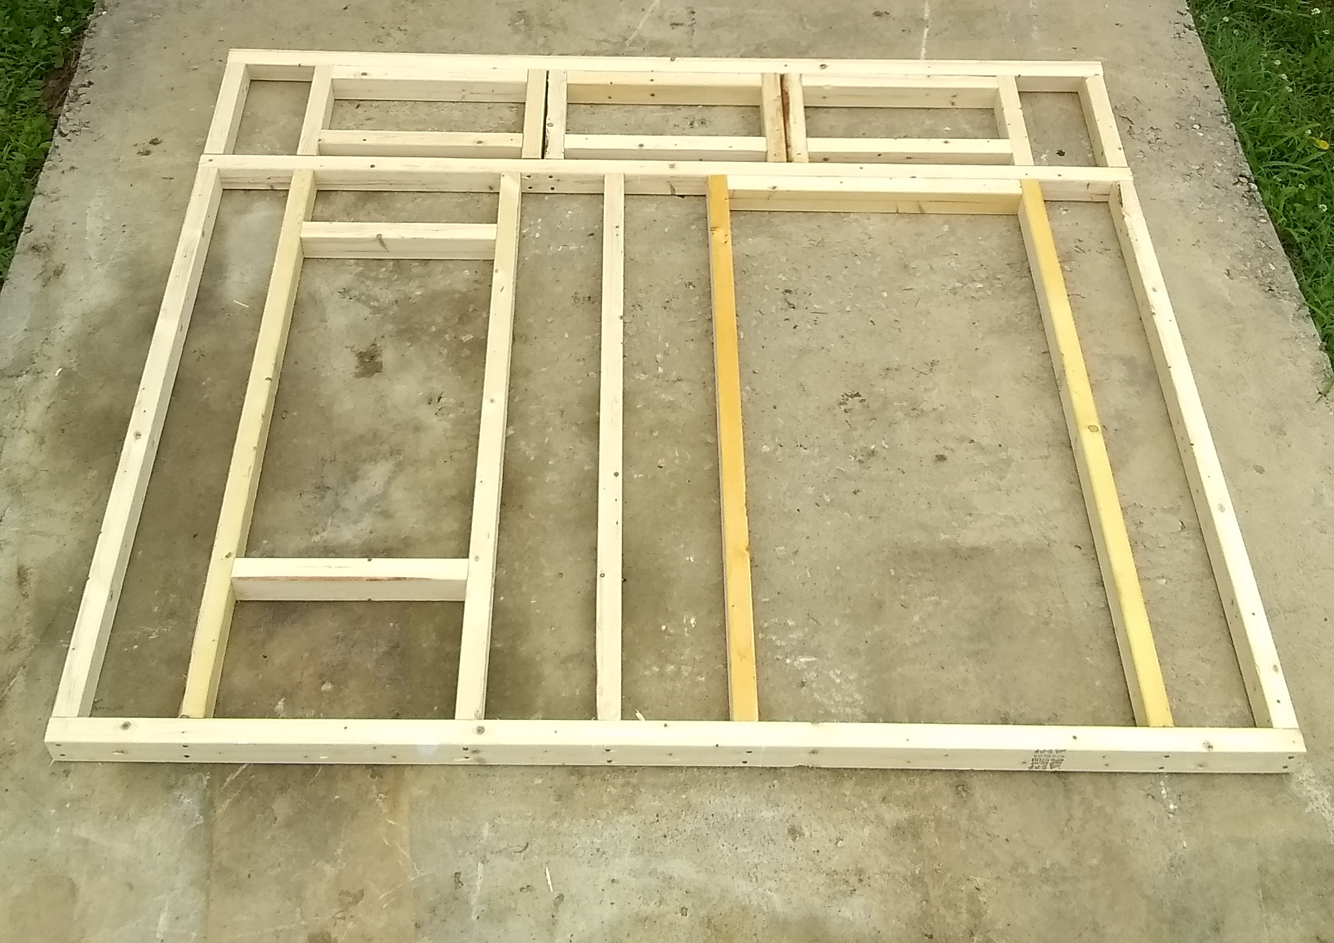
Completed Front Wall Frame

Slide 20
Wall Framing
Continue framing the other walls as shown in the drawings
Attach the window framing components and secure the cripple above the window first when framing the left and right walls as shown below

Slide 21
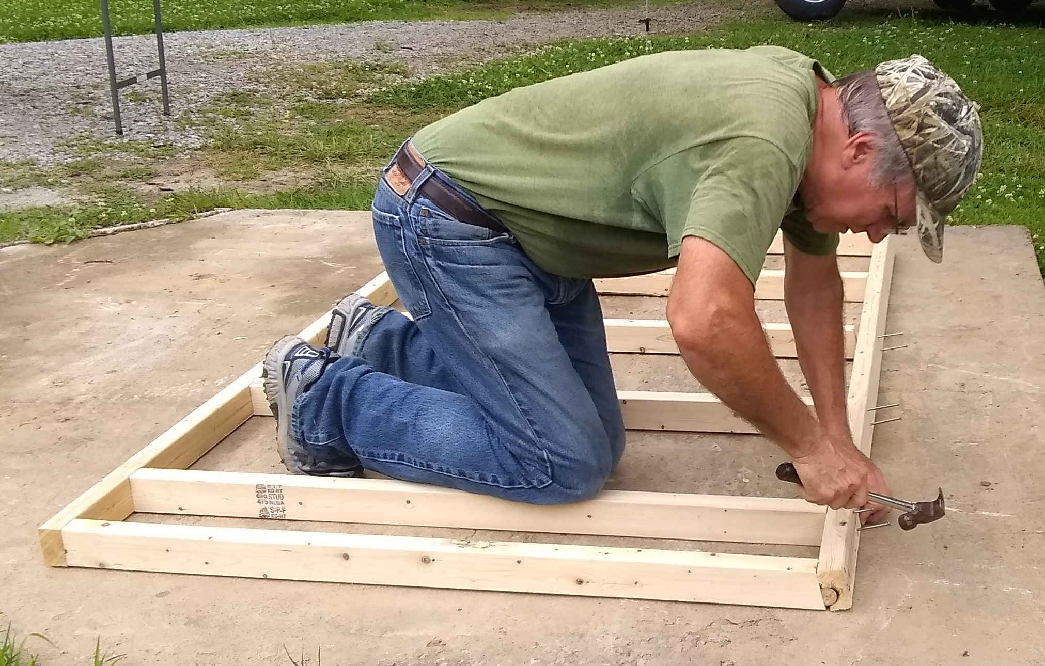
Back Wall Framing
Note that top plate is aligned
with inside of stud

Slide 22
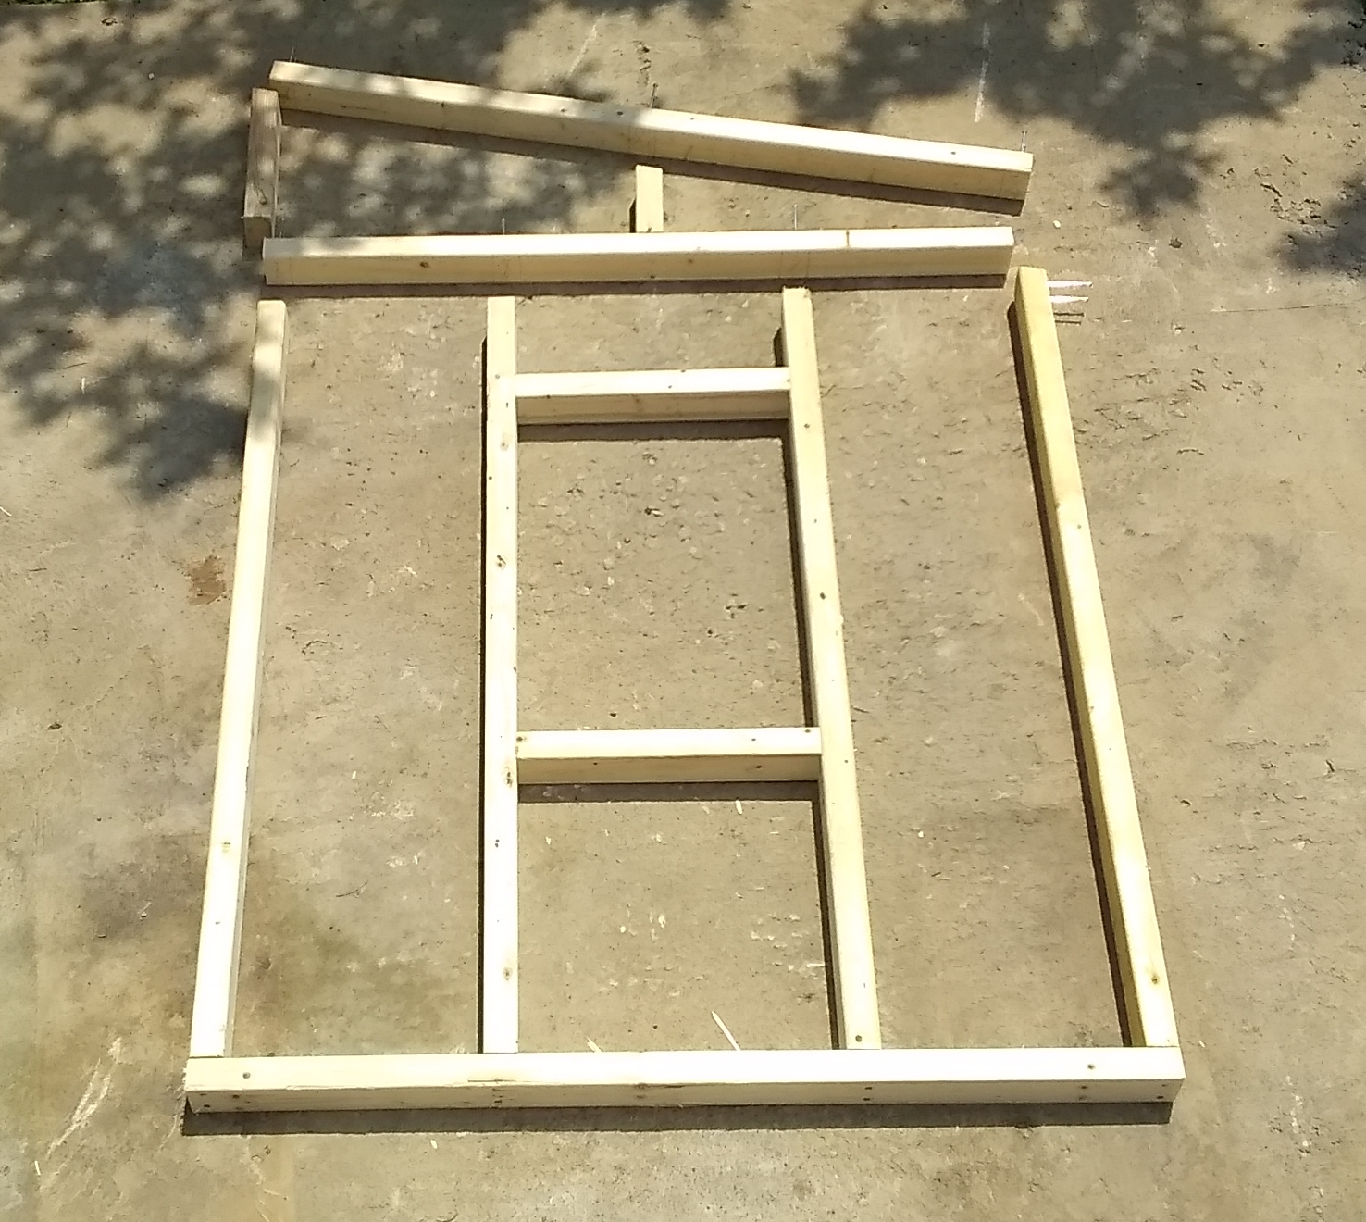
Right Wall Framing
Attach this cripple first

Slide 23
Wall Sheathing – Right and Left
After painting each piece, place the sheathing on top of the framing for each wall
The sheathing should extend 2 7/8” past the framing on the sides and extend 1¼” below the bottom of the frame. See pictures below
First align the bottom plate according to these extension dimensions

Slide 24
Wall Sheathing – Right and Left
To ensure that the framing is square, drive all nails (use 6d, exterior) on the bottom row, then align the upper part of the frame by tapping with a hammer until the siding extends 2 7/8” past the framing on both sides near the top of the wall
Window and door openings should also be aligned
Drive the remaining nails. Note that the nails on the right and left side will be driven into the front and back siding after assembling the four walls

Slide 25
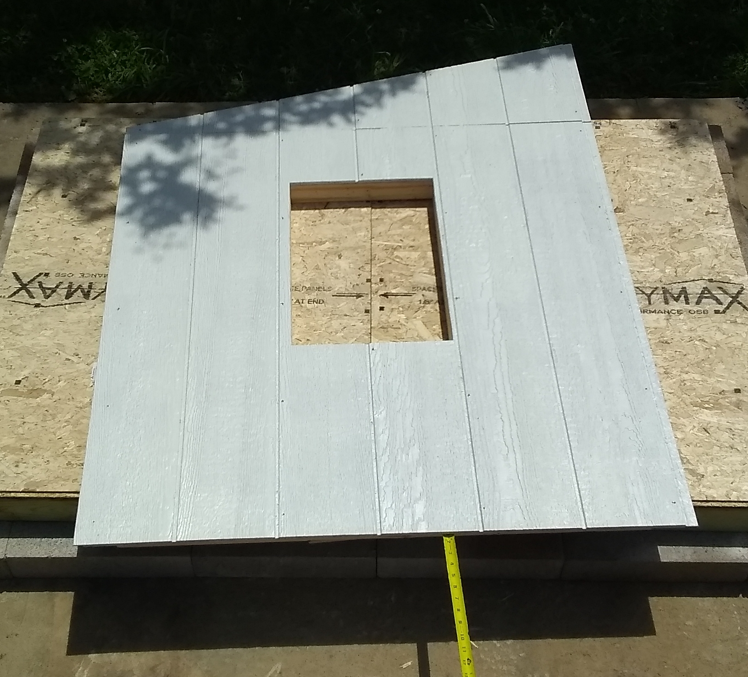
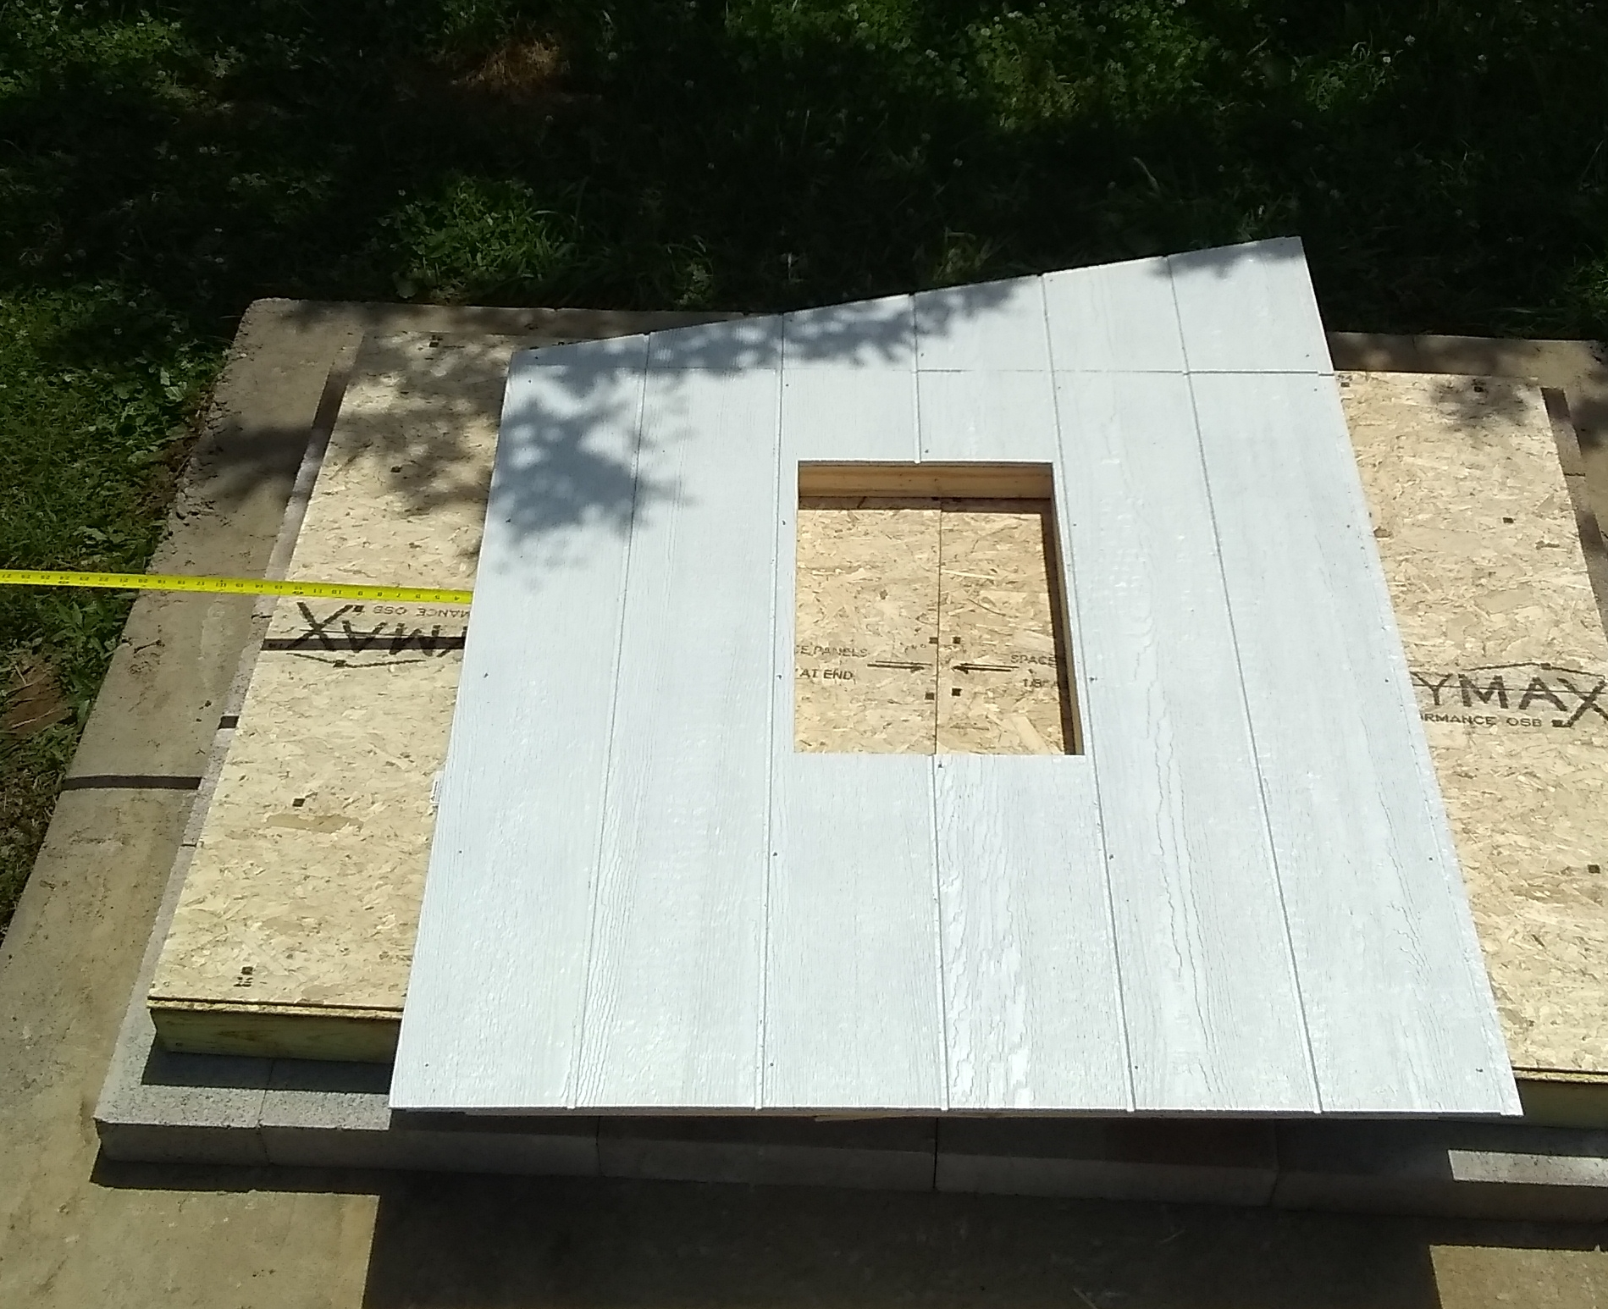
Align Siding with Required Overhang

Slide 26
Wall Sheathing – Front and Back
After painting, place the sheathing on top of the framing for each wall
Check that the ship lap joints are properly aligned
The sheathing should be flush with the framing on the sides and extend 1¼” below the bottom of the frame
To ensure that the framing is square, drive all nails (6d, exterior) on the bottom row, then align the upper part of the frame by tapping with a hammer
Window and door openings should also be aligned
Drive the remaining nails

Slide 27
Wall Erection
Starting with the left and back walls, place the two wall panels on the floor, ensure that the walls are properly aligned and engaged then drive a 10d common nails through the top hole in the back stud on the left wall into the left stud on the back wall. We used a small clamp to hold the walls together while nailing
Add the right wall then the front wall, again driving the top nail through the studs at each joint

Slide 28
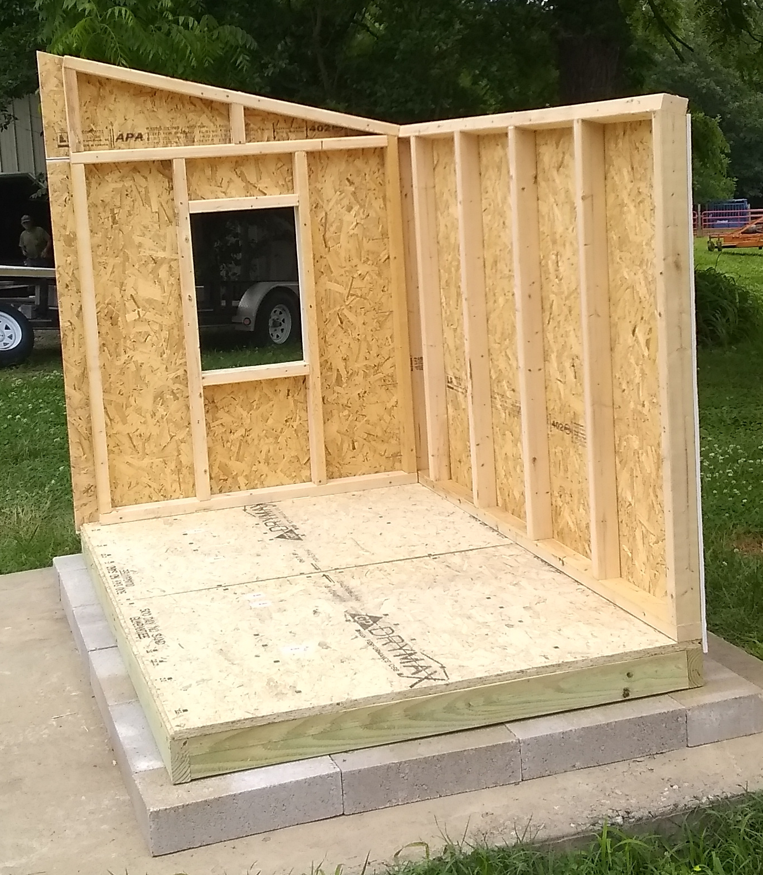
Erect Back and Left Walls

Slide 29
Wall Erection
After ensuring that the bottom of the wall sheathing fits tight against the floor, drive 10d exterior nails through the holes in the bottom plates of all walls into the floor
Drive 10d common nails into the remaining holes in the wall-to-wall connections
Drive 6d exterior nails through the holes in the side wall sheathing into the front and back wall framing

Slide 30
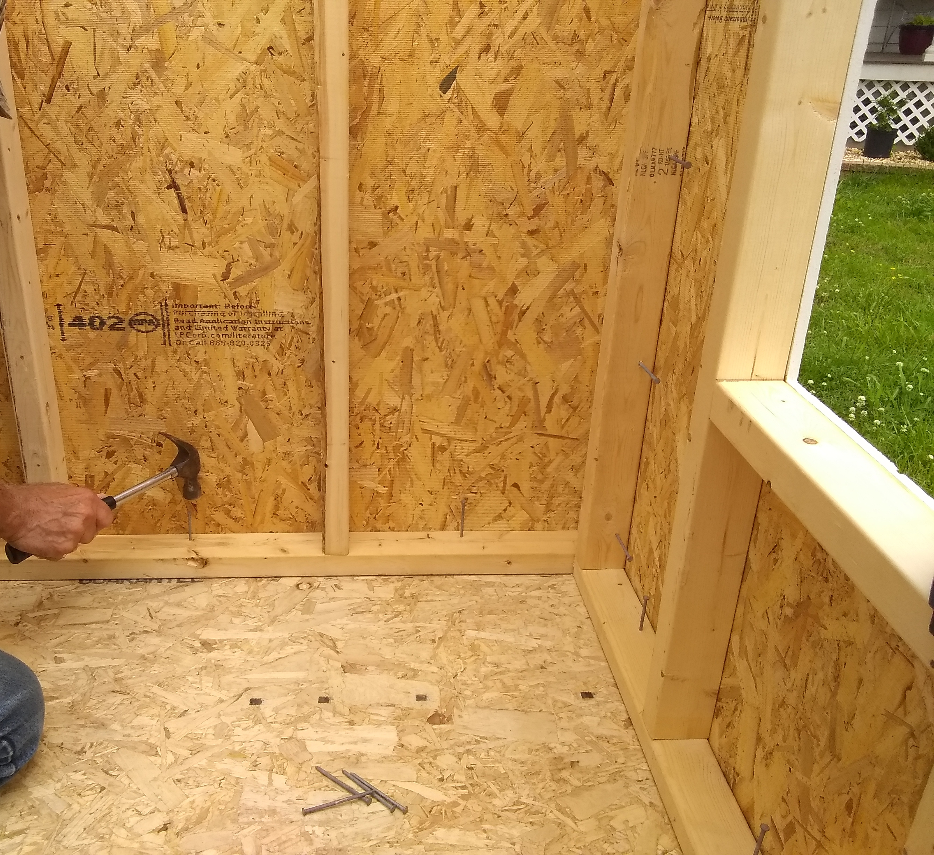
Nail Walls to Floor

Slide 31
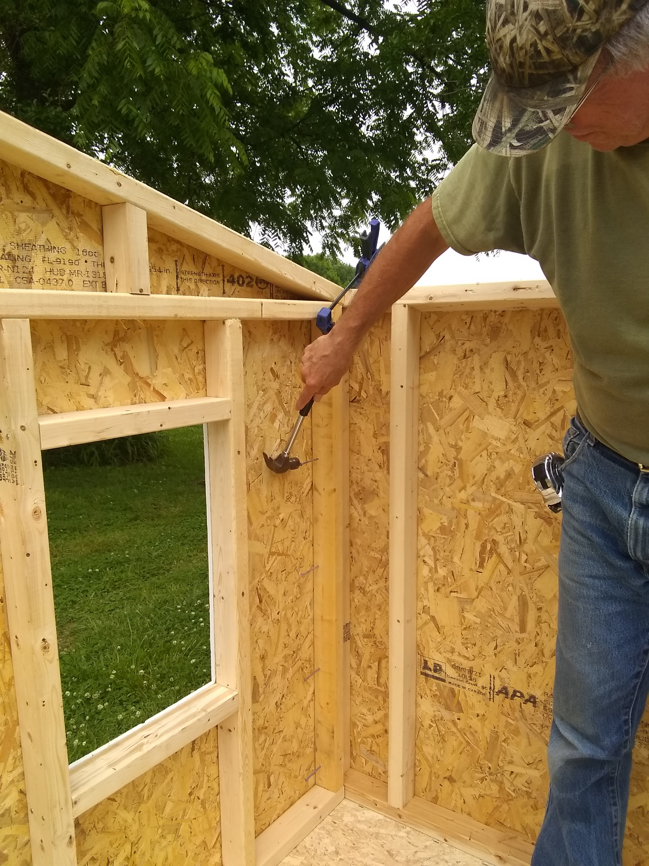
Finish Driving Nails to Secure Walls

Slide 32
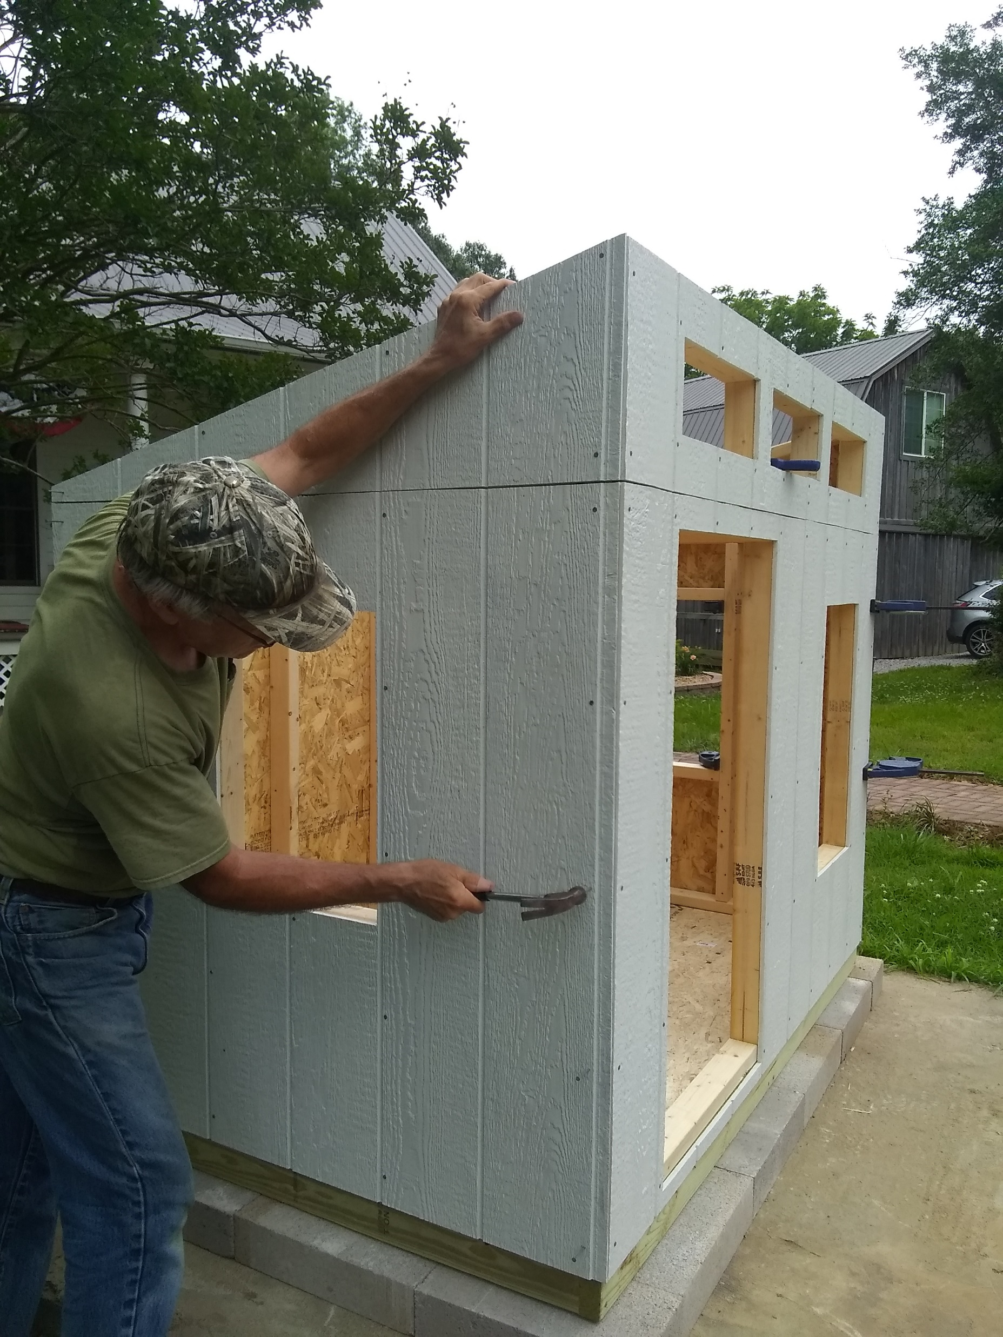
Attach Side Wall Sheathing to Front Wall Frame

Slide 33
Roof
Roof is constructed from two 5’ x 3½’ pieces of T&G floor panel
Paint the top and edges of the roof panels and a 9” border around the underside (eaves)
Preassemble the two pieces with the underside up and attach the 1x2 PVC trim piece using 1¼” screws as shown below. See Figure 22 (Sheet 4)
Remove the trim piece and set each piece in place on the roof after placing a bead of exterior glue in the groove
Reattach the trim to the existing holes and use it to align the roof panel on the assembled wall framing

Slide 34
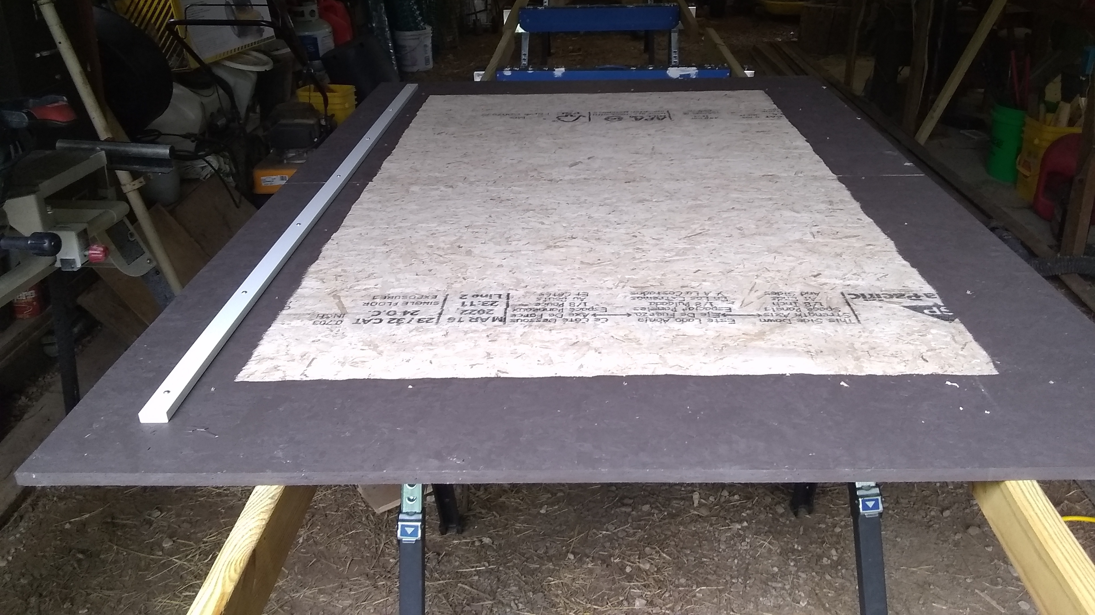
Trim Attached to Underside of Roof

Slide 35
Roof
After ensuring that the 1x2 PVC trim piece is bearing on the siding at the top of the front wall, that the roof is centered over the walls and that the tongue and groove joint are uniformly engaged, drive 8d exterior nails through all holes in the roof into the wall framing

Slide 36
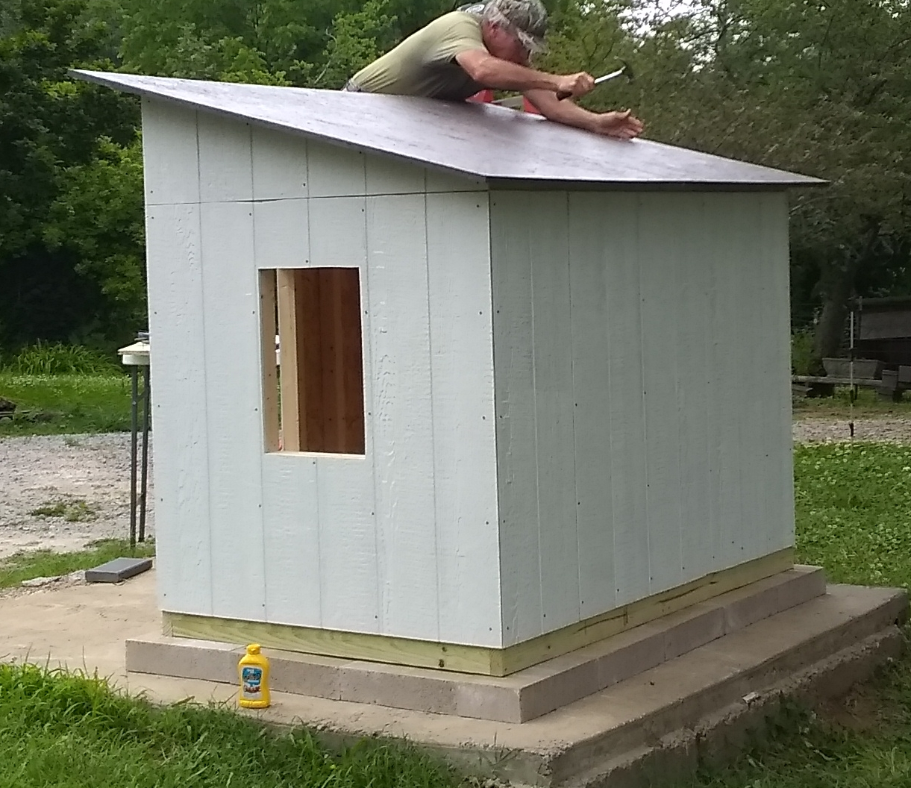
Nail Roof to Walls

Slide 37
Trim
Using a hand saw, cut the 2x3 framing lumber out of the door opening
After painting the trim, glue all pieces in place using an exterior, instant-grab adhesive
We initially cut all door and window trim to the length given in the drawings. It was necessary to shorten many of the pieces in order to fit in the assembled walls. It would be best to complete the fit-up before painting the trim pieces
Fit the other trim pieces to the assembled playhouse and cut to length. Glue these in place
Figures 37 and 38 (Sheet 5) show the location of trim pieces
Touch up the paint, as required

