Slide 1
NAHB Playhouse
Component Fabrication

Slide 2
Component Fabrication
All framing lumber and sheathing should be cut, marked and predrilled before engaging the students
Fabrication can be accomplished by anyone with basic carpentry skills
Depending on experience level, about 8 hours are required to fabricate the components
In some cases, it may be appropriate to engage the students in some of the marking and drilling tasks

Slide 3
Fabrication Tools
Miter saw
Circular saw
Tape measure
Carpenter pencil
Speed square
Drill
Drill bits – 7/64”, 1/8”, 5/32”
4-foot ruler or straight edge
Work gloves
Masks

Slide 4
Material List
21 - 2x3 x 8’
2 - 2x4 x 8’ Pressure Treated
1 - 2x4 x 12’ Pressure Treated
2 - ¾” x 4’x8’ Moisture Resistant T&G Floor Panels
3 - 4’x8’ LP® SmartSide® 3/8 Grooved 8 OC Panel Siding
2 - 1x2 (5/8” x 1 ½” actual) x 8’ PVC trim
3 - 1 ¾” x ¼” x 8’ PVC trim
10 - 1-1/8” x 1-1/8” x 8’ PVC outside corner (nominal 1¼”)
5# - 10d Common Nails
1# - each, 6d, 8d, 10d Galvanized Nails
6 - 1 ¼” screws
15 - 4x8x16 Solid Concrete Blocks
Paint
Adhesive

Slide 5
Component List
The components are shown in Figures 1 (Sheet 1, 2 and 3) of the drawings
Each component is given a letter designation shown on the piece in the drawings
All components and the required quantities are listed below

Slide 6
Floor Components
Designation | Description | Quantity
A | 72” 2x4 PT | 2
B | 45” 2x4 PT | 4
C | 36” x 48” ¾” T&G Flooring | 2
Dt | 60” x 42” ¾” T&G Flooring with tongue | 1
Dg | 60” x 42” ¾” T&G Flooring with groove | 1

Slide 7
Wall Framing Members
Designation | Description | Quantity
E | 72” 2x3 | 5
F | 42 ½” 2x3 | 13
G | 22 ½” 2x3 | 1
H | 14 ½” 2x3 | 6
I | 16” 2x3 | 6
J | 11” 2x3 | 8
K | 45 5/8” 2x3 | 6
L | 43” 2x3 | 2
M | 41 ½” 2x3 | 2
N | 44 3/8” 2x3 | 2
O | 46” 2x3 | 2
P | 5 3/16” 2x3 | 2
Q | 10 3/8” 2x3 | 2

Slide 8
Wall Sheathing Components
Designation | Description | Quantity
R | 16 3/8” x 48” Panel | 1
Sb | 48 ¾” x 48” Panel – Back wall | 1
Sr | 48 ¾” x 48” Panel – Right wall | 1
Sl | 48 ¾” x 48” Panel – Left wall | 1
T | 8 3/8” x 48” Panel | 1
U | 40 3/8” x 48” Panel | 1
V | 32 3/8” x 48” Panel | 1
W | 40 3/8” x 13 5/16” Panel | 1
X | 32 3/8” x 13 5/16” Panel | 1
Y | 48 ¾” x 13 3/8” Triangular Panel – Right wall | 1
Z | 48 ¾” x 13 3/8” Triangular Panel – Left wall | 1

Slide 9
Trim Components
Designation | Description | Quantity
T1 | 6” PVC Outside Corner | 6
T2 | 14 ½” PVC Outside Corner | 6
T3 | 16” PVC Outside Corner | 6
T4 | 21” PVC Outside Corner | 4
T5 | 22 ½” PVC Outside Corner | 2
T6 | 27” PVC Outside Corner | 2
T7 | 44 ½” PVC Outside Corner | 2
T8 | 75 ¾” PVC 1x2 | 1
T9 | 52” PVC 1x2 | 2
T10 | 72” PVC 1 ¾” x ¼” | 2
T11 | 48” PVC 1 ¾” x ¼” | 2
T12 | 50” PVC Outside Corner | 2
T13 | 50” PVC Outside Corner | 2
T14 | 62” PVC Outside Corner | 2
T15 | 62” PVC Outside Corner | 2

Slide 10
Floor Framing Components
Floor framing is constructed from 2x4 pressure treated lumber
Be sure to follow all proper handling instructions when working with treated lumber, e.g.
https:///www.southernpine.com/proper-handling-storage-pressure-treated-lumber/
The cutting plan for the floor framing is shown in Figure 2 (Sheet 1)
Figure 3 (Sheet 1) shows the required markings on the 6’ stringers. Two holes should be drilled at each “X” as shown in Figure 3a

Slide 11
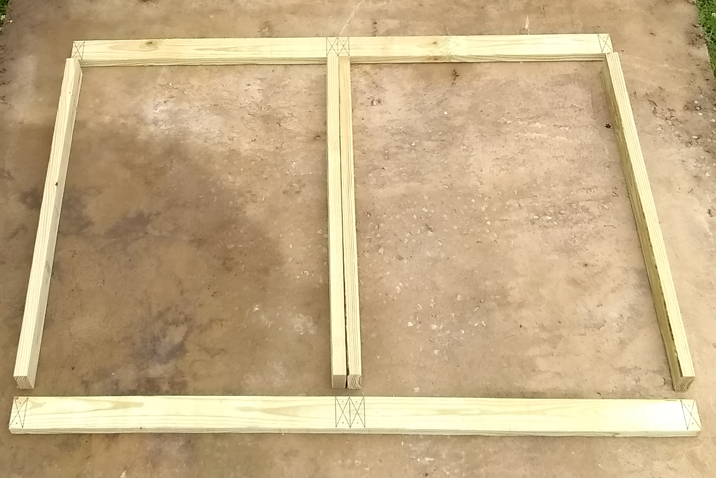
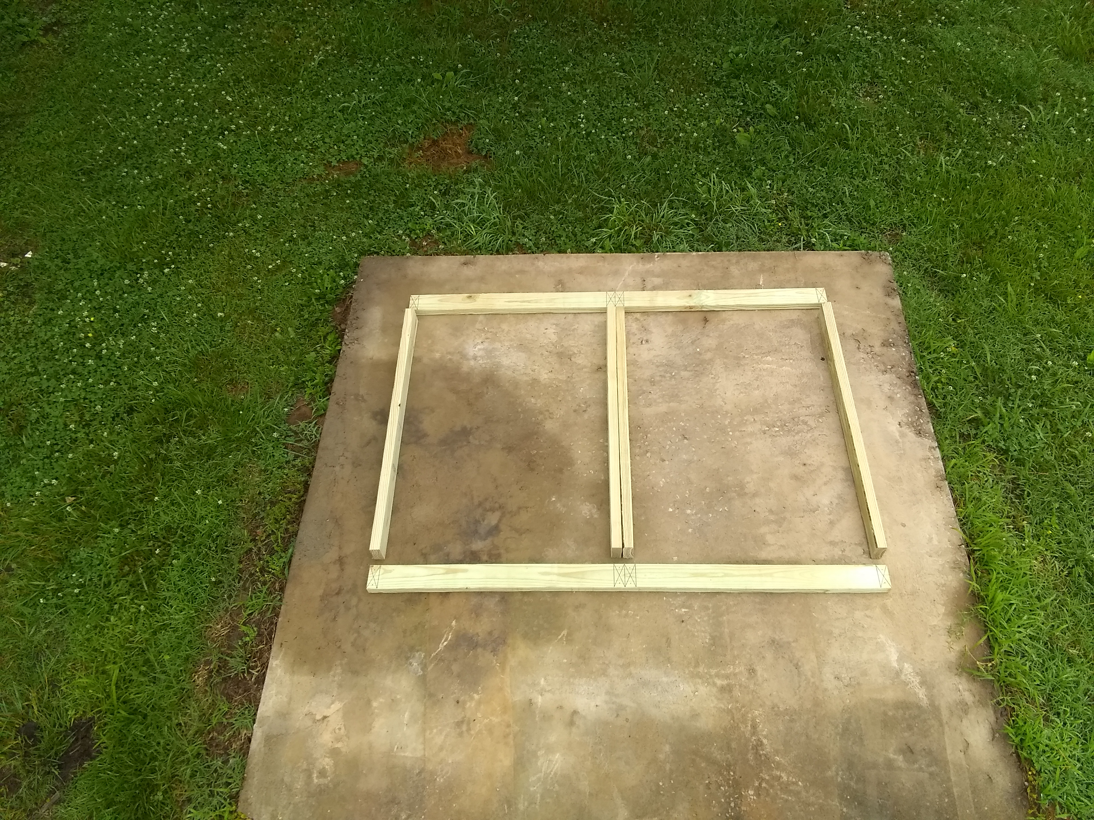
Floor Framing Prepared for Assembly
Stringers
Joists

Slide 12
Wall Framing Components
The framing for the four walls will be constructed from 2x3 stud lumber
The cutting plan shown in Figure 5 (Sheet 2) uses only commonly available 8-foot lengths
Marking and drilling plans in Figures 6 (Sheets 5 and 6) give details on the location of adjoining members
Some of the connections will require toe nailing. A 45° hole should be drilled in the primary members for each nail, as shown

Slide 13
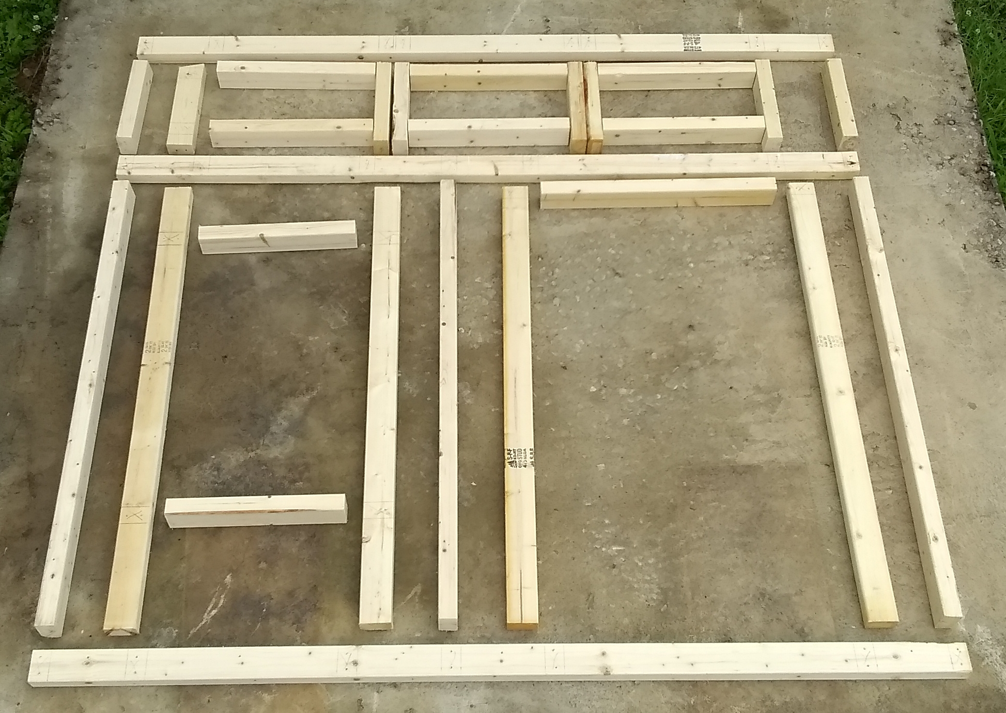
Front Wall Framing Prepared for Assembly

Slide 14
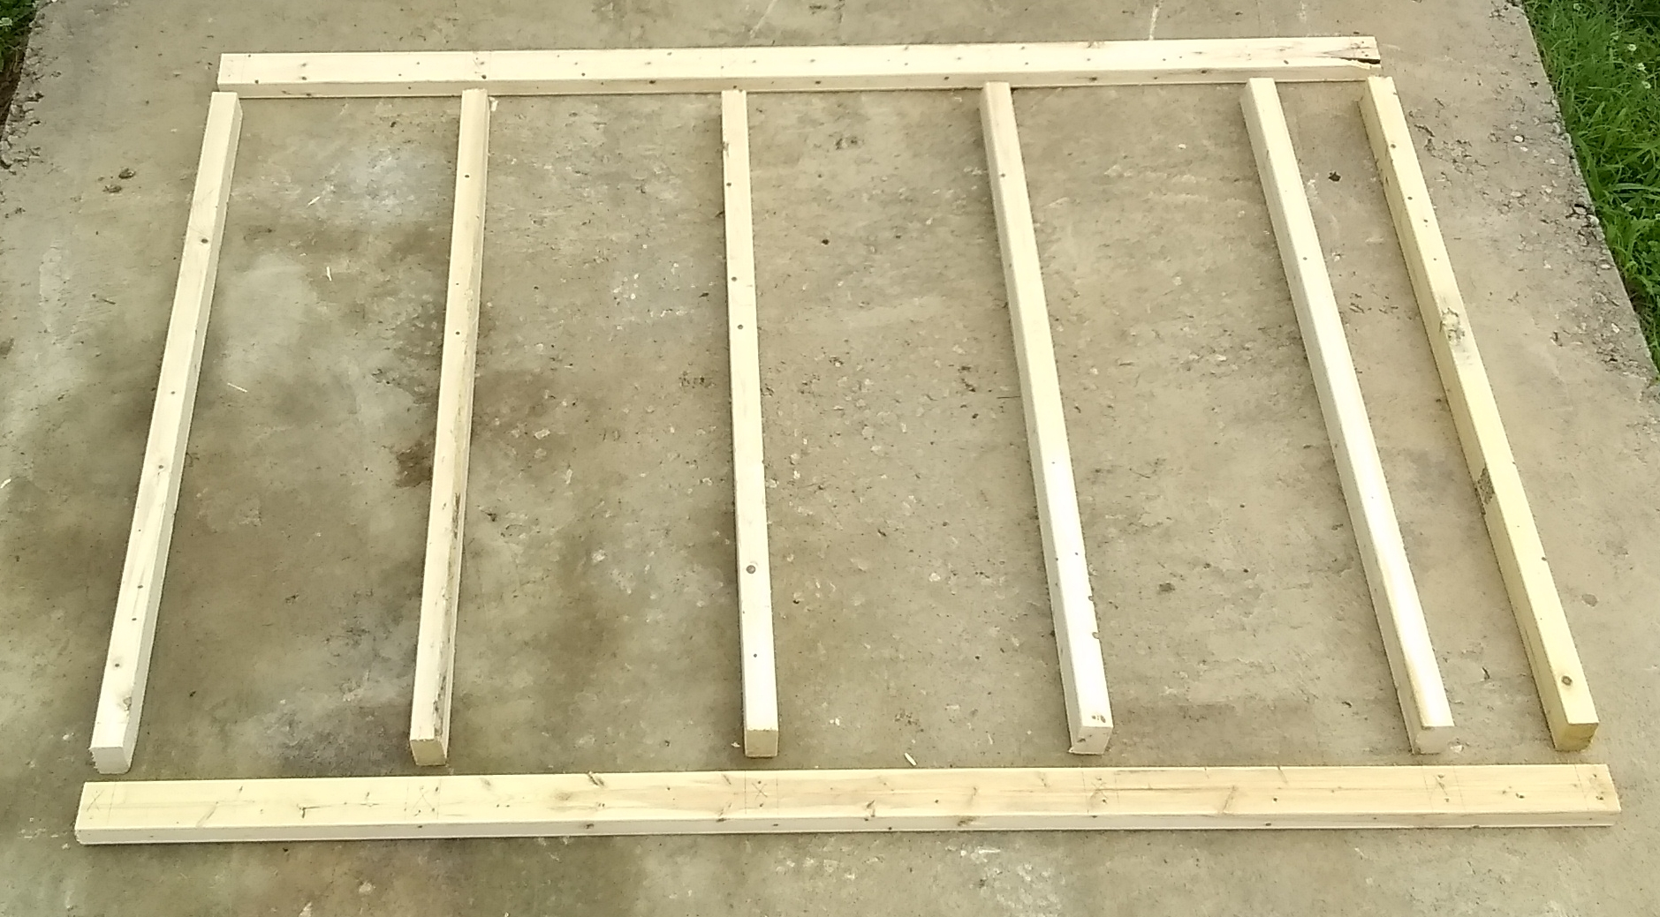
Back Wall Framing Prepared for Assembly

Slide 15
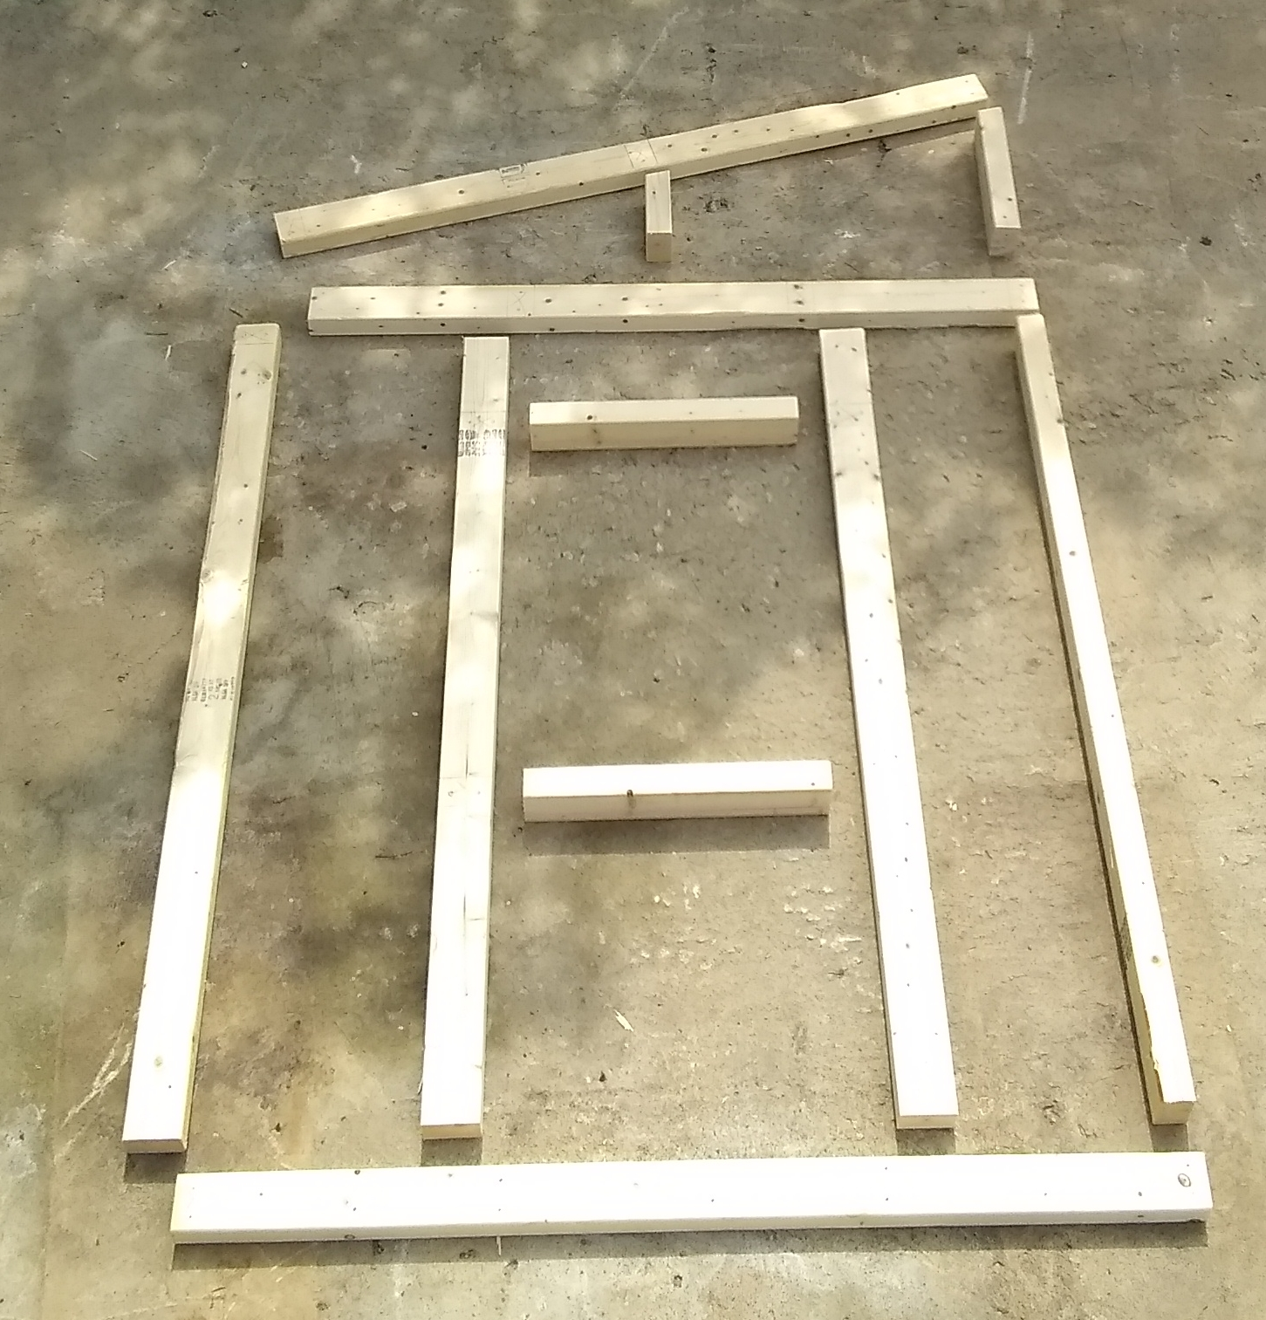
Left Wall Framing Prepared for Assembly

Slide 16
Floor and Roof Sheathing
The floor and roof sheathing are constructed from ¾” tongue and groove (T&G) flooring. We recommend a product with a 500-day, no-sand guarantee
The two pieces for the floor will be identical, but the roof will have a T&G joint, so one piece must retain the tongue and the other the groove
Cutting as shown in Figure 8 (Sheet 1) will allow two factory-cut edges to butt at the middle of the floor
Figures 9 and 10 (Sheet 4) are the drilling plans

Slide 17
Wall Siding Components
The three, 4’x8’ siding panels will all be cut into 4’x4’ pieces
The front and side walls will be sheathed with a 4’ tall piece at the bottom and a smaller (rectangular or triangular) piece above
Siding will be aligned with the studs so that the nails will, generally, be placed 3/8” from the edge of the vertical grooves in the panels
Rectangular holes will be cut for the door and 6 windows

Slide 18
Wall Siding Components
The panels on the front and back walls were designed so that the 4-foot shiplap joint on the front wall is full length and not interrupted by the door or window
Two partial 4’-tall pieces are used on the front wall
The remainder of these two pieces and another full 4’ piece is used on the back wall
The cutting plan for the wall sheathing on the front and back walls is shown in Figure 11 (Sheet 3). Note that the groove lines were removed for clarity

Slide 19
Wall Siding Components
Each side wall will use the full width of one sheet which includes an extra ¾” shiplap for a total 48 ¾” width. The bottom of the shiplap with be on the front of the playhouse on both side walls
The top portions of the front and side walls will be cut from one 4’ piece of siding as shown in Figure 12 (Sheet 3)
Figures 13 (Sheet 7) are drilling plans for the wall sheathing

Slide 20
Door/Window/Corner Trim Components
The outside edge of door and window openings and the corners of the playhouse will be trimmed with 1¼” PVC outside corner
Figure 14a (Sheet 2) is the cutting plan for these trim components
Both ends of the door and window trim are miter cut at 45°. The dimension is given to the point that contacts the inside corner of the opening. Mark the inside surface at these points and carefully align the saw blade with the mark
Some custom trimming may be required to fit these components in place

Slide 21
Door/Window/Corner Trim Components
  Note that only a couple of dimensions are given in the cutting plan (Figure 14a) for clarity. Leave 2” between the marks on adjacent trim pieces. The 22” and 24” dimensions given indicate this. The 2 inches allows room for the miter cuts with minimal waste.

Slide 22
Door/Window/Corner Trim Components
Approximate lengths are given for the four corner trim pieces. The 14° angle should be cut near the end of the trim piece after the other pieces are cut. These are labeled Back Corner Trim and Front Corner Trim in Figure 14a. Note that the orientation of the trim piece in the miter saw is different for each of these.
After the playhouse is assembled, mark the square end of these pieces in place and make the final cut to length

Slide 23
Other Trim Components
The joint at the top of the 4’-tall siding panel on the front and side walls is covered with 1¾” x ¼” PVC
The same material is used to cover the exposed 2x3 at the top of the back wall
The top of the front and side walls are trimmed with 1x2 PVC
The front edge of the roof is covered with 1¼” PVC outside corner

Slide 24
Other Trim Components
The cutting plan for these pieces is given in Figure 14b (Sheet 1)
The lengths shown in Figure 1e (Sheet 1) are slightly longer than will be required
After the playhouse is assembled, mark the actual length on these pieces and make the final cut to length

