Slide 1
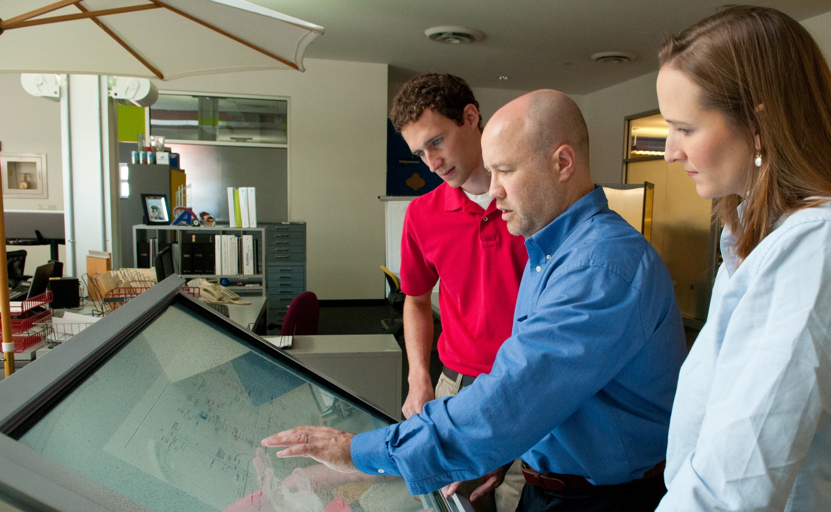


Webinar

Slide 2

^{Goal:}
For employers, educators and communities to come together across regions and create cutting edge programs to provide students and adults the skills demanded by employers in Kentucky’s priority sectors.

Slide 3
^{What this means:}
Led by skill demands of employer-partners
High school and post-secondary elements required
Focused on Kentucky’s priority sectors
(Kentucky Workforce Innovation Board)
Data and metrics (we can help)
Seeking greatest leveraging of state funds

Slide 4
^{Priority Industry} ^{Sectors:}
Advanced Manufacturing
Health Science
Transportation & Logistics
Business & IT Service
Construction & Trades

Slide 5

^{Eligible projects include:}
construction and equipping of a new facility for the purpose of providing workforce training and education,
renovation or upgrade of an existing facility, and
purchase of new or upgraded equipment, software and furnishings.

Slide 6
^{Applicant Partnerships}
Eligible applicants are public-private partnerships which shall include:
private sector employers,
high schools or secondary technical schools, and
postsecondary institutions.
Applicants are encouraged to include broad partnerships, potentially also including:
  local elected officials,
  workforce development boards, and
  economic development agencies.
  Partners should collaborate on a project designed to provide the necessary facilities, equipment, programs and curriculum to train and educate workers to meet the regional workforce needs of Kentucky’s employers now and in the future.

Slide 7
^{Eligible Costs and Funding}
Work Ready Skills Initiative proposals should create, maintain and promote higher wage and sustainable career opportunities.
Work Ready Skills Initiative funds must be matched with at least 10% local investment in the project. Substantially higher levels of local investment are expected except in hardship areas.
A public scoring matrix will provide additional points for projects with higher levels of local investment.
Scoring matrix will also provide additional points for facilities training high school students by day in dual credit courses and adults by night.

Slide 8
^{Eligible costs include:}
land acquisition,
facility acquisition, design, construction, expansion, improvements and renovation,
Industry relevant equipment and furnishings, and
marketing expenses for the first year of the project.
A partner public educational institution will be the owner of the facilities and equipment associated with the project.
Parties responsible for future maintenance and support of project operations will need to demonstrate financial and operational capability.

Slide 9
^{The Process & Timeline}
A new application period will occur every 6 months when funding is available.
Applications will include a pre-application screening prior to the submission of a full application.
A nine-member committee will publically score each proposed application and determine the compatibility of each pre-application in relation to the goals of the Work Ready Skills Initiative.

Slide 10
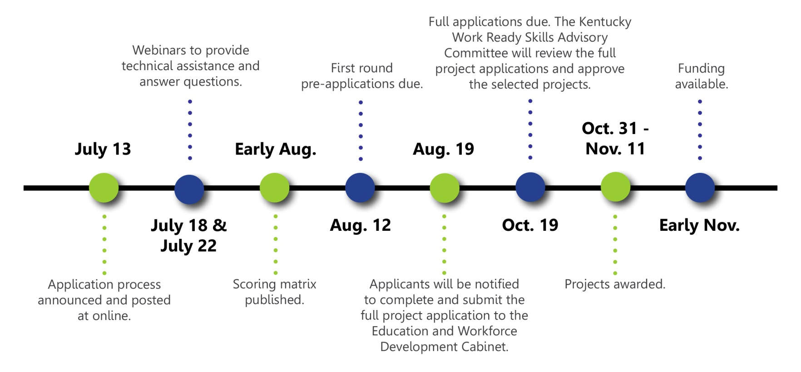
The timeline for the initial round of applications and awards will be:

Slide 11
Additional Details:
An agreement will be negotiated between the applicant and the Education and Workforce Development Cabinet, including all negotiated terms, conditions and requirements.
Funds will be released on a monthly basis as costs are incurred and after local investment has been made.
Annual reporting of metrics identified in the agreement will be submitted to the Education & Workforce Development Cabinet.
Additional application rounds will be announced by the Work Ready Skills Advisory Committee.

Slide 12
^{To learn more, contact:}
^{ANDY HIGHTOWER}
^{workreadyskills@ky.gov}
⁵⁰²⁻⁵⁶⁴⁻⁰³⁷²
http://EWDC.ky.gov/KY-Work-Ready-Skills

