Slide 1
THE COST OF BUILDING A HOME

Slide 2
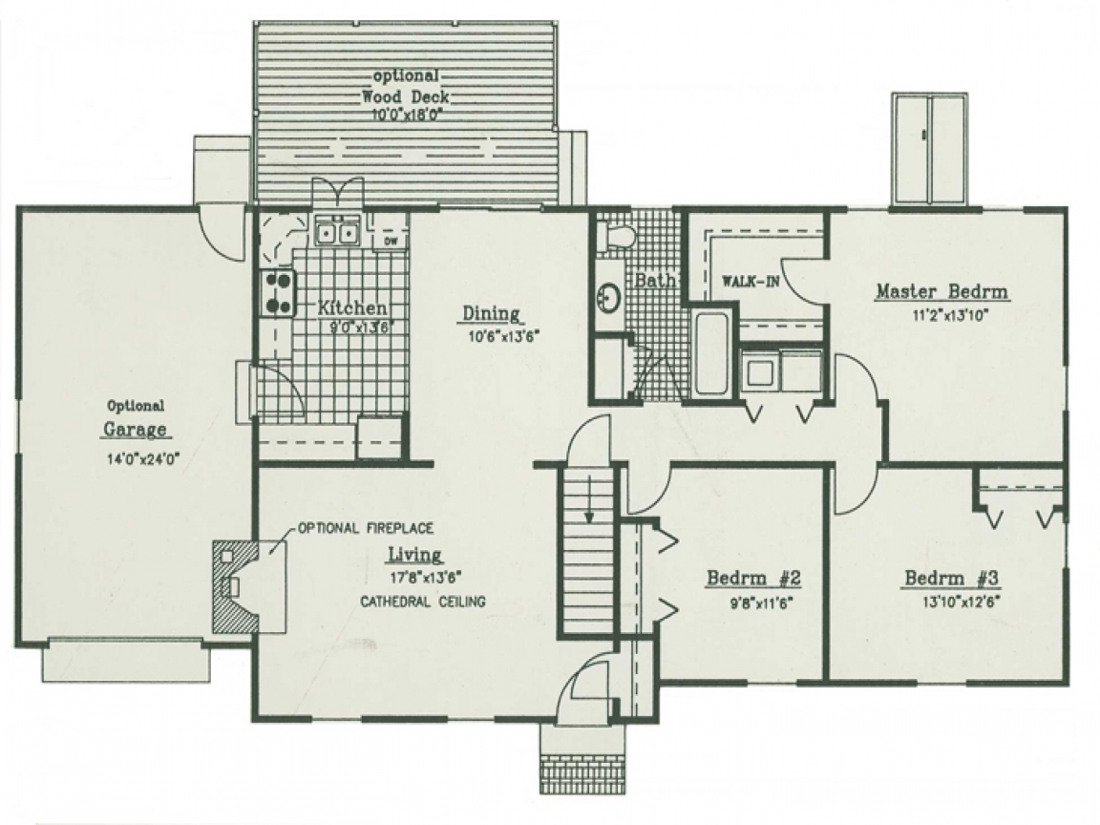
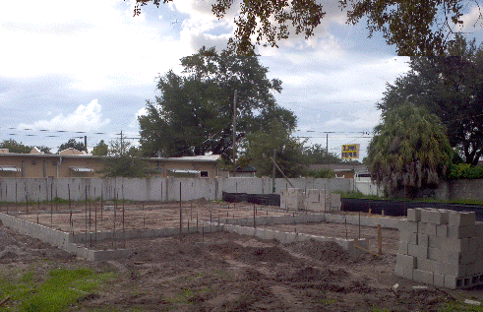
PROCESS
START WITH PLANS
THEN WORK FROM THE GROUND-UP, AND OUTSIDE-IN

Slide 3
ROLES IN CONSTRUCTION
Architect/Engineer
Estimator
Project Manager
Trade Partner
Design the home’s appearance and make sure that it will stand
Uses the plans to determines how much it will cost
Manages the construction process (ensures it finishes on time and budget)
The ones who actually build the house (sub-contractors)

Slide 4

MATH THAT WE USE EVERYDAY
Area = L x W
Volume = L x W x H
Total Price= L x W x (Price per Square Foot)
Let’s Review

Slide 5
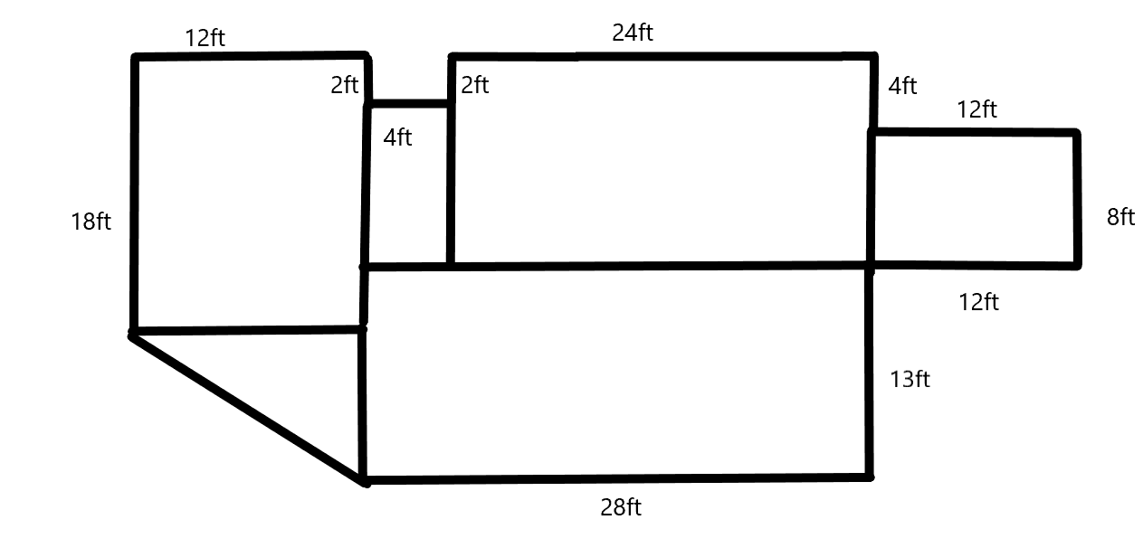
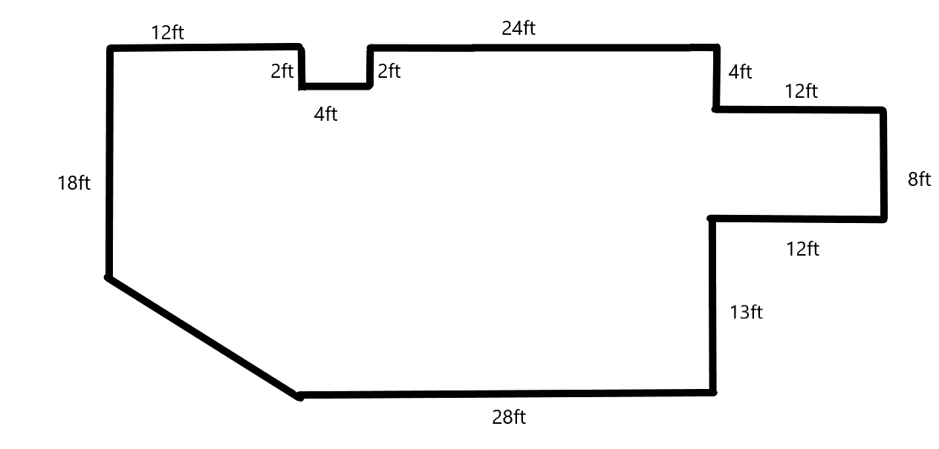
AREA REVIEW
288 sf
216 sf
40 sf
96 sf
42 sf
364 sf
Total = 1046 sf

Slide 6
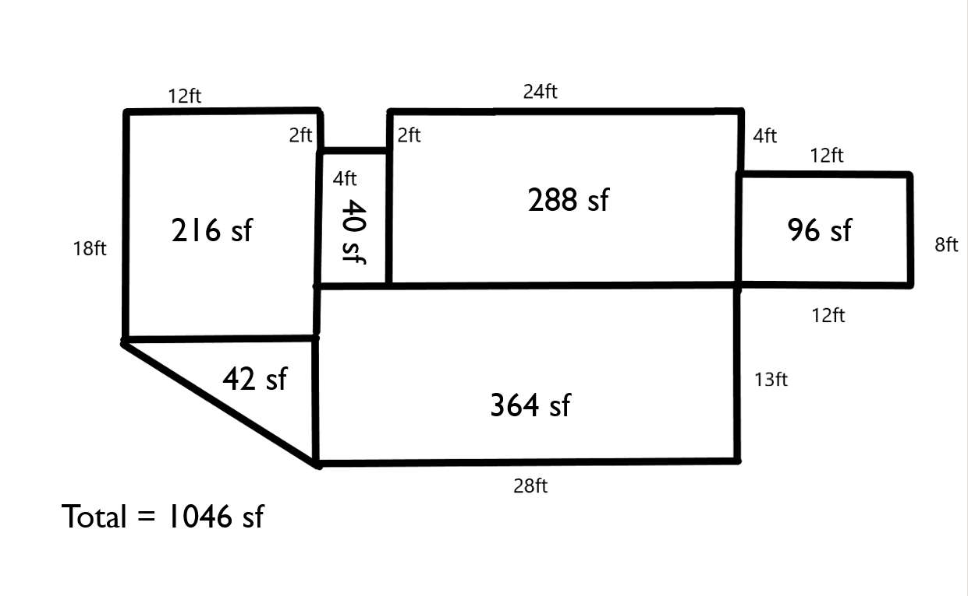
ADDING PRICE TO THE EQUATION
Bathroom
Bedroom
Kitchen = $150 per SF
Bedroom = $75 per SF
Bathroom = $125 per SF
Living Area = $75 per SF
Kitchen
Bedroom
Living Area
Bathroom
Total Cost = $104,150
$99.50 dollars per SF

Slide 7
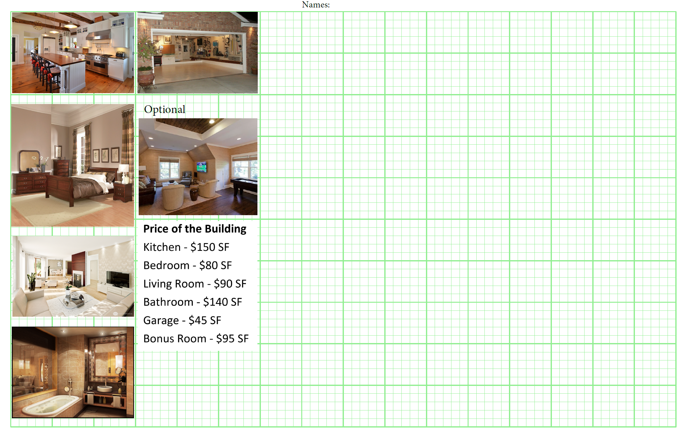
ACTIVITY
Designing and Estimating your own house

Slide 8
ACTIVITY
  1800 SF to 2500 SF (each large square = 100sf)
  Minimum 2 bathrooms (at least 7’ x 10’)
  Minimum 3 bedrooms (at least 10’ by 10’)
  Must also have a kitchen and living area
  Other rooms are optional and cost the same as the living area.
  A garage is also required, but is not counted as part of the home’s SF, a garge should be at least 400sf
  Once your house is finished, figure out the cost based on the information provided in the worksheet.

Slide 9
WHAT DRIVES COST
IN OUR EXAMPLE
IN REAL LIFE
Size of the Kitchen
Number of Bathrooms
Overall size of the house
Type of finishes
Size of the lot (and area of town)
All of the elements in our example

Slide 10
CONCLUSION
None of your houses ended up the same
There were 11,800,000 homes started in 2017
There was 1.3 Trillion spent on construction in 2017
7,000,000 people work in construction ~ 6% of the work force
Opportunities are awesome!

