Slide 1
Why am I here today?
Home Utility Expenses

Slide 2

Home Utilities
What are utilities?
  What utilities do you have at home?
What is an expense?

Slide 3
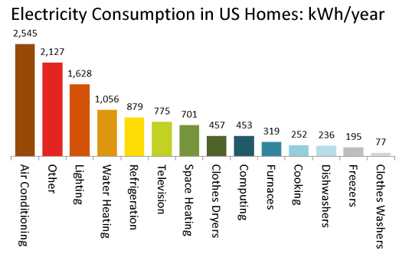
Electricity
What uses electricity in your home?
  Heating and Cooling
  Appliances
  Lighting
Homes account for 37% of electric use in the USA

Slide 4
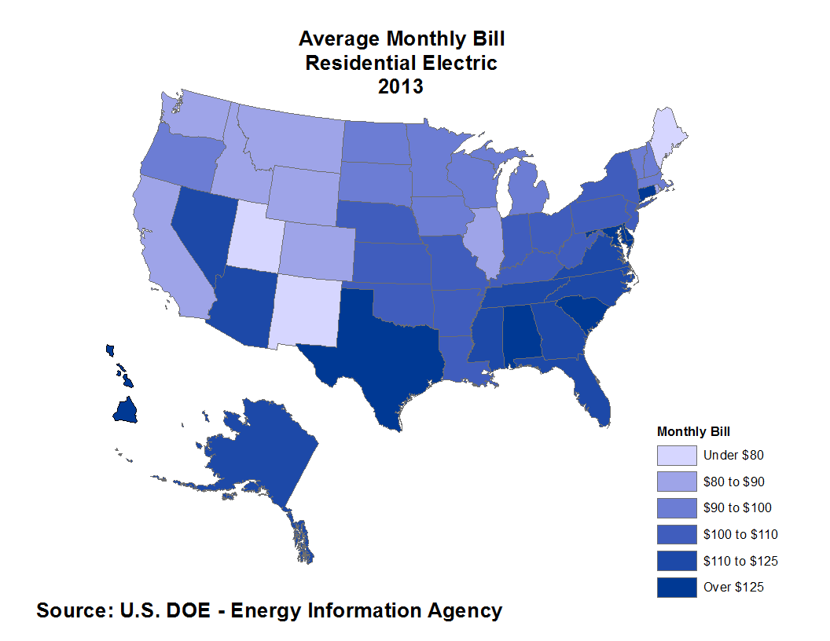
Electricity
Average electrical expense is $110/month
What are some ways to use less electricity?
  Smart Thermostats
  Improved Insulation
  Keeping lights Off
  Fix Duct and Space Leakage

Slide 5
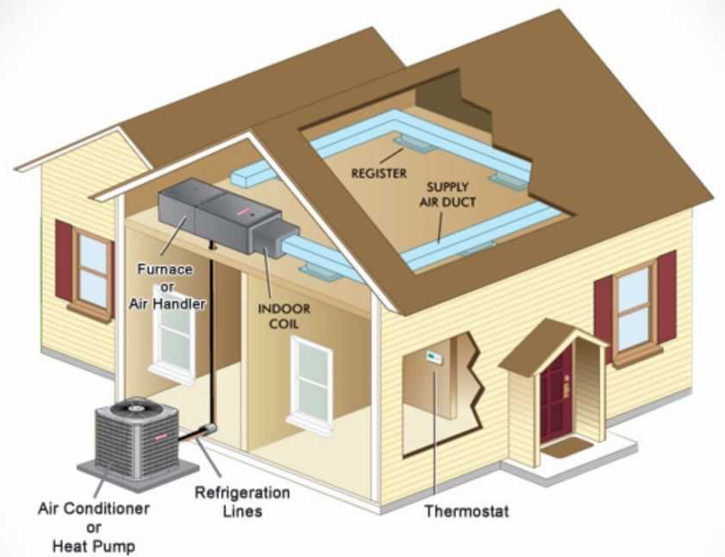
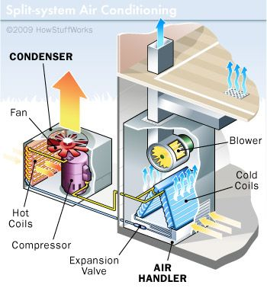
Electricity
Does anyone know how most air conditioners or heaters in a home works?

Slide 6
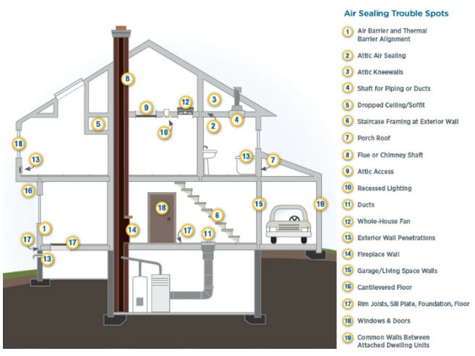
Electricity
Air Leakage: When your conditioned air seeps out of your home through small openings.
Where would air leaks occur?
What could be a way to reduce air leaks?

Slide 7
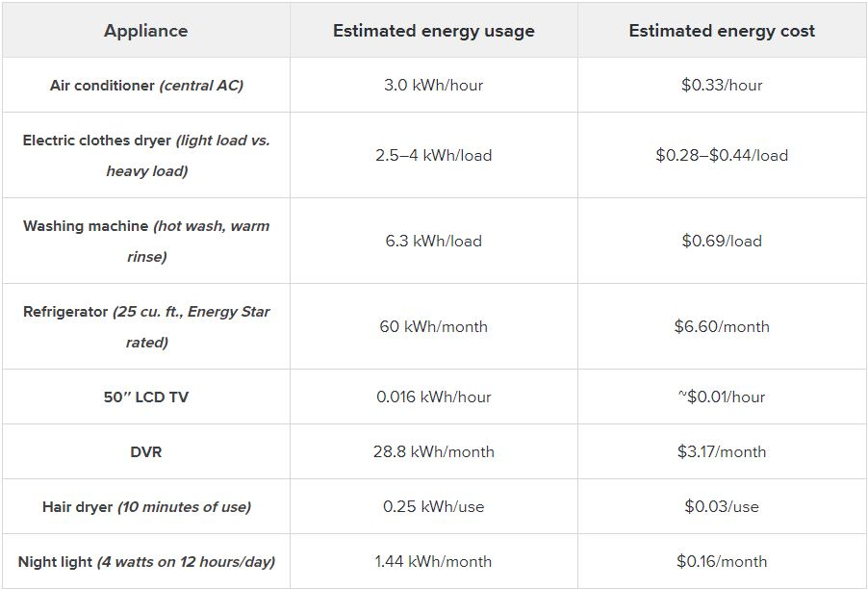
Electricity
Use this table to answer question 1 on your worksheet.

Slide 8
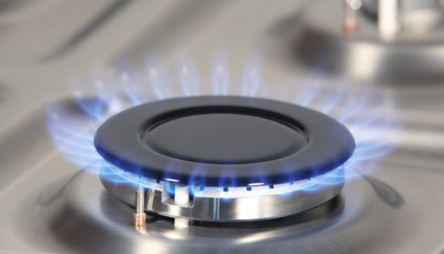
Gas
What uses gas in your home?
  Heating
  Cooking
  Clothes Dryers
  Water Heating
  Fireplaces,
Average gas expense is $83/month
Why would winter months have more expensive gas bills compared to summer months?

Slide 9
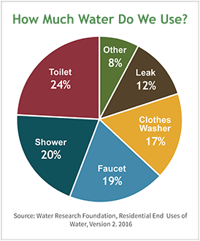
Water
What uses water in your home?
  Toilets
  Kitchen sink
  Bathroom sink
  Washing machine
  Sprinklers
Average water expense is $50 per month

Slide 10
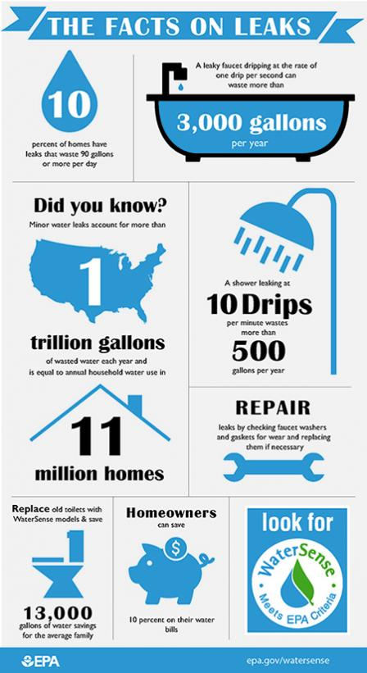
Water
Average person consumes 88 gallons per day
Average family wastes 180 gallons a week from leaks!
How can you use less water?
  Water off while brushing can save up to 8 gallons/time
  Running dishwasher only when full up to 320 gallons/year!
  Water off while doing dishes can save 10 gallons every 5 minutes!
  Up to 50% of irrigation water is lost to evaporation, wind, or runoff

Slide 11

Garbage/Recycling
What happens to your garbage?
4.4 lbs/person every day!
Average Household spends $16 per month

Slide 12

Garbage/Recycling
American’s generate about 254 million tons of trash
About 87 millions tons are recycled or composted (34%)
What are some ways to reduce our waste?

Slide 13
Maintenance
What is something that you have to maintain at your house?
  Paint
  Landscaping
  HAVC service
  Filter changes
Why is it important to perform maintenance on a home?

Slide 14
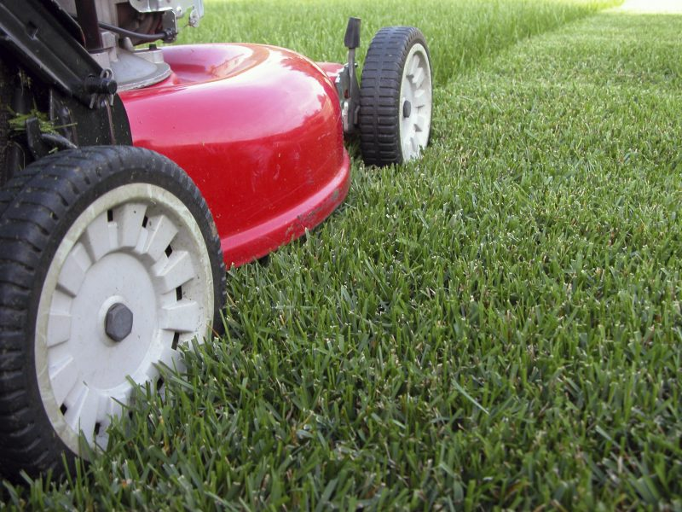
Maintenance
The U.S. spends nearly $29.1 billion/year on lawn care ($90.23/person)
How can you save on maintenance?
  Mow your own grass
  Clean
  Learn basic repairs

Slide 15

Why Does All This Matter To A Home Builder?

