Slide 1

Energy Efficiency in Home Appliances

Slide 2

What is “Green building”?
Building a house with environmentally friendly and resource-efficient components.
  These resources mainly include water and energy.
The U.S. contains 5% of the world’s population, yet accounts for nearly 25% of the world’s energy consumption. This means that the U.S. averages 5 times the energy consumption of other countries, when compared to its population.

Slide 3
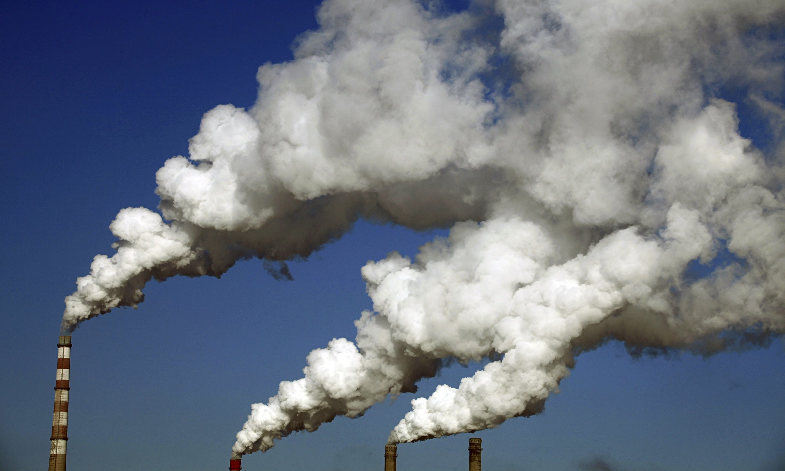
Why is Energy Efficiency Important?
Reduced Energy Costs for Homeowners
Reduced Carbon Footprint
Reduced Energy Demand for Utility Companies
  Non-renewable resource use reduction
    Coal & natural gas supply 2/3 of electricity in the US

Slide 4
What is a homebuilders role in energy efficiency?
Homebuilders’ discuss the options available in each home with the buyer(s)
  Home orientation
  Color size and style of:
    Tile
    Cabinetry
    Countertops
    Brick
  Where are the windows (natural light)
  Insulation
  What Appliances

Slide 5
What do you think affects these decisions?
More energy efficient options are usually more expensive.
  Is the extra cost worth it?
  Bigger home, or a more energy efficient home?
  How long will it take to pay off?
    Life cycle costs
We want to show you how some of these decisions can be made!

Slide 6
Examples of different appliances’ electricity consumption
Appliance Type | Standard Wattage | High Efficiency Wattage | Difference in Wattage
Dishwasher | 1300 | 1105 | 195
Hot Water Heater | 3800 | 3230 | 570
Television | 80 | 70 | 10
Light Bulb | 60 | 15 | 45

Slide 7
Example
Appliance | Standard Wattage |  | Energy Efficient Wattage |  | Wattage Difference |  | # of Appliances |  | Monthly Usage (hours) |  | Difference in (Wh) per month | Difference in appliance cost
Dryer | 500 Watts | - | 425 Watts | = | 75 Watts | x | 1 | x | 20 Hours | = | 1500 Wh (Watt Hours) | $450 - $350 = $100

Slide 8
Calculating energy savings Worksheet
Energy saved per month
  [kWh/month] = [# of units] x [difference in wattage] x [hours used per month] / [1000]
  kWh: kilowatt hours; this is the unit of measurement for how much electricity an appliance uses
Energy $ saved per month
  [total $ savings] = [total kWh/month] x [price per kWh]
  Price per kWh = 10¢ (or) $.10
Use your home’s average ‘hours per month’ for your calculations
  If you think your house uses an appliance more than average, use the higher end of the average range
  If you think your house uses less energy than average, pick a number on the lower side of the range

Slide 9
Cost/Time comparison of standard vs. high efficiency appliances (example)

Slide 10

How many years would it take you to pay off swapping all of your appliances to their energy efficient substitute if you had all standard appliances?
Add up the total cost of switching to energy efficient appliances
[# of years] = [cost of energy efficient appliances] / [savings per year]
  This will give you the number of years until you break even
  After this point you will be saving the difference of running your appliances
Savings
Years

Slide 11
Questions?

