Slide 1
COMPETITION IN A BOX
St. Louis, MO

Slide 2
What is Competition in a Box?
One day event with local high schools introducing students to the industry in a meaningful way.
Several rounds of questions and problems revolving around blueprints and construction methods
Structured in a “trivia” type way to make the competition fun and exciting

Slide 3
Objectives:
To provide high school students with an opportunity to develop and showcase residential plan-reading and quantity take-off skills
To provide local HBA’s a venue for identifying and interacting with high school students who may with to enter the residential construction field
To expose high school students to the management skills needed in residential construction.

Slide 4
Planning
Identify a “Champion”
Individual member, member company, committee, council
Identify Potential Schools
Send Letters of Inquiry
Identify a Target Date
Select a Day, Time and Location
Recruit Sponsor(s)
Breakfast/Lunch, drinks, prizes

Slide 5
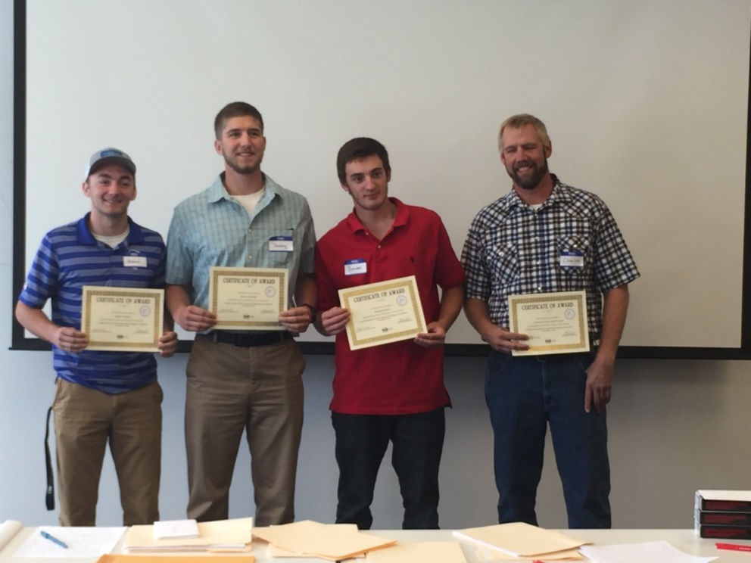
Execution
Register Teams
Prepare Teams
Come up with blueprints
and questions
Run the Competition
End on a Positive Note

Slide 6
Sample Questions
What is the area of the first floor?
How many vertical #6 reinforcing bars are required for identified wall?
How this is the basement floor slab?
Fill out window schedule with room, quantity, size, type
What size and how many stringers are used for the stair support?
How is the attic ventilated?

Slide 7
Marketing and Support
Publicize to entire membership and encourage participation
Provide support in recruiting schools/students for the competition
Provide ongoing support and coordination for the event
Publicize the results to membership and through the press

Slide 8
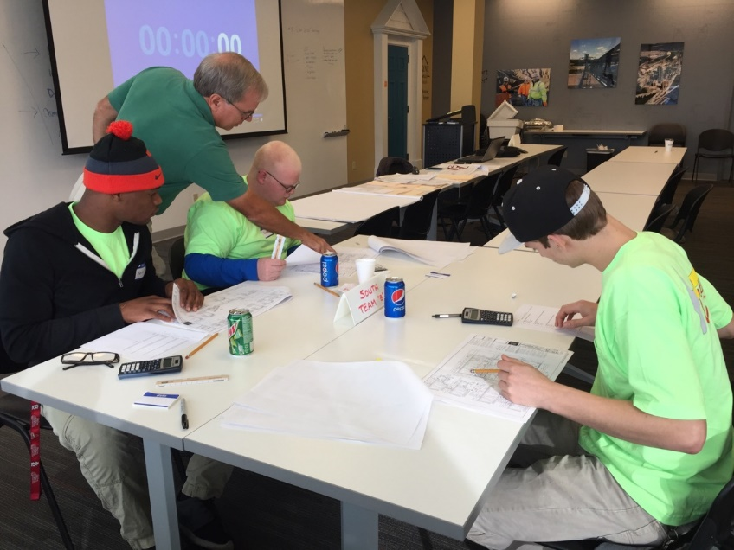
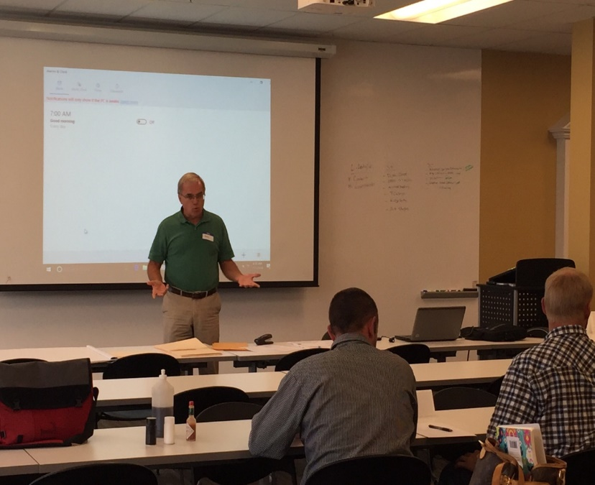
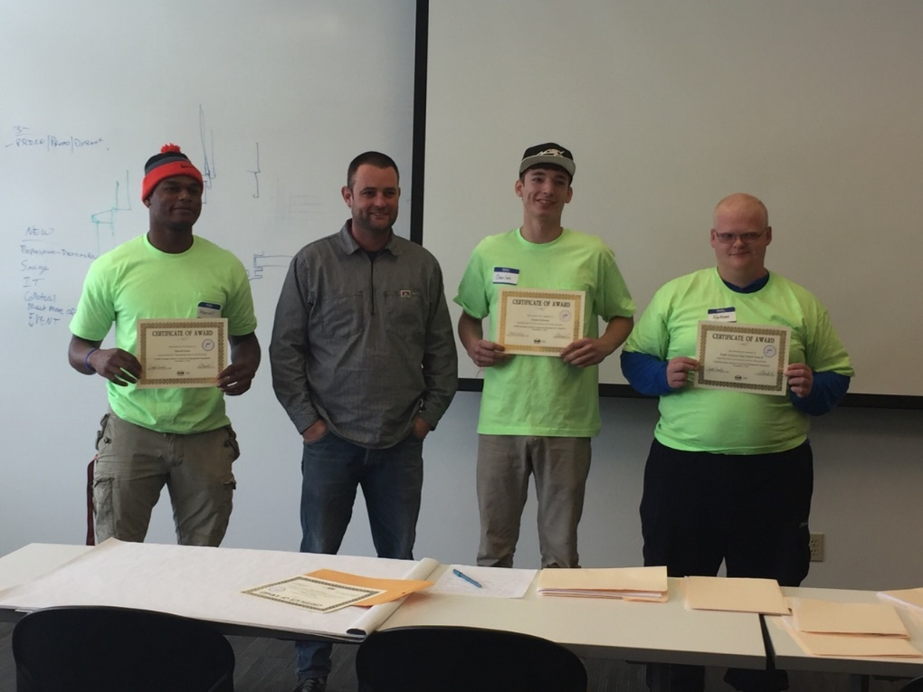
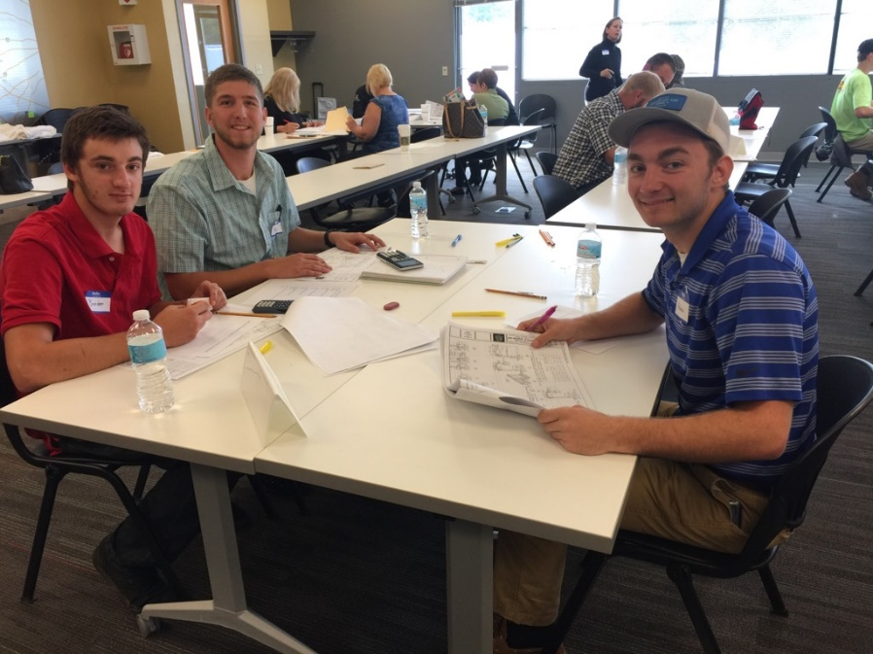
Questions?

