Slide 1
The Challenges of Impact Fees
Notes:
For more information on Impact Fees download NAHB’s Impact Fee Handbook under the Infrastructure Finance and Development Fees tab on the Land Use 101 webpage: https://www.nahb.org/research/land-development/land-use-101.aspx

Slide 2
Impact Fees
What are impact fees?
Why do we have impact fees?
Local government fiscal stress and the rise of impact fees
Sienna
Notes:
The United State continues to experience a public infrastructure financing deficit.
Fiscal stress is when public service demands grow because of increasing population, inflation, rising real incomes, or other reasons, while the local revenue base—taxes, grants, and user fees and charges—does not grow fast enough to meet the increased public service demands. Another source of fiscal stress has come from decreasing aid from the federal government,
Many communities have turned to impact fees as a politically expedient means by which to construct public infrastructure systems on the assumption that new development must pay its way.
Yet, the use of impact fees shifts much of the financial burden away from all public infrastructure users (the general public) to a narrow segment of the public— home builders and new homebuyers.
Impact fees are:
An impact fee is a fee that is imposed by a local government on a new or proposed development project to pay for all or a portion of the costs of providing public services to the new development (Wikipedia)
levied on an "up-front" or "front-end" basis, usually at the time of building permit issuance or subdivision approval, or certificate of occupancy;
prescribed by ordinance, although the dollar amount may or may not be specified.

Slide 3
Legal Concepts of Impact Fees
Authority to impose impact fees
Impact fees as unlawful taxes
Federal and state constitutional issues
Sienna
Notes:
Aside from basic issues of fairness and equity, the use of impact fees raises legal, economic, technical, administrative, policy, and financial concerns for interested parties. Without the proper legal authority, municipalities are unable to enact an impact fee. This authority is express—granted by a state legislation—or implied by a municipality’s inherent powers.
Municipalities that operate under Dillon’s Rule are limited to those powers which have been expressly granted by the state. On the other hand, home rule municipalities have a greater degree of independence and have broad discretion in the exercise of their planning and zoning powers.
An impact fee may result in an unlawful tax; depending on the facts of a specific case and specific tests created by state courts.
Impact fees may be challenged on three grounds under the U.S. Constitution: (1) the ordinance violates a developer’s due process rights; (2) it results in a violation under the Equal Protection Clause; and (3) the fee is an unconstitutional exaction under the Fifth Amendment.

Slide 4
Economic Implications of Impact Fees
Who ultimately pays an impact fee?
Implications of higher house prices
Are impact fees really necessary?
Summerlin
Notes:
The ultimate burden of payment will, to varying degrees, be passed to new home buyers in the form of higher house prices (or, equivalently, smaller houses with fewer amenities).
One is an adverse effect on housing affordability. One way to illustrate the potential extent of the adverse effect is to apply national mortgage underwriting standards to estimate the households that qualified for a mortgage before a house price increase, but no longer qualify for a mortgage afterwards. Households that no longer qualify for a mortgage following the price increase are referred to as being “priced out” of the market for the home. (https://www.nahb.org/research/housing-economics/housings-economic-impact/households-priced-out-by-higher-house-prices-and-interest-rates.aspx)

Slide 5
Economic Implications of Impact Fees
NAHB models
Meridian Court
Notes:
The premise underlying the use of impact fees is that development, especially residential development, does not pay for its fair share of the burden imposed upon the local government, as new development requires the expansion of public infrastructure as well as the hiring of additional public sector workers.
NAHB has developed a model to estimate the costs to local governments for the additional public infrastructure and public sector workers that are attributable to new growth.
NAHB has also developed a model to estimate the total economic benefits of home buildings. The model captures the effect of the construction activity itself (Phase I), the ripple impact that occurs when income earned from construction activity is spent and recycled in the local economy (Phase II) and the ongoing impact from new homes occupied by residents who pay taxes and purchase locally produced goods and services (Phase III).

Slide 6
Impact Fee Technical Studies
What are they?
Should only consider capital costs, not operating and maitenance costs
Becker at Porch Street on Adele, TK Images
Notes:
Local governments will commonly direct either staff or a consultant to prepare a document that analyzes the public costs of constructing capital facilities, calculates the share that is needed to serve new development, and determines the portion of that share which will not be paid from other fees and taxes on new development.
An impact fee technical study should consider only capital costs, not operating costs. Generally accepted cost items include: land, buildings, durable equipment and machinery, grading, paving, landscaping, and associated energy costs.
Items that would generally not be considered as capital costs include recurring expenses, such as those for consumable supplies, salaries, training, maintenance, repairs, administrative costs, program operating costs, nondurable equipment (less than three years useful life), and the like. If state impact fee laws apply, the local ordinance may be more restrictive but may not include a broader range of cost items than the state law permits.

Slide 7
Impact Fee Technical Studies
Varying methodologies
Population and Land Use Assumptions
Levels of Service
Replacement, Construction, and Land Costs
Service Areas
Notes:
Three essential types: the incremental expansion approach, the buy-in approach, and the plan-based approach. All three approaches are commonly employed in the United States.
Many state impact fees enabling laws require the community to specify the population and land use assumptions upon which the impact fee calculation will be based. This is important because the plan-based approach and buy-in methods rely on projections of future population and land use.
Level of service is a concept for defining the quantity of public facilities that must be provided in order to adequately satisfy citizens' demands for capital facilities. Many communities assume, wrongly, that they are free to select the level of service of public facilities for new development.
Replacement costs should be based on estimates prepared by qualified state license engineers, actual bids, or data provided by a costing service. Land values should be supported by recent comparable land sales occurring within the immediate area over the last 6-month period. Certain state enabling acts, such as Utah and Arizona, require impact fees to be reduced based upon future cash flows generated from new development. An impact fee payer is entitled to a reduction in the amount of the impact fee (a credit) to compensate for contributions he or she has made or will make toward the cost of capital facilities. It is essential that the technical study and/or impact fee ordinance provide developers and builders with a mechanism to receive credits if they are due.
Service areas allow impact fees to be more closely linked to the actual cost of providing capital facilities in a given service area. This does not mean that the facility is reserved exclusively for service area residents or that the facility never provides services to those outside the service area.

Slide 8
Impact Fee Technical Studies
Issues to consider:
Transportation-Related Issues
Legitimacy of Growth-Related Costs
Proportionate-Share Impact Fees
Discount Impact Fee Schedules
Eastmark
Notes:
There are a number of technical issues related to the calculation of traffic or road impact fees that do not apply to other types of impact fees. These have to do with peak versus average daily traffic volumes, trip diversion, trip substitution, and sources of trip generation data. Different land uses generate traffic at different rates. Road impact fee formulas should take this into account by making use of local trip generation studies or data from national sources such as the Institute of Transportation Engineers (ITE).
In an ideal world, the capital facility needs of new growth are set out in a well-considered and duly-approved long-range comprehensive plan. Every year the five-year capital improvement plan that identifies the cost and source of funds for capital projects is updated and adopted.
At times a jurisdiction may use proportionate-share impact fees. The rationale behind proportionate-share impact fees is that impact fees for new residential units are “proportionate” to unit size. The idea being that larger units have more people with higher incomes who generate greater impacts on public facilities.
After calculating the impact fee amount according to a formula that will vary for each type of impact fee, many communities discount this nominal fee amount by a certain percentage. The nominal impact fee amount represents the highest amount that can be legally charged.

Slide 9
Commonly Found Errors
Construction Cost Estimate and Adopted Capital Improvements Plan Inconsistencies
Current Levels of Service Not Properly Documented and/or Applied
Funding Offsets Ignored or Improperly Applied
Inflated Land and Building Cost Estimates
Math Errors
Correcting Existing Deficiencies
Impact Fee Alternatives Not Considered
State Statute Compliance
Notes:
Local governments are attracted to impact fees because of their potential to generate revenue at a lower political cost than some other measures such as jurisdictional general obligation bond elections.
There is a cost to be paid, however, which is related to the greater complexity and difficulty of setting a truly fair and legal impact fee amount.
Impact fees must be proportional to the actual cost of providing capital facilities.
Making these calculations, as the above discussion points out, is neither simple nor straightforward. It is also easy to make mistakes. As a result, the community imposing the fee pays a price in the form of higher administrative costs, consultant fees, and legal fees when the methodology is challenged.

Slide 10
Misuses of Fees
Misappropriation of Fees
Using Fees to Correct Existing Deficiencies
Using Specific Impact Fees to Fund Non-Authorized Capital Facilities
Using Fees for the Payment of Non-Capital Assets
Using Fees for the Repair and Maintenance of Existing Facilities
Looking Behind the Curtain
Notes:
Besides common errors, the misappropriation of fees comes in many forms, from using fees to correct existing deficiencies to using fees for the payment of non-capital assets. See Looking Behind the Curtain, by Carter T. Froelich for a detailed breakdown on how impact fee spending by jurisdictions.
Most jurisdictions attempt to use fees for intended purposes, but there can be a disconnect between those who prepare impact fee studies and those responsible for collecting and expending the fees leading to the expenditure of fees outside the scope of their intended purpose.

Slide 11
The Comprehensive Plan and Capital Improvement Plan
The public facility needs assessment should not be a "wish list“
The capital improvement plan (CIP) will identify costs and funding to the facilities identified in the comprehensive plan
Alto at Midtown, Jeffrey Aron Photography
Notes:
The capital facility requirements should be based on a thorough analysis of future growth and appropriate levels of service for each type of facility that establishes a clear and logical connection (rational nexus) between anticipated growth and the type and amount of capital spending that growth will require.
The comprehensive plan should include population and land use projections, establish appropriate levels of service for public facilities, examine existing service levels and deficiencies, and identify the capital facilities that will be needed because of new growth.
The CIP usually covers a five-year period and is updated and approved every year. Other documents may be relied on to provide a public facility needs assessment, but the comprehensive plan and CIP have the advantage and added weight of being officially adopted by the legislative body after a public hearing process.

Slide 12
Independent Fee Calculation Study
Impact Fee Reduction
Independent Fee Study Considerations
Firethorn at Summers Corner, Johnson Pictures Inc.
Notes:
An applicant commissions and pays for a study, which may entitle the applicant to a reduction in impact fees if it convincingly shows that the project will require less public capital expense than assumed in the impact fee study.
A community should offer a variance process when the applicant believes that the schedule of fees in the ordinance does not reflect the actual monetary impact of a particular project.

Slide 13
When Fees Are Due, Accounting, and Refunds
Timing considerations
Payment processes
Camelia at Summers Corner, Johnson Pictures Inc.
Notes:
From the building industry's point of view, it is preferable for the impact fee amount to be determined at the earliest possible time but to fall due and payable at the latest possible time.
Impact fees must be separately accounted for and expended for the specific purposes for which they were collected.
The most convenient way to administer an impact fee program is to withhold some permit or approval needed for development or occupancy until the impact fee is paid.
Impact fee payment can be made a condition of plat approval, of issuance of a building permit, or of certificate of occupancy. Most common practice is to make impact fees due at the time the building permit is issued.
All impact fee ordinances should contain refund provisions.

Slide 14
Credits, Reimbursements, and Exemptions
A developer may agree to provide land or to construct facilities of the type for which impact fees would be charged.
Credits should also apply when there is a change in existing land use. But the impact fees should not be based on the total number of trips generated by the commercial use but on the net increase in trips.
One example of exempt land use might be affordable housing for low- and moderate-income households.
Notes:
A developer is entitled to receive a credit or reimbursement equal to the market value of the land or facilities provided which is subtracted from his impact fee bill
In cases where the value of land or facilities exceeds the amount of impact fees due, the developer might receive the difference in cash or in the form of transferable credit against future impact fee liabilities.
Many ordinances do not address credits or reimbursements. In all cases, developers and builders should attempt to include language in their development agreements with the community’s charging impact fees that provide for credits and/or reimbursements as a safeguard.
It would not be fair to burden new development with increased fees because some categories are exempt. Capital facilities for exempt land uses should be funded from a source of revenue other than impact fees on new development.

Slide 15
Infrastructure Financing Challenge
Development more complicated and riskier today
Limited commercial lending for new development
Government revenues remain strained too
How to finance infrastructure efficiently and effectively without driving up housing costs
Eastmark
Notes:
As communities struggle with having adequate revenues for roads, schools, water, sewer, and more, it is common for them to revive and increase impact fees on new homes on the assumption that new development must pay its way.
Impact fees are an imperfect tool for financing infrastructure, because they can’t be spent until they accumulate, they rise and fall with the pace of construction, and they unfairly burden new homebuyers to solve what is fundamentally a broader community need.
They are also often based on flawed assumptions about costs of growth and later improperly spent and accounted for.
Further, relying on them during the sustained construction boom that preceded the recession did not help build our way out of the infrastructure challenge.

Slide 16
The Search for Solutions
Need to better understand available tools and where they have been used successfully
Rethink assumptions and better leverage available existing resources
Requires innovation and collaboration between public and private sectors
Eastmark
Notes:
NAHB has worked with municipal finance experts to conduct substantial research on infrastructure financing over the past several years.
What we have found is that are many alternative municipal finance solutions that better meet the needs of both private development and the public sectors, but that there is also a continuing need for sharing information about the most promising approaches and where they’ve been used successfully.

Slide 17
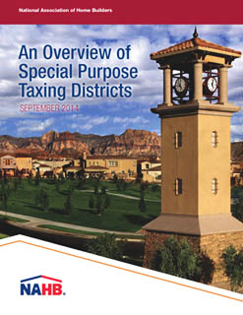
NAHB’s Series of Reports
Notes:
NAHB also hired DPFG to write a report on what they and others believe are the best alternatives to impact fees: special district financing.
This report, “An Overview of Special Purpose Taxing Districts,” is available online at nahb.org.
Special districts are quite simply more reliable as well as more equitable revenue sources, there is a clearer connection between the assessed fee and what benefits are being bought with them, they can be used more easily with other financing tools, and they are much more of a positive collaboration between the public and private sectors.

Slide 18
States that Allow Use of Key Tools
Notes:
NAHB worked with the National Conference of State Legislatures in 2005, 2007, and 2012 to take stock of which states allow the use of key innovative infrastructure financing tools.

Slide 19
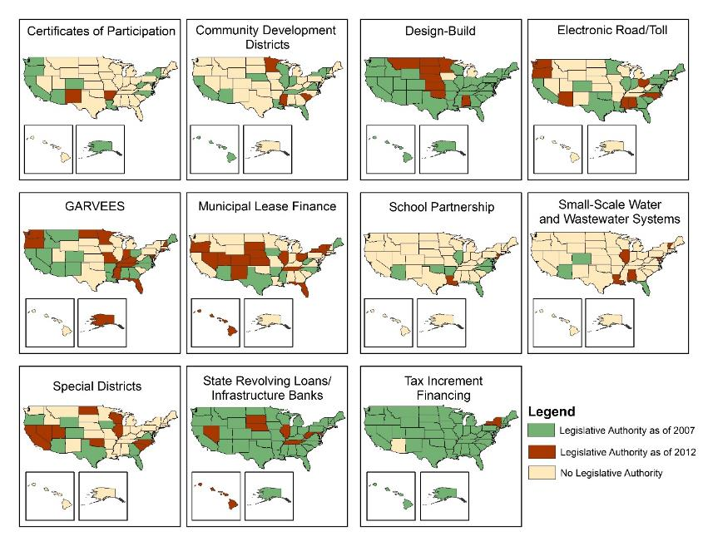
Change in Enabling Authority 2007-2012
Notes:
As you can see from these maps we generated based on the information NCSL produced, there was quite a lot of productive work being done by states between 2007 and 2012, while the recession was underway, to add capacity for local governments to use a wider array of tools.

Slide 20
Many States Now Allow the Use of Special Districts
Notes:
Here is the snapshot of state enabling authority for special districts with two more states added—Idaho and Hawaii—since the NCSL update in 2012, based on the report DPFG did for NAHB in 2014.
In 2005 only a handful of states authorized their use, now it’s nearly half.

Slide 21
Good Climate for Collaboration!
It’s hard work, no question!
But:
Public & private sectors realize they cannot do this on their own
Public-private partnerships manage risks and rewards for both partners
Sienna
Notes:
In today’s financial environment, it has become clearer than ever before that we need a broad, flexible array of tools, not a scaling back.
We need to work together to help local officials understand these tools and to share insights gleaned from the new realities of the marketplace on how best to structure these tools to safeguard both public and private sector interests.
Creativity, innovation, and collaboration are the key to meeting our infrastructure challenges together.

Slide 22
Questions?
All of these reports are available in the Land Use 101 toolkit on www.nahb.org, under the Infrastructure Finance and Development Fees section.

