Slide 1
Infill and Mixed-Use Development

Slide 2
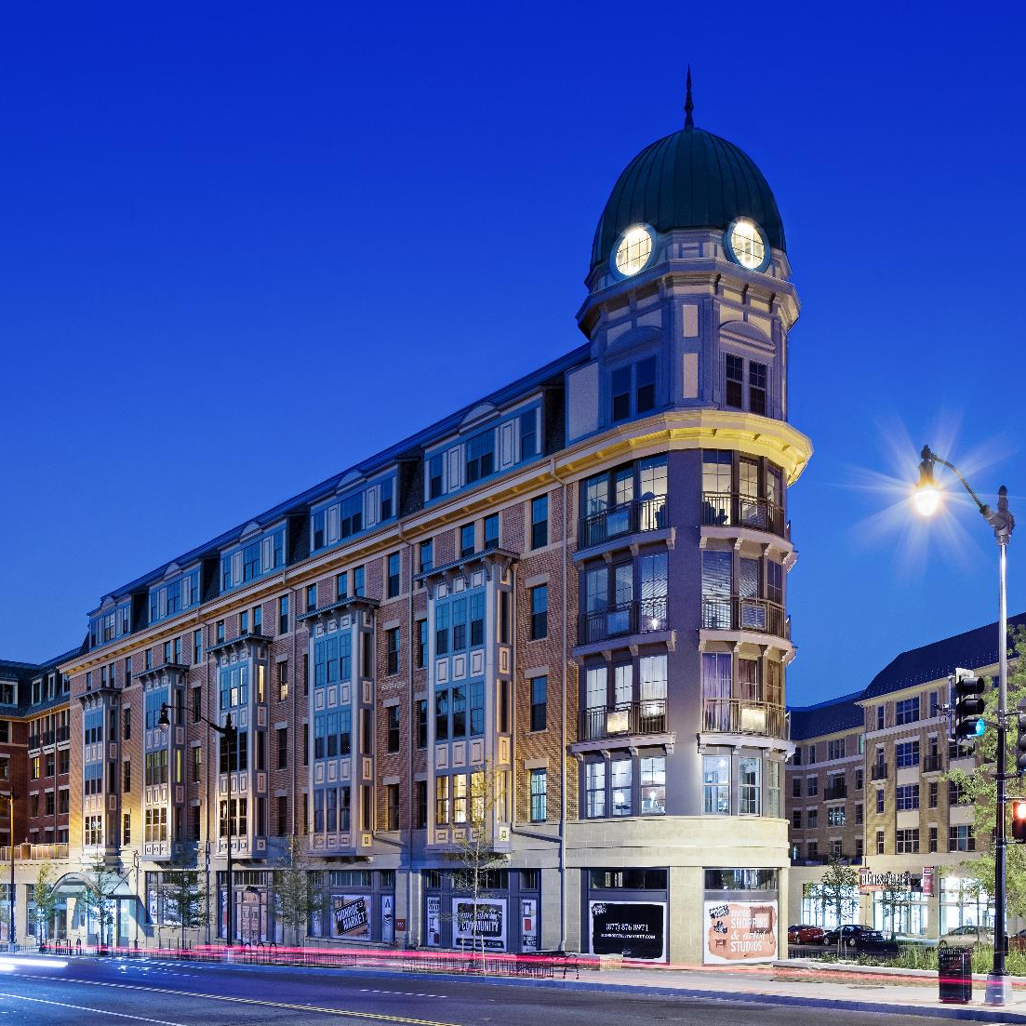
Introduction
The purpose of this slide show is to discuss the challenges that face the homebuilding industry when developing infill and mixed-use parcels and housing as part of a mixed-use development,
Provide some solutions to these challenges,
Explain mixed-use housing will sustain its current momentum, and
Share real-life experiences with local homebuilder associations.
Monroe Street Market, The Bozzuto Group
Notes:
Mixed-Use is more a reference to a zoning district that allows for a variety of uses within one district or structure. Typically, Neo-Traditional Development is a design concept that also goes by several terms, including, Traditional Neighborhood Design (TND) and New Urbanism. TNDs typically have a mixed-use element as part of their design concept. Infill development is more a reference to location, meaning new development constructed in developed areas, typically surrounded on all sides by existing development.
The common thread is that all these “kinds” of development better meet the goals of smart growth and sustainable development than conventional residential development.

Slide 3
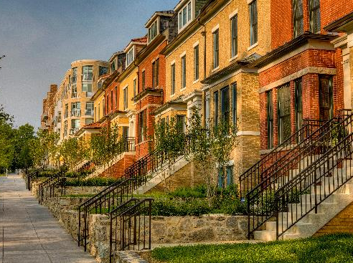
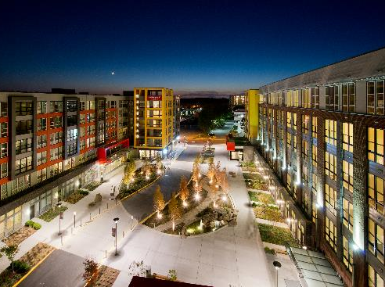
Topics of Discussion
Local Zoning and Regulatory Barriers
Economic Challenges
Acquiring developable land parcels
Market Uncertainty
Cathedral Commons, The Bozzuto Group
Halstead Square, Eric Taylor

Slide 4
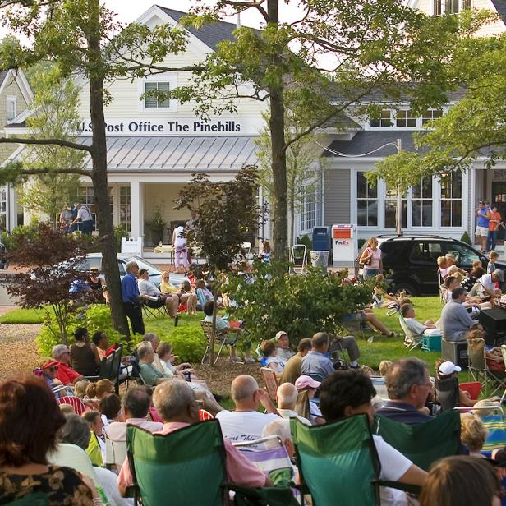
Local Zoning and Regulatory Barriers
Euclidean Zoning – Separation of uses discourages or prohibits.
NIMBYisms – Not In My Back Yard, fear of the unfamiliar
Allowing Mixed-Use by right – forgo the “Variance Procedure” by enacting a Mixed-Use Zoning District
Infrastructure Financing and other Subsidies – Public –Private Partnerships may be needed
The Pinehills
Notes:
Euclidean Zoning” – Most local zoning uses a Euclidean zoning scheme that encourages the separation of land uses and for the most part prohibits mixed-use development.
NIMBYisms – Not In My Back Yard – Fear of Unfamiliar. Many residents have become accustomed to the separation of uses. For instances, residents of a single-family development will find a similar single-family development on an adjacent parcel least objectionable. Different or a mix of uses, such as commercial, retail, restaurants, bars, high density housing, and even religious institutions may raise alarm bells with neighboring residents.
Allowing Mixed-Use by right – forgo the “Variance Procedure” may help circumvent a lengthy and contentious public hearing process that could add to the cost of a project.
Do to the increased complexities and uncertainties related to mixed-use development ,infrastructure financing and other subsidies may be needed from a local jurisdiction or other government agency to make a project viable.

Slide 5
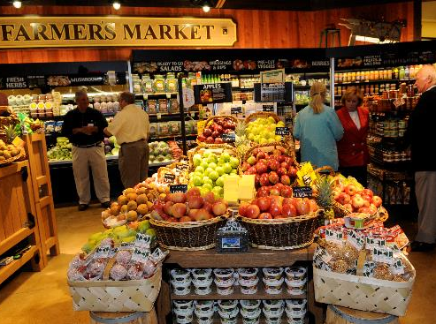
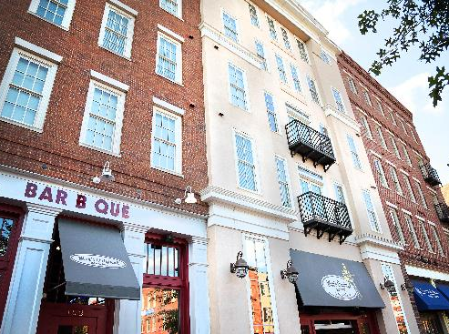
Economic Challenges
Requires Patience and ability to “Think Outside the Box”.
Although these projects have become more commonplace, lenders have become more risk adverse to complex projects with multiple players.
Easier to make profits through “cookie cutter approach” repetitive process.
Unusual Leasing and Management Arrangements may Destabilize Long Term ROI.
Architects must deal with tricky issues such as sound, ventilation and loading not needed with single use structures.
The Pinehills
The Village of Providence
Notes:
For both the developer and the local jurisdiction, pulling off a successful mixed-use development requires patience and the ability to “Think Outside the Box”. Although a greater number of mixed-use projects means that obtaining financing for these projects has become more routine, volatility in today’s lending market has also made lenders more risk adverse. This is bound to dampen interest in building mixed-use in today’s market.
Simply put, it is much easier to make profits through “cookie cutter approach” repetitive process. Lenders understand this and are more willing to lend for this form of development. There are also unusual leasing and management arrangements for mixed-use that can further complicate the ability to construct a successful and viable project that delivers a profitable return on investment. However, there is an unmet demand for infill/mixed-use development is not conducive to this approach.
Architects must develop unusual and unique solutions to having a mix of uses in one building (sound, ventilation, loading). This can add to both the soft and hard costs of development.

Slide 6
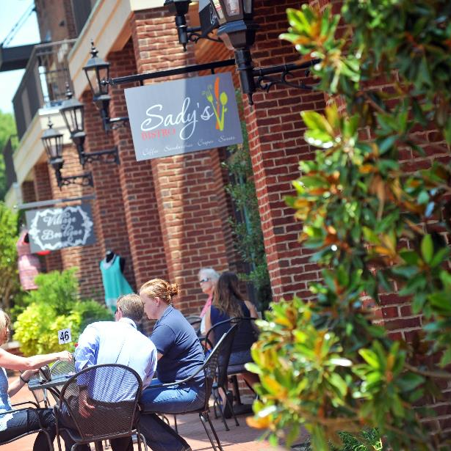
Economic Challenges
Due to complexity even in boom times, mixed-use is especially susceptible to become a troubled property
Failure of commercial space can have negative implications on the property values of residential units
Overall creates high risk for foreclosure and other financial problems
The Village of Providence
Notes:
Due to complexity of mixed use even in boom times, mixed-use is especially susceptible to become a troubled property. For instance, failure of commercial space can have negative implications on the property values of residential units. This can create an overall high risk for foreclosure and other financial problems.

Slide 7
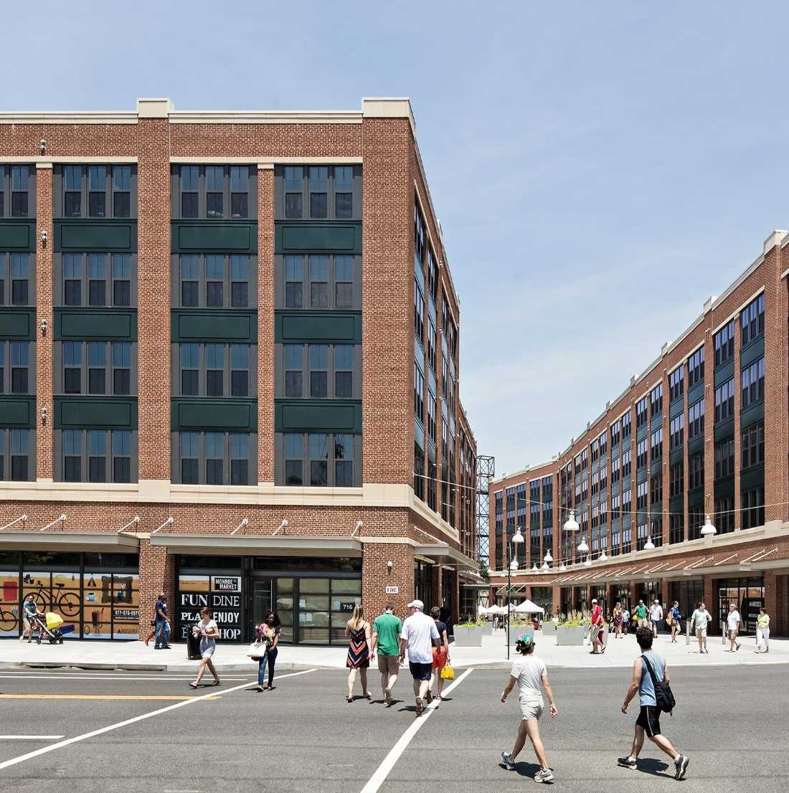
Acquiring Developable Land
Land Assembly in Urban Environments
Larger Mixed-use projects often require some form of land assembly from multiple landowners
Assistance from Municipalities
Greyfields – Building on Abandoned or Underused Shopping Mall Parking Lot
Monroe Street Market, The Bozzuto Group
Notes:
Many times mixed-use developments end up being public-private partnership between local government and developers. Land assembly and donation or land leases often times are ways in which a local jurisdiction can contribute in order to make a project viable. Larger mixed-use projects often require some form of land assembly from multiple landowners
Many local jurisdictions have “Greyfield” sites– underutilized or abandoned retail centers, that may be optimal locations for mixed-use development. Many sites are in foreclosure or tax delinquent, making them viable for public ownership. These sites are also adjacent to other commercial properties, so mixed-use development would be less objectionable to nearby property owners.

Slide 8
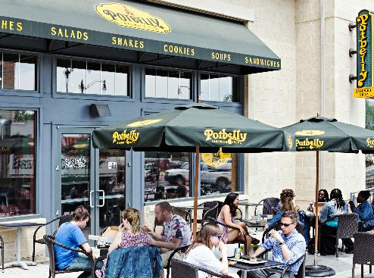
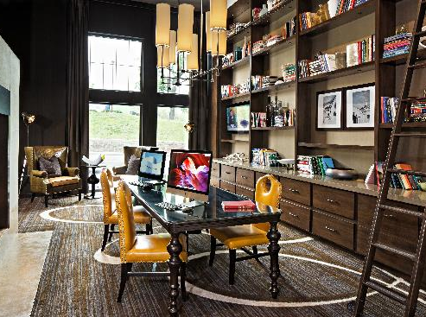
Who is in the Market for Mixed-Use?
Household numbers growing as size decreases.
Creates new market for smaller housing units.
Creates additional pressure to build more houses!
Single professionals, empty nesters, “bored-suburbanite syndrome”
Live/Work and Telecommuters – an increasing market share of workers. What will be the impact on housing preference?
Monroe Street Market, The Bozzuto Group
Notes:
Other market trends to consider in the future are that, in many markets, the number of households will grow as household size decreases. This is creating a market for smaller housing units. Additionally, single professionals, empty nesters, and single-parent households are all growing in number of total households as a percent, while the traditional, “nuclear family” is a shrinking number of households as a percent of the whole.
Also, technology will most likely dictate a rise in live/work and telecommuters – an increasing market share of workers. What impact this will have on desired housing type is yet to be seen.

Slide 9
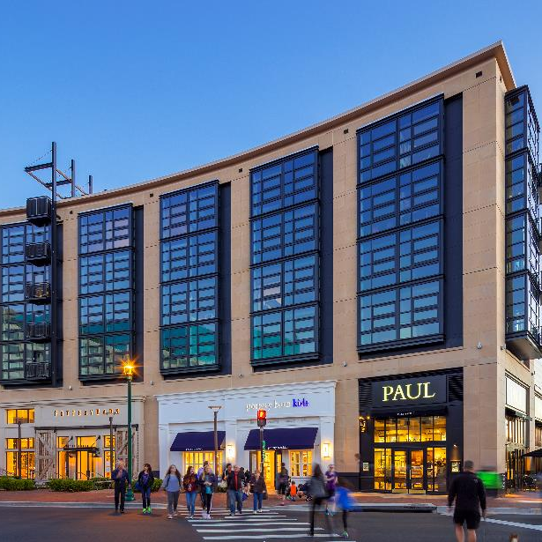
Know the Trends for Mixed-Use Development
Empty Nesters, Active-Retirees/Baby Boomers are potential markets.
Generation Y/Millennials are the largest generation yet in terms of numbers and are more interested in an urban and walkable lifestyle.
HOWEVER! A majority of Americans still love their cars and SFH on a fee-simple lot.
The Darcy + The Flats, Max Zhang
Notes:
Other factors that may dictate a growing demand for mixed-use development are more active retirees that are looking for a retirement lifestyle filled with cultural amenities, dining, shopping and other “urban” style amenities.
On the other end of the age spectrum, the coming of age generation is more accustomed to an “urban” culture than the two previous generations, and will be more interested in living in an urban setting. This is also a generation that is even larger than the baby boomers.
However, despite the growing trend toward mixed-use development in the past 20 years, a majority of Americans still prefer to carry out most of their daily trips by car and live in single-family homes.

Slide 10
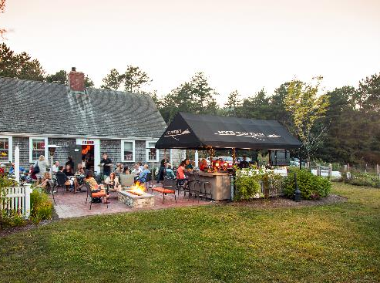
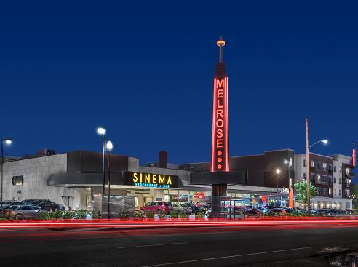
Will Mixed-Use Continue to Grow?
PROBABLY, due to
  greater difficulties acquiring land for residential development in the greenfield areas,
  due to rising traffic congestion,
  NIMBY Backlash,
  Loss of Open Space
Builders must look for new opportunities where they may not have previously existed.
However, demand for mixed-use will vary widely from region to region across the country.
Therefore, there should be caution not to take a “one size fits all” approach. Both horizontal and vertical mixed-use options should be explored.
The Pinehills
The Melrose, Ron Jackson
Notes:
Due to greater difficulties acquiring land for residential development in the greenfield locations, due to rising traffic congestion, NIMBY Backlash, Loss of Open Space. Generally this will vary from region to region across the country based on environmental and political conditions. For instance, it will be much easier to build in greenfield locations in places like Texas, Idaho or Indiana, than place such as Maryland, Massachusetts or New Jersey.
Therefore, depending on the regional locations, builders must look for new opportunities where they may not have previously existed. Mixed-Use development on a large scale is not for every community. Therefore, there should be caution regarding a “one size fits all approach”. It is also good to remember that mixed use can be horizontal as well as vertical. It is possible to have a mix of uses and housing types in more suburban model neighborhoods.

Slide 11
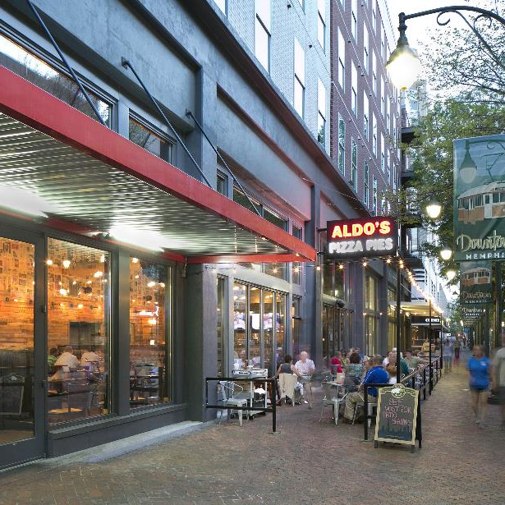
Mixed-Use in Your Community
Identify potential sites, such as Greyfields, and allow for mixed-use by right, expedite permitting
Explore subsidies such as establishment of Tax-Increment Finance Districts, waiver of fees, etc.
Amend local codes to allow for quick expedition of permitting for infill/mixed-use projects.
Partner with both lenders and municipalities
Mixed-use development is not for everyone! Local governments should decide if it’s the right fit.
Notes:
Progressive municipalities interested in mixed-use development should first identify and target potential sites, such as “Greyfields” and allow for mixed-use by right, expedite permitting, Change zoning from Commercial to Residential.
Local jurisdictions should consider targeting subsidies such as establishment of Tax-Increment Finance District, waiver of fees, etc., tax foreclosure, and land assembly assistance.
Local jurisdictions should also amend local codes to allow for quick expedition of permitting for infill/mixed-use projects.
Lenders and Municipalities must act as partners with homebuilders and developers in providing for this type of development. Often times, public-private partnerships are the key.
Mixed-use is not for every market, region or community. Beware “top down” or “one-size-fits all approaches” towards mixed use and leave the final decision with the local government.

Slide 12
Questions?
Nicholas Julian
Program Manager, Land Use, NAHB
njulian@nahb.org
202-266-8309

