Slide 1
Form-Based Codes

Slide 2
Terminology
Euclidean or Conventional Zoning - characterized by the segregation of land uses into specified geographic districts and dimensional standards stipulating limitations on development activity within each type of district.
Form-Based Code or Zoning - a method of regulating development to achieve a specific urban form.
Hybrid Codes - involve the combining of conventional zoning codes with architectural design standards that typically address setbacks, parking placement, massing, materials, and architectural features.
New Urbanism - an urban design movement which promotes environmentally friendly habits by creating walkable neighborhoods containing a wide range of housing and job types.
Notes:
Advantages in Euclidean zoning include relative effectiveness in suburban areas, ease of implementation as long as the code is updated regularly, long-established legal precedent, and familiarity. However, Euclidean zoning has received criticism for its lack of flexibility and institutionalization of now-outdated planning theory. From its inception, conventional zoning was about separating uses.
Form-Based Zoning regulates not the type of land use, but the form that land use may take. For instance, form-based zoning in a dense area may insist on low setbacks, high density, and pedestrian accessibility. The concept has grown out of the New Urbanist movement, which has gained momentum in the past 20 years—placing greater emphasis on mixed-use and walkability.

Slide 3
Why Were Form-Based Codes Developed?
New Urbanist’s sought a way of regulating development to address challenges in the built environment and achieve specific community design goals. These challenges include:
Urban/Suburban Sprawl
Deterioration and depopulation of older central cities and inner ring suburbs
Loss of open space
Monotonous “cookie cutter” development
Overemphasis on the automobile
Notes:
Historically, the strict segregation of land uses in the 20th century was seen as a necessary public health issue to protect residential areas from such noxious uses as tanneries, refineries, rendering plants and a myriad of widely unregulated industrial and manufacturing facilities.
With conventional zoning, vernacular traditions declined as a guide to development patterns, and the widespread adoption by cities of single-use zoning regulations discouraged compact, walkable communities.
Form-Based Codes are a way of regulating development to address these challenges in the built environment and achieve specific community design goals.

Slide 4
Why are Communities Adopting Form-Based Codes?
As municipalities try to revitalize their urban core or inner-ring suburbs, they are turning to a concept that is reminiscent of how cities and towns had been built for the last several centuries:
  Walkable blocks and streets
  Housing and shopping in close proximity
  Accessible public spaces
  Human-scaled urban design
Principles can be applied to new development, urban infill and revitalization, and preservation and all scales of development including rural Main Streets, suburban areas, urban neighborhoods, and dense city centers.
Notes:
Many argue that conventional zoning creates a monotonous, sprawling, auto-dependent landscape that contributes to a perceived growing public health menace: climate change, greenhouse gas emissions and related environmental degradation.
With conventional zoning there was a widespread adoption by cities of single-use zoning regulations that discouraged compact, walkable communities.
Can achieve a more predictable physical result because the elements controlled by these codes are those that are most important to the shaping of a high-quality built environment.
Loss of open space; monotonous “cookie cutter” development that disregards local traditions and “sense”.

Slide 5
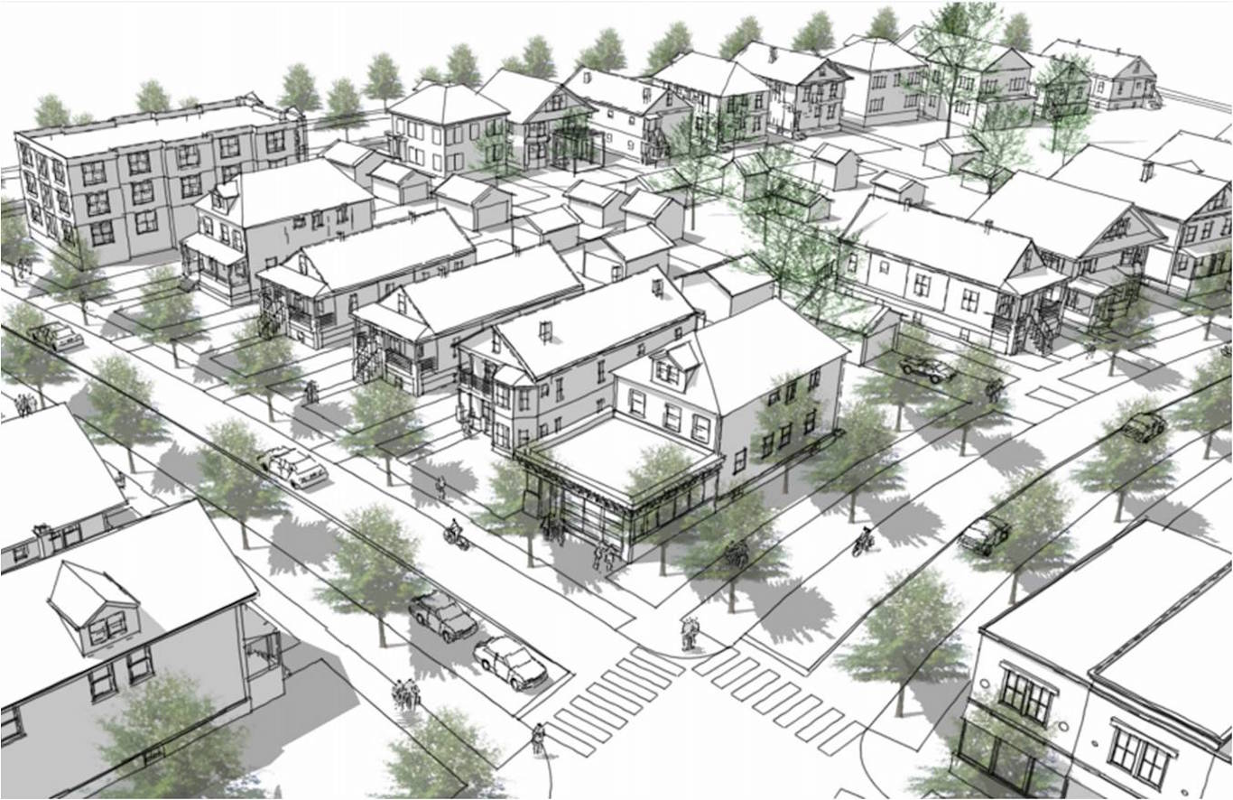
Why are Communities Adopting Form-Based Codes? (continued)
Encourage public participation because they allow citizens to see what will happen where, leading to a higher comfort level about greater density.
User-friendly because they are much shorter, more concise, and organized for visual access and readability.
Good replacement for design guidelines, which can be difficult to apply and enforce consistently and offer too much room for subjective interpretation.
cnu.org
Notes:
There is no true one-size-fits-all form-based code. The code must be calibrated to each local situation. Conventional zoning is much more of a "one-size-fits-all" approach, and the result is obvious: development that looks the same no matter where you are in the country.

Slide 6
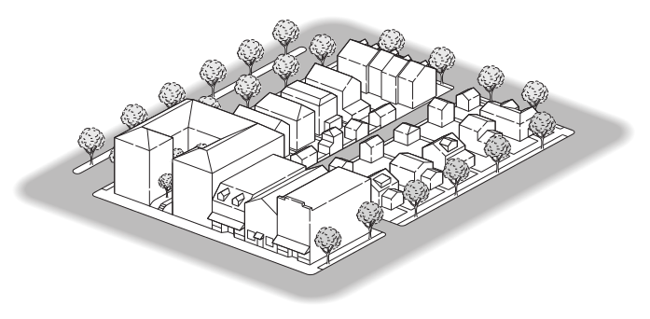
What are the Components of a Form-Based Code?
Regulating Plan
Building Form Standards
Public Space/Street Standards
Architectural Standards
Landscape Standards
Parking Standards
formbasedcodes.org
Notes:
Regulating Plan - (a schematic representation of the master plan) illustrating the location of streets, blocks, public spaces (such as greens, squares, and parks), and other special features. Regulating plans may also include aspects of Building Form Standards such as “build-to-lines” or “required building lines” and building type or form designations.
Building Form Standards - governing basic building form, placement, and fundamental urban elements to ensure that all buildings complement neighboring structures and the street. These standards should be based upon study of building types appropriate for the region, climate, and neighborhood vitality.
Public Space/Street Standards - defining design attributes and geometries that balance the needs of motorists, pedestrians, bicyclists, and transit riders while promoting a vital public realm. These standards should include design specifications for sidewalks, travel lane widths, parking, curb geometry, trees, and lighting.
Architectural Standards -exterior materials and quality.
Form-based codes are generally firm and predictable about basic urban form, but flexible about use, density, detail and design but note that many form-based codes have no architectural restrictions. The degree of restrictions is up to the community.

Slide 7
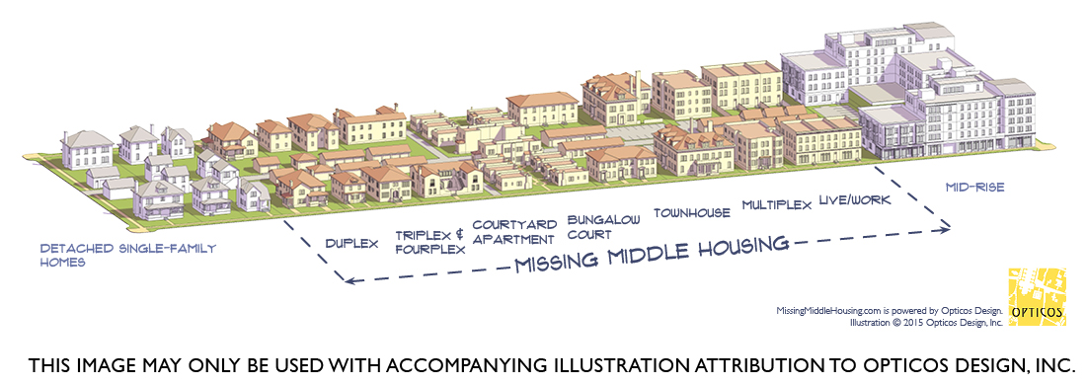
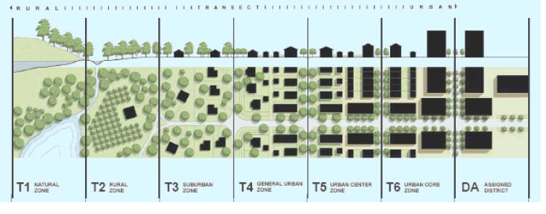
Planning Models Evolved from Form-Based Code
Since the development of form-based codes and other traditional neighborhood design principles we have seen the emergence of related concepts such as:
Smart Code
Missing Middle Housing
Lean Urbanism
Smart Code
Notes:
Since the development of form-based codes and other traditional neighborhood design principles we have seen the emergence of related concepts such as SmartCode, Missing Middle Housing, and Lean Urbanism.
Traditional Neighborhood Development (TND) refers to the development of a complete neighborhood or town using traditional town planning principles. TNDs include a variety of housing types and land uses in a defined area. The variety of uses permits educational facilities, civic buildings and commercial establishments to be located within walking distance of private homes. A TND is served by a network of paths, streets and lanes suitable for pedestrians as well as vehicles.
Smart Code – Originally developed by Duany Plater-Zyberk & Company, developers of Seaside, Fla., this program is a model form-based code designed to create walkable neighborhoods across the full spectrum of community types, from the most rural to the most urban. These areas are divided into transects, each with their own zoning, subdivision regulations, urban design, and basic architectural standards. It is a kind of model ordinance.
Missing Middle Housing – Missing Middle is a range of multi-unit or clustered housing types (duplex, carriage house, bungalow, court, etc.) compatible in scale with single-family homes that help meet the growing demand for walkable urban living. Missing Middle Housing cannot be effectively regulated by conventional, land-use and density-based zoning because these building types often have medium to high densities, excluding them from the singly-family use zone, but their small footprints with lower heights don’t meet the requirements of multifamily use zones. Hence the need for form-based codes.
Lean Urbanism - Lean Urbanism is the most recent policy project from Duany Plater-Zyberk & Company which seeks to devise common-sense techniques that reduce the time, resources, and hurdles required for regulatory compliance. These techniques will be made freely available to governments seeking to streamline their processes and to would-be entrepreneurs who require a transparent economy.

Slide 8
Benefits of Form-Based Codes
Tool to create economic value by providing incremental value back and forth from property to property
Can achieve a more predictable physical result because the elements controlled by these codes are those that are most important to the shaping of a high-quality built environment; level about greater density
Reduce the need for large land assemblies.
Are a good replacement for design guidelines, which are difficult to apply consistently, offer too much room for subjective
Notes:
For example, two projects in Duncanville, Texas, increased in value from $130,000 to $1.8 million. Retail rents have risen from $6 per square foot to $16, and market rate rents are $1.20 per square foot where no market rate units existed previously.
Form-Based codes work best when adopted as on overlay zone. And most form-based codes are adopted for individual neighborhoods. There are a handful of citywide codes, most of which provide a framework for creating neighborhood-based codes. Because form-based codes are inherently "place-based," they have to be tailored to the needs of individual neighborhoods.
Form-based codes should always be drafted after an extensive public process in which a shared vision of the future physical and social character of the community has been developed. There is extensive public participation at the "front end" of preparing a form-based code so the code reflects what citizens want.

Slide 9
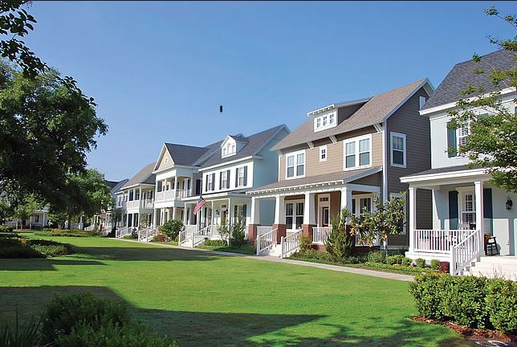
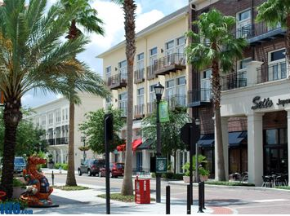
Real World Examples of Form-Based Codes
In some ways, Form-Based Codes are the “next generation” of the PUD.
  Seaside, Fla.
  Baldwin Park, Fla.
  Columbia Pike Corridor in Arlington, Va.
  Metro Louisville, Ky.
  Airport Boulevard, Austin, Texas
  Cincinnati, Ohio
  Livermore, Calif.
  Flagstaff, Ariz.
  Beaufort County, S.C.
Baldwin Park, Fla.
Notes:
Form-Based Codes have been used for many years as part of master planned communities developed as Traditional Neighborhood Developments, such as Seaside in the Florida panhandle and Celebration and Baldwin Park in the Orlando area.
Arlington County, Virginia, an urban jurisdiction of about 185,000 people located directly across the Potomac River from Washington, D.C., has implemented Form-Based Codes in limited areas to revitalize its fading Columbia Pike corridor.
City of Austin, Airport Boulevard – Urban infill project, example of how to redevelop an aging, automobile-oriented, commercial corridor. Public/private partnership between the city and Gateway Planning Group.

Slide 10
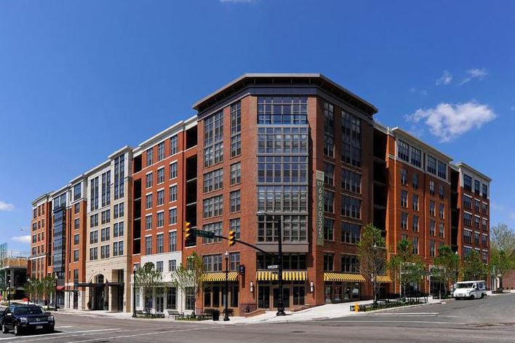
Columbia Pike Corridor
Instead of regulating use by residential, commercial, industrial, etc., the following regulating areas have been defined:
  Town Center
  Village Center
  Neighborhood Center
  Western Gateway
  Main Street Sites
  Avenue Sites
  Local Sites
  Neighborhood Sites
Projects under Form-Based Code Review can be viewed online at https://projects.arlingtonva.us/neighborhoods/columbia-pike-form-based-codes/form-based-code-review-projects/
Buildabetterburb.org
Notes:
It should be noted that the Columbia Pike Form-Based Code Overlay is an optional development approval process.
The conventional zoning in Arlington does not allow the high density, mixed use product that was ultimately built. Form-Based Codes reduced traditional restrictions within the building envelope, such as Floor Area Ratio.
A developer of one of the three projects indicated there were both drawbacks and advantages to using this overlay approach.
Drawback - Minor changes can trigger additional review.
Advantage - Ultimately added value to the property.

Slide 11
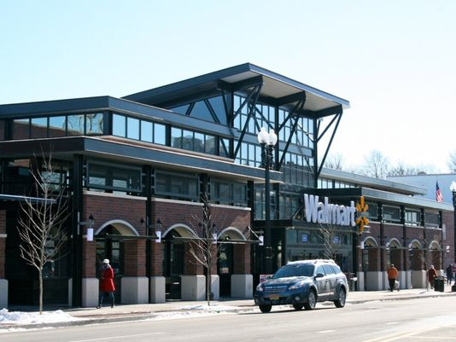
Metro Louisville, Ky.
This citywide Form-Based Code regulation has been carved into the following districts:
  Traditional Neighborhood Districts
  Traditional Marketplace Corridor Districts
  Town Center Form Districts
  Traditional Workplace Form Districts
  Village Form Districts
  Suburban Form Districts
The Form-Based Codes in Louisville steer clear of over-regulating aesthetics by focusing only on site elements such as scale, setbacks, volume and general “compatibility,”
Cartky.org
Notes:
The Louisville code is actually a hybrid between form-based code and conventional zoning using the existing underlying zoning and a form-based overlay.
Home builders sat on the visioning committee. Because of this, when the Form-Based Codes went into effect, there was very little resistance from the home building community.

Slide 12

Builders Concerns with Form-Based Codes
Higher costs of development from increased uncertainty
Public resistance could lead to NIMBY issues, creating longer approvals and higher costs
Form-Based Codes are too subjective
Developers are not architects, builders buy finished lots from developers, so reviewing architecture at the development review level may be inappropriate
Jurisdictions may adopt Form-Based Codes as a means to exclude more affordable housing from a community, an act known as Exclusionary Zoning
Notes:
There are many common objections, which are either based on misconceptions about what form-based zoning is or upon poorly drafted form-based codes that were watered down in the course of the adoption process.
Now that mixed-use zoning is being incorporated into many conventional zoning codes, are Form-Based Codes really necessary? A jurisdiction may find that it can use its existing “toolkit” of zoning tools to implement what a form-based codes attempts to achieve. Such tools may include the Planned Unit Development.
Because Form-Based Codes seek to more strongly influence the building envelope, as well as the urban form around a project site, NIMBY issues should actually decrease under Form-Based Code and certainty increase. This is because, if implemented correctly, there should have been strong community involvement at the time of developing the ordinance.
If Form-Based Codes are too similar to architectural review guidelines, which is sometimes the case with hybrid codes, they could become subjective. Planning and Zoning staff and Commissions may also lack the expertise to legislate aesthetic standards.
If Form-Based Codes are not implemented correctly they may not be as easy to understand what is required as with conventional zoning and subdivision control.
Form-Based Codes seeks the requirement of architectural standards to be approved at the beginning of the land development process, when often times builders are not involved in the development approval process, so there is no architecture to regulate.

Slide 13
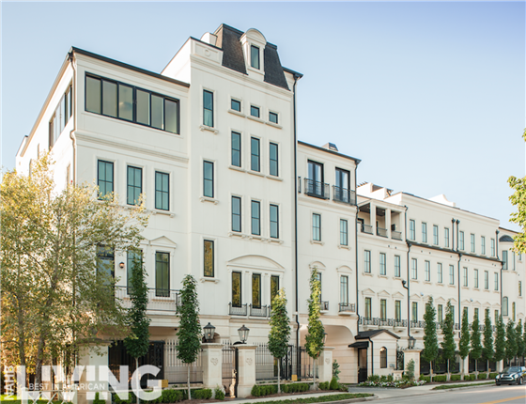
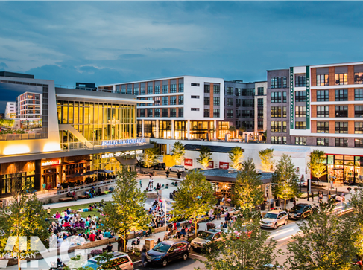
What to do in the event of a Zoning Code Rewrite
A Visioning exercise or Blue Ribbon Panel of community stakeholders and the Public, should be the initial step involving any major re-write of a zoning code.
The Comprehensive or General Plan should be updated to clearly state what the intent of the Form-Based Code is and what goals the community hopes to achieve by implementing one.
Winfield Gate, Rob Muir
Modera Mosaic, Max Zhang and David Madison
Notes:
Builders and developers should insist that any re-write that deviates substantially from a conventional use based code to a Form-Based Code first begin with a Visioning or Blue Ribbon Panel of community stakeholders and the Public, so that everyone is well educated and “on-board” towards any radically different approach to regulating the Built Environment.
Before any adoption of a formal regulating ordinance, the community’s Comprehensive or General Plan should be updated to clearly state what the intent of the Form-Based Code is and what goals the community hopes to achieve by implementing one. Conversely, it’s important to remember that a community can state lofty objectives in its Master Plan or General Plan but — unless specific place-based codes are adopted — these will remain lofty abstractions and any development will proceed as usual under conventional zoning requirements.
The Building Community should work with the Planning Department and their consultants to ensure that a Form-Based Code does not contain any onerous and unreasonable architectural or aesthetic standards that could substantially raise the overall cost of constructing housing and developing new communities, thereby reducing affordable housing.

Slide 14
Questions?
Debbie Bassert
AVP, Land Use & Design, NAHB
dbassert@nahb.org
202-266-8443
Nicholas Julian
Program Manager, Land Use, NAHB
njulian@nahb.org
202-266-8309

